Slide 2
for event participants
Online booking &
travel requests
Notes:
Présentation standard de l’ESRF.
Elle est composée de 11 diapositives présentant :
- L’ESRF en bref avec des chiffres clés
- L’ESRF : Une coopération de 21 pays
- Le campus EPN (European photon & neutron science campus)
- Au cœur du campus mondial d’innovation
- L’ESRF joue un rôle crucial dans l'Europe de la recherche
- Il y a environ 50 synchrotrons dans le monde
- 4 prix Nobel parmi les utilisateurs
- Une meilleure technique pour une meilleure science
- ESRF : PLUS de 20 ans de succès et d’excellence
- Un programme ambitieux de modernisation
- Esrf upgrade programme PHASE II

Slide 3
Objectives and pre-requisites:
The following slides explain:
How to make an online booking
How to submit your travel request
Pre-requisites:
The ESRF recommends that beforehand, you looked at:
Introduction to SAP Concur for ESRF event participants
First connection to SAP Concur for ESRF event participants

Slide 4
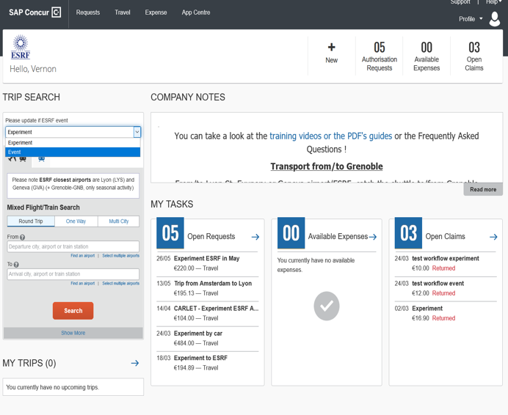
SAP CONCUR - HOME PAGE
From the home page, online booking starts with the « Trip Search »
This default value must be updated:
Please select « Event »

Slide 5
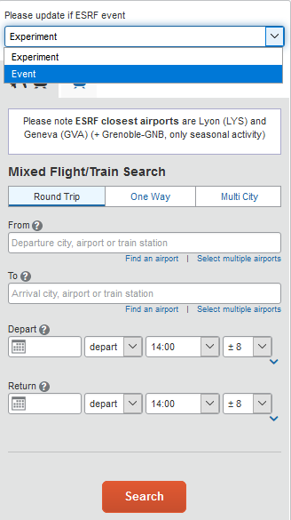
SAP CONCUR – TriP SEARCH (1/4)
Default value is “Experiment”, please select “Event”
Default value is Airplane/train search
Reminder
Default value is “Round Trip”
Departure/arrival: to be filled-in by traveler
Dates: to be filled-in by traveler (minimum D-14)
By default, the application will report available tickets from 6:00 to 22:00
Fill-in « From », « To », « Depart » and « Return » dates
And then, click Search

Slide 6
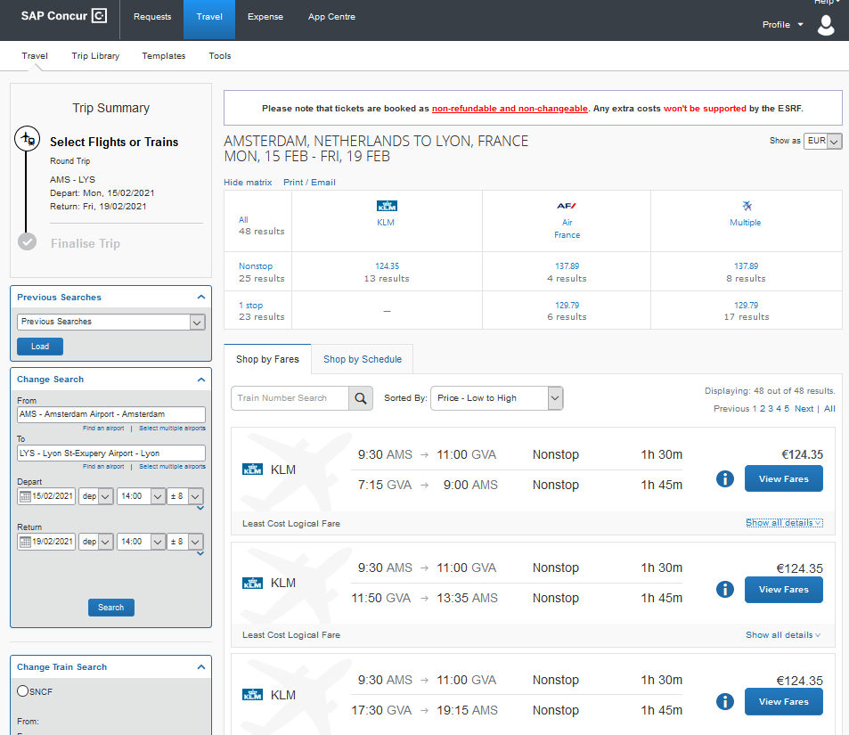
SAP CONCUR – TRIP SEARCH (2/4)
For example: Amsterdam-Lyon (or Geneva), from 15 to 19 Feb. 2021
Reminder
Available
flights
Travel
options…

Slide 7
SAP CONCUR – TRIP SEARCH (3/4)
TRAVEL SUGGESTIONS ARE COMPLIANT WITH ESRF TRAVEL POLICY:
Great!
you choose the most economical fare, compliant
with ESRF travel policy
These tickets require justification and are subject to ESRF prior agreement
Sorry, these tickets are not authorized by ESRF travel policy

Slide 8
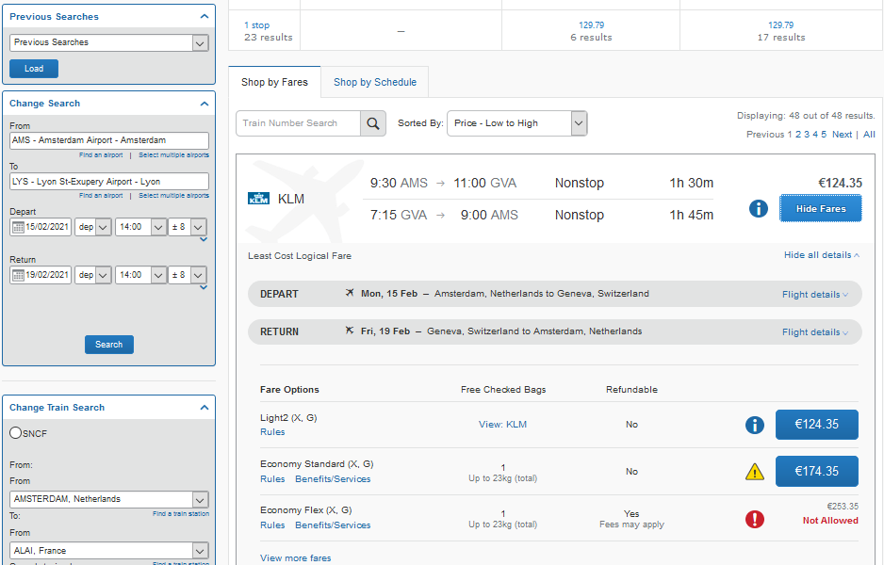
SAP CONCUR – trip search (4/4)
Select your tickets, by clicking on
Luggage
Y/N?

Slide 9
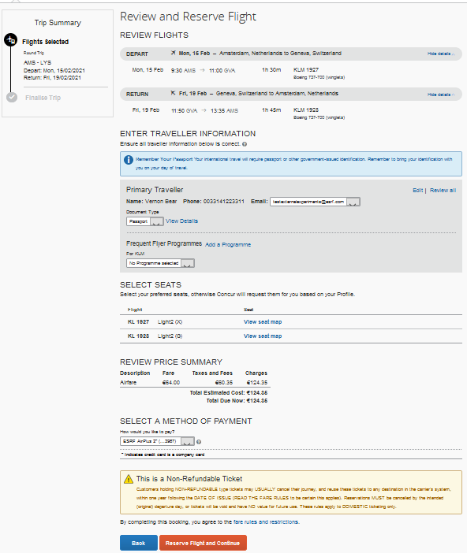
SAP CONCUR – BOOKING confirmation (1/4)
The flights you selected:
Traveler’s data, automatically
reported in Concur (can be
completed by the traveler)
Please note ESRF credit card
for direct invoicing
Reminder: If you booked low-cost flights,
once clicked on “Reserve flight and continue”, flights will be immediately charged to the ESRF (please be sure of your choice!).
If ok, click here for next step

Slide 10
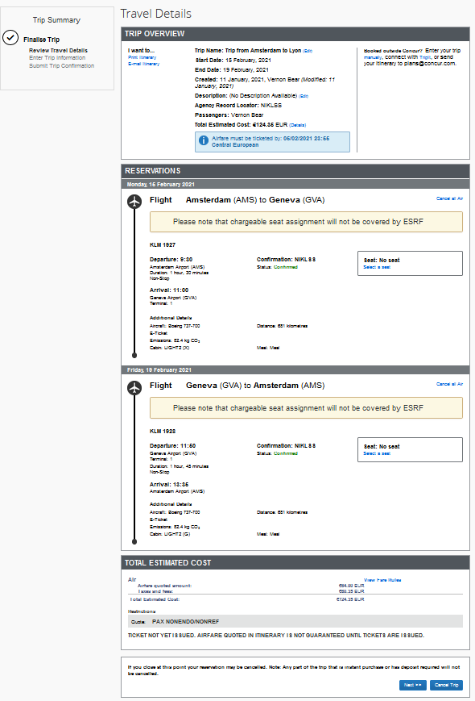
SAP CONCUR – BOOKING confirmation (2/4)
Flight details
If ok, click here for next step

Slide 11
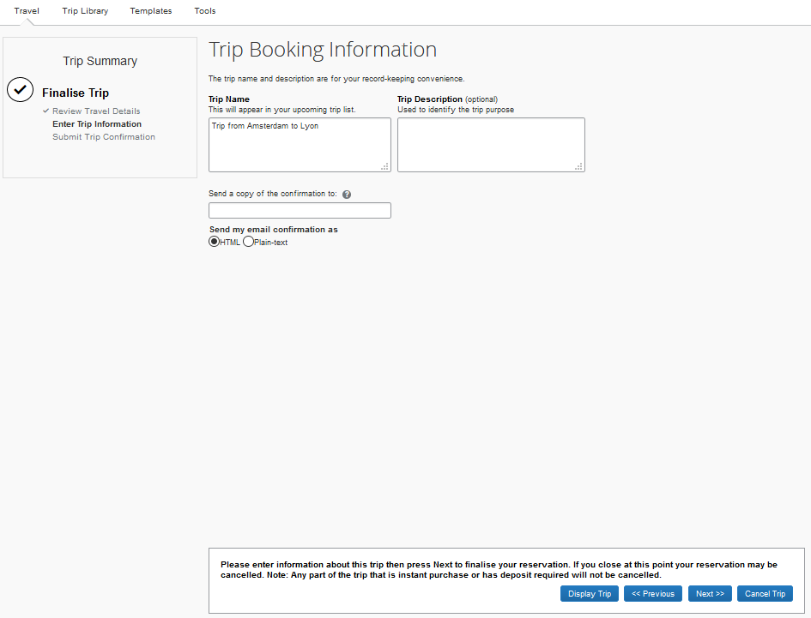
SAP CONCUR – bOOKING confirmation (3/4)
Trip name
automatically filled-in
(changeable by traveler)
If ok, click here for next step

Slide 12
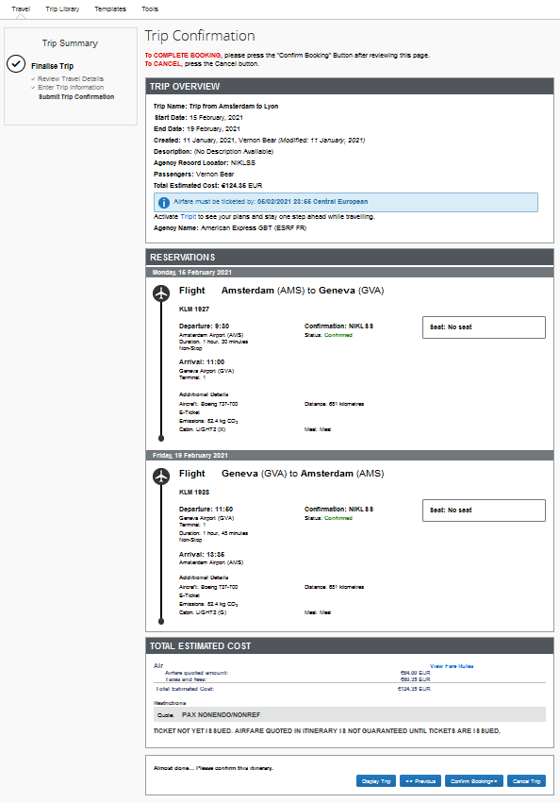
SAP CONCUR – BOOKING confirmation (4/4)
Final review of the booking:
If ok, click on “Confirm bookings”

Slide 13
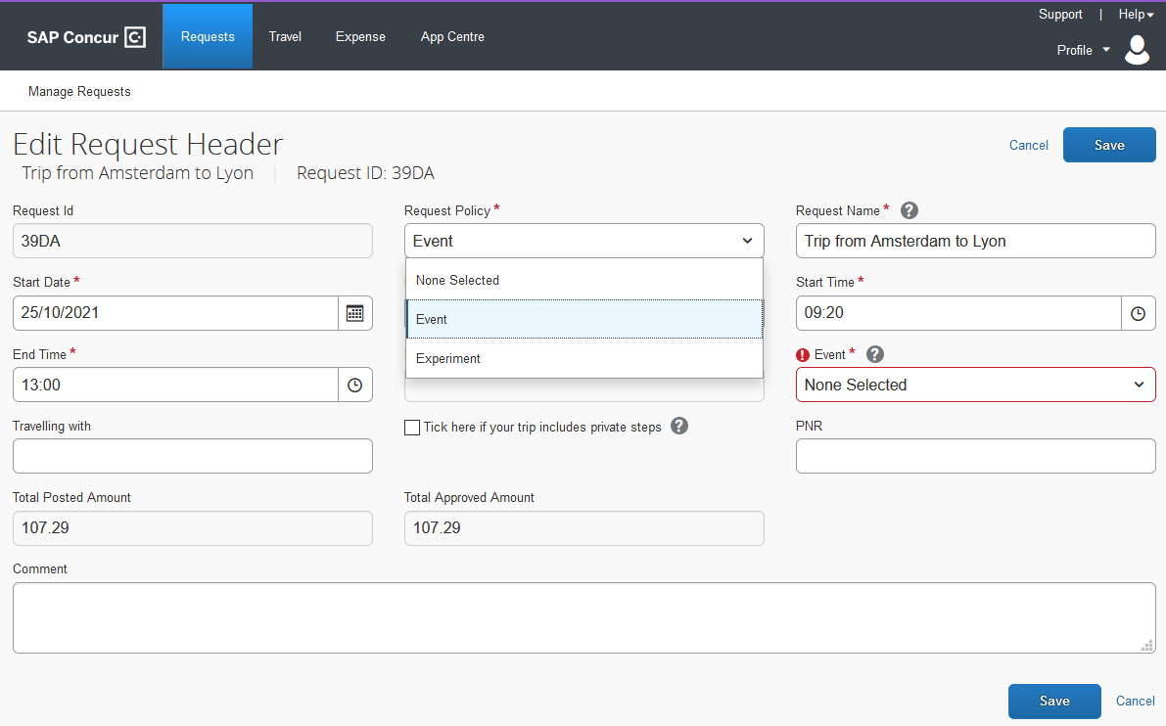
SAP CONCUR – CREATION OF THE REQUEST HEADER
Well done! Now, your online booking needs to be approved by ESRF
You can see below the header of your travel request (automatically filled-in)
Select “Event”
Select your event name from the list
Click “Save” for next slide

Slide 14
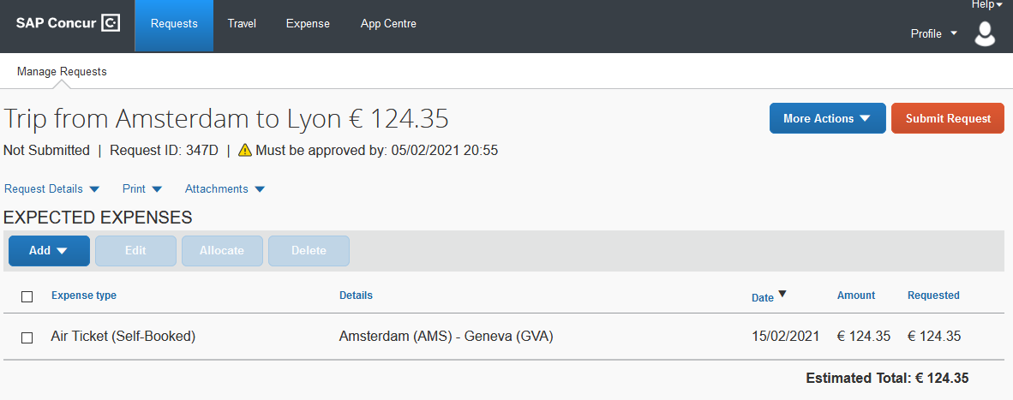
SAP CONCUR – TRAVEL EXPENSES
As booked online, your flight expense is automatically reported,
Now, you are requested to add the extra travel expenses you would like to be reimbursed by the ESRF, such as shuttle, bus,…
(see next slides)

Slide 15
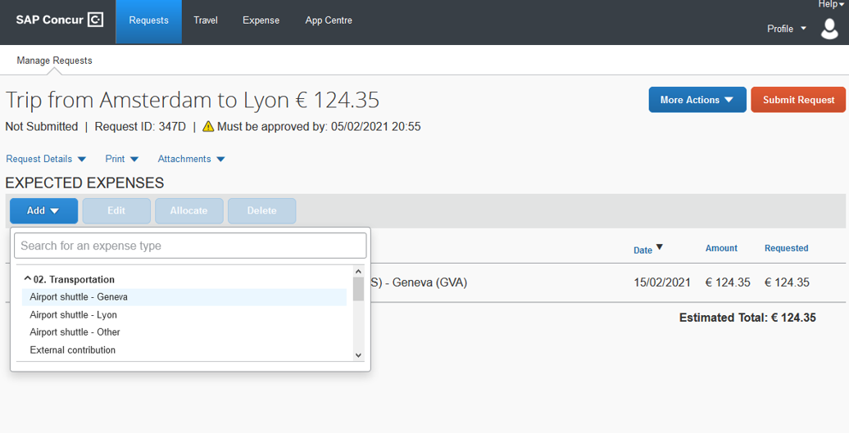
SAP CONCUR – ADD TRAVEL EXPENSES
Click on « Add » and select the extra travel expenses
For example: airport shuttle from Geneva airport to reach the ESRF

Slide 16
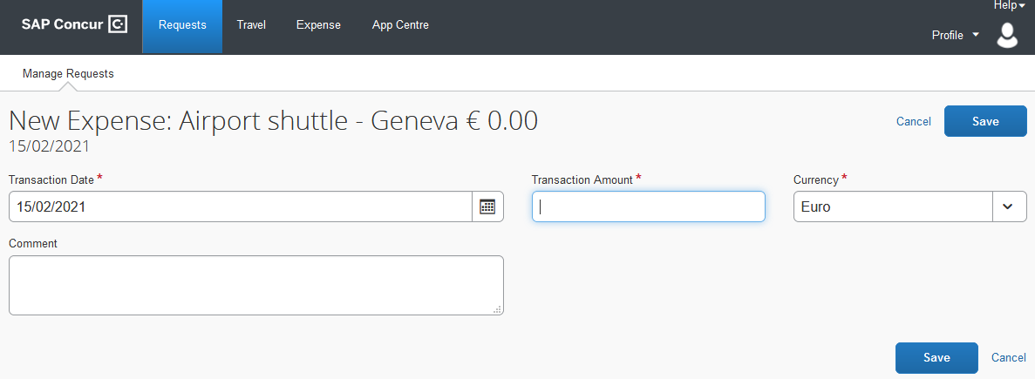
SAP CONCUR – ADD TRAVEL EXPENSES
Fill-in all the mandatory fields (i.e those with « * »)
For this item, it’s only the shuttle ticket price
Click « Save » to validate (or « cancel » to go back)

Slide 17
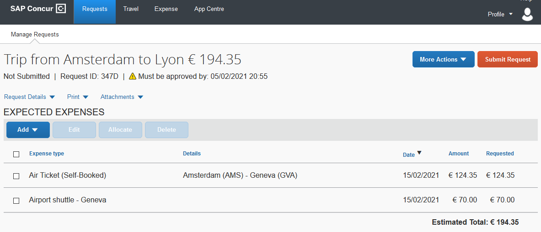
SAP CONCUR – ADD TRAVEL EXPENSES
Now, the shuttle ticket is added to your travel request
Click again on « Add », for extra travel expenses

Slide 18
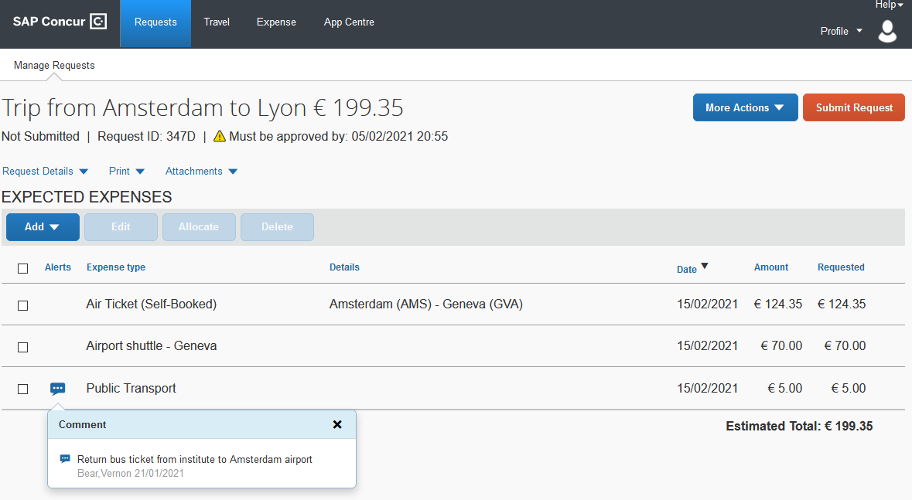
SAP CONCUR – ADD TRAVEL EXPENSES
Click again on « Add », for extra travel expenses
When necessary, add explanation in the comment field of each travel expense

Slide 19
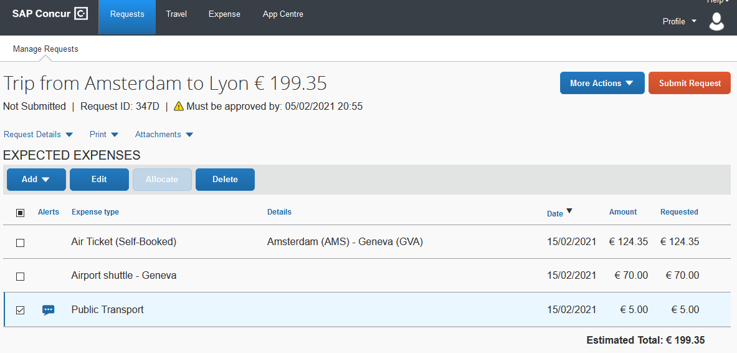
SAP CONCUR – changes / cancellation
For changes or cancellation, select the item first
Click on « Edit »
for changes
Click on « Delete »
to remove the expense
Once all foreseen expenses are reported, please click on « Submit Request »

Slide 20
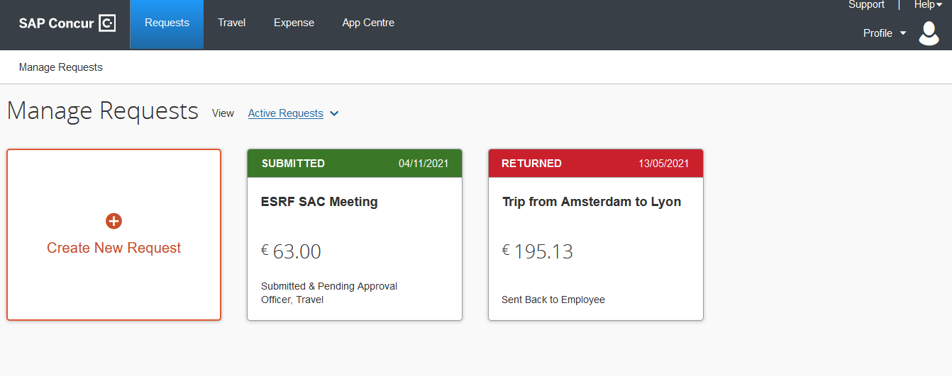
SAP CONCUR – TRAVEL REQUEST IS SUBMITTED
Once submitted, your request is filed with your other travel files (depending on the date of departure). A different color indicates the status of each file.
Complement: check your emails regularly and follow SAP Concur notifications

