Slide 2
for event participant
Expense Report
& mobile application
Notes:
Présentation standard de l’ESRF.
Elle est composée de 11 diapositives présentant :
- L’ESRF en bref avec des chiffres clés
- L’ESRF : Une coopération de 21 pays
- Le campus EPN (European photon & neutron science campus)
- Au cœur du campus mondial d’innovation
- L’ESRF joue un rôle crucial dans l'Europe de la recherche
- Il y a environ 50 synchrotrons dans le monde
- 4 prix Nobel parmi les utilisateurs
- Une meilleure technique pour une meilleure science
- ESRF : PLUS de 20 ans de succès et d’excellence
- Un programme ambitieux de modernisation
- Esrf upgrade programme PHASE II

Slide 3
Objectives and pre-requisites:
The following slides explain:
How to create and submit your expense report, with SAP Concur mobile application
Pre-requisites:
The ESRF recommends that beforehand, you:
Download the SAP Concur mobile Application, to get certified copies
of your travel tickets

Slide 4
INTRODUCTION
Receipts are required for the submission of your expense report
Two alternatives:
Certified receipts, if scanned from SAP Concur mobile
Paper receipts are no longer required
Attached images, if NOT scanned from SAP Concur mobile
Original receipts must be sent to ESRF Travel agency (by postal mail)
Complements:
Expense report must be submitted from the approved travel requests (as several
fields will be automatically populated)
Unexpected expenses and higher amounts are subject to ESRF approval

Slide 5
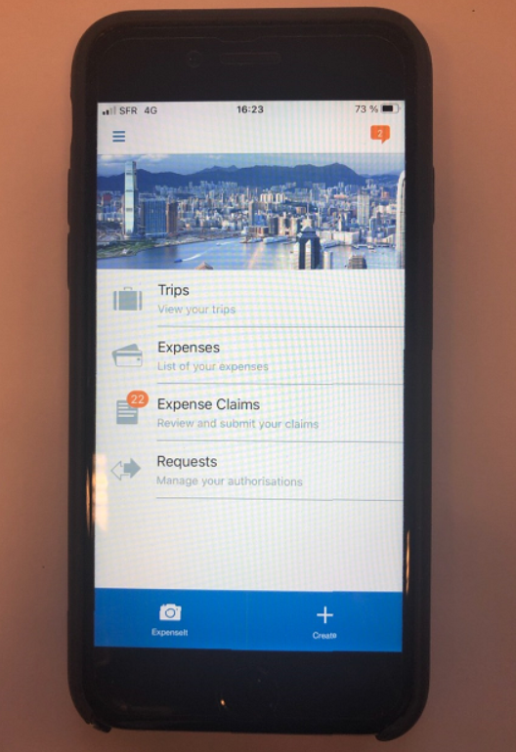
CONcUR MOBILE
Thanks to SAP Concur mobile App.,
you will be able to:
- Take pictures of your receipts (with ExpenseIt)
and get them certified
- Add the certified tickets to your claim
- Submit your expense report, electronically

Slide 6
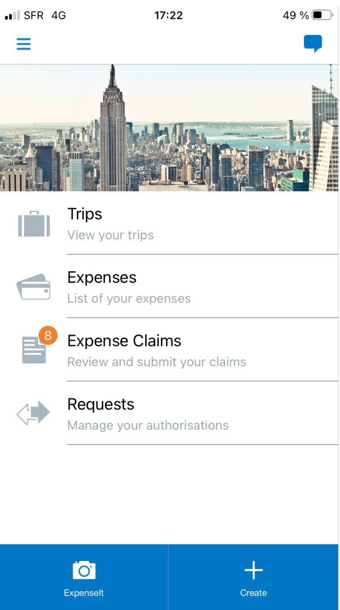
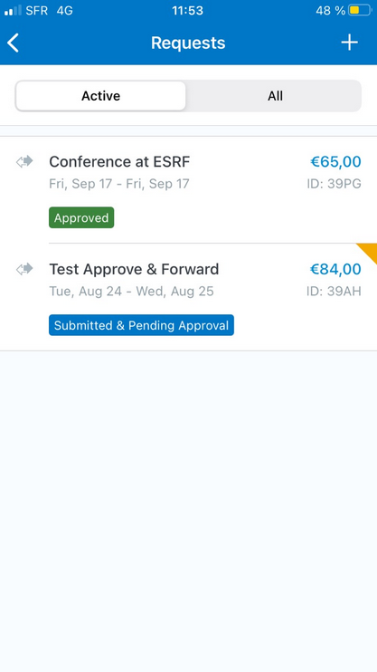
Creation of the expense report
From the home page, select « Requests » to view all your active files
Then, choose the
related approved request

Slide 7
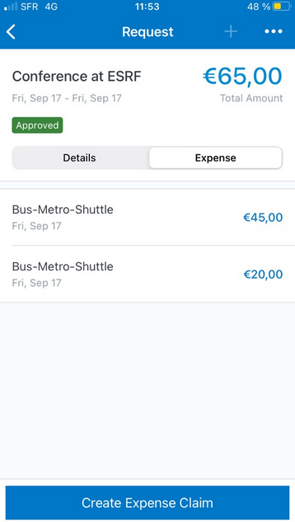
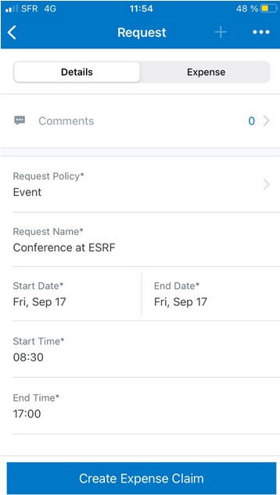
Creation of the expense report
Expenses of the approved request, are reported
Select « Details » to check the request header
Create the Expense Report, here

Slide 8
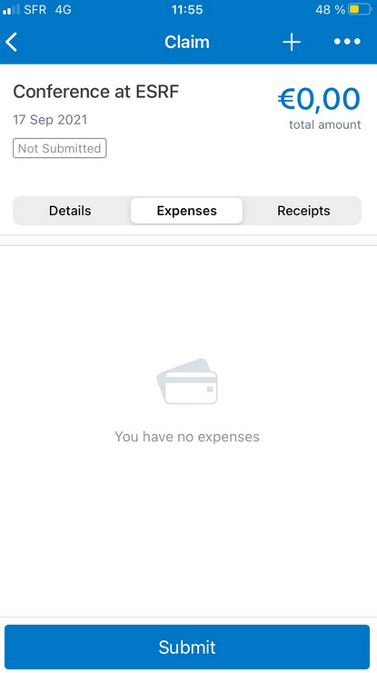
Creation of the expense report
Well done! the expense report has been successfully created
The Export Report is pending for your receipts

Slide 9
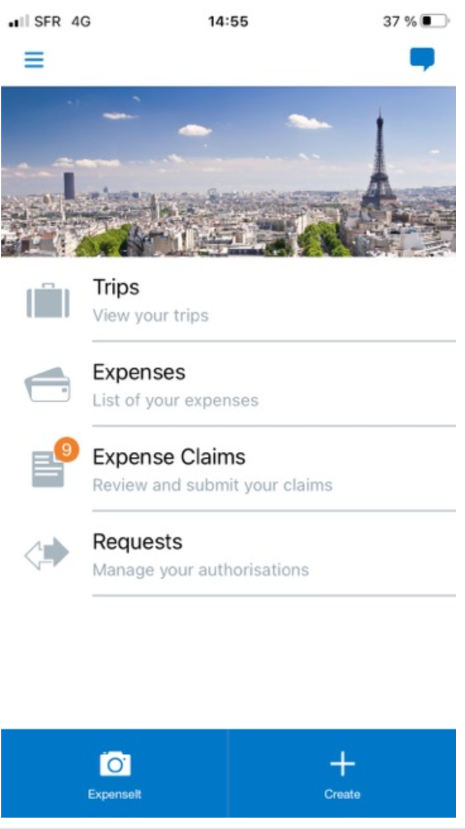
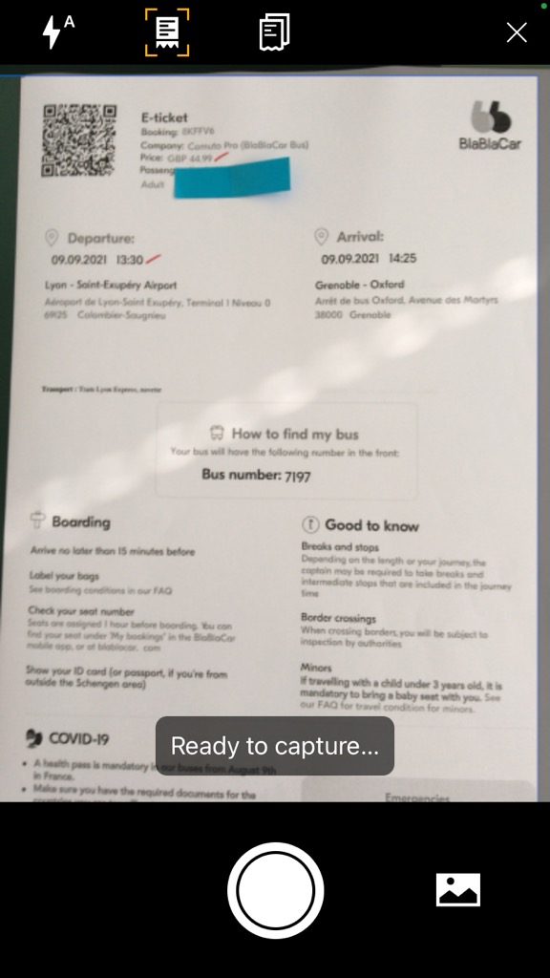
TAKE A PHOTO OF your ticket and get A cERTIFIED RECEIPT
From the home page, click on « ExpenseIt »
Then, zoom on the receipt, as much as possible…
Once ok,
take your photo

Slide 10
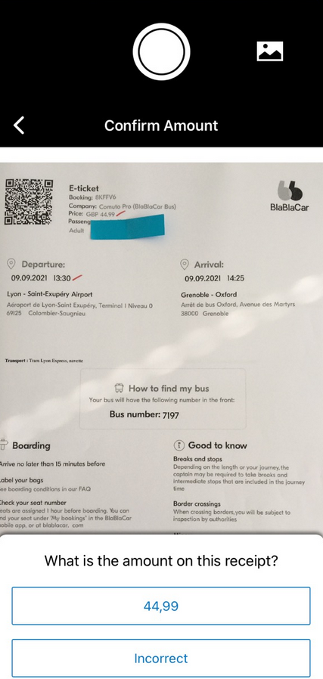
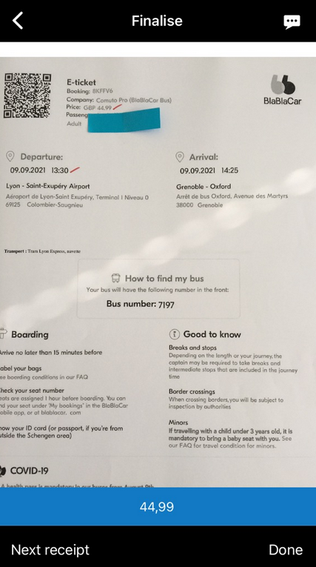
TAKe A photo of your ticket and get A certified RECEIPT
Your scanned receipt
is now certified!
(see the blue logo on the top left)
Check the amount of your
ticket (confirm or update)
Select « Done » to upload

Slide 11
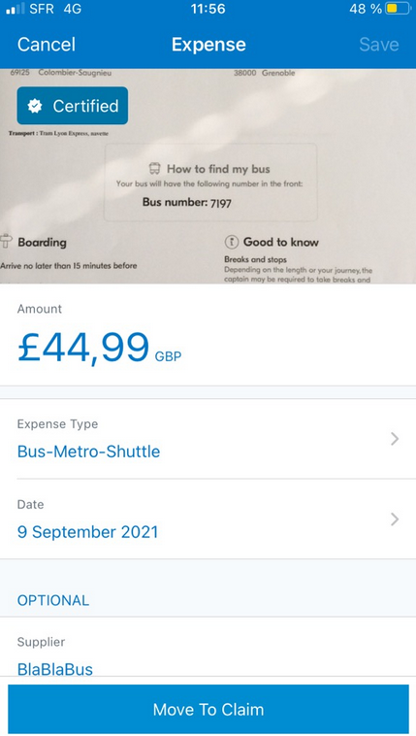
ADD THE certified receipt to the expense report
Click on the expense and check the reported information
Update each item,
if necessary
Revised
Once ok, click on « Move To Claim »

Slide 12
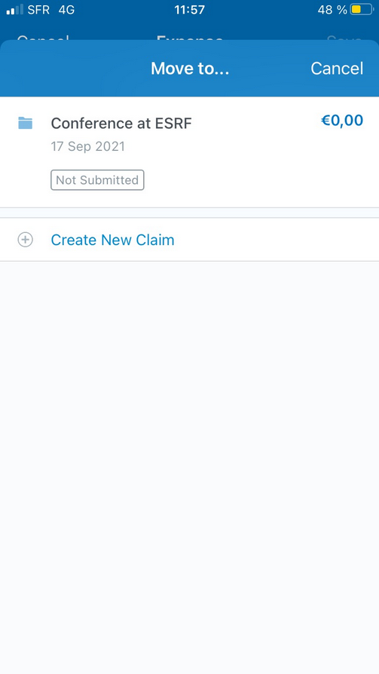
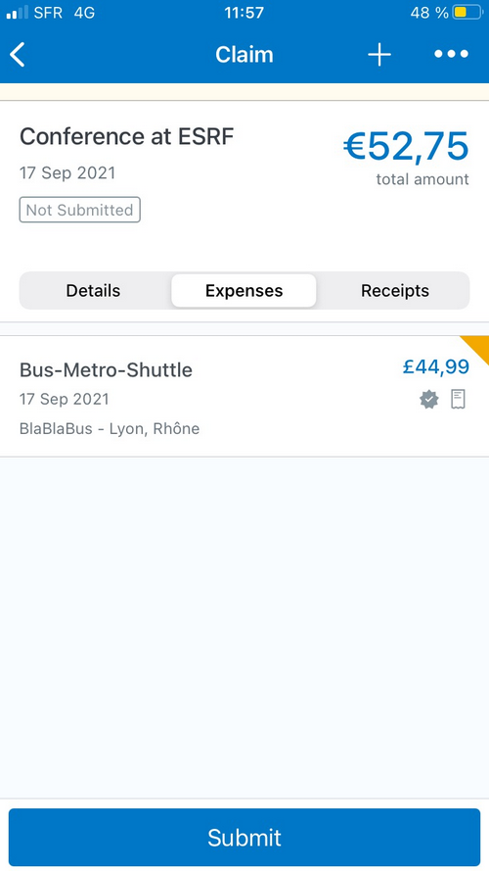
ADD THE CERTIFIED RECEIPT
Choose the expense report you created beforehand
The receipt is
added, now
Select « + »
to add extra expenses

Slide 13
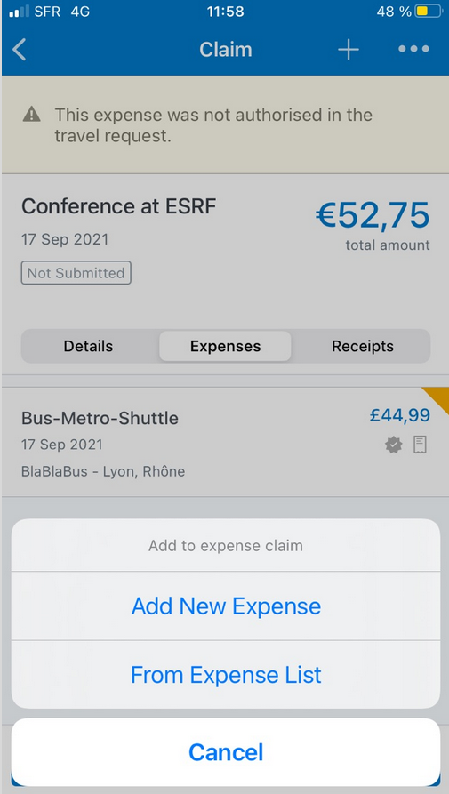
ADD EXTRA RECEIPT
Select « From Expense list » to add another certified receipt
Select it
Then, « Move To Claim »

Slide 14
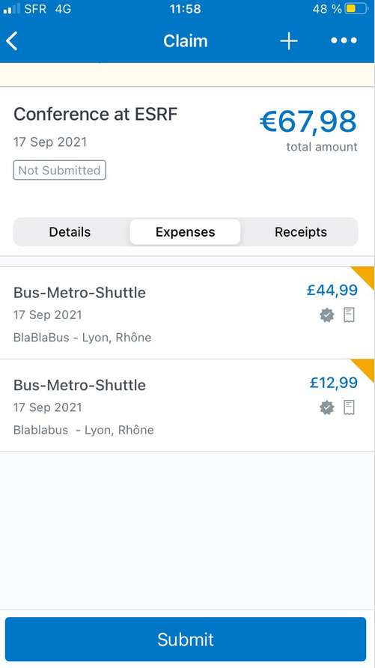
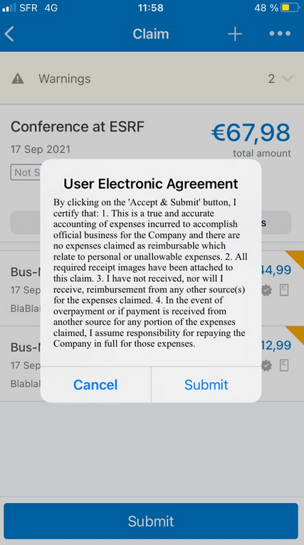
SUBMISSION OF the EXPense REPORT
Once all your expenses are added, select « Submit »
Read the agreement
and « Submit »

Slide 15
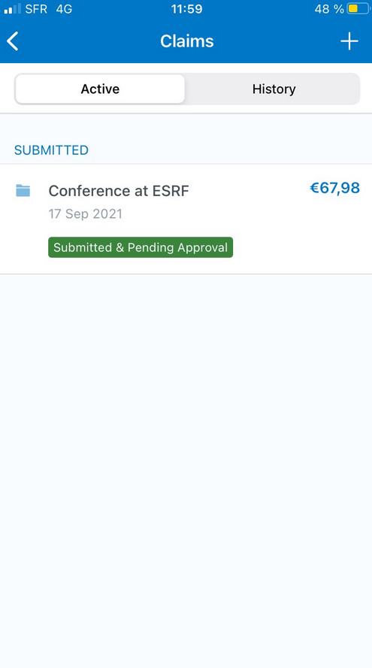
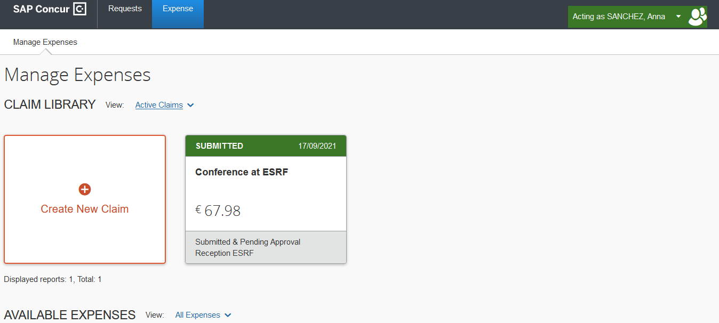
submission of the expense report
The expense report is correctly submitted and is pending for ESRF approval
Similarly, on the mobile App.
And on the web application

