Slide 1
Peter Marten
Senior RF Technician
Diamond RF Group
15th ESLS-RF Meeting, October 5-6th, ESRF
IOT Measurements & Amplifier Improvements at Diamond

Slide 2
Agenda
IOT Statistics
Amplifier Trips
IOT Measurements
Amplifier Faults
Modifications
Current Projects

Slide 3
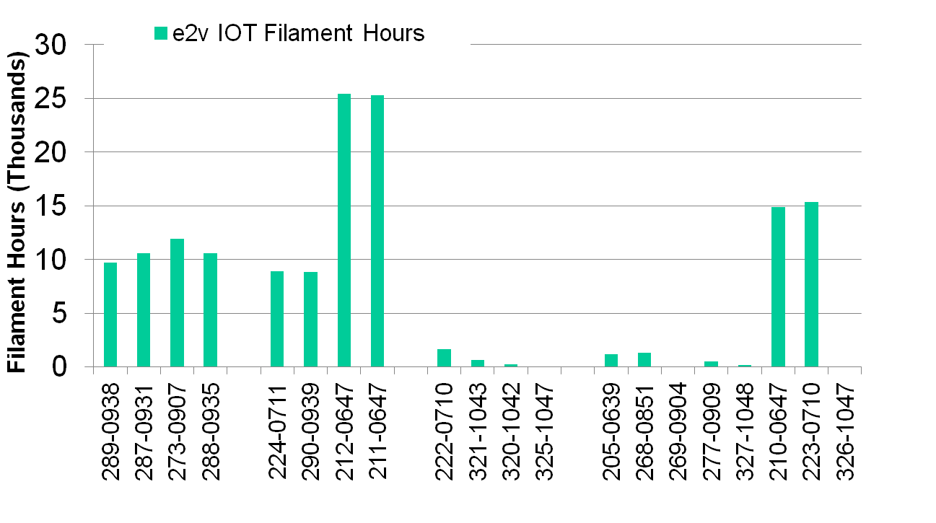
IOT Operating Hours
SR Amp. 3
Faulty / Spare
SR Amp. 1
Faulty
RFTF/Test Amp. 2
20 IOTs, 12 in 3 amps.
17 Working:
10 IOTs have combined operating hours over 141,000 hours
(2 IOTs have operated for > 25,500 hours)
All 10 are still working well
7 Spare IOTs undergoing conditioning
2 IOTs waiting for further investigation
3 Faulty:
1 Failed during initial e2v commissioning (2007), replaced under warranty
1 Failed during setup, Si contamination
Leaky ion pump on delivery,
  replaced under warranty

Slide 4
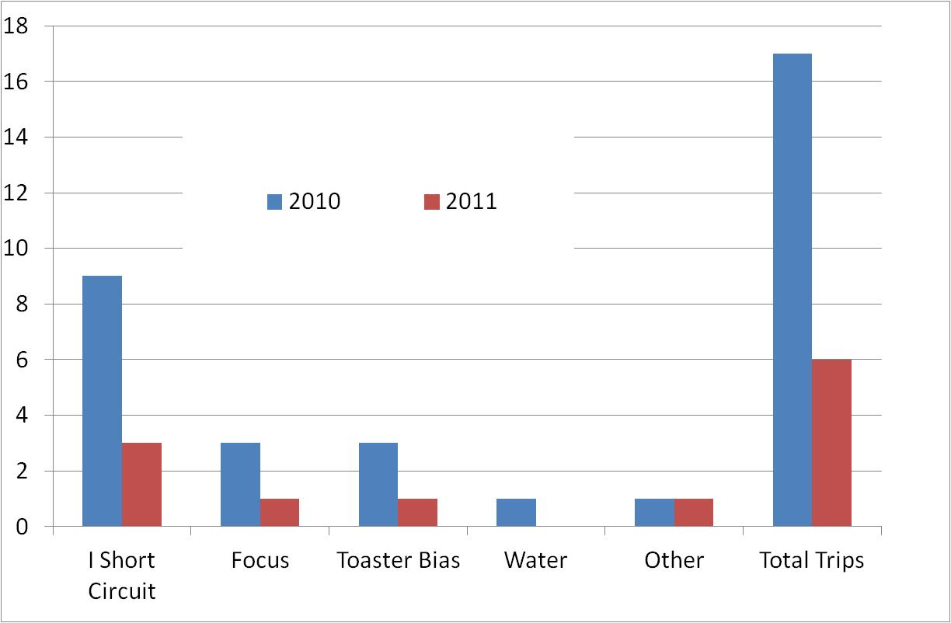
Amplifier Trips
2010: 17 trips, 9 ISC trips (mostly new IOTs)
2011: 6 trips, 3 ISC (to date)
No. of Trips

Slide 5
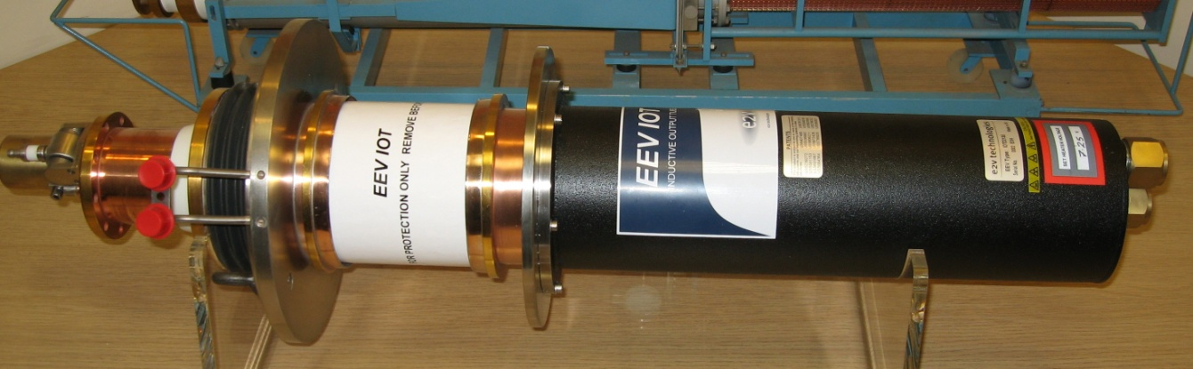
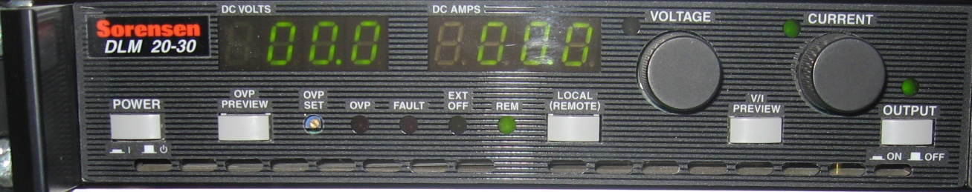
Trips
IOT Short Circuit
Geometry @ 500 MHz
Focus PSU
Output dead: no +5 V supply to Isolated logic or analogue comparator circuits > switching regulator not fired
Random noisy signal causing triggering of interlock signal

Slide 6
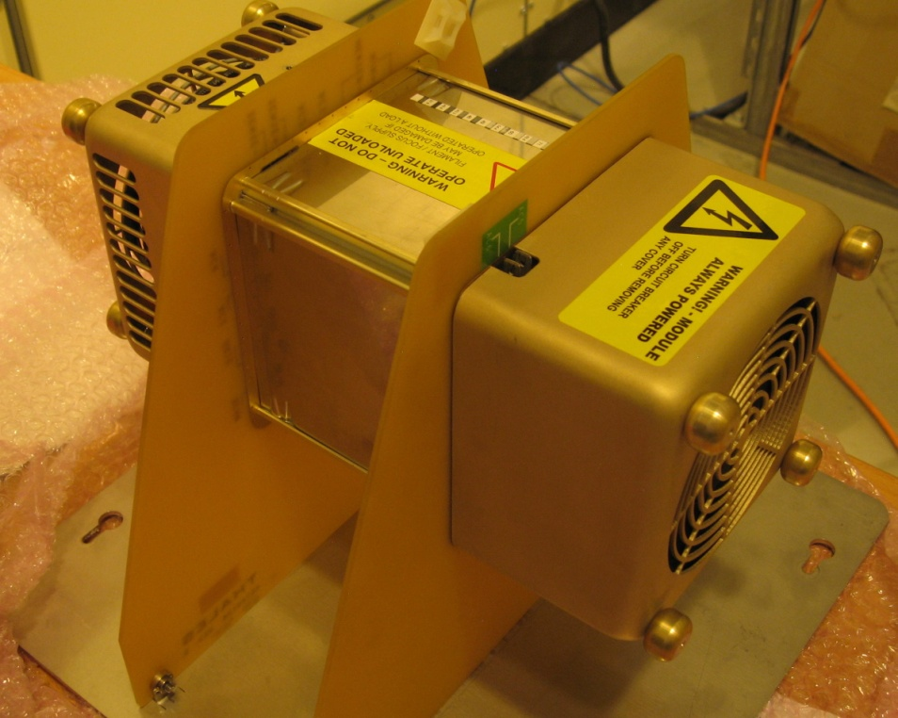
Trips
Toaster IOT Bias Supply
Faulty wiring
Input cavity fault
Water
Faulty flow monitor switch
Other
Load arc > before arc detector upgrade
Human error

Slide 7
Transfer Curve

Slide 8
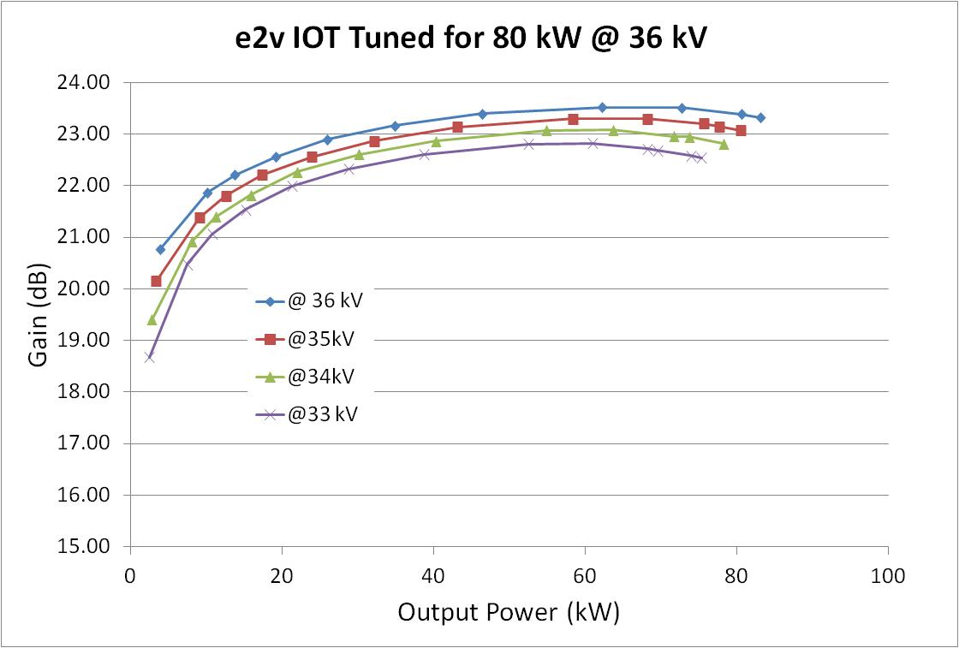
Effect of High Voltage on Gain
Reduce ISC trips @ 33 kV?
Gain -0.5dB (60 kW)
Plenty of drive available in DA to compensate

Slide 9
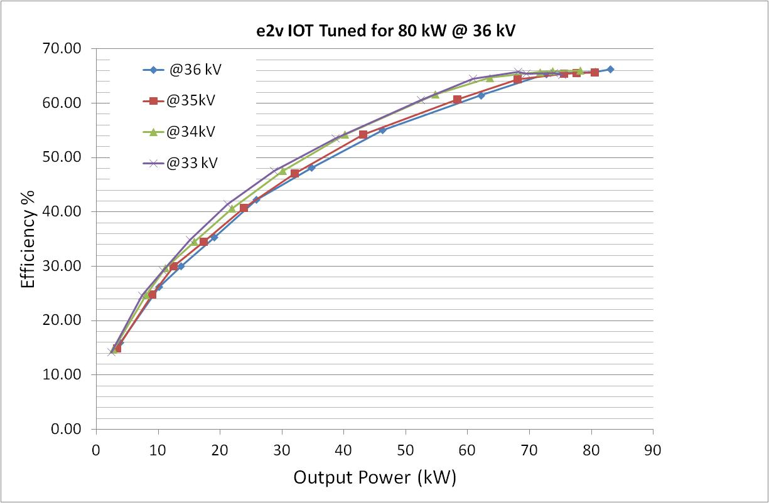
Effect of High Voltage on Efficiency
5% increase in efficiency (33 kV)
Operation at 80 kW is easy
  HV > control room
  No re-tune required

Slide 10
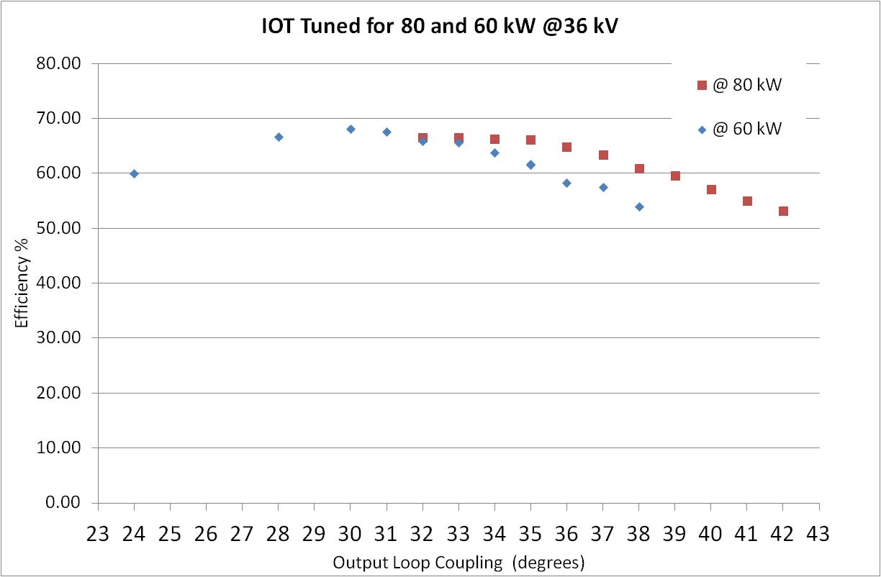
Effect of Output Coupling on Efficiency
Same efficiency if OLC tuned
Problem:
Can’t increase power instantly to 80 kW
Danger of tube damage if run in undercoupled region
Undercoupled

Slide 11
Effect of Filament Voltage on Power

Slide 12
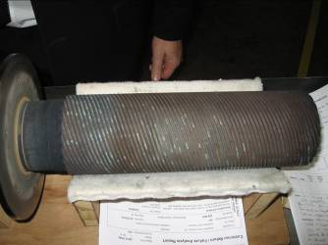
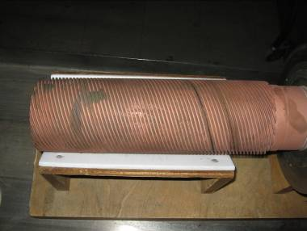
Amplifier Faults
Water System
Blackened Cu collector (268-0851) failed at 80 kW during tests compared with an example after 8 years service in a TV transmitter

Slide 13
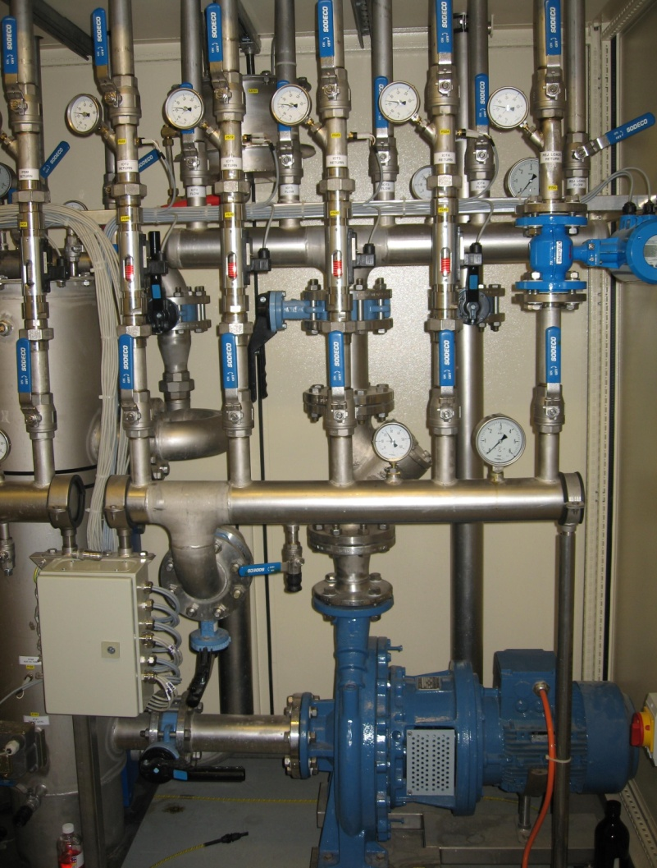
Amplifier Faults
Water System
Si contamination
IOT failed during conditioning at 80 kW
IOT Power limited to 60 kW
Coolant and Cu collector analysed > Si
Dowcal 10 formula had changed
Decontaminated water systems
Replaced with 40% Thermocal C

Slide 14
Modifications
PSM AHU belts replaced (Optibelt)
Smoke detectors installed inside HVPS
PSM PSI 04 current measurement board modified
Second AHU for rack and IOT cooling
Drive amplifier coax upgraded (<loss, RF, life)

Slide 15
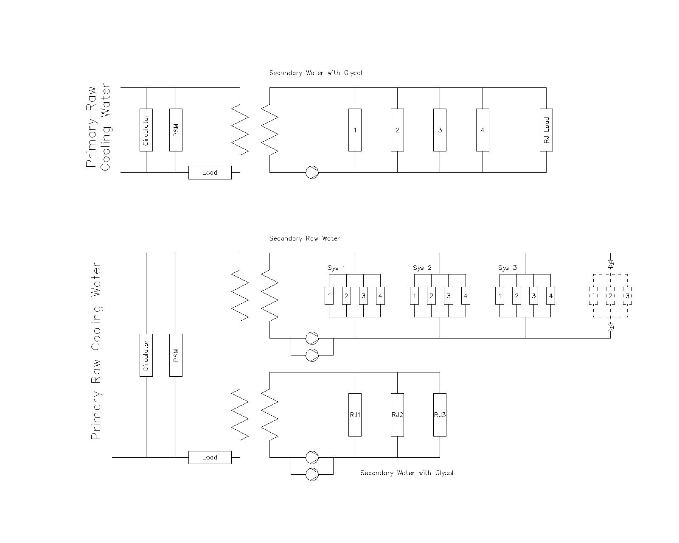
Water Upgrade Project
Secondary System with Glycol
Primary Cooling
Current System x 3
Secondary System with Water
Reject Loads
Primary Cooling

Slide 16
Water Upgrade Project
Provide duty and standby pumps
Eliminate glycol from IOT cooling
Improve present water system (disturbance during repairs often causes unrelated leaks)
Ideally remove Glycol requirement from reject loads (H & S, messy, reduced cooling efficiency)
Simplify design to cool all three systems from one secondary water system (R. load modelling)

Slide 17
The Water Load Development

Slide 18
The Water Load
The present load uses a mixture of 40% Glycol and 60% Water
Need to maintain a separate circuit(?)
The new load will use pure water
Easier maintenance

Slide 19
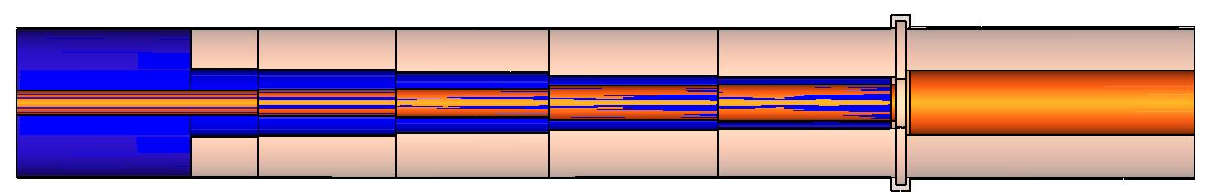
The High Power Co-axial Load
Matched to the input transmission line
Absorb all the input power
Remove the heat generated by water circulation
Section at A-A′
A
Input
A′
Extra length to absorb remaining energy
Slowly introduce water while keeping matched so that the wave attenuates on its forward travel
d and d1 are changed in steps to keep impedance matched and introduce more & more water

Slide 20
Dielectric Properties of Water & Glycol
 | 40% Glycol-Water Mixture @25°C | Pure Water @25°C
Dielectric Constant (ε′) | 56 | 78
Loss Tangent (tanδ) | ~0.2 | ~0.024
Glycol
Impedance matching is relatively easy
Good absorber of RF Power
⇒ Fast attenuation leading to compact design
Water
Impedance matching is relatively difficult
Not a good absorber of RF power
⇒ Slow attenuation leading to increased length

Slide 21
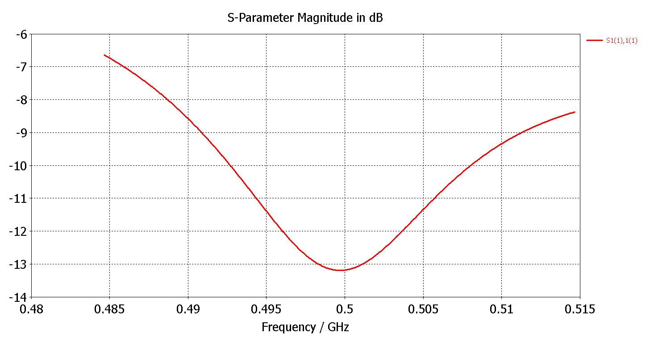
Numerical Design of Water Load
Using CST Studio Time Domain / frequency Domain Solvers

Slide 22
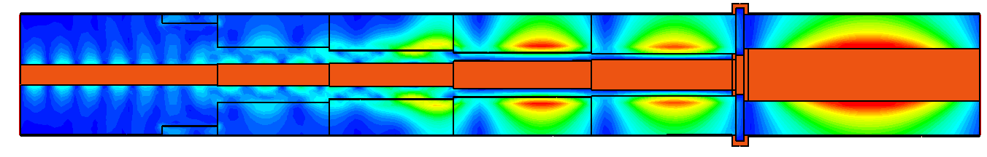
Numerical Design of Water Load
E – Field
Due to relatively low tanδ there is still enough energy left at the end.
Need more sections of Teflon
Design in progress
The Load

Slide 23
Fast IOT Fault Detection and Isolation
Purpose
IOT breakdown is single largest amplifier fault
Fault on one IOT isolates HV for all 4 IOTs
Typically 10-15 trips per year / 8 IOTs in operation
Recovery is fast – but beam is lost
Possible solution
Detect IOT fault (µs)
Isolate IOT HV (dissipated energy < 9J)
Maintain beam –> Other IOTs to ramp up
Re-instate IOT -> Other IOTs ramps down

Slide 24
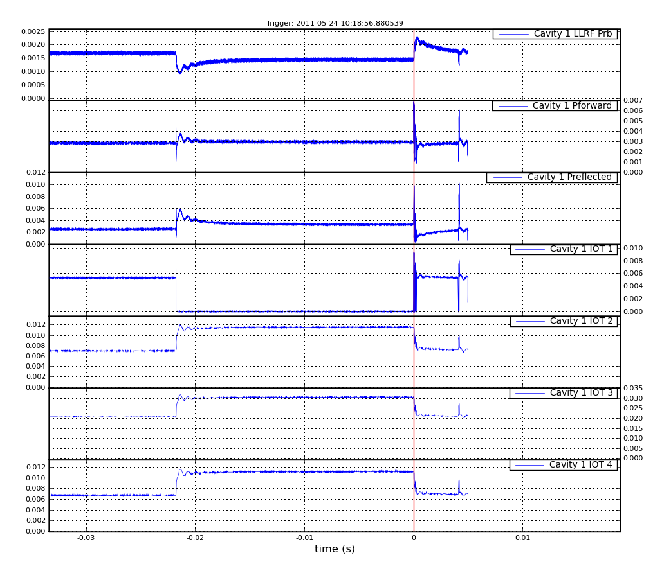
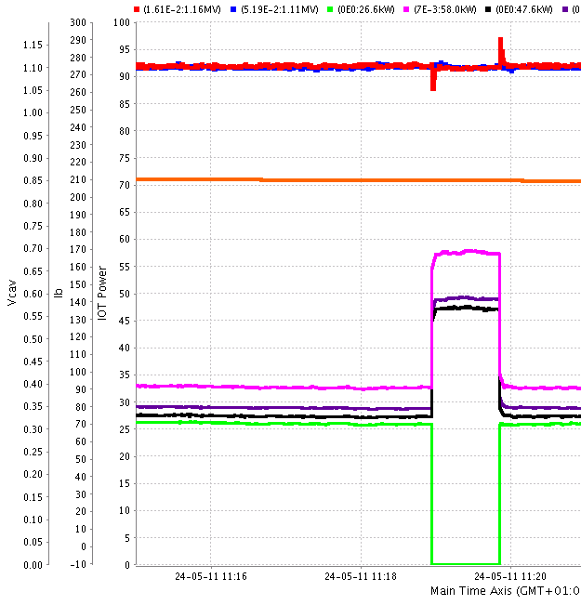
Fast IOT Fault Detection and Isolation
Successful First Test of Principle
Close up of IOT turn OFF and ON
Small voltage disturbance during switching
Cavity 1 Voltage
Cavity voltage
Forward Power
Beam current = 210 mA
Reflected Power
IOT 2, 3, 4
IOT 1 OFF
IOT 1
IOTs 2, 3 and 4 UP
IOT power
Note IOT 1 turned off and IOTs 2,3 and 4 compensate
20 ms
Preparation:
Quench Detector turned OFF
Reflected power trip turned off

Slide 25
Ongoing Work
Signal debounce and first fault reporting
Filament management
HV PSM regulation investigation at certain loads

Slide 26
On behalf of the RF Group
Morten Jensen
Pengda Gu
Matt Maddock
Peter Marten
Shivaji Pande
Simon Rains
Adam Rankin
David Spink
Alun Watkins
Thank you for your attention

