Slide 1
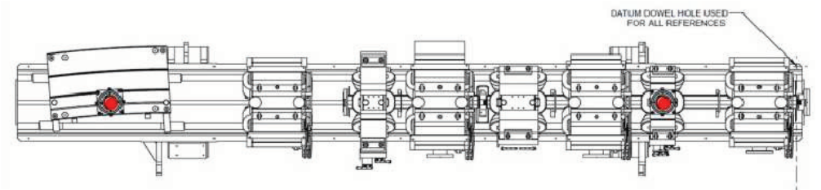
Transparent Re-alignment of the
Diamond Storage Ring
M. Apollonio – Diamond Light Source Ltd
ESLS – XXII Workshop, ESRF Grenoble, November 25th 2014
M1
M2

Slide 2
Outline
  Motivations
  Low Coupling
  Alignment & Tests
  Transparent Re-alignment (TR)
  Conclusions

Slide 3
Motivations Coupling Alignment Tests TR Conclusions
Why aligning the machine?
perfectly aligned machine ensures
  nominal performance
  nominal photon beam properties
misalignments minimized via orbit corrections
  CMs (dipoles) correct orbit but introduce dispersion in both planes
  CMs correct the orbit at BPMs
  orbit can be ≠ 0 anywhere else
off axis orbit at quadrupoles
  dipole kicks → more corrector strength → more dispersion
  H dispersion errors → H emittance errors
  V dispersion → V emittance (> quantum limit ~0.6 pm)
off axis orbit at sextupoles
  dipole kicks
  tune shift (H offset at sextupoles makes a normal quad)
  β-beating
  betatron coupling (V offset at sextupoles makes a skew quad)
  dynamic aperture reduction
  lifetime increase
  …
these distortions can become relevant especially at low coupling ...

Slide 4
Reduced Vertical Emittance
Motivations Coupling Alignment Tests TR Conclusions
In response to request from Science Division, vertical emittance has been reduced from 27 pm.rad to 8 pm.rad for user operation (1% to 0.3% coupling)
Initially confined to machine development periods
Two week period from 17th October to 1st November 2012
Standard operational mode since 6th March 2013
Benefits include increased brightness / transverse coherence, smaller spot size
1% coupling
0.3% coupling

Slide 5
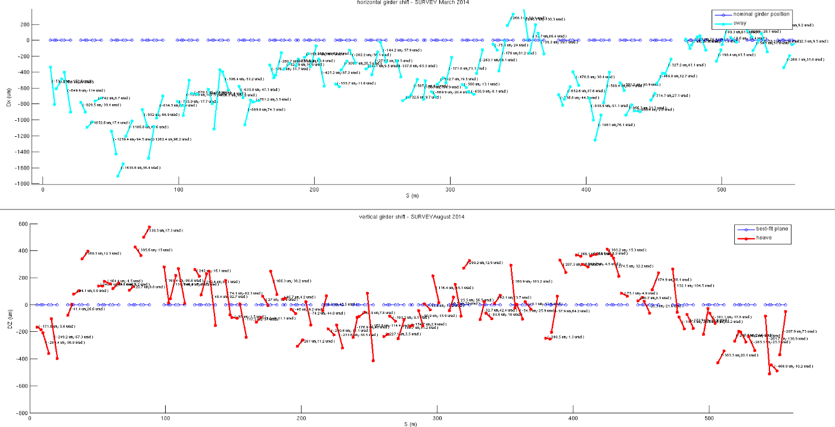
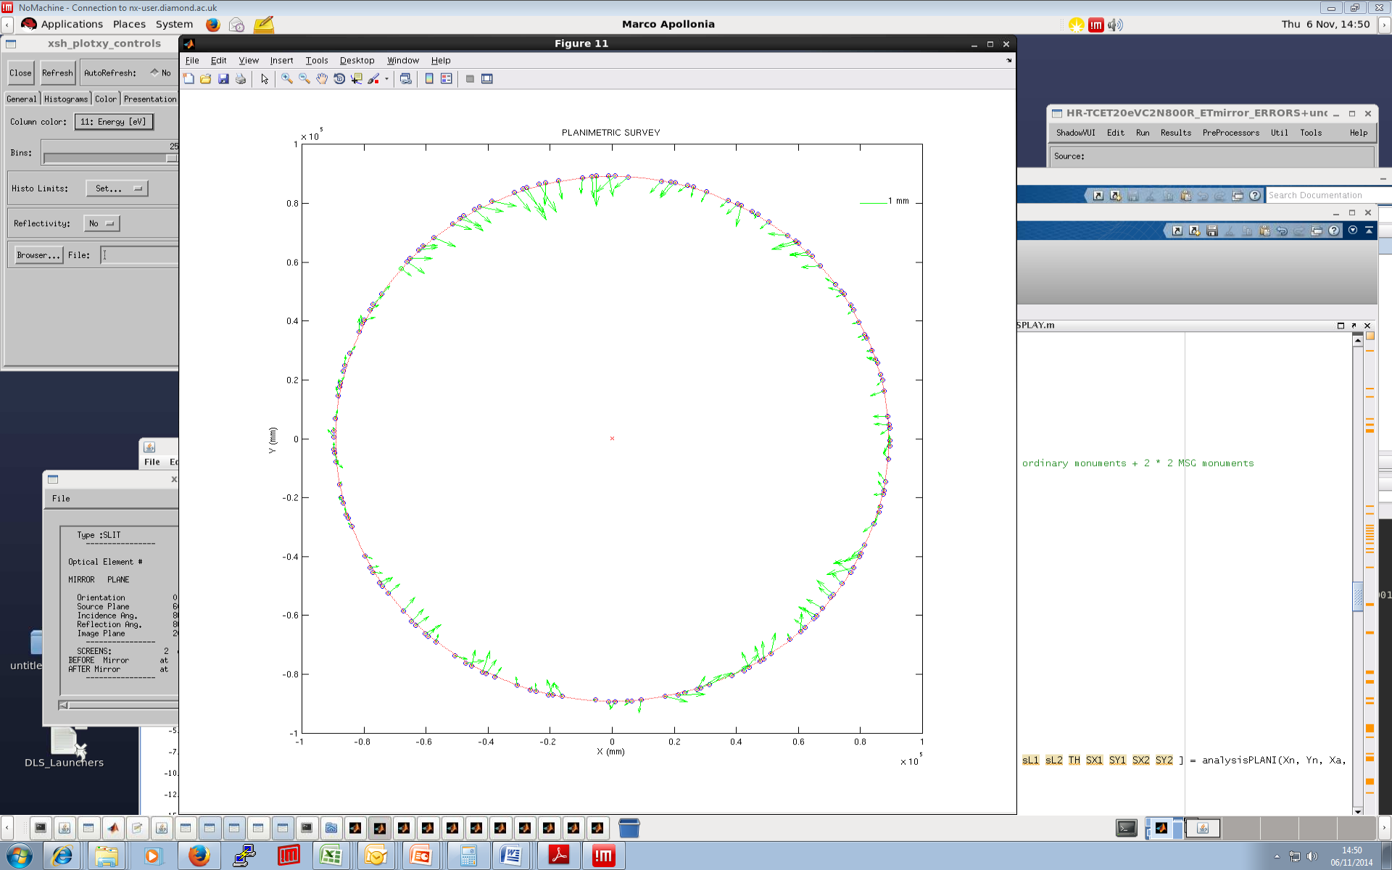
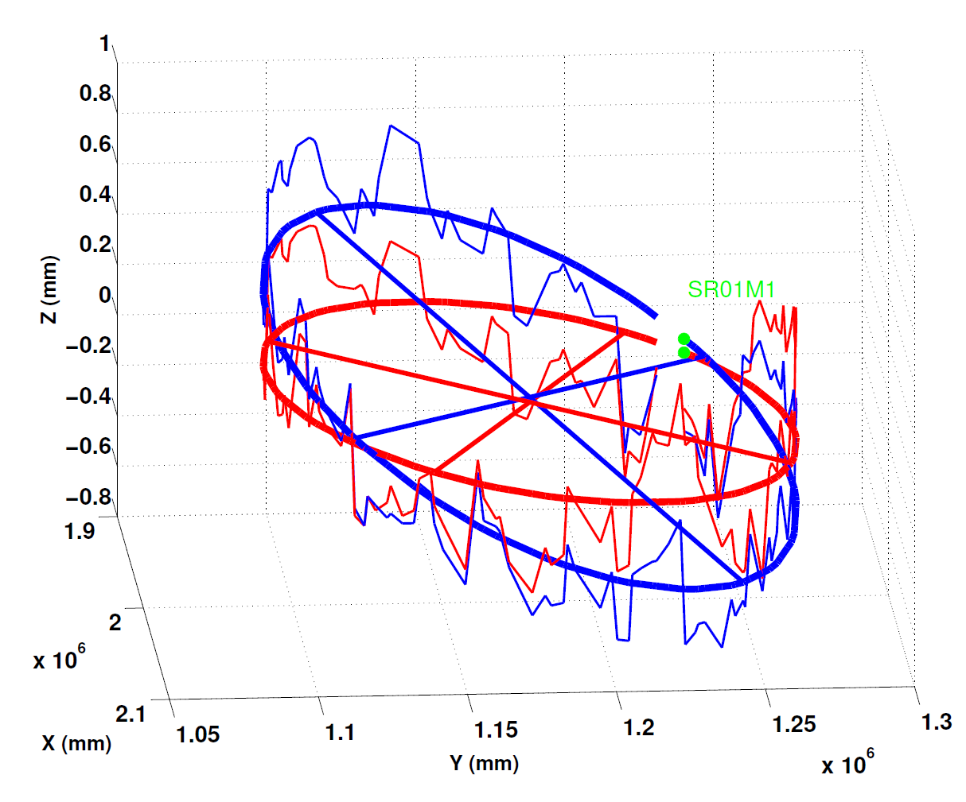
Motivations Coupling Alignment Tests TR Conclusions
Survey Data
H-plane
Survey March 2014
dR
> 1mm sway
S
Survey August 2014
V-plane
best fit plane
MOPRO099, IPAC2014
dZ
1000 um
S
> 600um heave

Slide 6
Motivations Coupling Alignment Tests TR Conclusions
Girder moves – model
AT model
MATLAB functions change magnet positions according to survey
girder → (sway,yaw, heave,pitch)
quadrupoles/sextupoles magnetic centres moved w.r.t. to girder according to data
  residuals <50um
BPM positions in the model defined accordingly
  primary fixed to floor
  secondary anchored to girder
DX
YAW
SEXT
primary
BPM
secondary
BPM
QUAD
BM

Slide 7
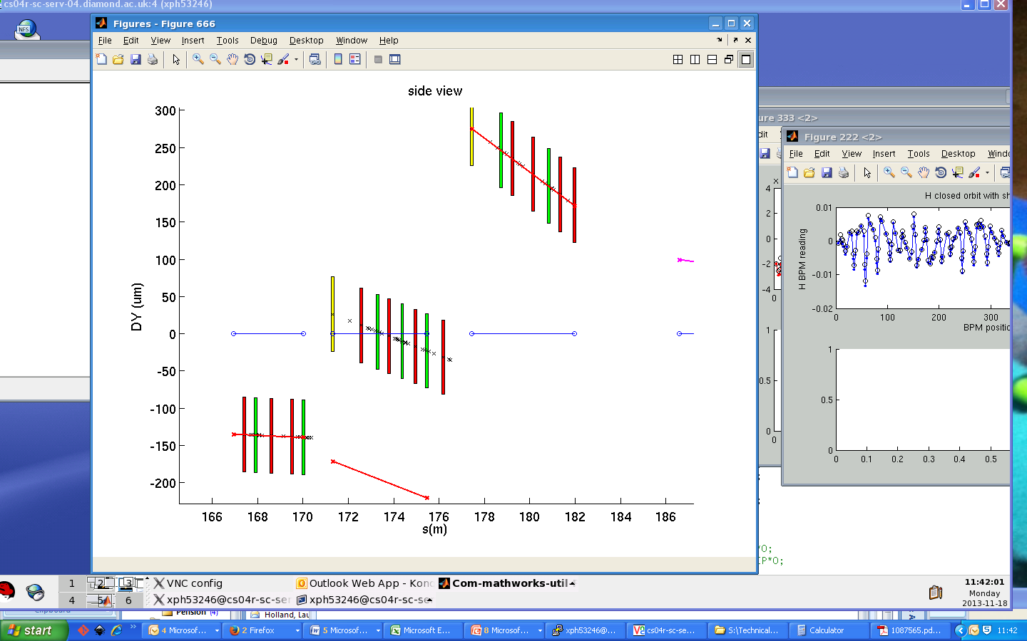
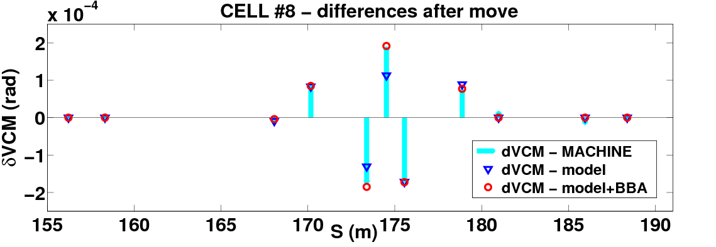
Motivations Coupling Alignment Tests TR Conclusions
Girder moves – initial tests (2013)
5-cam axis motor (u,v,χ,η,σ)
  rack in-tunnel: local control
  single girder moves
  temporary protection system
  limit excessive strain on bellows
preliminary to program of full SR re-alignment
reinforce confidence in model
gain confidence in control system
Girder | Heave/Sway (um) | Yaw/Pitch (urad) | Date
HC3G2 | +324 | 0 | 04122012
VC20G1 | +94.2 | -53.5 | 19022013
VC8G2 | +197 | 0 | 30042013
VC2G2 | -162.5 | 0 | 02072013
VC13G2 | +194 | -8.6 | 24092013
VC3G1 | -245.2 | -21.4 | 22102013
VC3G3 | -272.9 | 48.5 | 19112013
VC4G1 | -335.6 | -27.0 | 21112013
VC3G2 | -254.5 | 2.5 | 17042014
model highly predictive
CM variation correctly reproduced when BBA corrections are introduced in the model (as done in the machine)
VC8G2
heave=+197um

Slide 8
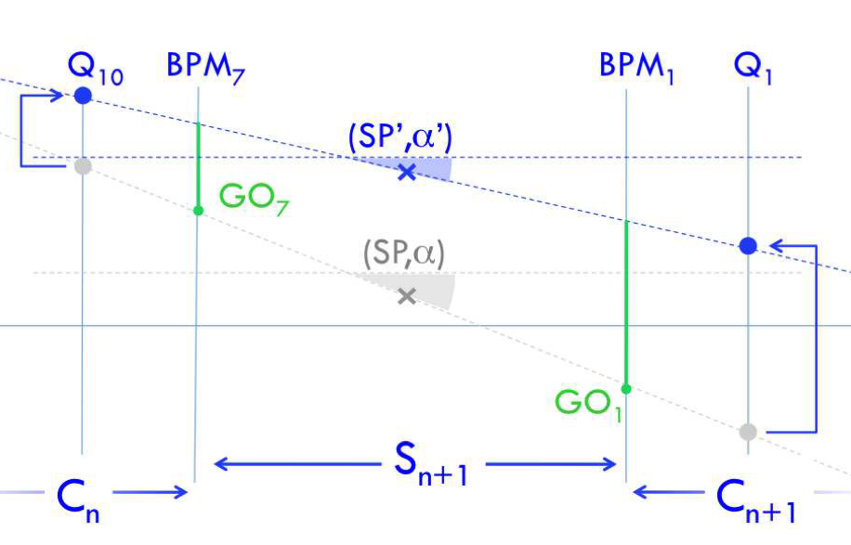
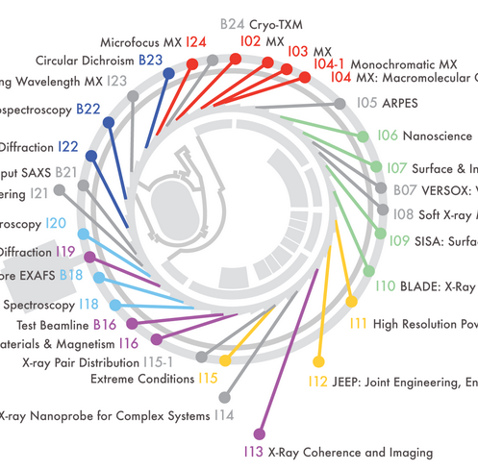
Motivations Coupling Alignment Tests TR Conclusions
Girder moves – transparent re-alignment (TR)
leading idea: re-align the machine with no impact on operating beamlines
orbit variations compensated by introducing Golden Offsets at primary BPMs
MOPRO101, IPAC2014
initial single girder tests (I03) → TR project: Cell-4, 5, 6: (I05)

Slide 9
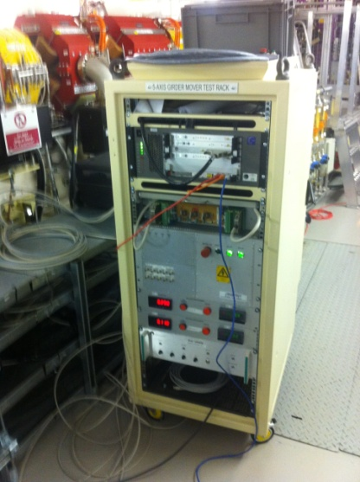
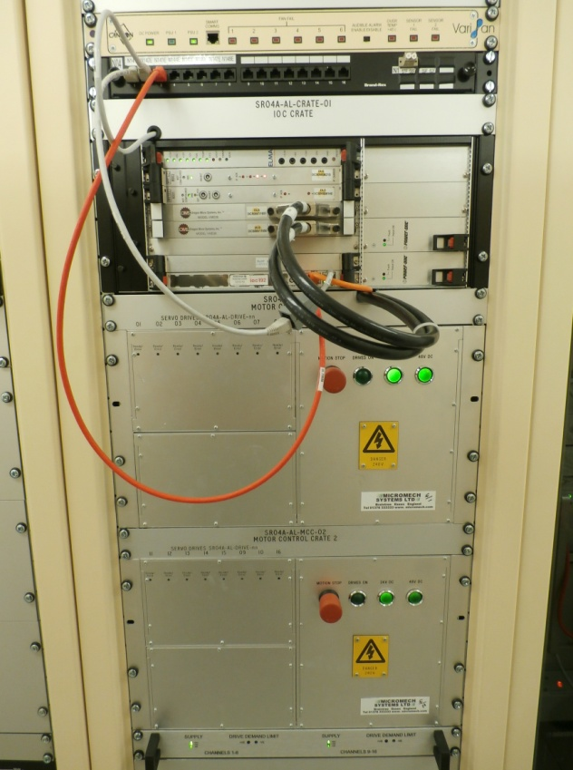
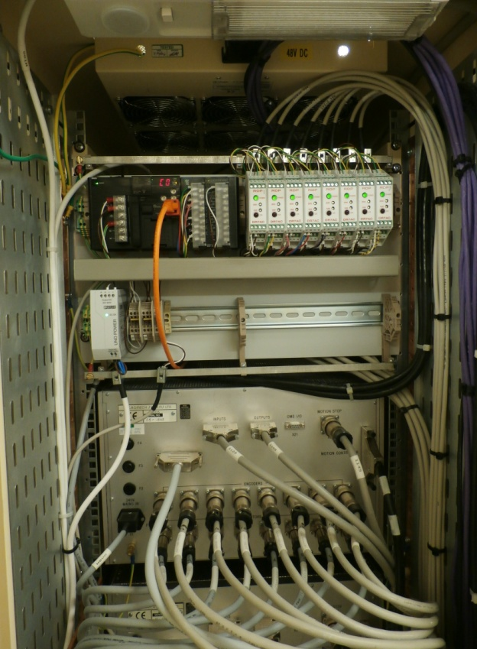
Motivations Coupling Alignment Tests TR Conclusions
CELL move – control system
2013 – single girder move
local rack (inside tunnel)
temporary LVDT sensors
(on girder bellows)
- local PC
2014 – cell (multi-girder) move
- CIA rack (outside tunnel)
- 8 permanent LVDT sensors per cell
EPICS with PC from control room
PLC LVDTs

Slide 10
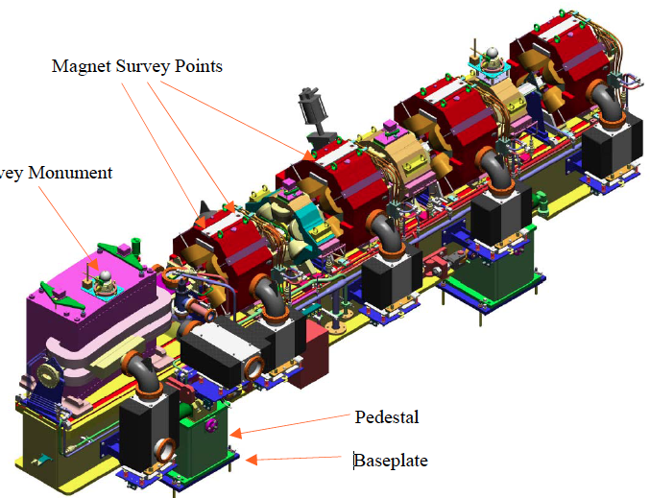
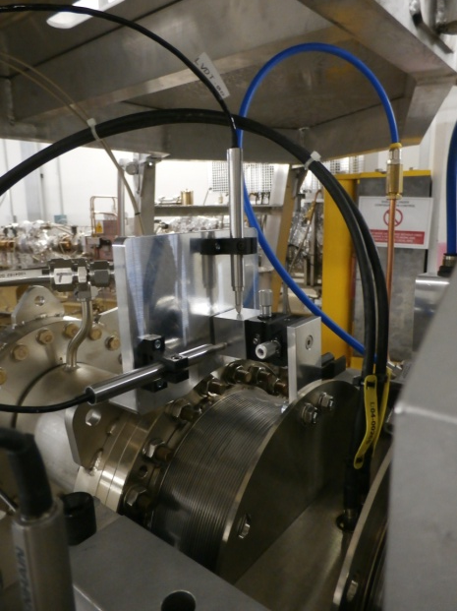
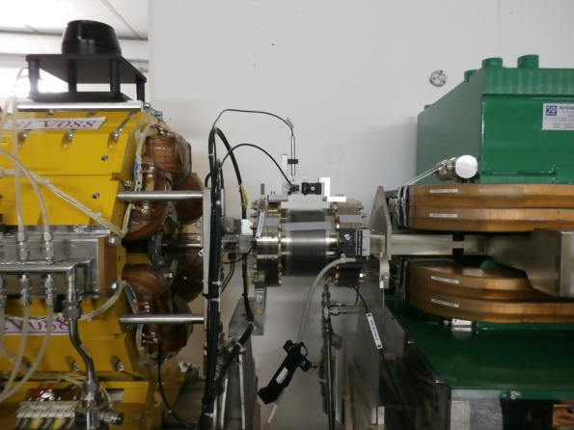
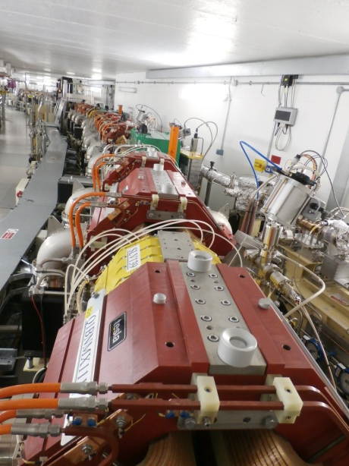
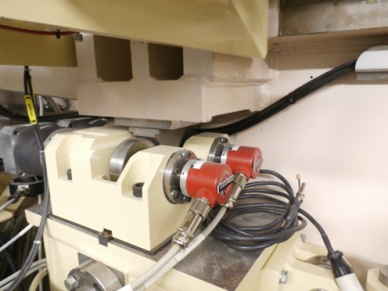
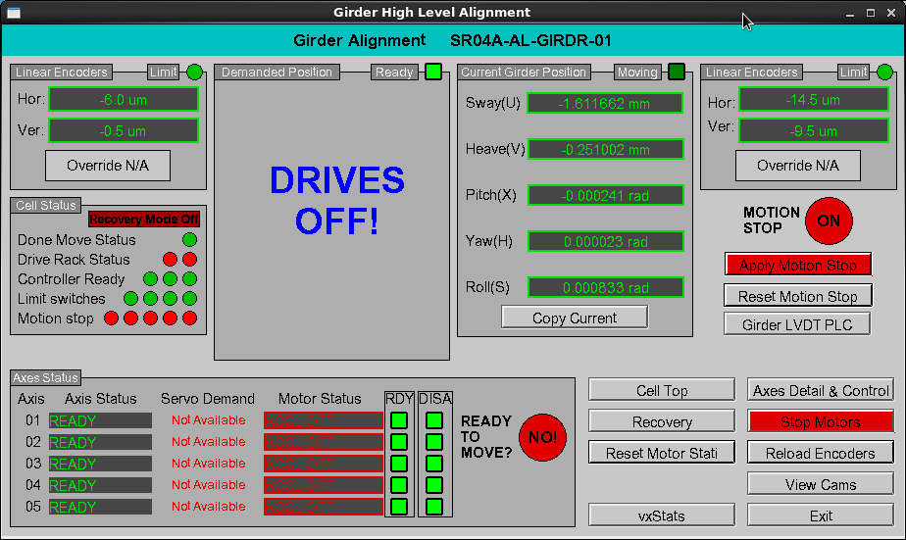
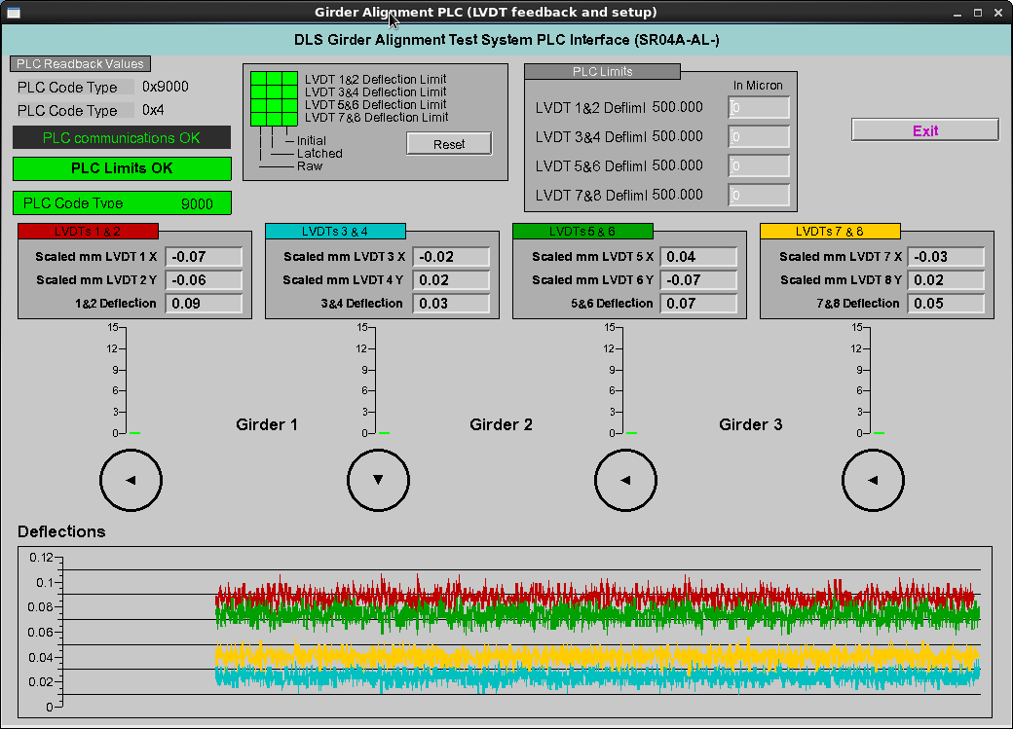
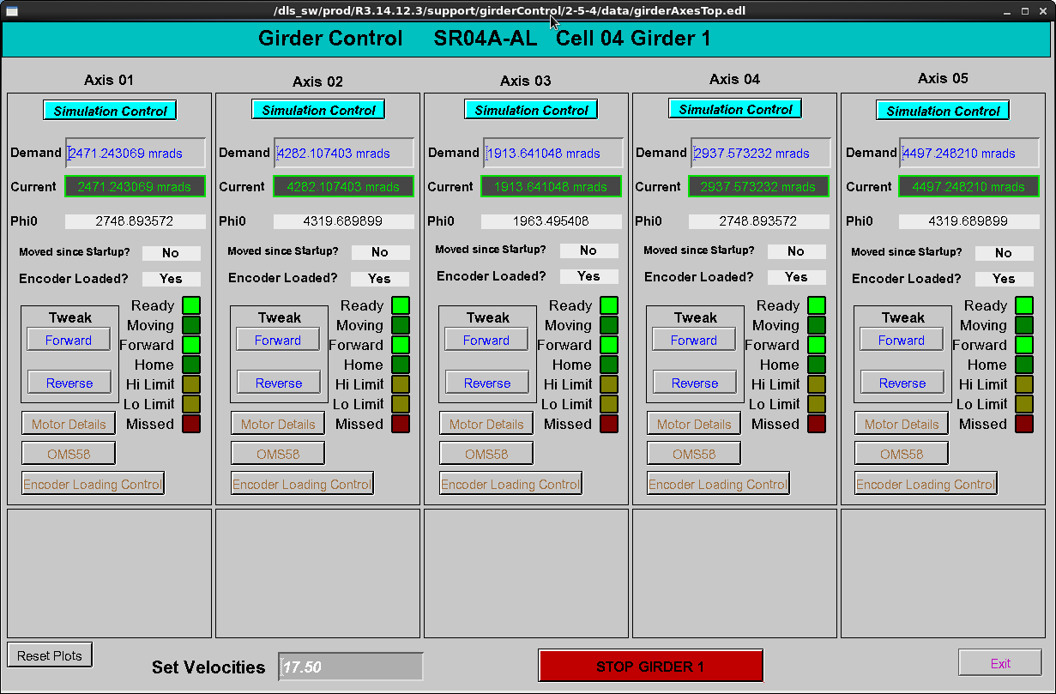
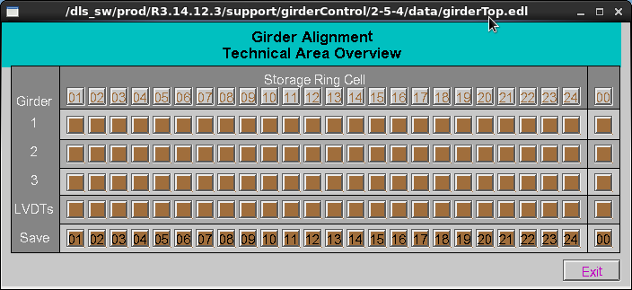
Motivations Coupling Alignment Tests TR Conclusions
CELL move – control system
LVDT motion sensors
bellow @ G3 end
LVDT motion sensors
bellow @ G2 – G3
View of cell-4
CAM motors

Slide 11
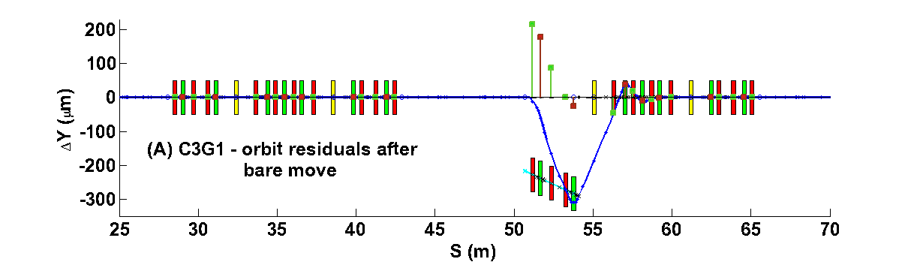
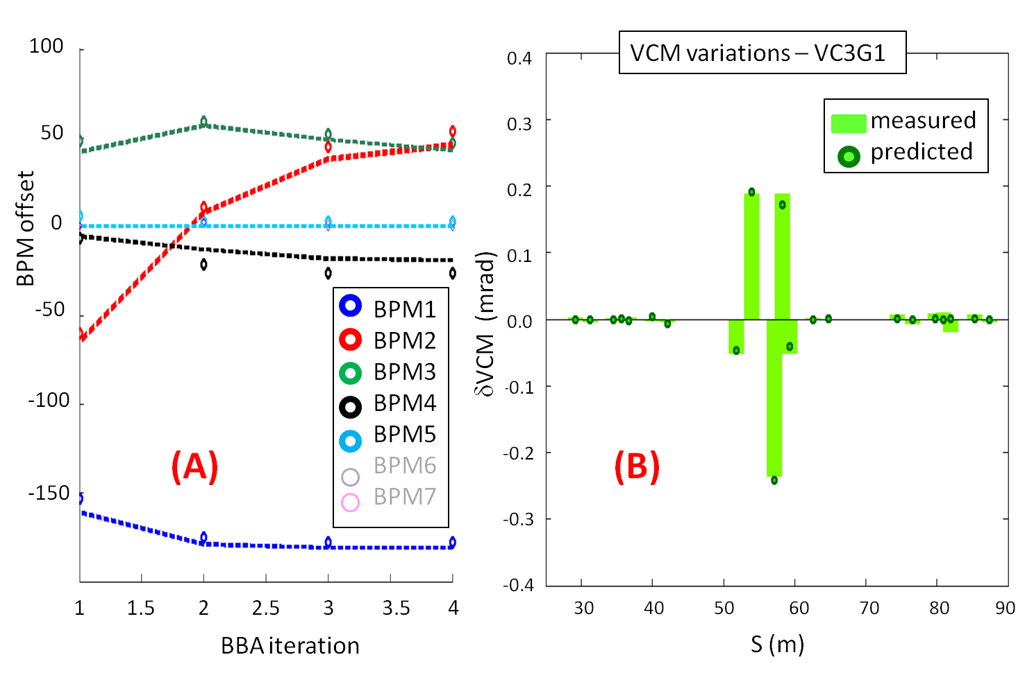
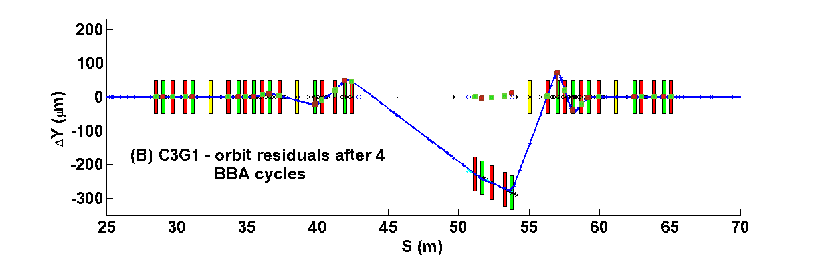
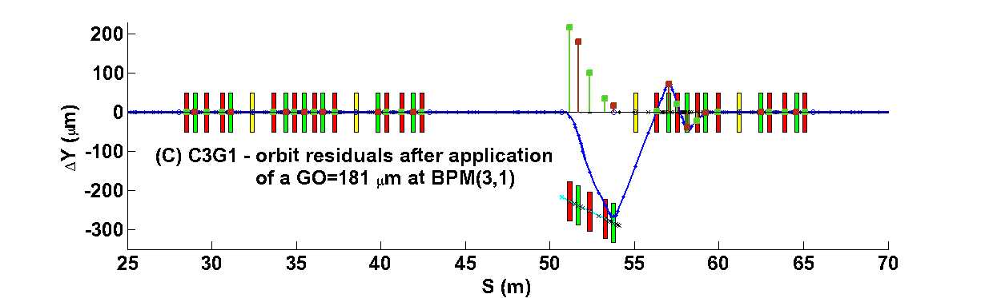
Motivations Coupling Alignment Tests TR Conclusions
1st test of transparent re-alignment at BL-I03: BBA and orbit restoration via Golden Offset
MOPRO101, IPAC2014
VC3G1 - 22/10/2013
heave = -245 um
pitch = -21.4 urad
model
data
GO =191 um
22/10/2013
(SP,α) = (-95um,-28urad)
VC3G1
heave = -245 um
pitch = -21.4 urad
(1) (2)
BPM offset after BBA
VCM @ cell-3
Orbit after move
Effect of BBA
Effect of GO(3,1) = 181um
XBPM-measured tilt: -28.7urad / AT prediction: -28. urad

Slide 12
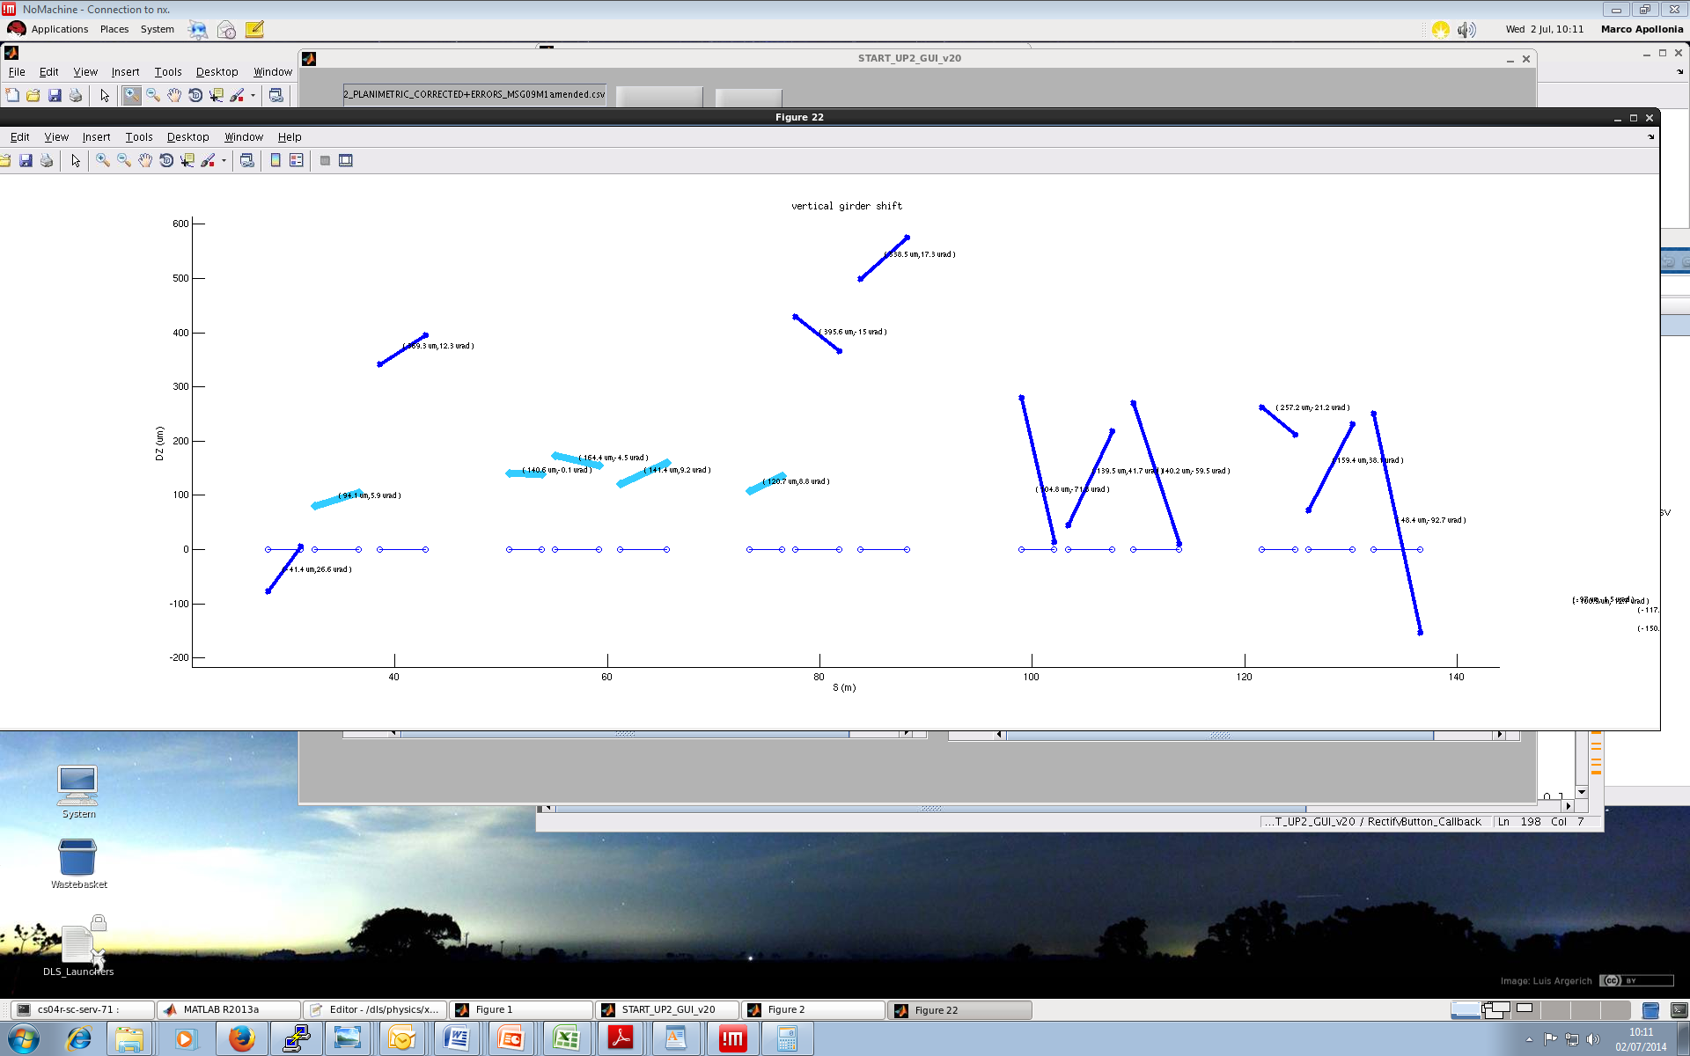
Motivations Coupling Alignment Tests TR Conclusions
getting ready for TR at BL-I05
δSP=-150um
δa = 27urad
(1) (2)
120.7 um
ID05
C2 C3 C4 C5 C6
VC4G2+G3
heave G2= -275 um G3 = -250 um
pitch G2 = 15 urad G3 = -17 urad

Slide 13
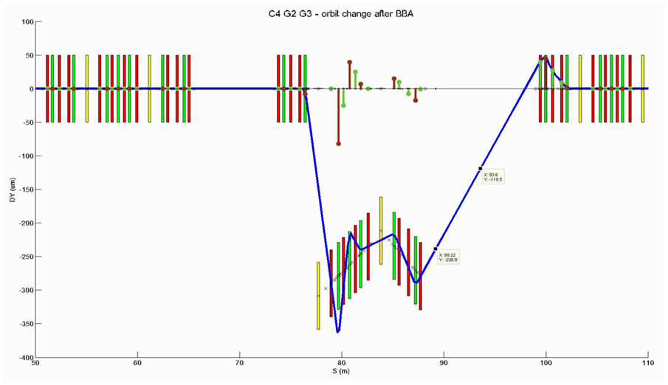
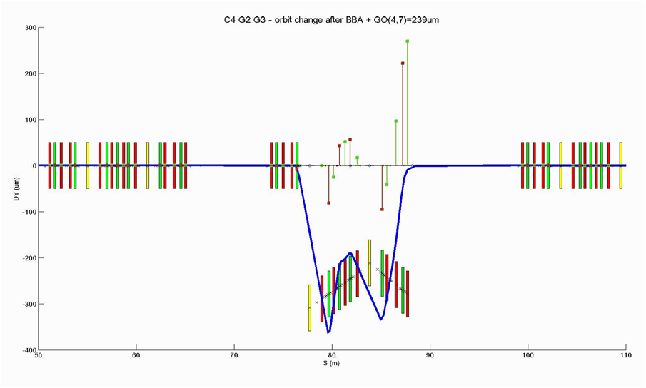
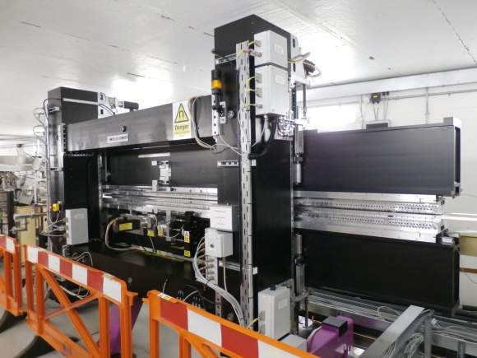
Motivations Coupling Alignment Tests TR Conclusions
getting ready for TR at BL-I05: BBA (1) and orbit restoration via Golden Offset (2)
δSP= 0um
δa = 0urad
GO=239 um
-239 um
(SP,α) = (-150um,27urad)
(SP,α) = (0um, 0urad)
(1) (2)
ID05
VC4G2+G3
heave G2= -275 um G3 = -250 um
pitch G2 = 15 urad G3 = -17 urad

Slide 14
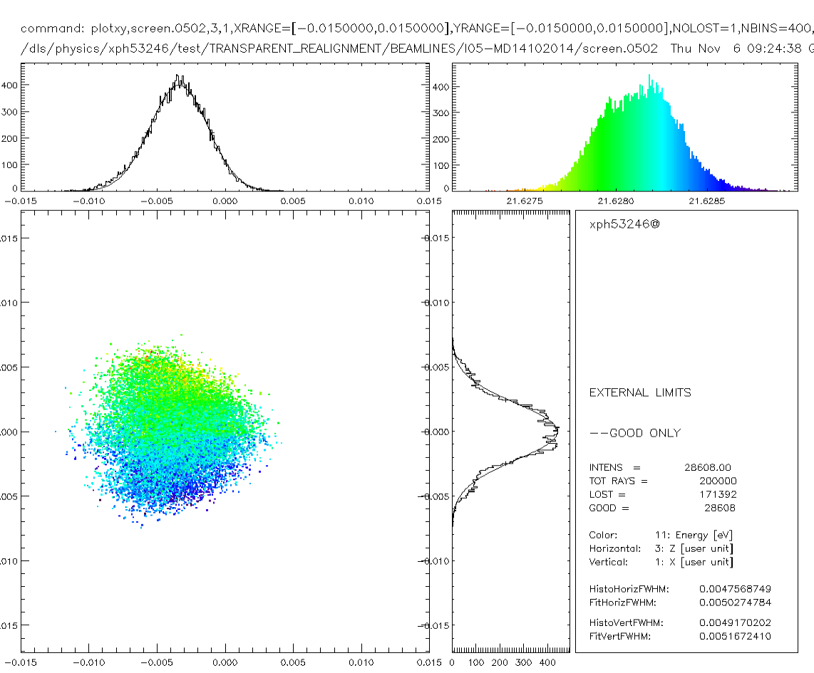
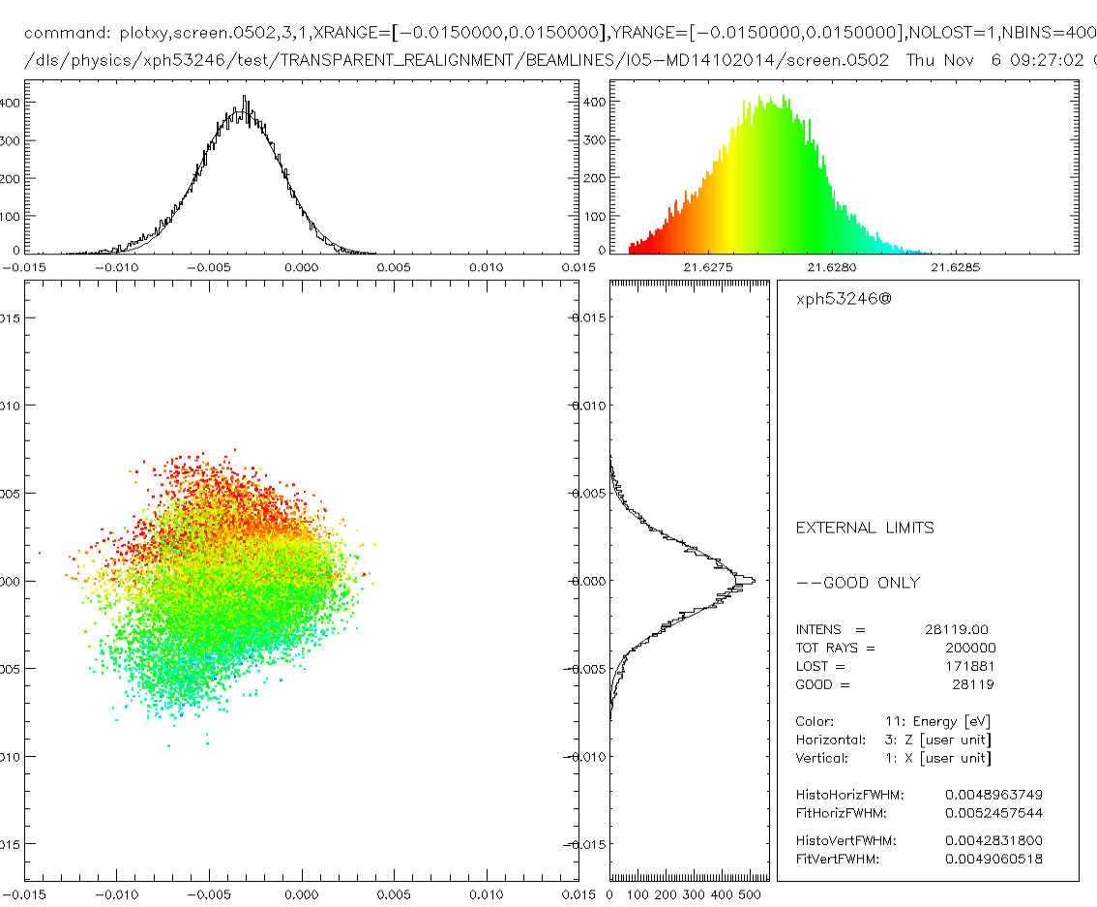
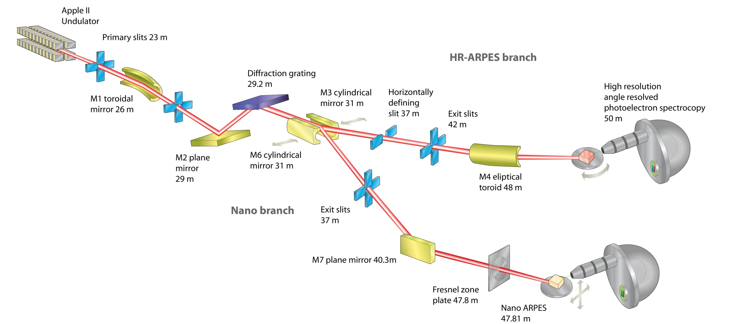
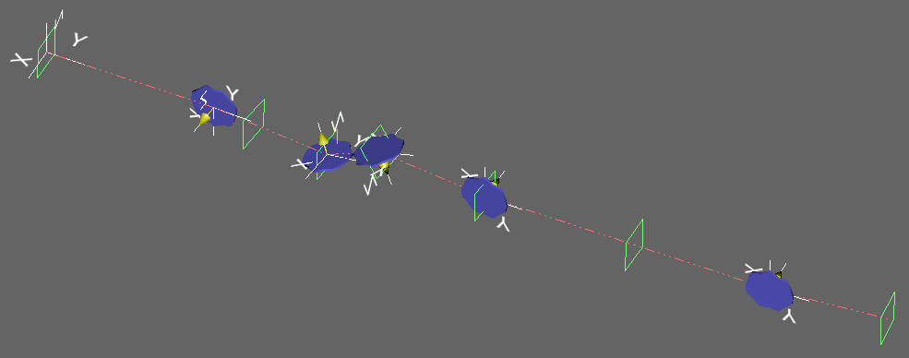
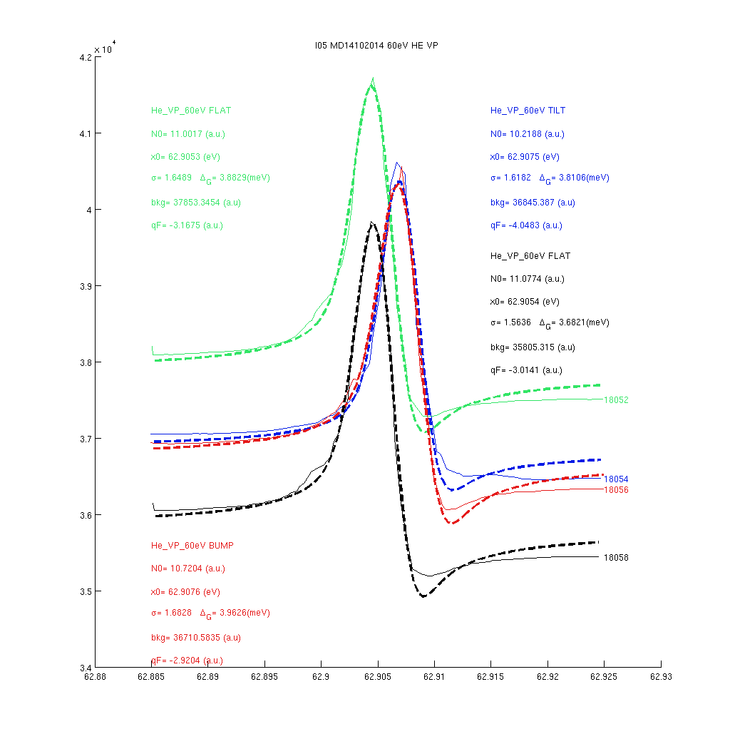
Motivations Coupling Alignment Tests TR Conclusions
getting ready for TR at BL-I05:
effect of orbit tilt on I05 energy peaks (SHADOW simulation)
(He-photo ionization peaks, data from BL-I05)

Slide 15
Motivations Coupling Alignment Tests TR Conclusions
Conclusions
aligning the Diamond Storage Ring represents a benefit in terms of reduced
vertical emittance
increase stability on feedback for present low coupling system
model of girder moves available (AT)
  very precise when determining local effects (girder moves)
a campaign of survey-based girder moves has been completed
  using a 5-axis control system
  1-H and 8-V moves actuated so far
  gained great knowledge both of the control system and of the model
  1st test of TR done (Oct 2013, vC3G1, I03)
now extended to multi-girder moves, possibly distributed on the entire machine
  cell 4, 5 and 6 equipped with new control system and commissioned
  cell-4 scheduled for move: Dec 19th
  preliminary tests to assess effects on nearby BL-I05
  - aim at completing cell-5, cell-6 before May 2015.

Slide 16
Thanks for your attention ...

Slide 17
Spares
CELL move – control system: CAM-axes
Beam Direction
Mover 3
Mover 2
GIRDER
Mover 4
Mover 5
Mover 1
5
4
3
1
2
Camshaft
Bearing
Axes of rotation
Range of motion

Slide 18
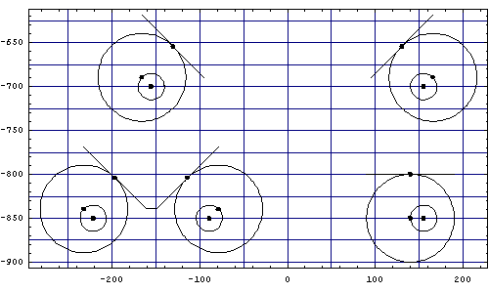
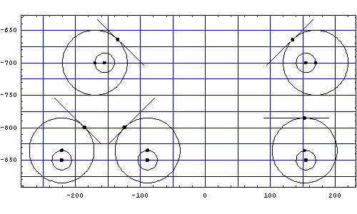
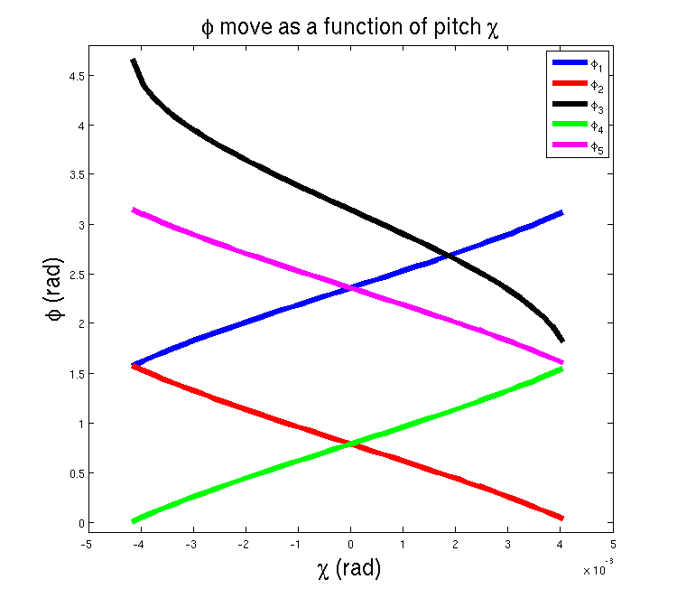
Spares
CELL move – control system: CAM-axes
All cams in their neutral position,:
u=0, v=0, χ=0, η=0, σ=0.
Pitch of 4.16 mrad:
u=0, v=0, χ=0.00416, η=0, σ=0.
PLC interface – LVDT readings

Slide 19
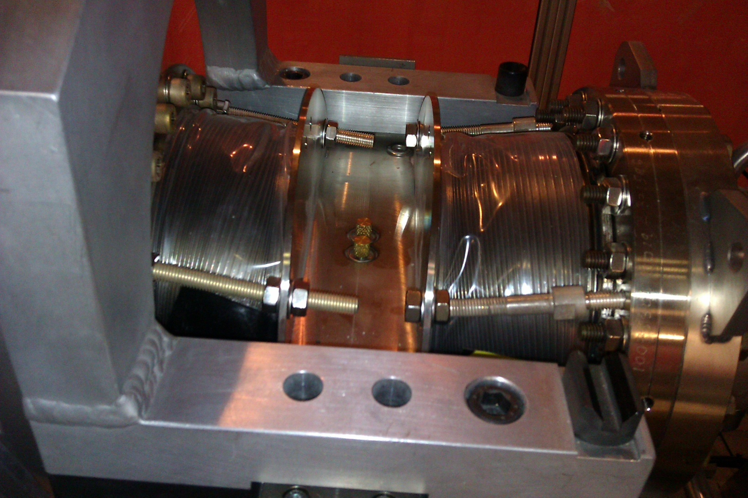
Spares
Importance of LVDT limiting sensors
Summer 2012 uncontrolled girder motion
“CELL-25” test

Slide 20
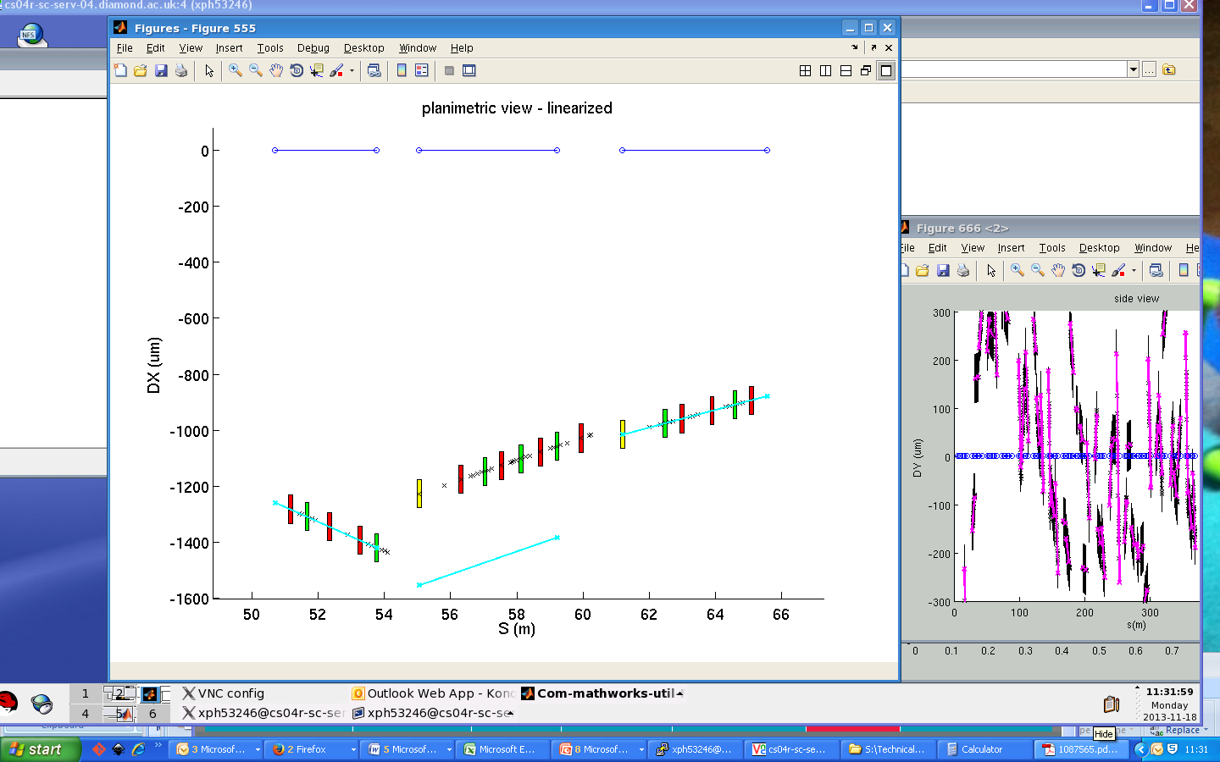
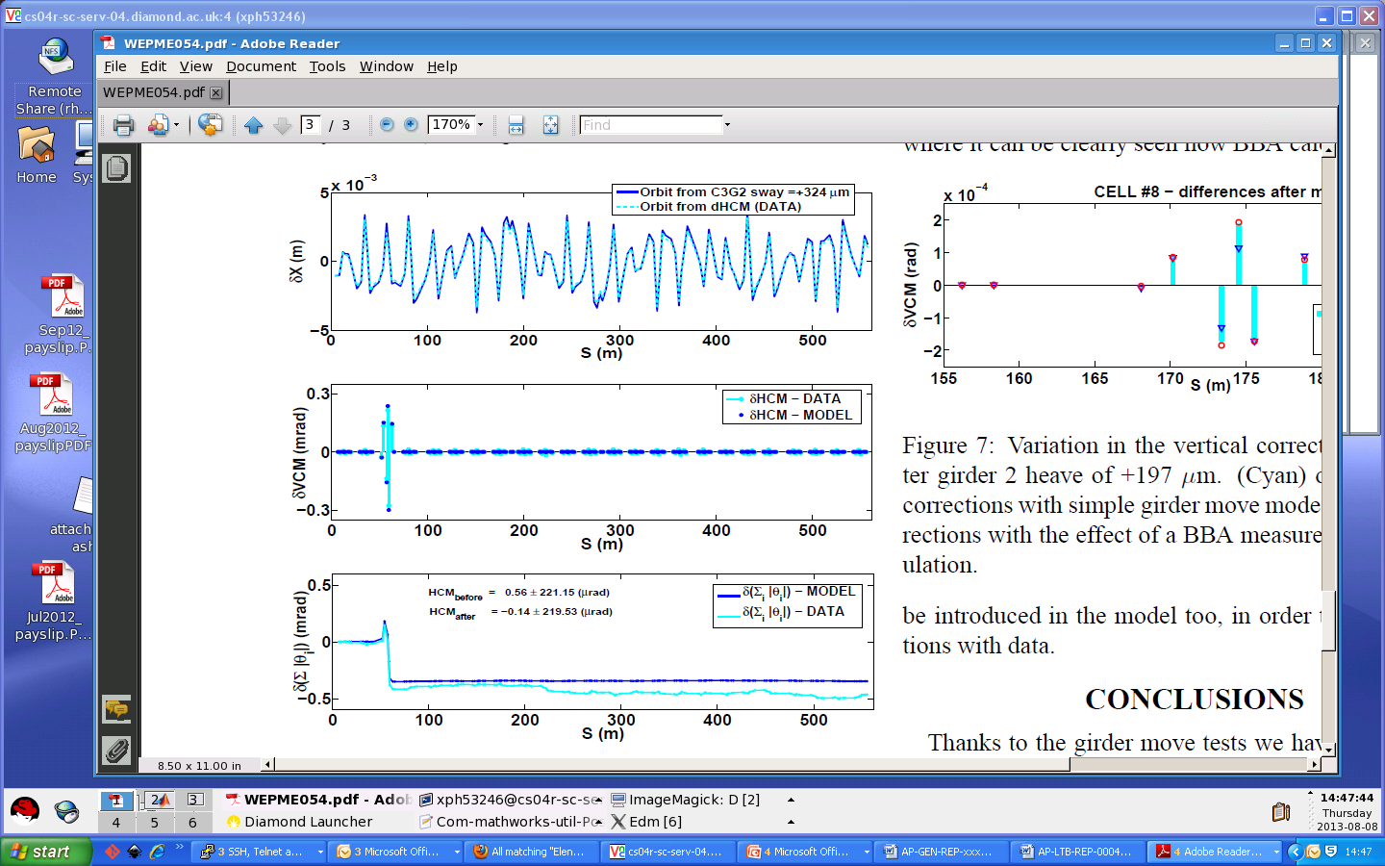
Spares
Girder moves – initial tests
HC3G2
sway=+324um
G1 G2 G3
model highly predictive when describing changes
C03
new position
original position
- orbit variation
correctly reproduced
CM variation correctly reproduced
local reduction in total CM kick angle reasonably reproduced

Slide 21
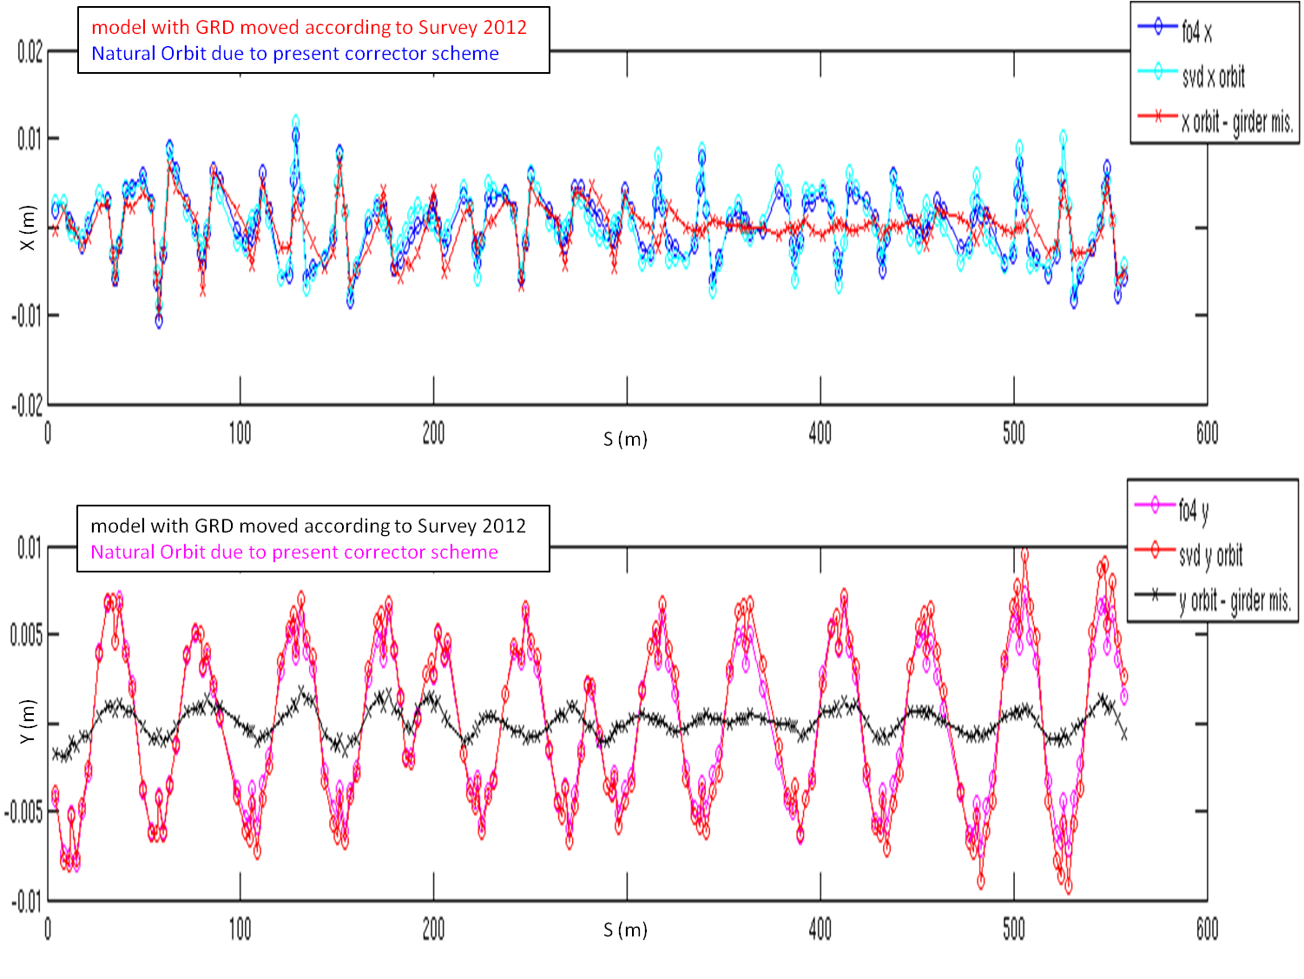
Spares
Girder moves – effect on orbit
Girder Moves explain 2/3 of the H-orbit. In V-orbit there is phase agreement, amplitude is not reproduced.

Slide 22
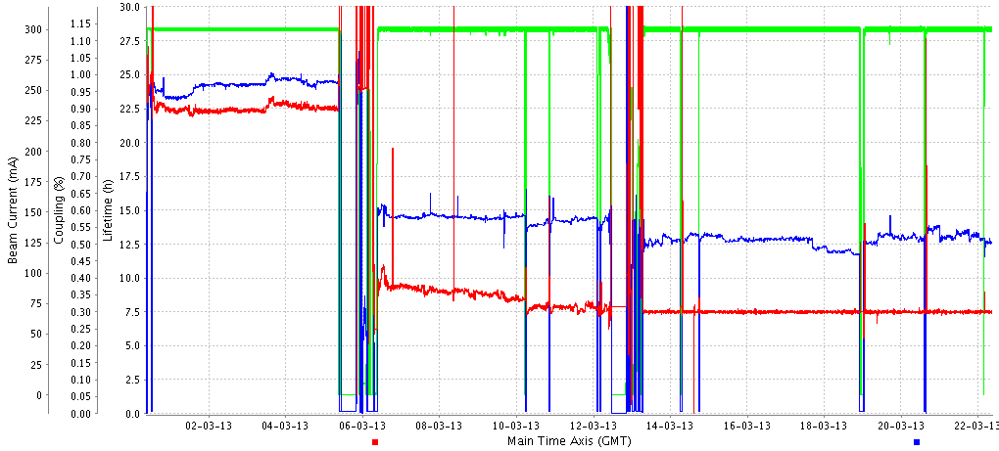
Reduced Vertical Emittance
Spares
coupling
lifetime
current
Coupling feedback started

Slide 23
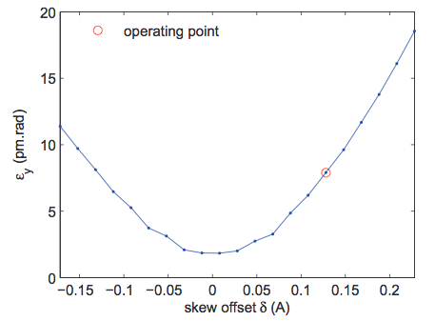
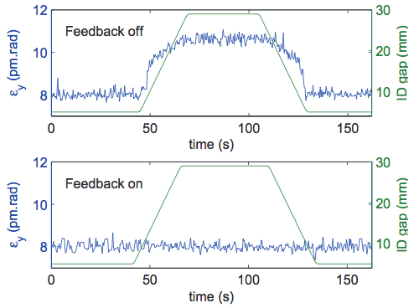
Reduced Vertical Emittance
Spares
Setting the vertical emittance:
LOCO correction during start-up
Apply correction to all skews
Add offset to set desired ε_{y} value
Use feedback to stabilise during user time
Issues:
Coupling correction only optimal for a particular configuration of ID gaps
Quality of correction drifts over days / weeks
pLOCO measurement and fit: 15m!
Begun girder re-alignment campaign to increase margin between minimum and desired ε_{y} values
MOPEA071, IPAC2013

Slide 24
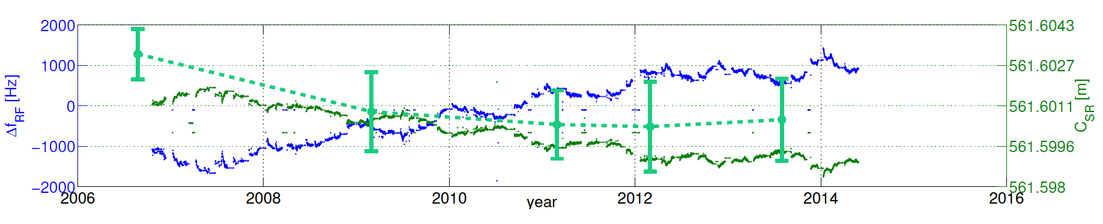
Motivations Coupling Alignment Tests TR Conclusions
Survey August 2013
H-plane
Survey January - August 2013
V-plane
best fit plane
MOPRO099, IPAC2014
1000 um
SR shrinking:
Δν_{RF}
C_{SR} = c h / ν_{RF}
measured circumference

