Slide 1
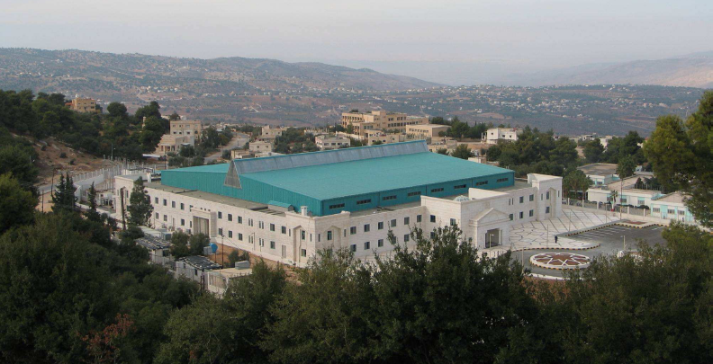
Status of SESAME
Synchrotorn-light for Experimental Science and Applications in the Middle East
Allan, Jordan
Maher Attal
On behalf of
SESAME Team
M. Attal, XXII ESLS Workshop, ESRF, Nov. 25-26, 2014

Slide 2
Introduction
✓ SESAME is an interregional 3rd generation light source being constructed in Jordan
(in Allan, 30km west of Amman) and expected to serve the user community in the Middle
East region.
✓ SESAME machine composes:
➢ BESSY I injector (22 MeV classical Microtron + 800 MeV Booster)
➢ completely new 2.5 GeV storage ring.
➢ mixture of donated ( by SLS, HZDR, LURE, Daresbury) and new beamlines.
M. Attal, XXII ESLS Workshop, ESRF, Nov. 25-26, 2014

Slide 3
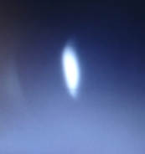
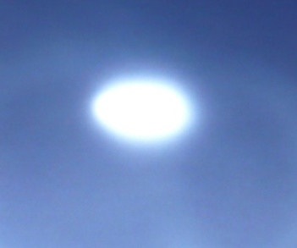
Microtron + TL1 Commissioning
SESAME Microtron Main Parameters
Extractable energy 5.3-22.5MeV
Extractable turns 10 – 42
Energy gain / turn 535 keV
Energy spread(FWHM) 35keV
Magnetic field 0.112T
Microwave frequency, power 3GHz, 2MW
Pulse duration 2μs
Beam power 400kW at 21MeV
H-emittance 3.8π μm.rad (100% of the beam @ 21MeV)
V-emittance 12.8π µm.rad (100% of the beam @ 21MeV)
✓ Full energy beam at Microtron exit (~22MeV) Nov. 28, 2011.
✓ Full energy beam at end of Microtron-Booster transfer line
(~22MeV) March 27, 2012.
3 mm
4.4 mm
M. Attal, XXII ESLS Workshop, ESRF, Nov. 25-26, 2014

Slide 4
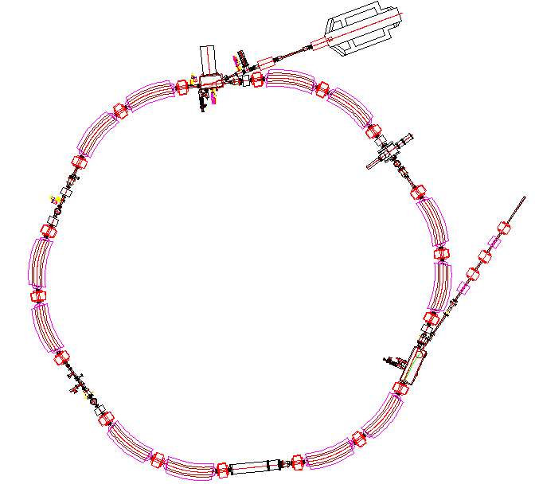
Booster Commissioning Results
Main Booster parameters
Injection energy 20MeV
Extraction energy 800MeV
Circumference 38.4m
H-emittance 300 nm.rad
V-emittance 30 nm.rad
Mom. com. factor 0.18
RF frequency 500MHz
RF max. power 2kW
Operation freq. 1Hz
Inj. kicker pulse ~ 4.5µs
TL1
Microtron
Booster
Transfer
line TL2
M. Attal, XXII ESLS Workshop, ESRF, Nov. 25-26, 2014

Slide 5
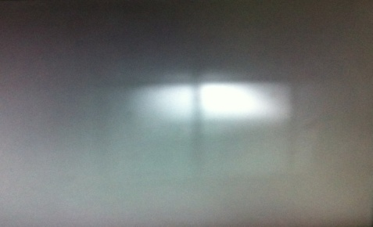
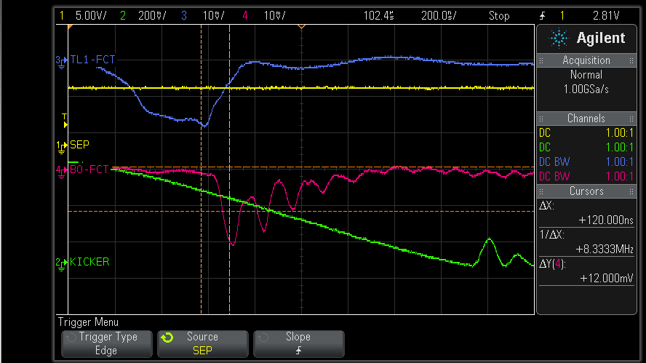
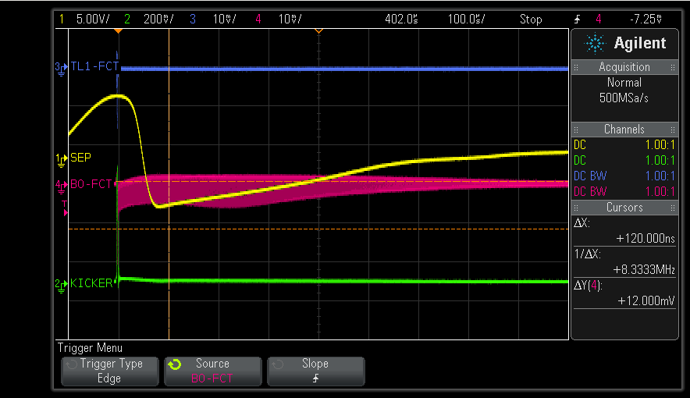
Booster Commissioning Results
✓ The first turn beam (July 15, 2014).
➢ No correctors are used.
✓ Few turn beam (July 16, 2014).
➢ No correctors are used.
➢ using model values (QF= 2.83A, QD= -2.18A, Dipole= 24.96A)
➢ Varying injection angle.
➢ optimizing amplitude and timing of injection kicker kick.
✓ Multi turn beam (thousands) (July 17, 2014).
➢ Varying magnets current slightly from model values.
➢ Modifying slightly injection angle.
➢ 0.2A in Corr. 3 enhanced the transmission substantially.
M. Attal, XXII ESLS Workshop, ESRF, Nov. 25-26, 2014

Slide 6
Characterizing the DC Mode
⧫ RF paramaters
✓ Varying RF phase had no noticeable effect on the beam current in the Booster.
✓ The theoretical RF frequency 499.654MHz showed almost the best performance.
⧫ Tune measurement
✓ Horizontal tune was measured easily using the beam injection oscillations.
✓ Vertical tune was measured by injecting the beam with vertical angle (shaker is not
ready yet).
✓ Three working points have been found as a result of scanning:
1- (2.22, 1.31), a working point mentioned in BESSY documents.
2- (2.22, 1.40)
3- (2.28, 1.47)
M. Attal, XXII ESLS Workshop, ESRF, Nov. 25-26, 2014

Slide 7
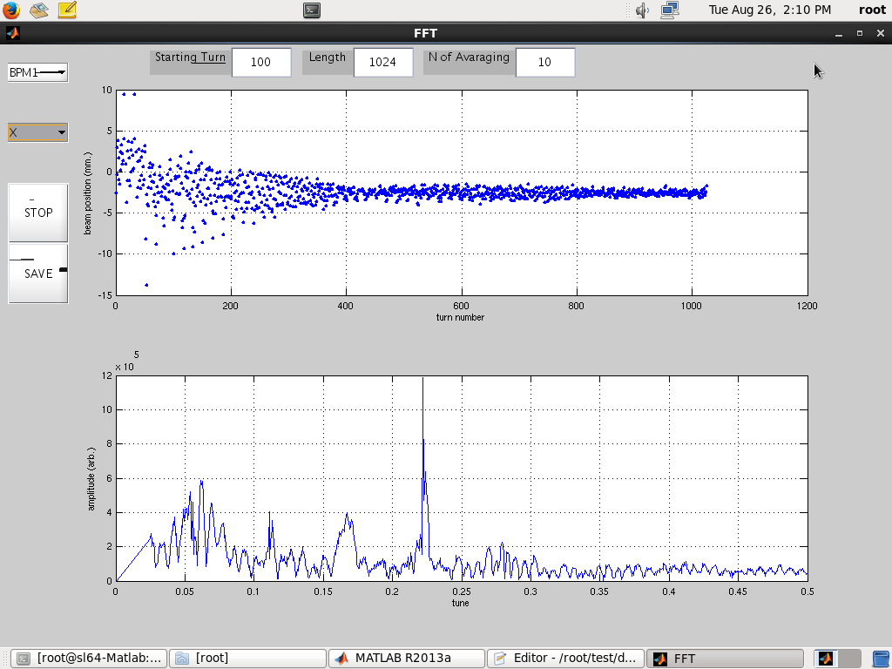
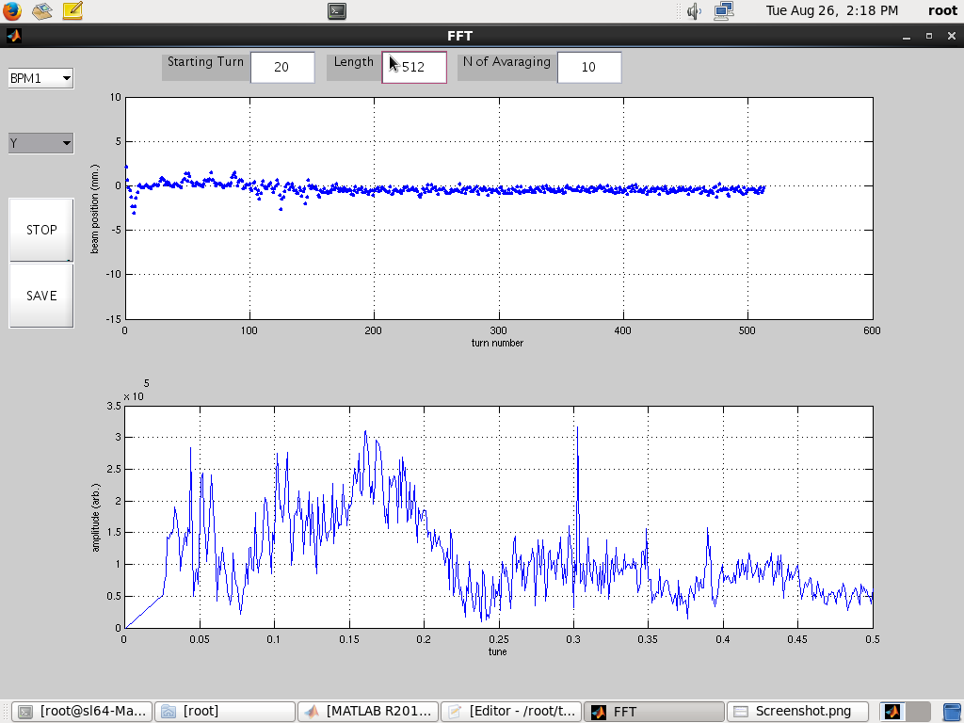
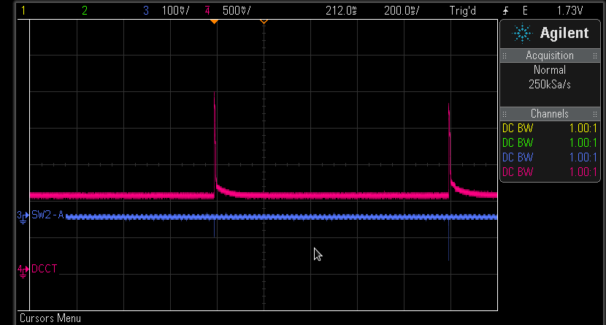
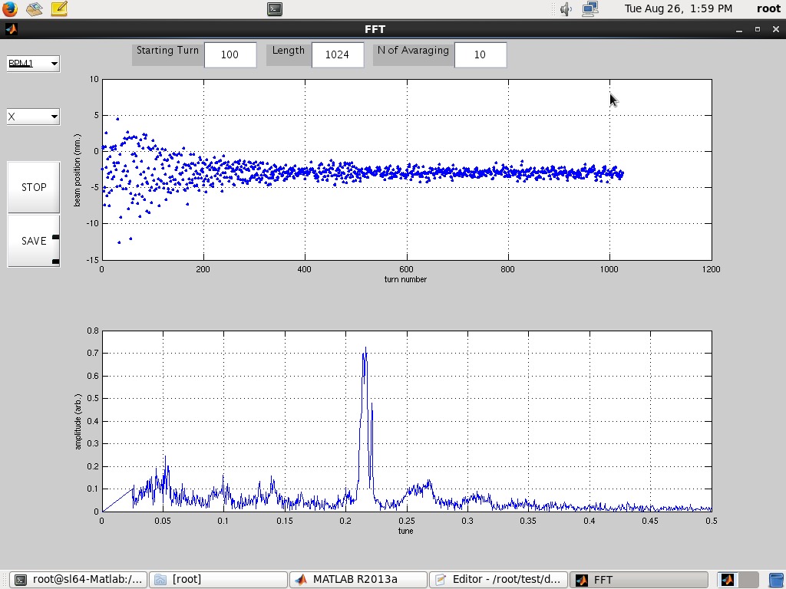
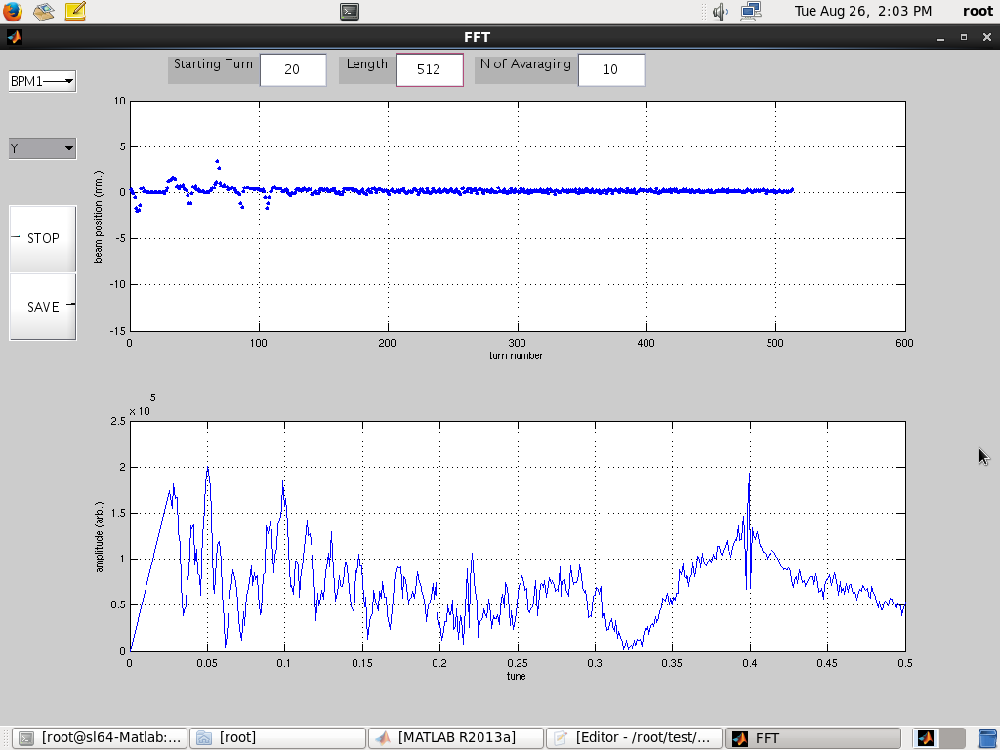
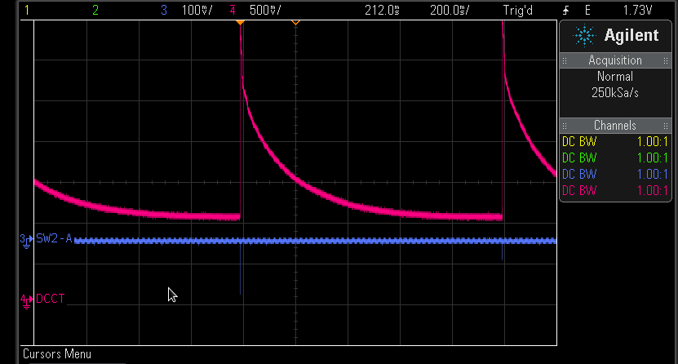
Characterizing the DC Mode
1- The point (2.22, 1.31) obtained for (QF = 2.67A, QD = 2.14A)
(corresponding model values are QF = 2.83A, QD = 2.18A).
It has low beam current transmission & low beam lifetime as shown by DCCT.
DCCT signal
2- The point (2.22, 1.4) obtained for (QF = 2.68A, QD = 2.27A).
It realizes better transmission with beam lifetime ~ 100ms.
M. Attal, XXII ESLS Workshop, ESRF, Nov. 25-26, 2014

Slide 8
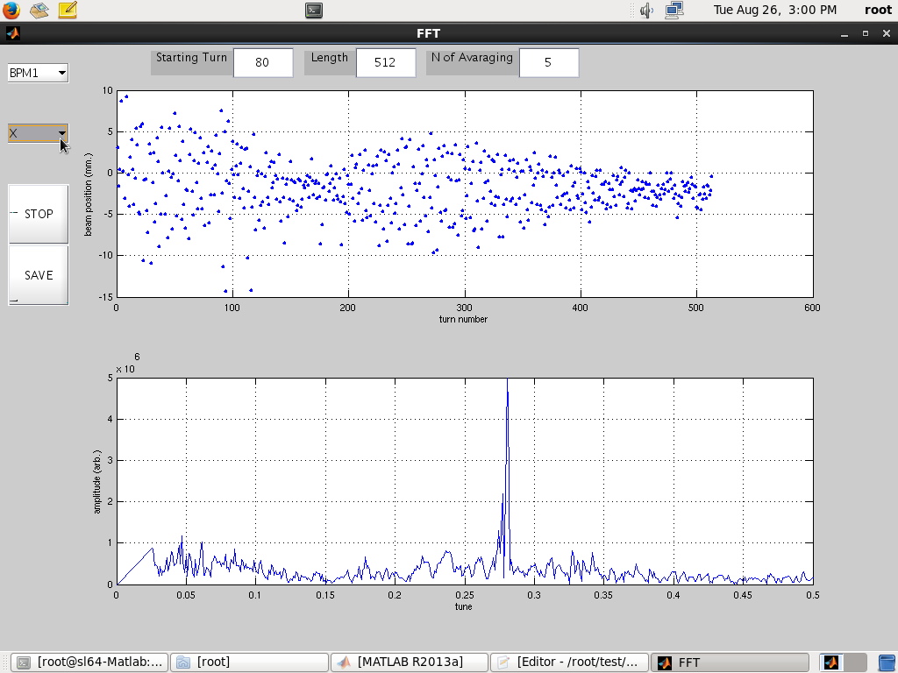
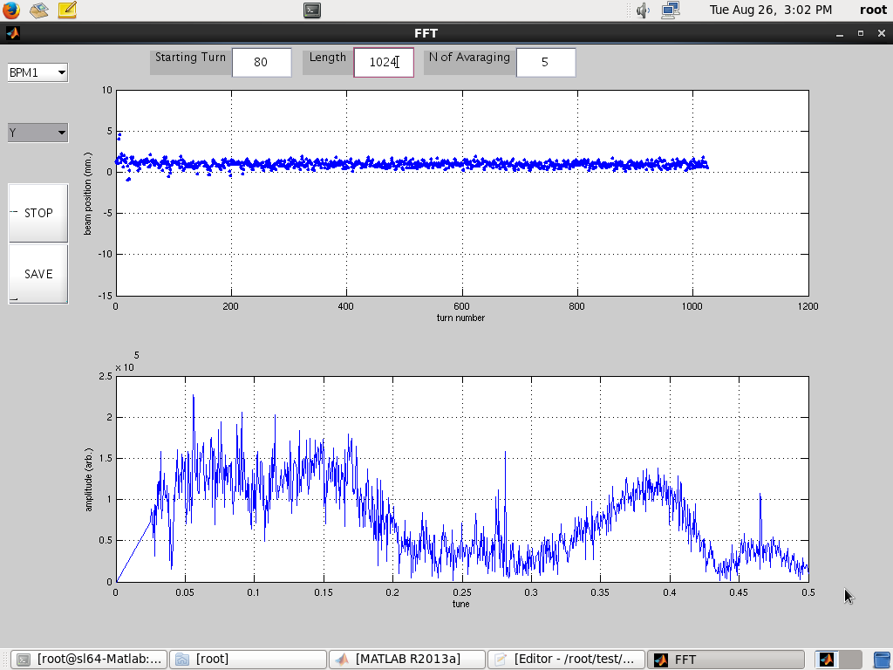
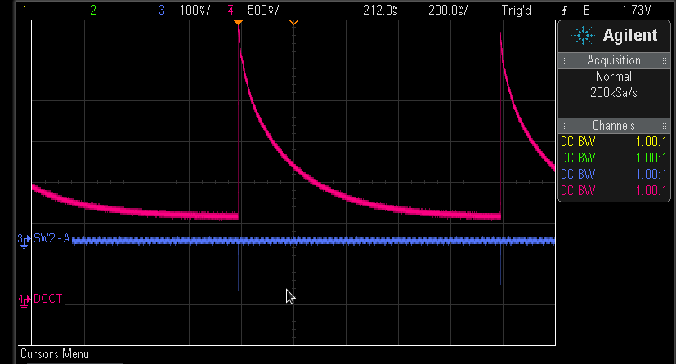

Characterizing the DC Mode
3- The point (2.28, 1.47) for (QF = 2.77A, QD = 2.47A).
It realizes good transmission with the best beam lifetime ~ 150ms.
Theoretical beam lifetime @20MeV is ~ 150ms if the Booster average pressure is 5e-7 mbar.
⧫ Betatron function measurement
✓ Measure ΔQ_{x} versus Δk_{QF} and Δk_{QD}.
✓ use the formula , N: number of family quadrupoles, L_{q} = 0.256m.
< β_{x} > = 4.65m @ QF (theoretical value is 5.3m) .
< β_{x} > = 0.94m @ QD (theoretical value is 1.12m) .
M. Attal, XXII ESLS Workshop, ESRF, Nov. 25-26, 2014

Slide 9

Characterizing the DC Mode
⧫ Dispersion function measurement
✓ Measure orbit position Δx for RF frequency Δf_{RF}.
BPM1 showed Δx = 2.3 mm for Δf_{RF} = -100 kHz.
✓ using the formula , and theoretical α_{c} = 0.18.
η_{x} = 2.06m (theoretical dispersion = 1.6m)
The fluctuating beam was always a prominent source of measurement error.
M. Attal, XXII ESLS Workshop, ESRF, Nov. 25-26, 2014

Slide 10
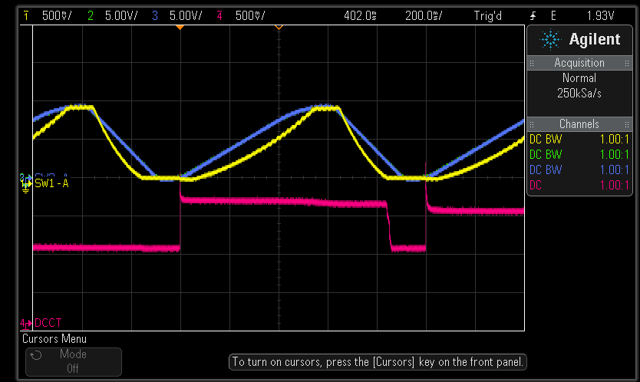
Energy Ramping Mode
✓ Beam energy was ramped successfully to 800MeV
(Sep. 17, 2014).
➢ I_{beam} = 1.3 mA (~ 1.7% injection efficiency)
➢ Injection was done at 23.9 ms delay in a semi-flat top
region in the dipole current ramping curve.
Dipole current
RF voltage
Injection moment
➢ The ramping curve started with the working point (2.22, 1.4) .
M. Attal, XXII ESLS Workshop, ESRF, Nov. 25-26, 2014

Slide 11
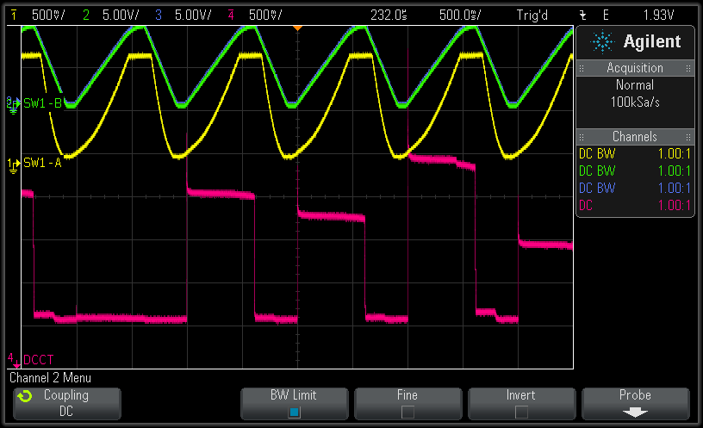
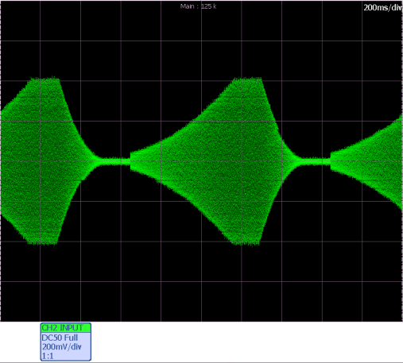
Energy Ramping Mode
✓ I_{beam} = 4 mA (~ 5% injection efficiency) was achieved
(Oct. 29, 2014).
➢ Another dipole current curve was used without
a flat-top region (injection on the fly).
Injection moment
* Beam fluctuation due to instability
in electrostatic injection septum.
RF voltage ramping curve
➢ The RF voltage ramping curve started with 5kV
and ended with 70 kV (injection voltage = 8kV).
M. Attal, XXII ESLS Workshop, ESRF, Nov. 25-26, 2014

Slide 12
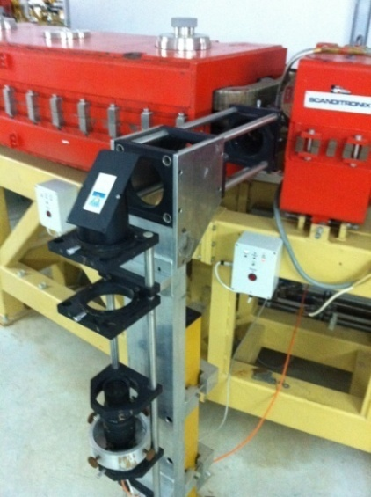
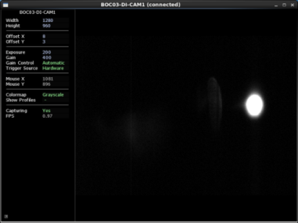
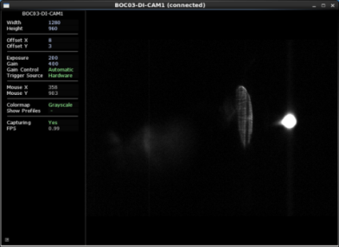
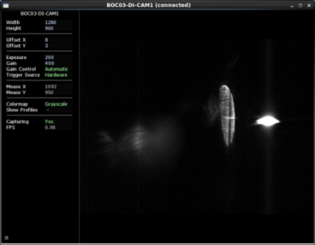
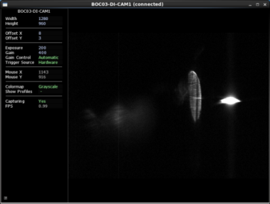
Beam Images at Different Energies
✓ The electron beam was imaged at different energies (during the ramping)
using the added Visible Light Diagnostic beam line.
✓ The beam size was roughly measured over the ramping time.
100ms (~120MeV) 300ms (~440MeV) 500ms (~735MeV) 640ms (~800MeV)
M. Attal, XXII ESLS Workshop, ESRF, Nov. 25-26, 2014

Slide 13
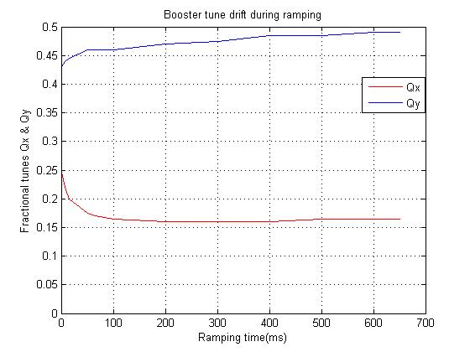
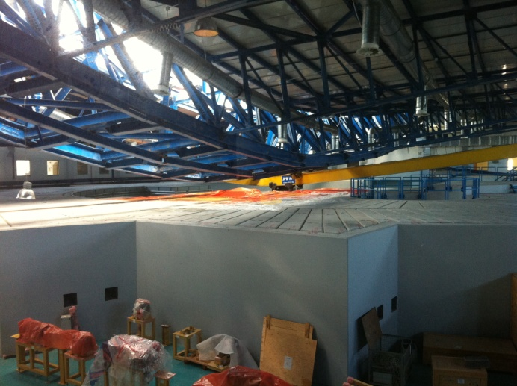
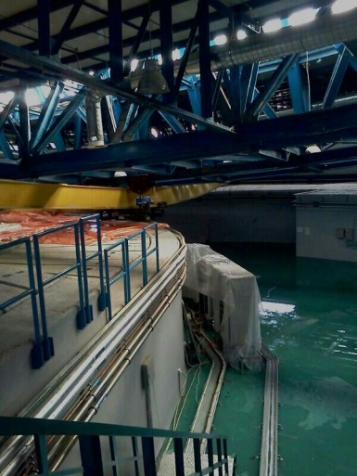
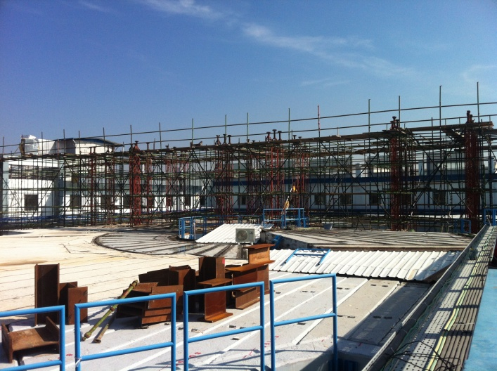
Tune measurement during ramping
✓ Although no impact was seen on the acceleration
efficiency, nevertheless the tune drift can be easily
corrected.
Booster Commissioning was done under Hard Conditions
December – April, 2014
November, 2014
✓ The new roof
is expected to
be ready by
Feb. 2015.
M. Attal, XXII ESLS Workshop, ESRF, Nov. 25-26, 2014
13

Slide 14
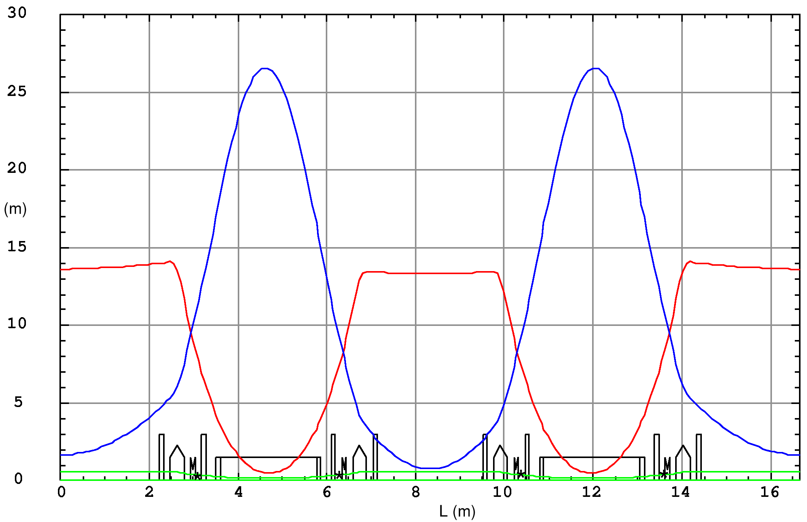
Storage Ring Characteristics
✓ Main 2.5 GeV Ring parameters:
➢ Simple DBA lattice (2 quadrupole families, 2 sextupole families) with dispersive sections.
➢ C = 133.2 m, Emitt. = 26 nm.rad.
➢ (Q_{x} , Q_{y} ) = (7.23, 6.19).
➢ Bending magnet: B₀ = 1.455T, g = -2.79T/m.
➢ 16 straight sections (8x 4.4m + 8x 2.4m).
➢ Up to 25 beamlines ( 13 from dipoles + 12 from insertion devices).
β_{y}
Super-period.
The ring is composed
of 8 super-periods.
β_{x}
η_{x}
M. Attal, XXII ESLS Workshop, ESRF, Nov. 25-26, 2014

Slide 15
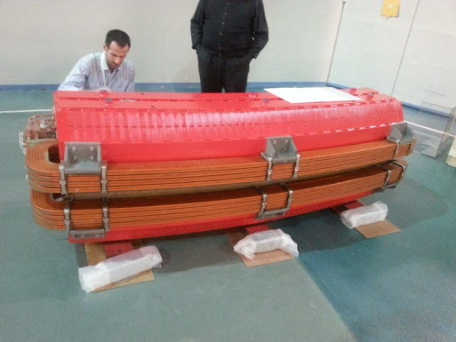
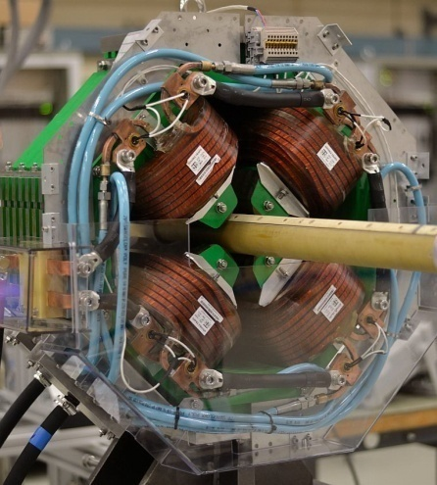
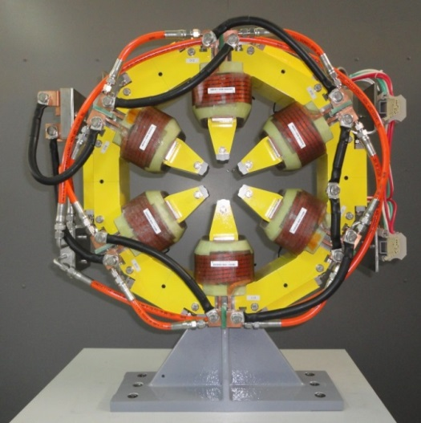
Storage Ring Status: Magnets
✓ Storage ring magnets are constructed through CESSAMag project in the frame of
SESAME-CERN/EU collaboration.
✓ Dipole (constructed by TESLA, UK) prototype is being magnetically
measured at ALBA.
All dipoles to be delivered by Sep. 2015.
✓ Quadrupole prototype is being assembled
(by Elytt-Spain, coils by STS-Turkey).
First batch to be measured at CERN by
March 2015.
✓ Sextupole prototype (by CNE-Cyprus & HMC-3-Pakistan, coils by
SEF-France) has been magnetically measured at CERN.
First batch to be measured at CERN by March 2015.
M. Attal, XXII ESLS Workshop, ESRF, Nov. 25-26, 2014

Slide 16
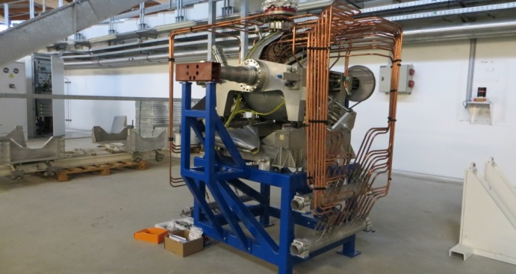
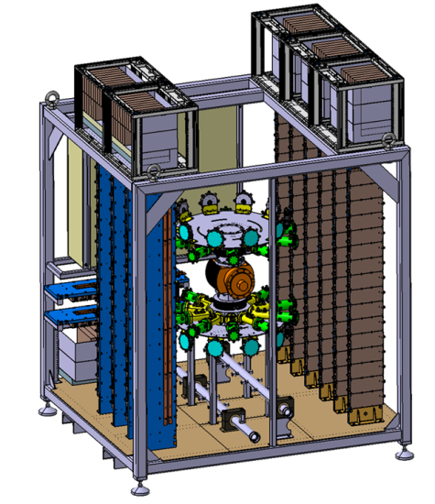
Storage Ring Status: RF System
✓ The 500MHz RF system is composed of 4 RF plants.
Each plant composes:
- 120kW Elettra cavity (detuned up to ±2MHz).
➢ Collaboration agreement was signed with Elettra.
➢ Delivery of 4 cavities foreseen by May 2016.
- 80kW solid state amplifier(the 1st to be built by SOLEIL,
the 3 others by Sigmaphi-SE).
➢ Construction to start soon.
- WR1800 waveguide (inkind contribution from DESY)
- Digital LLRF (in the tendering process)
Courtesy
of SOLEIL
M. Attal, XXII ESLS Workshop, ESRF, Nov. 25-26, 2014

Slide 17
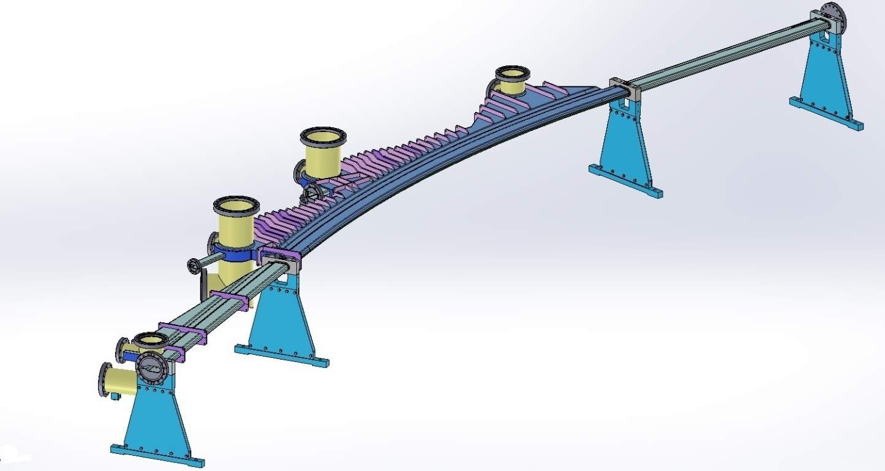
Storage Ring Status: Vacuum Chamber
✓ The ring contains 16 valves, 64 bellows, 32 BPMs + 32 ID BPMs.
✓ Contract has been signed with FMB.
✓ Expected delivery date of prototype is Feb. 2015.
✓ To be setup with magnets and prototype girder at CERN by March 2015.
✓ Valves, bellows, pumps
injection section, RF
section to be contracted.
BPM
One cell vacuum chamber
M. Attal, XXII ESLS Workshop, ESRF, Nov. 25-26, 2014

Slide 18
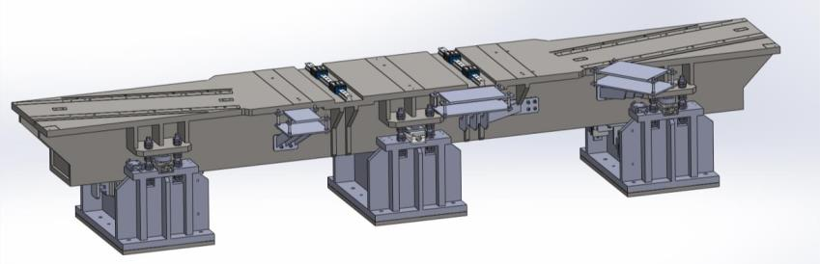
Storage Ring Status: Girders
5.2m
0.9m
0.953m
✓ Flatness < ± 50 µm, Pin-positioning < ± 50 µm, Deflection under load < 50 µm.
✓ Contract has been signed with Nortemecanica, Spain.
✓ Prototype delivery expected by Feb. 2015. To be setup with magnets & vacuum chamber
at CERN by March 2015 (SAT).
✓ Last batch to SESAME by May 2016.
M. Attal, XXII ESLS Workshop, ESRF, Nov. 25-26, 2014

Slide 19
SESAME Phase 1- Day 1 Beam Lines
No. | Beamline | Energy | Photon Source | Comment
1 | Protein Crystallography | 4 – 14 keV | IV Undulator ? | Under discussion
2 | XAFS / XRF (BASEMA) | 4.5 – 30 keV | Bending Magnet | Helmholtz-Zentrum Dresden-Rossendorf/ESRF. New focusing components. New hutch
3 | IR Spectromicroscopy (EMIRA) | 0.01 – 1 eV | Bending Magnet | Completely new beam line
4 | Powder Diffraction | 5 – 25 keV | 2.1T Wiggler | SLS (with source)
5 | Soft X-ray, Vacuum Ultraviolet (VUV) | 0.05 – 2 keV | Ellipt. Polarizing Undulator | Completely new beam line
6 | SAXS / WAXS | 8 – 12 keV | Bending Magnet | Daresbury
7 | Extreme Ultraviolet (EUV) Spectroscopy | 10 – 200 eV | Bending Magnet | Daresbury & LURE
M. Attal, XXII ESLS Workshop, ESRF, Nov. 25-26, 2014

Slide 20
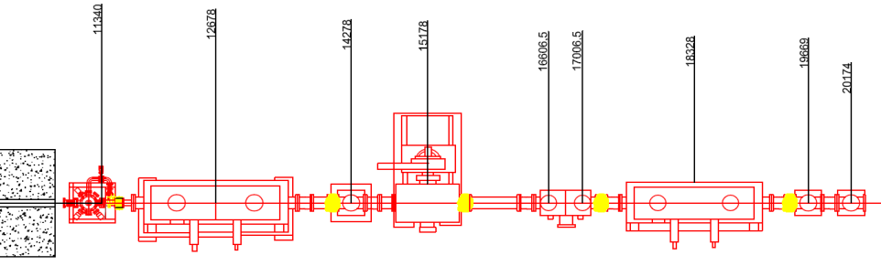
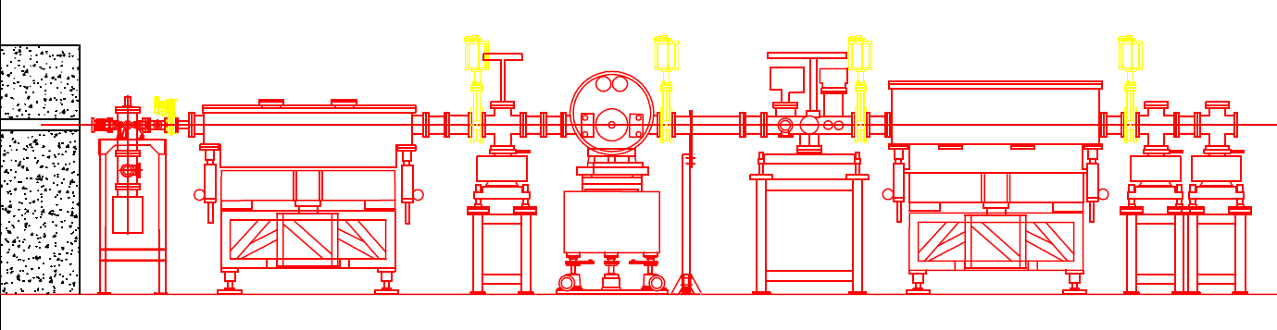
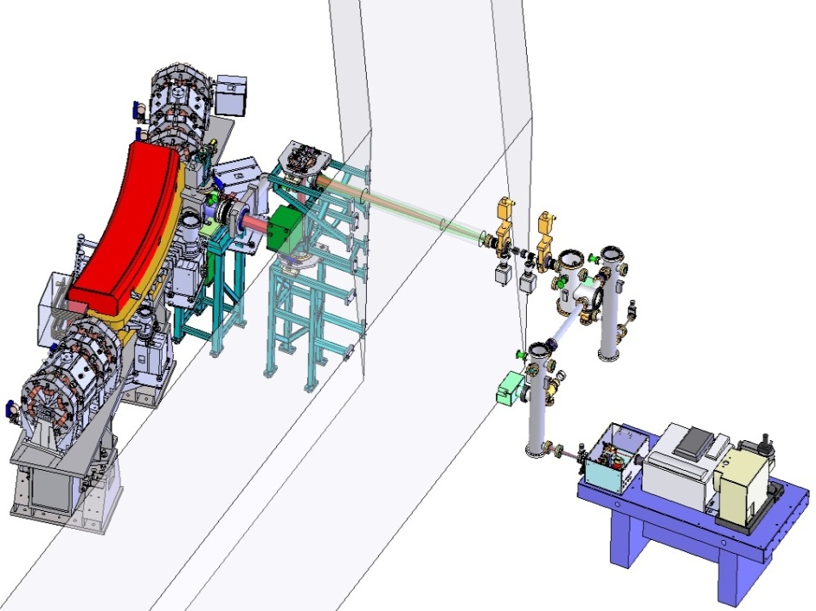
SESAME Phase 1- Day 1 Beam Lines
✓ (BASEMA) XAFS/ XRF beam line:
➢ CDR approved.
➢ Manual user documentation finished.
➢ Installation to be started in 2015.
✓ (EMIRA) IR beam line:
➢ Collected from main and edge dipole field.
➢ Tendering process is being processed.
➢ Expected to be functional by mid 2016.
Dipole chamber
Diamond window
Branch 2
Experimental station
Protection wall
Branch 1
M. Attal, XXII ESLS Workshop, ESRF, Nov. 25-26, 2014

Slide 21
Storage Ring Milestone Schedule
Deliverables | Contracted | Prototype | 1. Batch | Last Batch
Magnets (Dipole) | 08.2013 | 10.2014 | 02.2015 | 10.2015
Power-supplies | 05.2014 | 10.2014 |  | 06.2015
Vacuum Chamber | 01.2014 | 02.2015 | 05.2015 | 10.2015
Girder | 08.2014 | 02.2015 | 09.2015 | 05.2016
Cavities | 05.2014 |  | 12.2015 | 05.2016
RF-Amplifier | 10 -11.2014 (SOLEIL - Sigmaphi) |  | 11.2015 (SOLEIL & Sigmaphi) | 08.2016 (Sigmaphi)
✓ Storage ring commissioning expected by 1st of 2017.
M. Attal, XXII ESLS Workshop, ESRF, Nov. 25-26, 2014

Slide 22
Thank you
M. Attal, XXII ESLS Workshop, ESRF, Nov. 25-26, 2014

