Slide 1
European Synchrotron Light Source XXII Conference, Grenoble 2014
Basic approach to managing transverse coupling in Elettra: strategy and simulations
S. Di Mitri, D. Castronovo, B. Diviacco, E. Karantzoulis
Elettra Sincrotrone Trieste

Slide 2
Premise
Elettra has been running for ∼20 years with neither skew quads nor systematic LOCO-based control. In-house codes routinely ensure ∼1% coupling via orbit manipulation for spurious vertical dispersion.
A recent proposal for the lattice upgrade pushed us to acquire confidence with skew quadrupoles for coupling correction.
Being the LOCO modelling and interface to machine still in progress, Elegant code is being used to identify a (finite) hyperspace of parameters that promises coupling control down to ∼0.1% level.
In fact, this is a numerical exercise that reveals well-known concepts in coupling theory. You are invited to shine some light both on the strategy and the quantitative results that come out from this exercise.
Thank you in advance.

Slide 3
Modeling Coupling in Elegant
GLOBAL variables (defined through uncoupled optics + errors):
Normal mode emittances: ε₁, ε₂
Coupling integral:
Emittance ratio:
No immediate index for
chromatic coupling
We evaluate RMS vertical dispersion: η_{y,rms}
LOCAL variables (depend on s-along the ring):
Beam sizes: σ_{y}, σ_{x}
Apparent emittances: ε_{y}, ε_{x}
x-y beam Tilt
Vertical dispersion: η_{y}

Slide 4
Strategy of Simulations
Simulate machine with error budget (up to 1000 random seeds):
+ orbit correction
+ tune correction
+ chromaticity correction
Quantify coupling through local and global variables.
+ identify correlations between local and global variables (if any)
+ identify interplay of geometric and chromatic coupling.
N.B.: each skew quad is INSIDE a DBA cell.
Coupling correction: ideally, use few local variables to minimize the coupling globally.
+ allow improvement of the brilliance @ ID
+ minimize disturbances along the entire ring
Repeat optimizations as function of the number of skew quad families. Monitor skew quad strength.

Slide 5
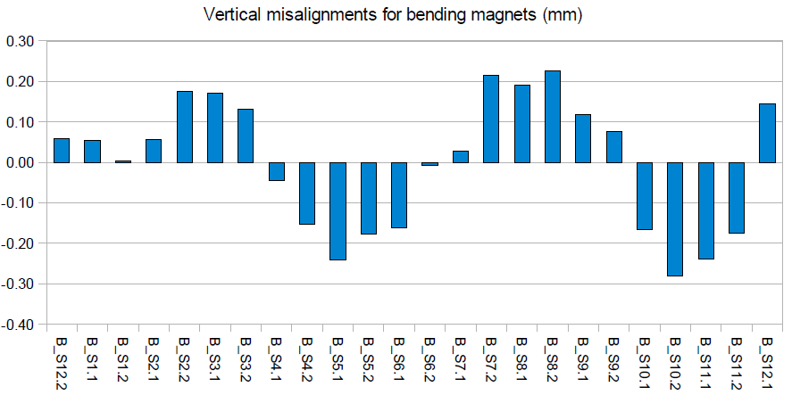
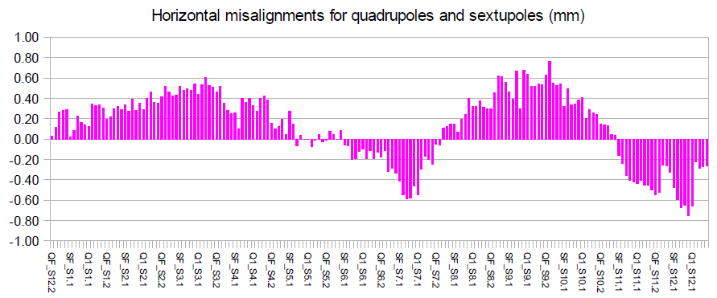
Machine Error Budget
Machine alignment: full survey in 2010 +
partial survey in 2014
Error random seed for:
field errors
roll of quads, sexts and BPMs
lateral offset of BPMs
BPMs noise signal
Correlations are in the model:
These are missing or partially available from the surveys.
Arbitrarily set to match experimental evidences like:
max. correctors’ strengths (1 mrad)
max. orbit excursion (4 mm abs.)
rms vertical dispersion (10 mm)
expected alignment accuracy
emittance ratio ∼ 1%

Slide 6
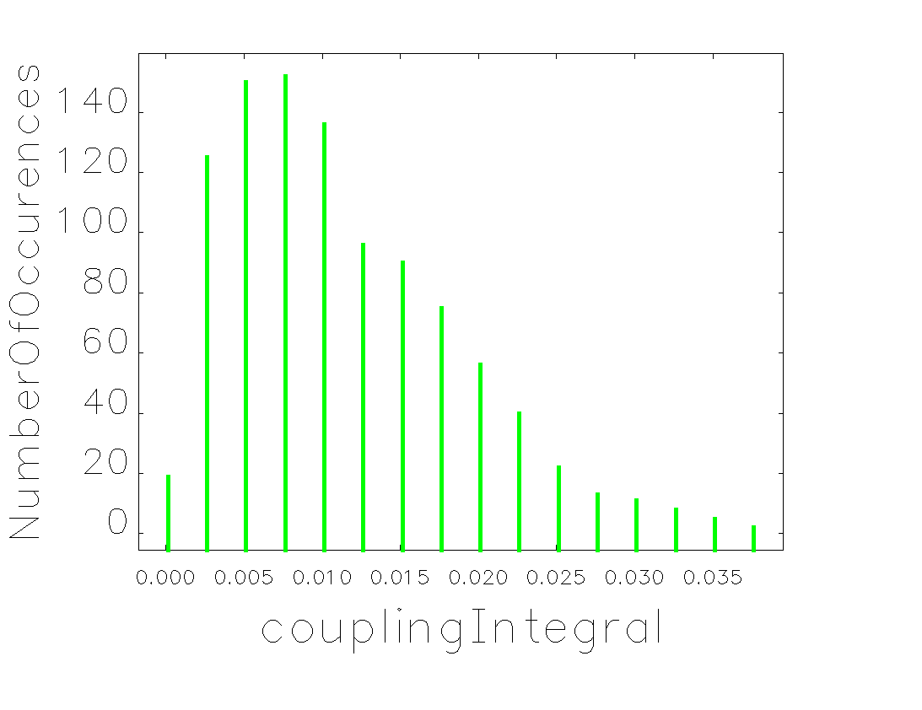
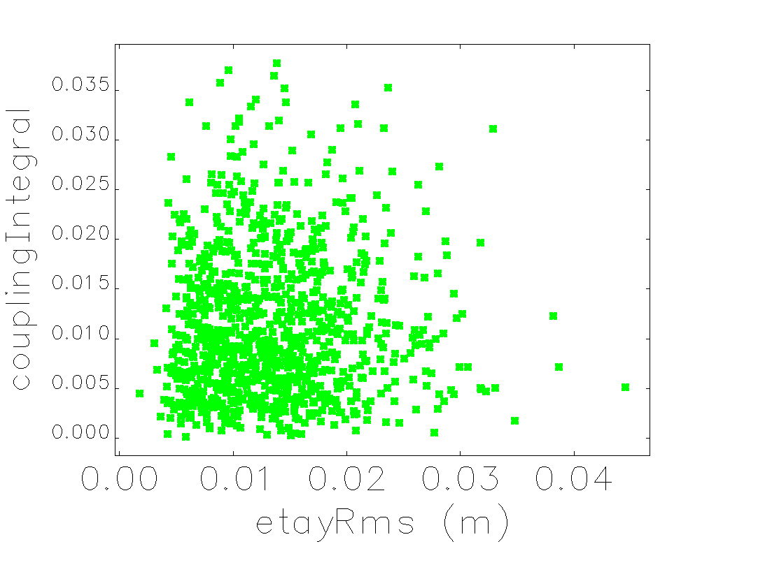
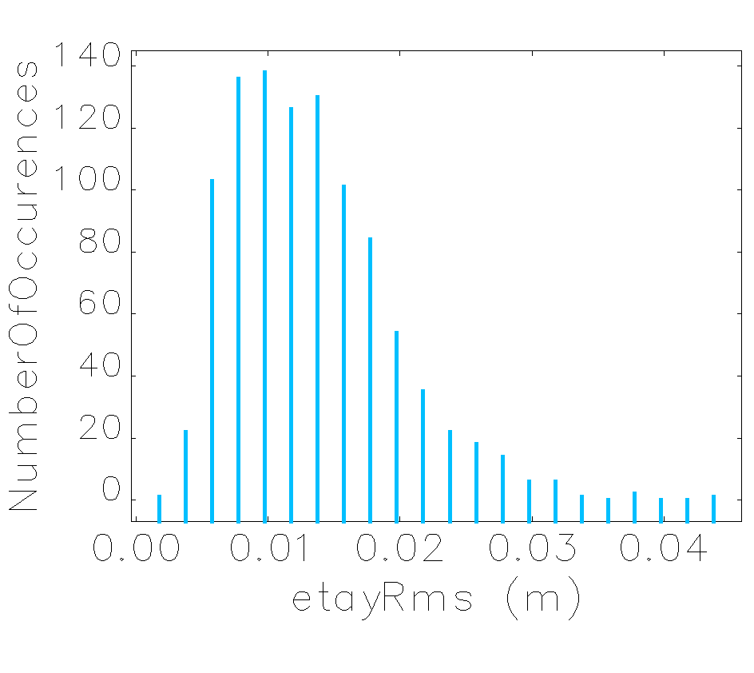
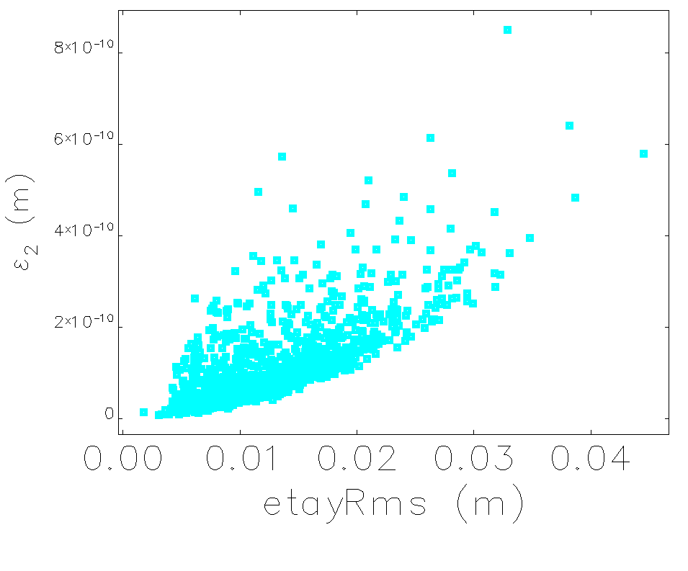
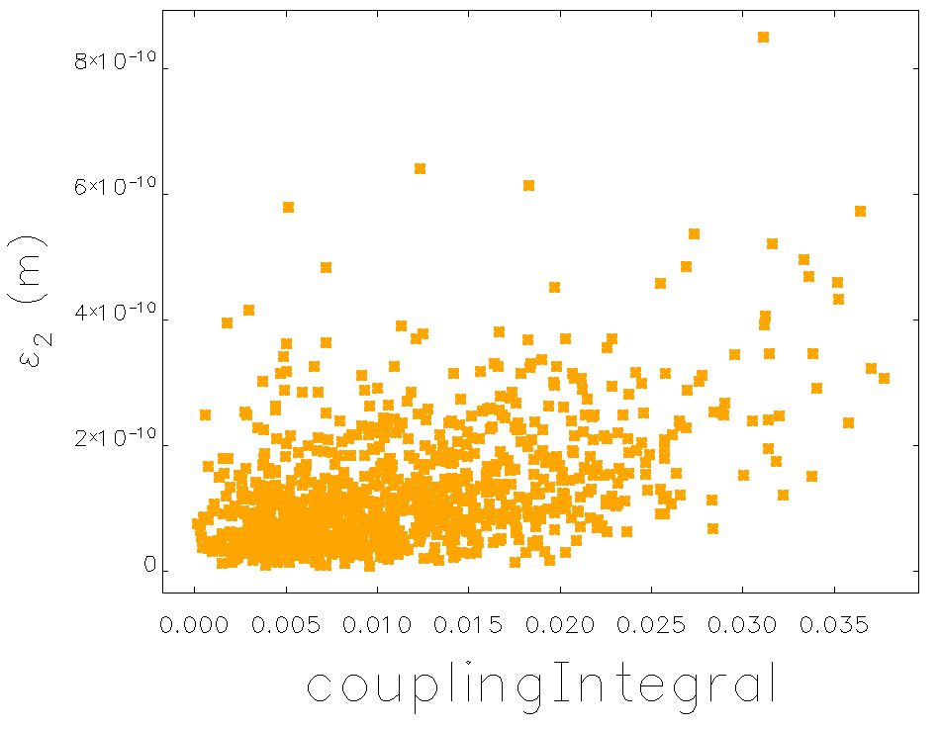
Before Optimization: κ vs. η_{y,rms}
Weak correlation: we have to manage β- and η-coupling independently
η-coupling has larger impact on the mode-2 emittance than β-coupling
strong correlation
weak correlation

Slide 7
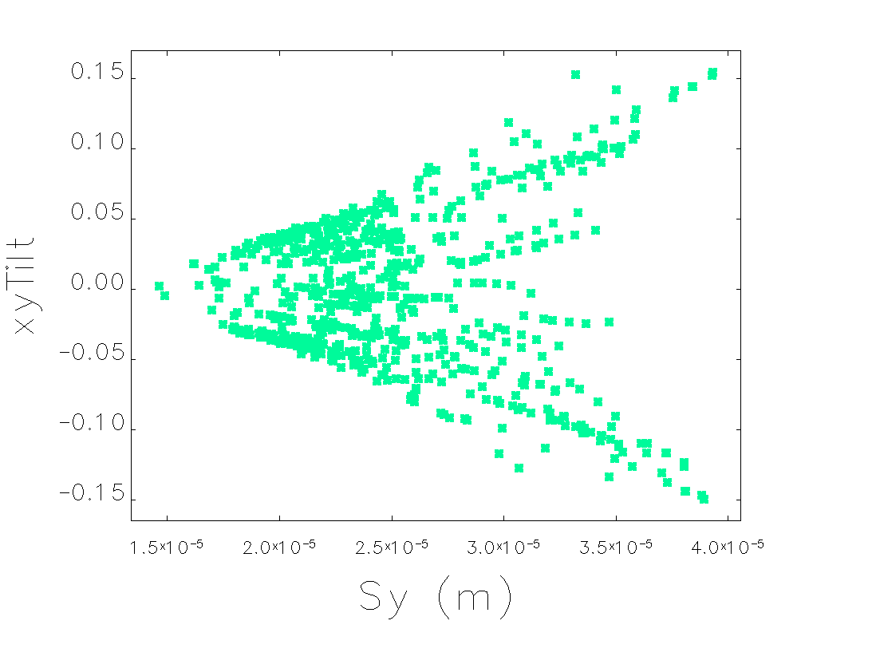
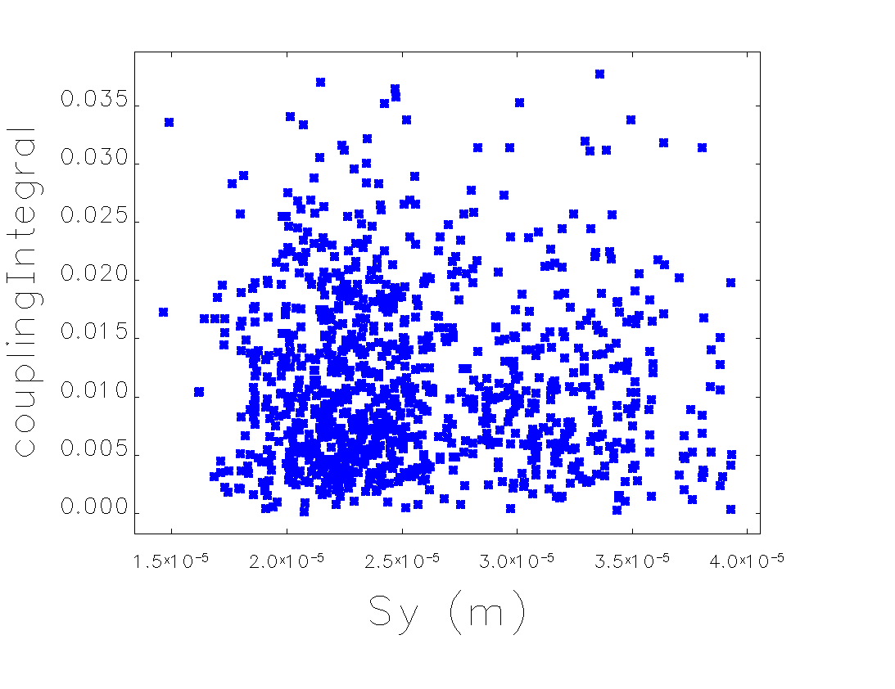
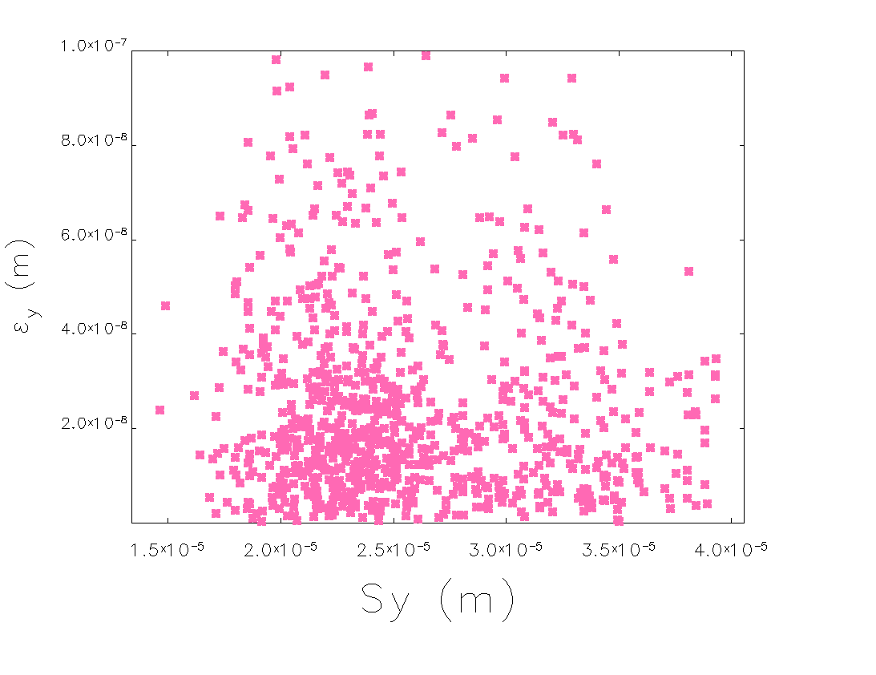
Before Optimization: σ_{y} vs. x-y Tilt
Use variables directly related to brilliance: xy-Tilt and σ_{y}.
Use σ_{y} instead of σ_{y}/σ_{x} to be insensitive to the horizontal beta-beat.
A reduction of σ_{y} minimizes the beam tilt, locally. Is it an “emittance” effect ?
Unfortunately not:
large apparent emittances are still allowed with small beam size (hint: vert. beta-beating).
Nor it minimizes the coupling integral

Slide 8
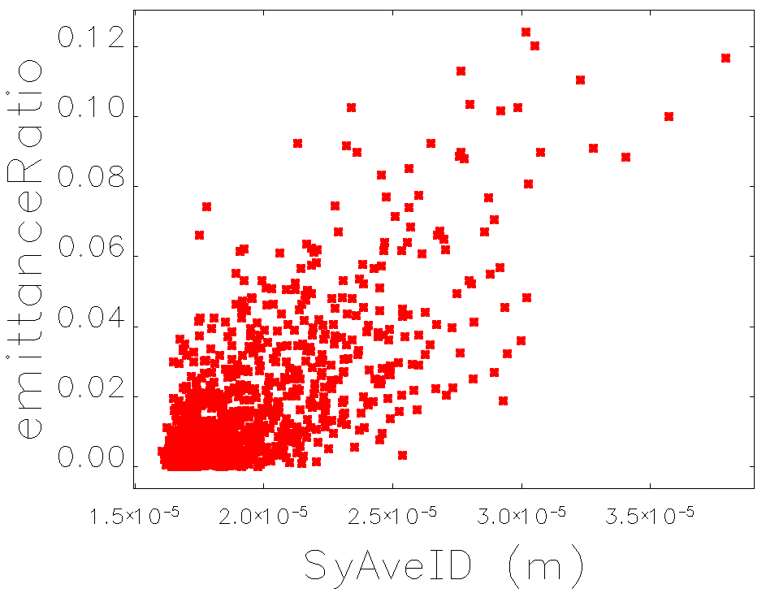
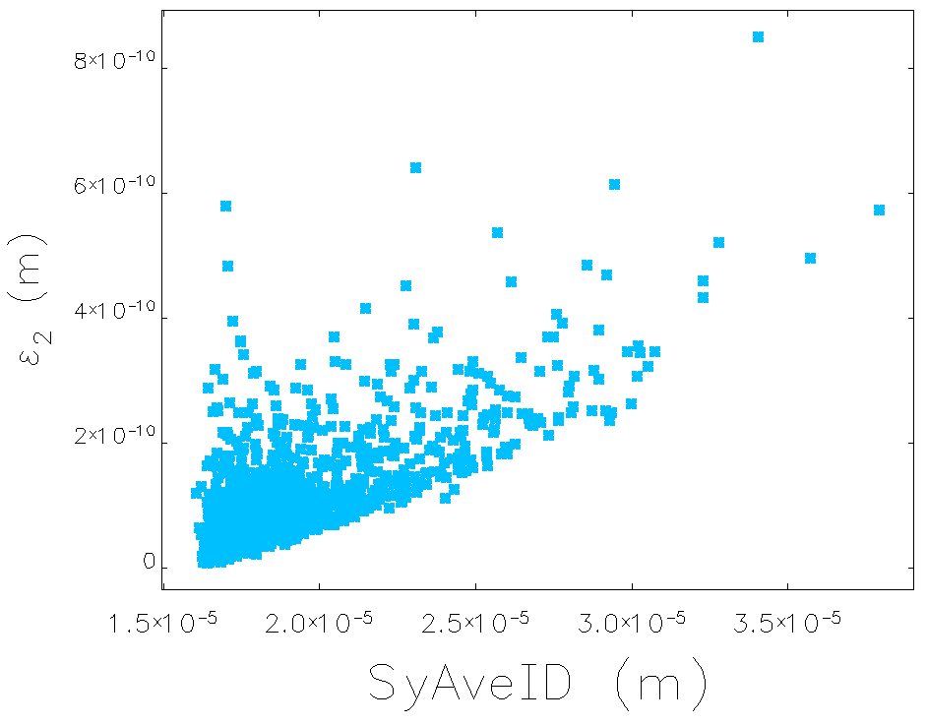
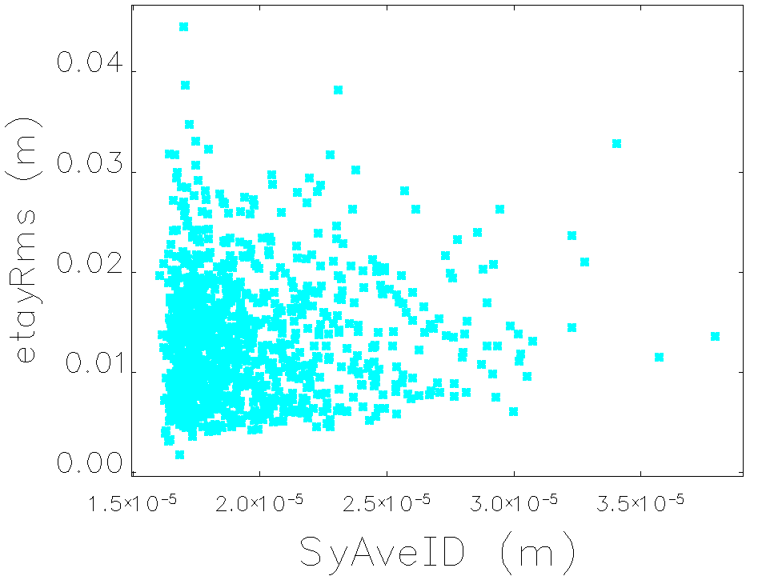
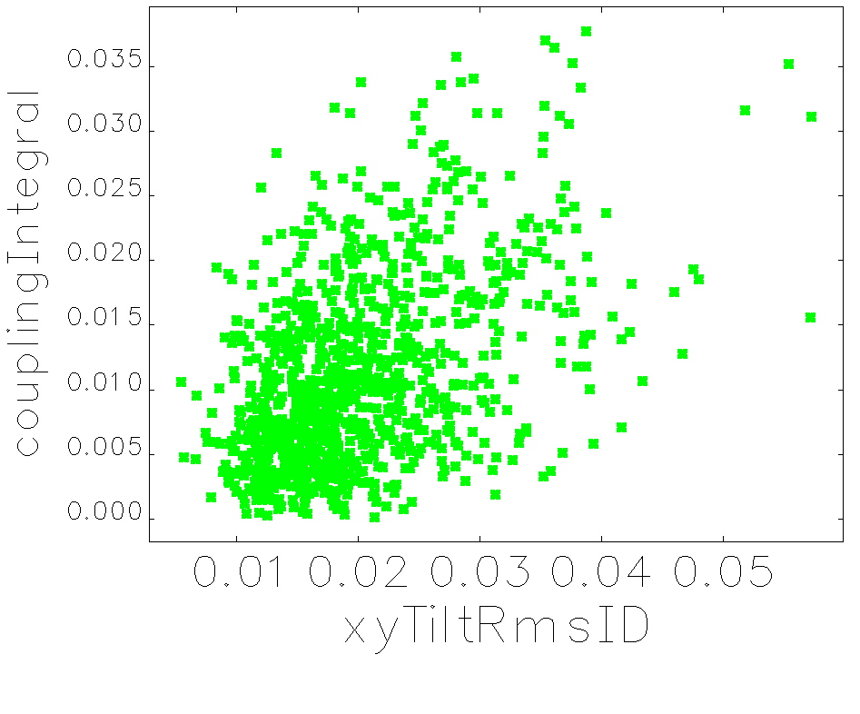
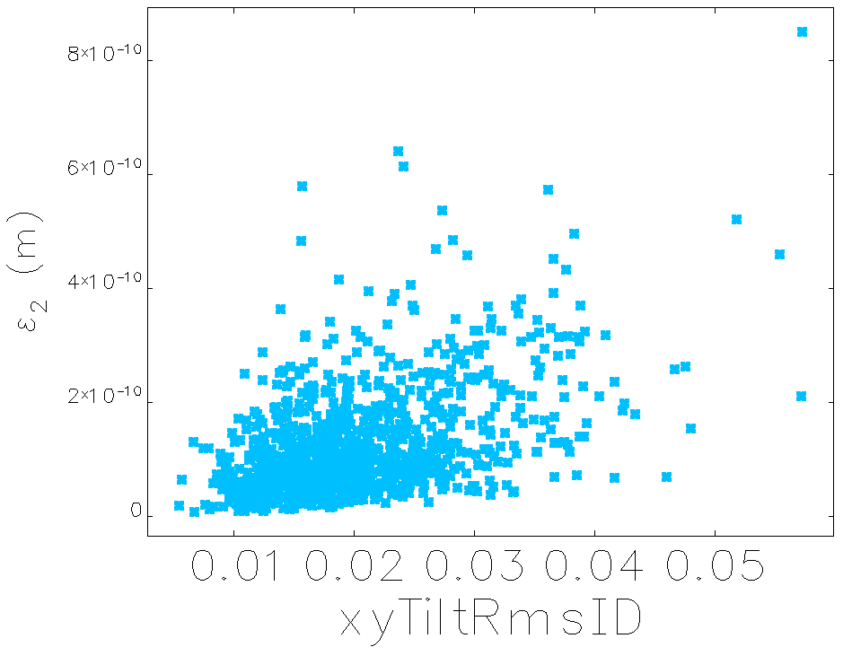
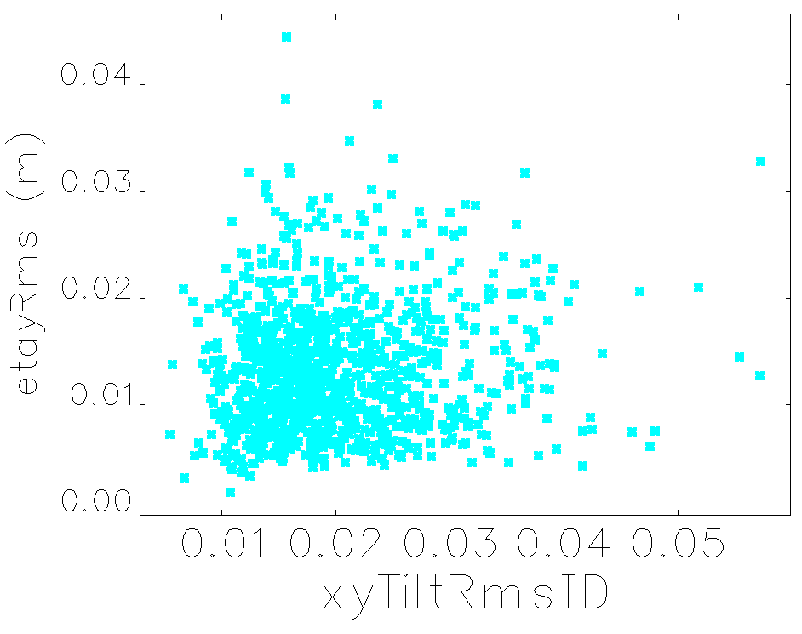
Averaged Local Variables vs. Global Ones
Extend local variables (Tilt, σ_{y}) to their s-averaged value.
Give priority to IDs.
ii) If correlated with global variables, they might be used for coupling correction.

Slide 9
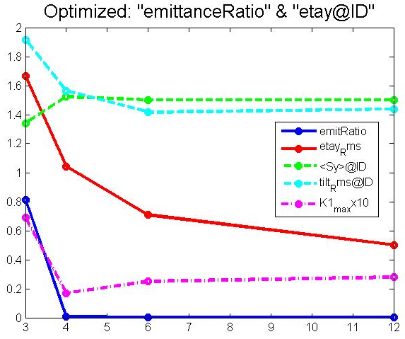
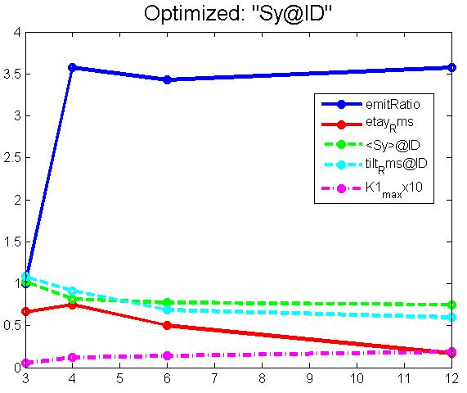
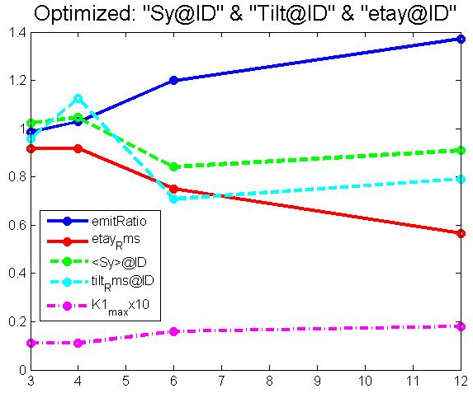
Coupling Correction vs. # Skew Quad Families
Number of Skew Quad Families: 3, 4, 6, 12.
Values before and after optimization refer to the peak of the statistical distribution over 100 runs, normalized to the non-optimized value.
Correlations in the perturbed lattices do not automatically reflect in the optimized lattices.
Beam xy-tilt, σ_{y} @ IDs and η_{y,rms} can be minimized, but their optimization is in conflict with the coupling integral.
A compromise can be reached with proper weights (to be finalized yet).

Slide 10
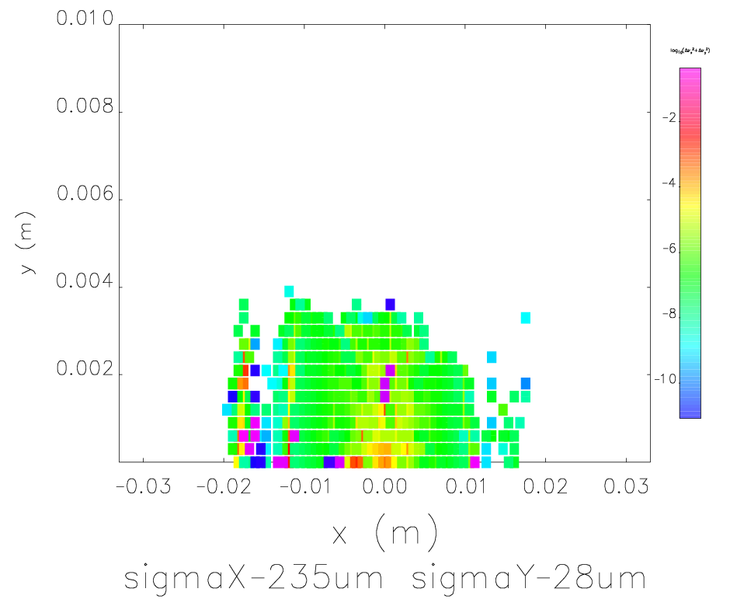
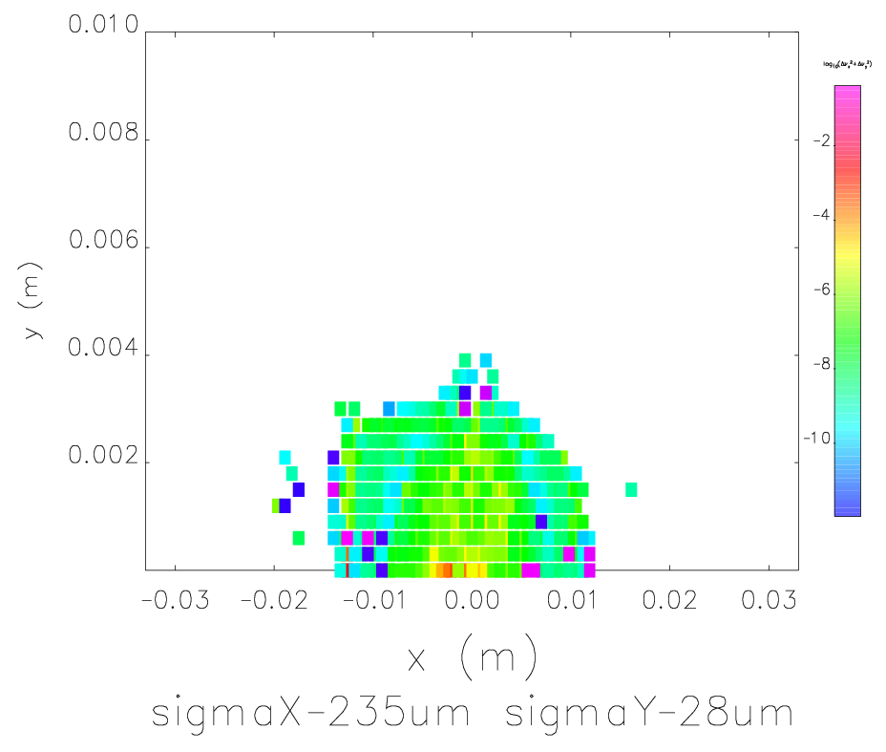
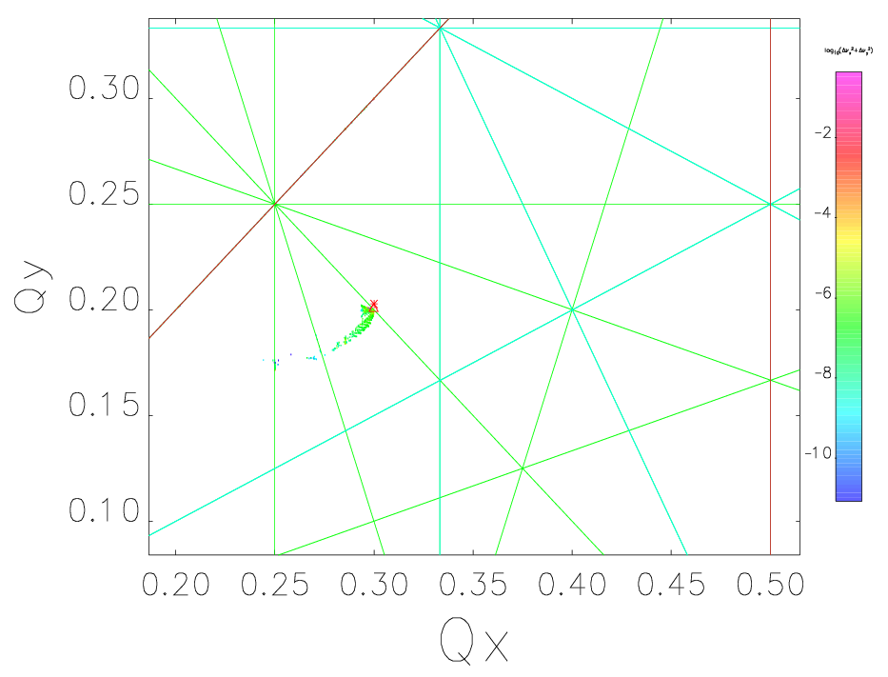
Nonlinear Dynamics, Insertion Devices
Preliminary investigation of the nonlinear dynamics and stability is ongoing. Below, the pessimistic case of 7 IDs, planar and elliptical, all at minimum gap (used kick maps in Elegant).
Plots are before and after coupling correction with 12 skew quadrupoles (emitRatio=0.1%, η_{y,rms}=6mm).
Touschek lifetime (300mA@2GeV) shrinks from 20hs to 14hs.

Slide 11
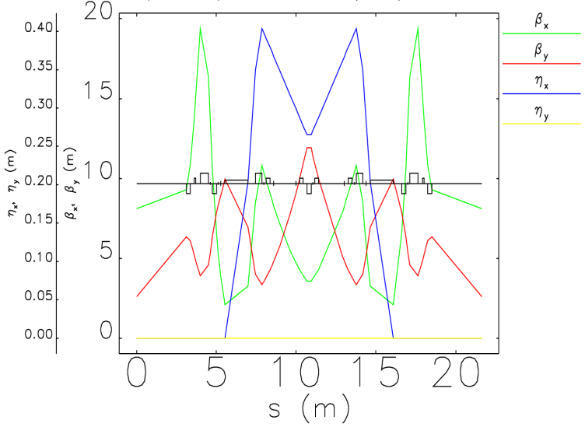
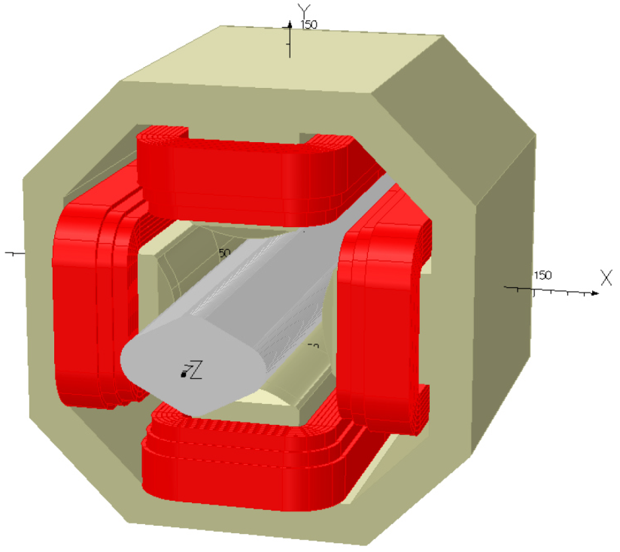
Magnetic & Mechanical Design
Room for skew quad, <0.3m
Magnetic design is in progress according to specification:
physical length < 0.3 m
integrated norm. strength k₁l < 0.015 m⁻¹
bore diameter ≥ 85 m
power supply at ≤ 20 A (30W)

Slide 12
Preliminary Conclusions
1. Coupling correction is feasible with skew quadrupoles:
Skew quads norm. integrated strength K₁l ≤ 0.015 m⁻¹ (0.12T @ 2.4GeV)
Skew quad is feasible and fits into the present DBA cell for simultaneous β- and η-coupling correction.
≥ 4 families (over 12 quads) are required to halve both κ and η_{y,rms}
≥ 6 families (over 12 quads) ensure best control of σ_{y,rms} and xy-Tilt @IDs
2. Next steps with Elegant:
Upgrade model with fringe fields, higher order components and new machine survey
Include orbit manipulation for improving the simultaneous minimization of local and global variables.
Compare with coupling correction via “skew quad - response matrix” (Pelegant)

Slide 13
Thank You for Your kind attention
Questions and comments are welcome

