Slide 1
Magnets for the ESRF upgrade phase II
G. Le Bec, J. Chavanne
on behalf of the ESRF upgrade project team
European Synchrotron Light Source XXII, Grenoble November 2014

Slide 2
Overview
Context
The ESRF phase II magnets
Design and prototyping challenges
Where are we?
Dipoles
Combined dipole-quadrupoles
Quadrupoles
Sextupoles, octupoles
Summary and conclusion

Slide 3
Context

Slide 4
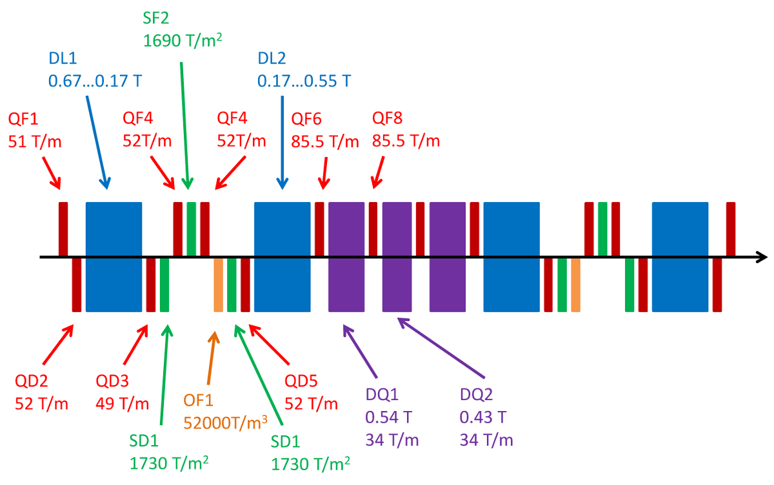
The ESRF phase II magnets

Slide 5
The ESRF phase II magnets
Reduced gradient
100 T/m➔ 85 T/m

Slide 6
The ESRF phase II magnets
Reduced field and gradient
0.85 T ➔ 0.54 T
49 T/m ➔ 34 T/m

Slide 7
The ESRF phase II magnets
Challenges
High gradients
Combined magnets
Small bore radius
Tight tolerances
No space longitudinally
More than 1000 magnets

Slide 8
Design constraints
Field quality
Integration and mechanical constraints
Magnet length
Vacuum chambers
Vibrations
Supports
Alignment
Tunability
Power consumption

Slide 9
Field quality and tunability
Magnet type | GFR radius [mm] | Field quality (systematic) | Tuning range [%]
DL | 13 | ΔB/B < 10⁻³ | 0
DQ | 7 | ΔG/G < 10⁻² | Gradient: +/- 2
Q – 50 T/m | 13 | ΔB/B < 5 10⁻³ | 55 – 110
Q – 85 T/m | 7 | ΔB/B < 5 10⁻⁴ | 95 – 105
S | 13 | ΔH/H < 0.1 | 20 – 130
O | 13 |  | 0 – 145

Slide 10
Small bore magnets
Assembly errors
Errors at the GFR boundary
Mechanical error
Multipolar error
at the bore radius
Bore radius
(GFR radius = ρ)
Error @ ρ =R/4 | ρ₀=R | ρ₀=R/2
Quadrupolar | ε₂ | 4ε₂
Sextupolar | ε₃ | 8ε₃
Octupolar | ε₄ | 16ε₄
High gradient ➔ Small bore radius ➔ Tight tolerances

Slide 11
Status

Slide 12
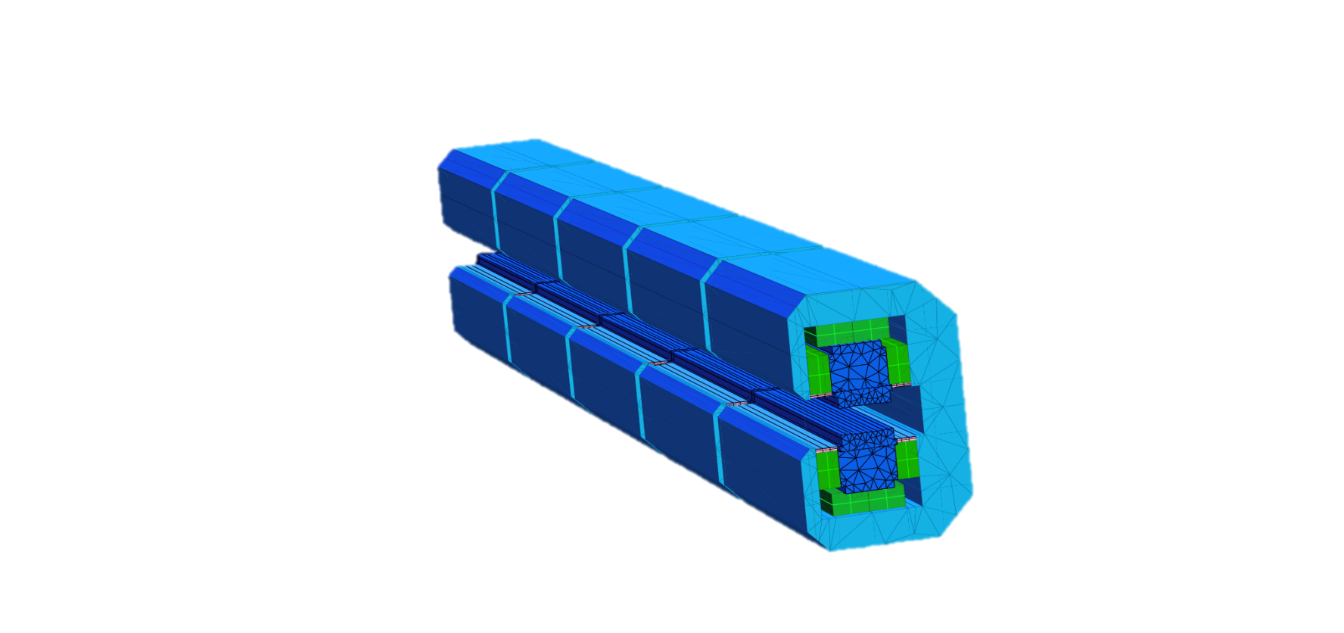
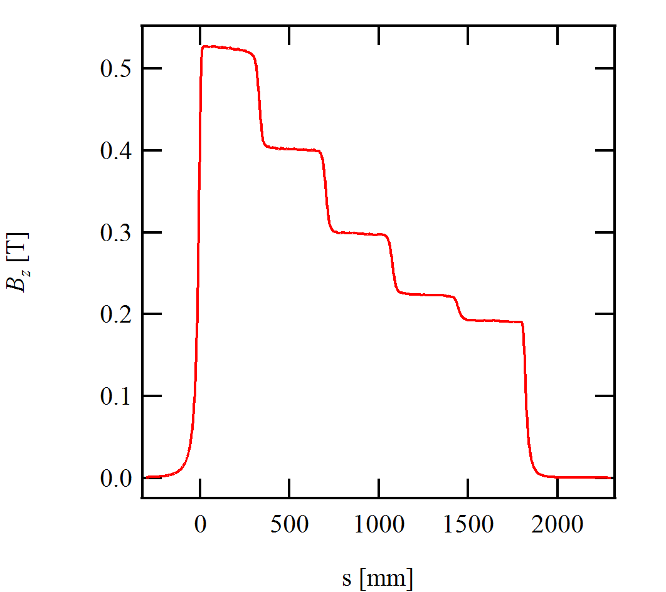
Dipole with longitudinal gradient
Field ranging from 0.17 T up to 0.55 T or 0.67 T
Total length: 1.85 m
Gap: 25 mm
Magnet mass: 400 kg
PM Mass: 25 kg/Sm₂Co₁₇ and 25 kg Strontium ferrite per dipole
(Design and measurements of the DL magnet: J. Chavanne)

Slide 13
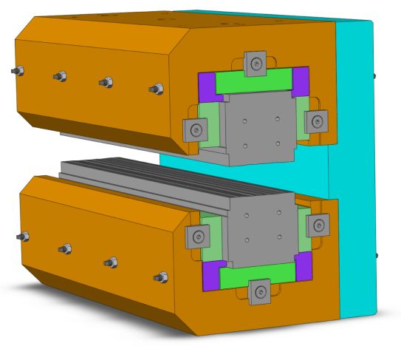
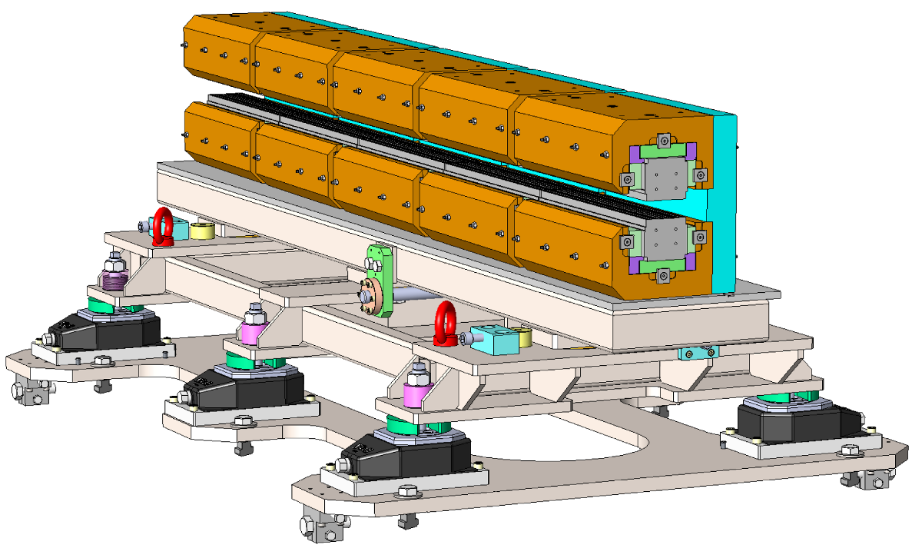
Dipole with longitudinal gradient
Iron pole and yoke
Aluminium spacers
PM blocks
DL module
Number of PM blocks is module dependent.
Temperature compensation is not shown here.
Complete DL magnet on its support

Slide 14
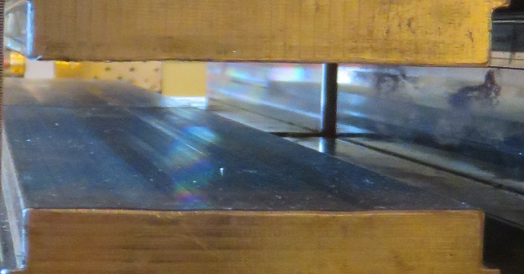
Dipole with longitudinal gradient
Homogeneity of central field
Quality dominated by pole faces parallelism
May need refinement of mechanical tolerances
Easy and fast mechanical correction (shimming)
Tolerance: ΔB/B < 10⁻³ @13 mm
Module 1 without shim (Hall probe meas.)
Module 2 without shim (Hall probe meas.)

Slide 15
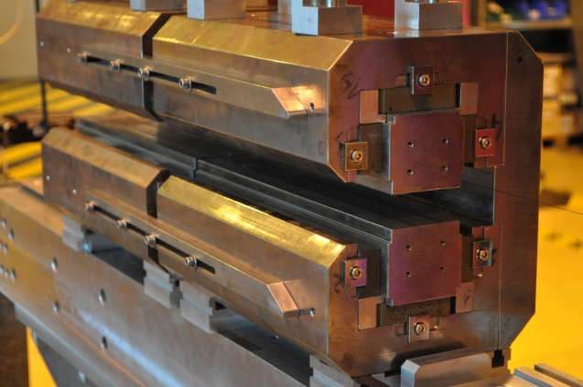
Dipole with longitudinal gradient
Integrated field
Preliminary study on straight integrals
Stretched wire method
Two modules with 0.62 T and 0.41 T
Longitudinal gap 5 mm between poles
End effect (sextupole) shims not installed
Will improve with additional modules

Slide 16
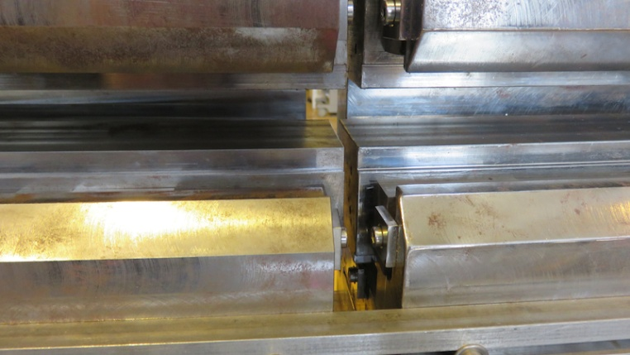
Dipole with longitudinal gradient
Longitudinal field
Flat top field at longitudinal gap g_{s} = 5 mm
The optimum g_{s} may change between the modules of the full magnet (field step dependence)
g_{s}

Slide 17
Dipole – quadrupoles (DQ)
B_{z}
B_{z}
x
x
Tapered dipole
High field
Low gradient
Offseted quadrupole
High field
High gradient

Slide 18
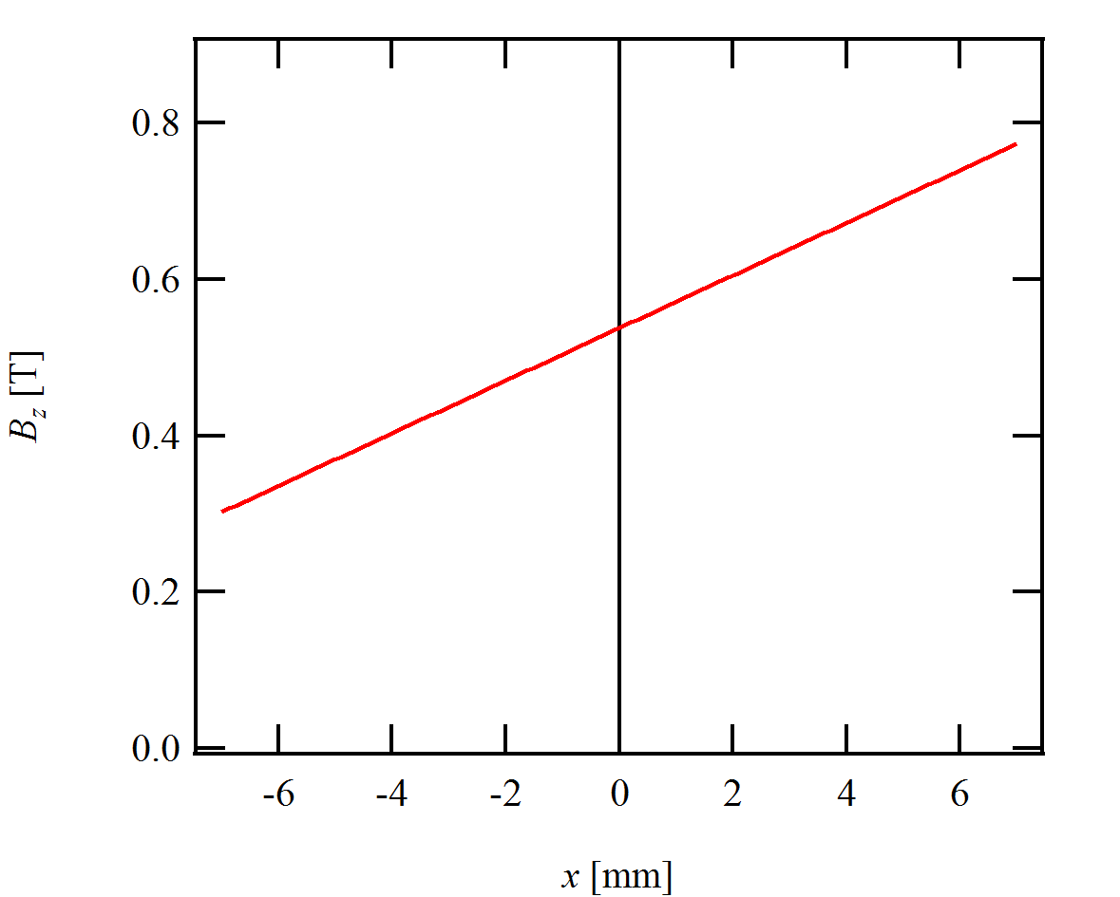
Dipole – quadrupoles (DQ)
B_{z}
x
DQ specifications
GFR radius 7 mm
Field 0.54 T
Gradient 34 T/m
Offseted quadrupole
High field
High gradient

Slide 19
Dipole – quadrupoles (DQ)
Field of an offset quadrupole
B_{z}
GFR
x
Additional power consumption, weight, etc.
Region of interest

Slide 20
Dipole – quadrupoles
A new target for DQ field
Pro
Lower power consumption and weight
Easy access on one side (vacuum chamber, magnetic measurements)
Cons
Design is more complex
B_{z}
GFR
x

Slide 21
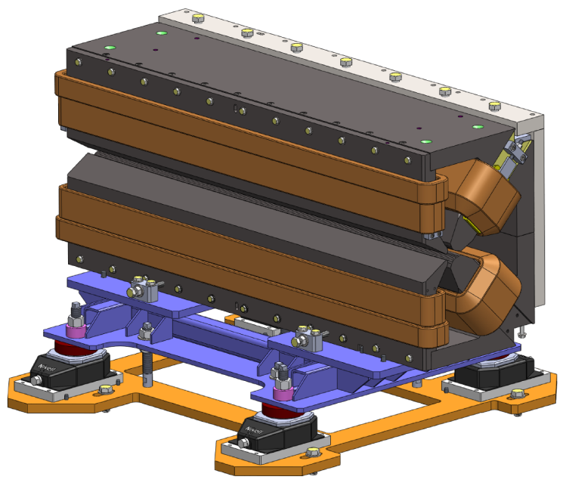
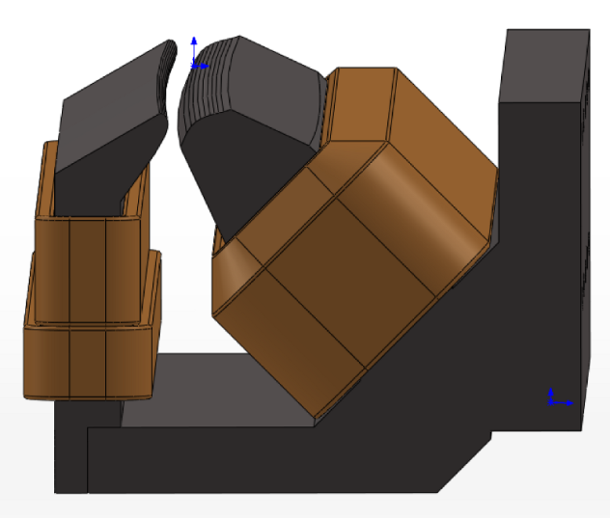
Dipole – quadrupoles (DQ)
Single sided dipole – quadrupole
2 poles + 2 “half” poles
0.54 T field, 34 T/m gradient
Iron length: 1.1 m
Magnet mass ~ 1 ton
Power consumption: 1.5 kW
Main pole
Main coil
Auxiliary pole
Auxiliary coil
(in series with main coil)
Trimming coil

Slide 22
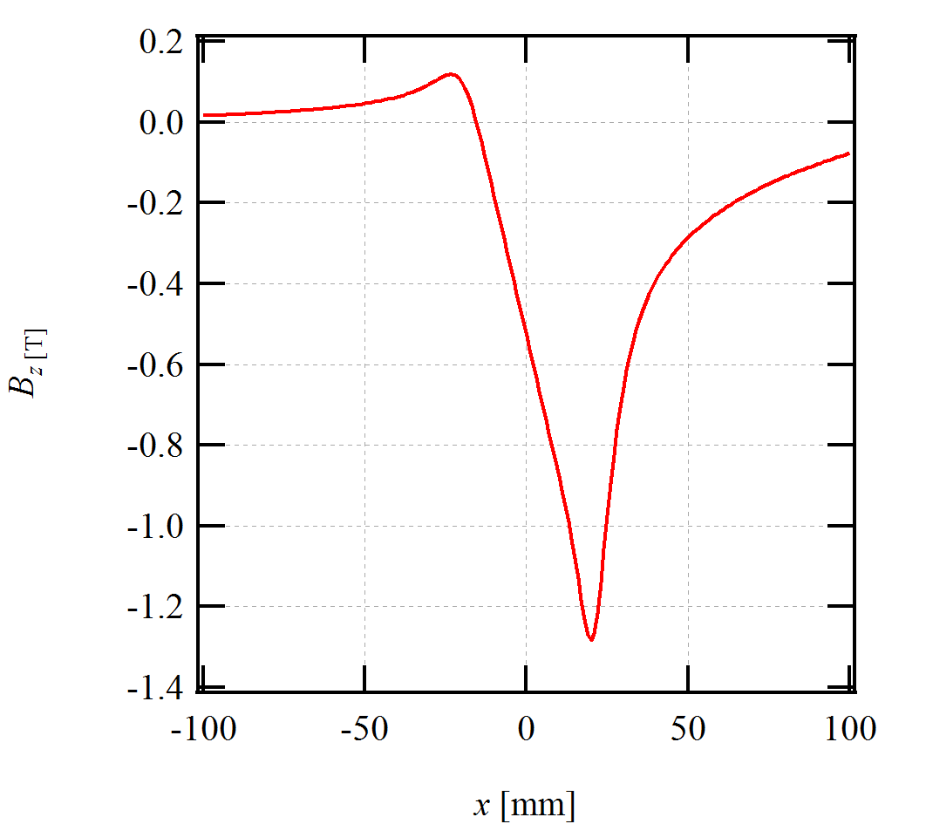
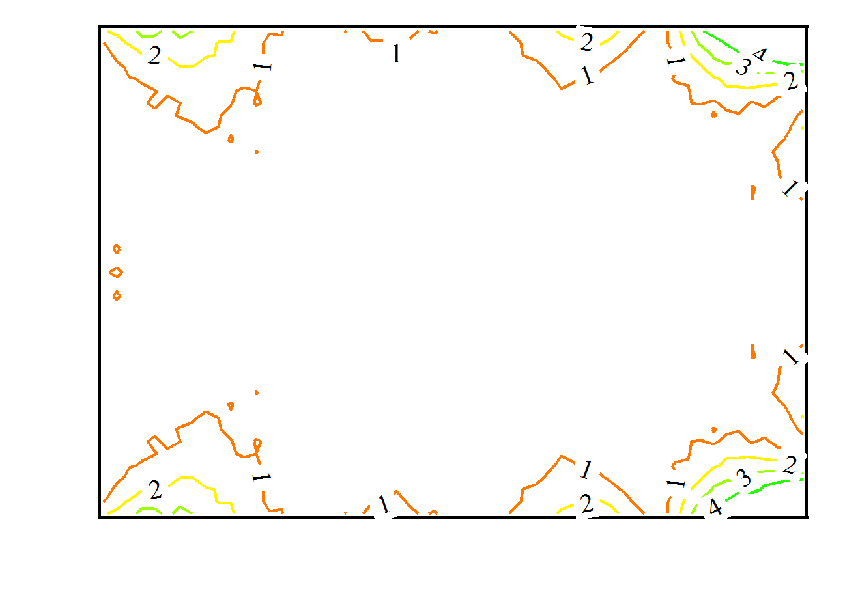
Dipole – quadrupoles (DQ)
Magnetic design
GFR
Vertical field vs. position.
Field is almost zero on one side.
ΔG/G expressed in 10⁻³. Specification: ΔG/G < 10⁻².
GFR: 7x5 mm
Field integration along an arc.

Slide 23
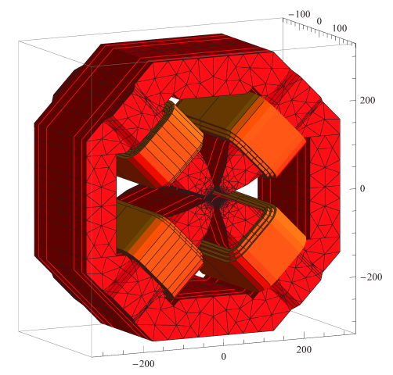
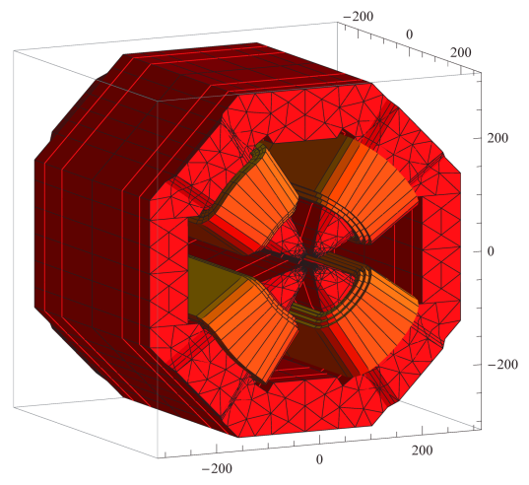
Quadrupoles
Two quadrupole families
Moderate gradient 51 T/m
Bore radius: 15.5 mm
Iron length ranging from 160 up to 300 mm
Working point: 50 – 110 % of nominal gradient
Power: 1 kW for the largest quadrupole
High gradient 85 T/m
Bore radius: 12.5 mm
Iron length ranging from 390 up to 480 mm
Working point: 95 – 105 % of nominal gradient
Power: 1.6 kW for the largest quadrupole
Moderate gradient
High gradient

Slide 24
Quadrupoles
Design criteria
Field quality
Fast pole shaping algorithm developed
Overall dimensions
Power consumption
Cooling and PS constraints
Sensitivity to background field
Decreased magnet’s power consumption
Decreased current density
Increased magnet’s transverse dimensions

Slide 25
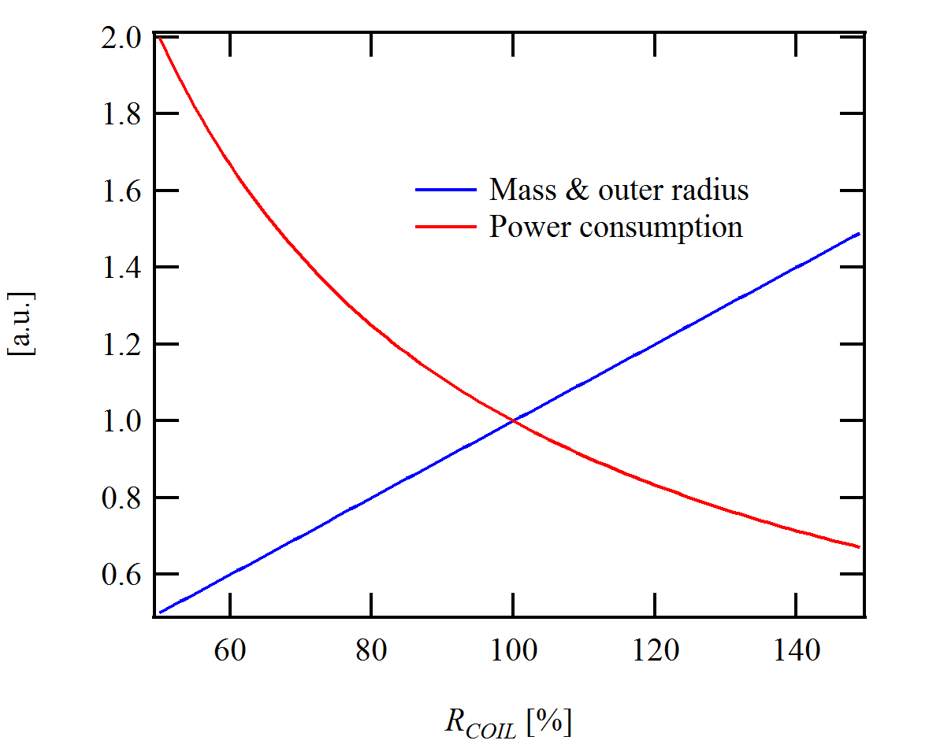
Quadrupoles
W_{YOKE}
R_{COIL}
W_{COIL}
W_{POLE}
W_{POLE} & W_{YOKE} constant
W_{COIL} constant (magnet length)

Slide 26
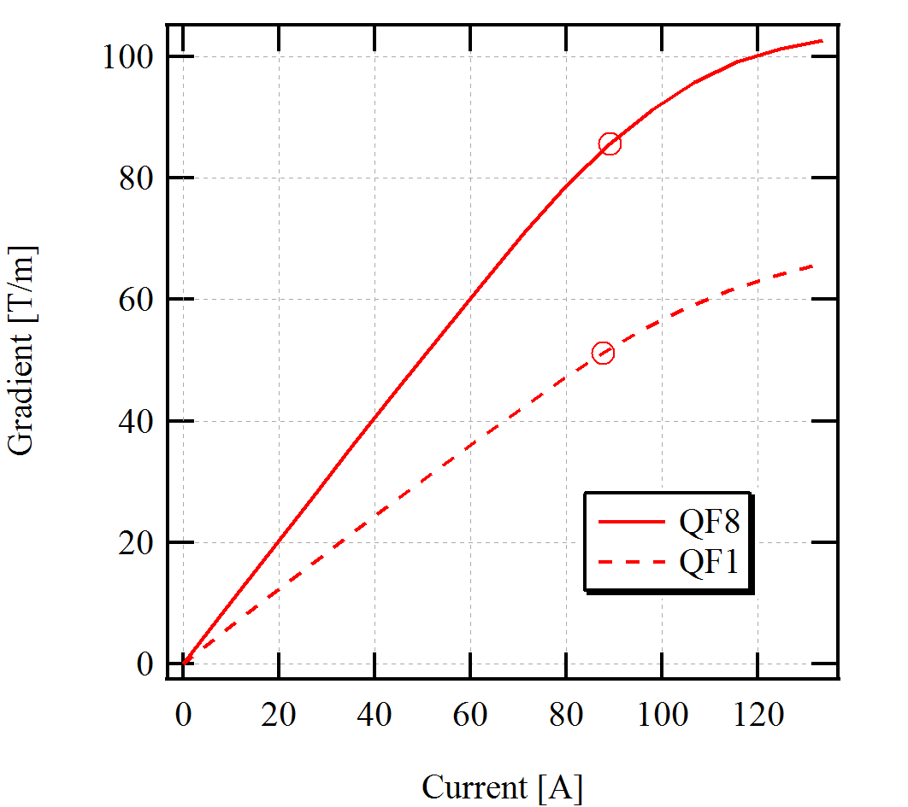



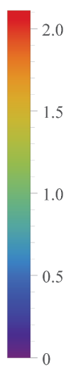
Quadrupoles
Excitation curve and saturation
Moderate gradient quads optimized at a linear working point
High gradient quads optimized at a saturated working point
T
T
(a)
(b)
Magnetization μ₀M [T] of the moderate gradient (a) and high gradient (b) quadrupoles at nominal current.
Excitation curve of
quadrupoles

Slide 27
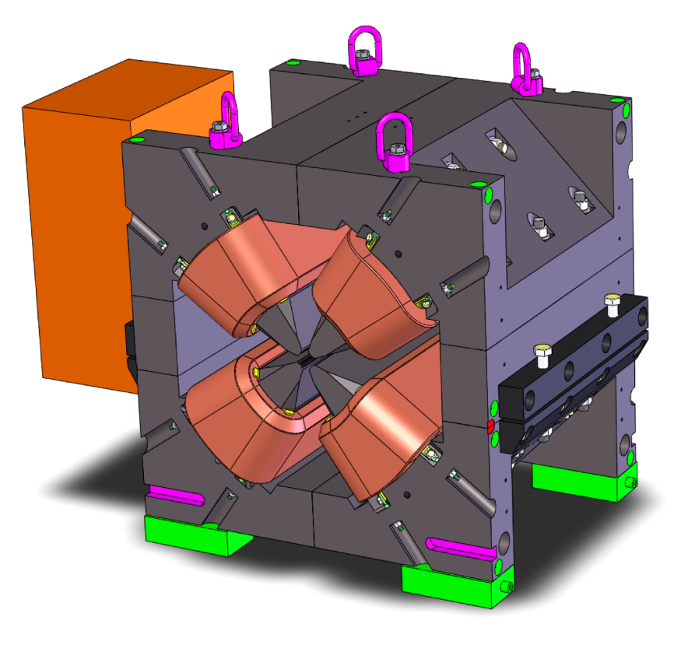
Quadrupoles
Magnet design properties
ΔG/G = 5 10⁻⁴ within the GFR
Iron length 480 mm→ 540 mm total length
Magnet mass ~ 1 ton
90 A, 69 turns, 1.7 kW
Prototyping
Prototype being manufactured

Slide 28
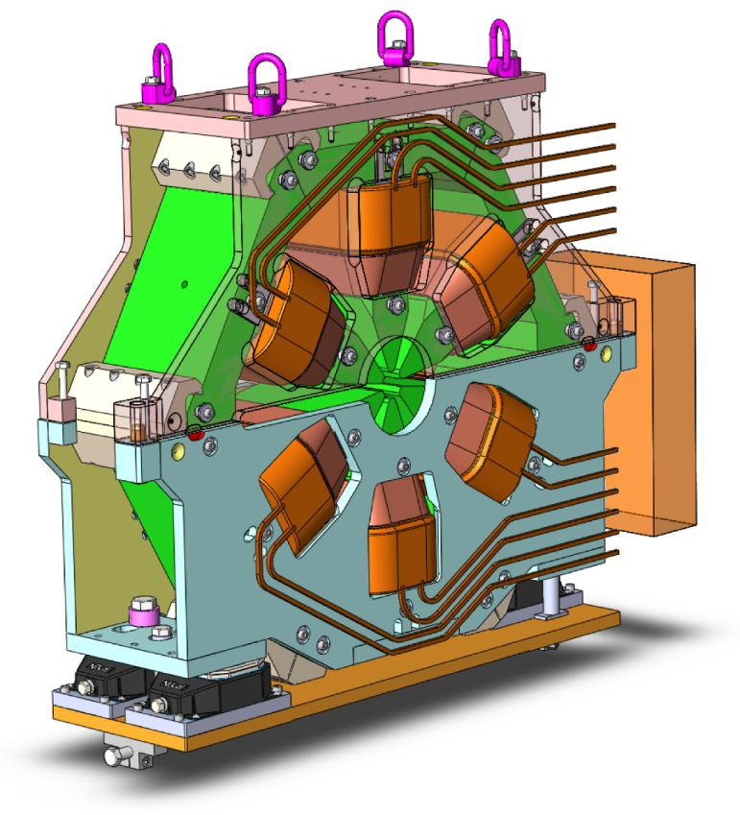
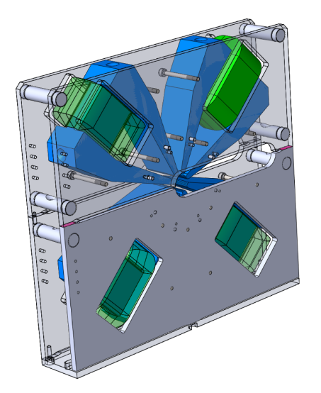
Other magnets
Sextupole
900…1600 T/m² nominal strength
Magnetic design stabilised
Engineering design almost completed
Opening/closure repeatability
Octupoles
Nominal strength 52 T/m3
Maximum strength 65 T/m3

Slide 29
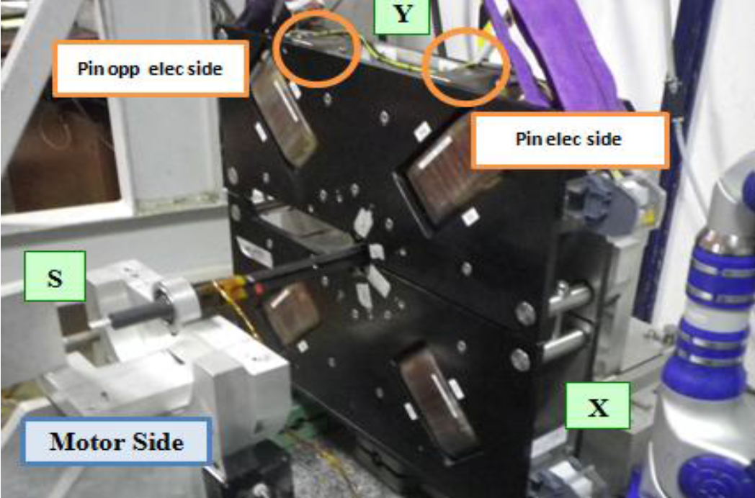
Other magnets
Sextupole
900…1600 T/m² nominal strength
Magnetic design stabilised
Engineering design almost completed
Opening/closure repeatability
Octupoles
Nominal strength 52 T/m3
Maximum strength 65 T/m3
Prototype built
Measured int. strength: 4504 T/m²
@ 6.2A (shorter, air-cooled coils)

Slide 30
Conclusion
Magnet design
DL, DQ and quads are challenging
Magnetic design stabilized for all the magnets
Engineering design well advanced
Prototyping
DL prototype measurements in progress
Manufacturing of 85 T/m quadrupole prototype in progress
Octupole prototype delivered

