Slide 1
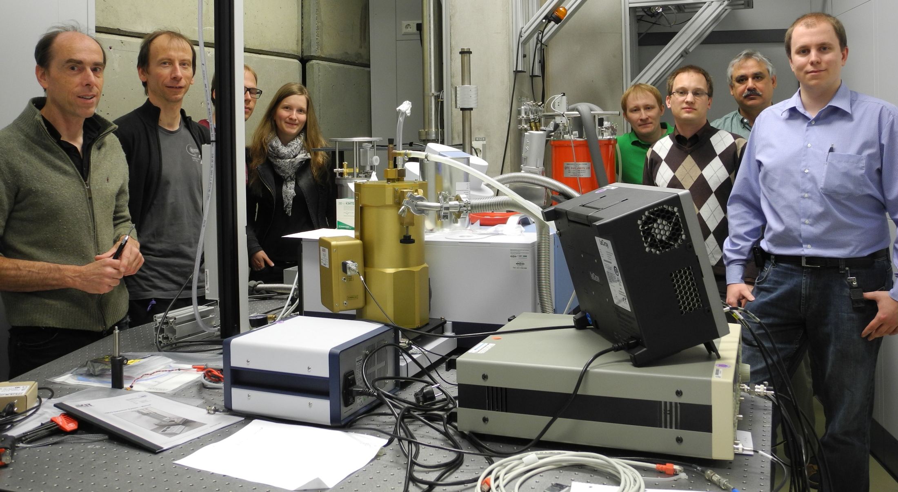
Generation of narrowband terahertz radiation at DELTA
Carsten Mai, Center for Synchrotron Radiation (DELTA), Dortmund

Slide 2






on behalf of
F. Bahnsen, L.-G. Böttger, S. Hilbrich, M. Höner, H. Huck, M. Huck,
S. Khan, A. Meyer auf der Heide, R. Molo, H. Rast, A. Schick, P. Ungelenk
S. Bielawski, C. Evain, M. Le Parquier, É. Roussel, C. Szwaj
M. Arndt, K. Ilin, A. Kuzmin, J. Raasch,
M. Siegel, P. Thoma

Slide 3
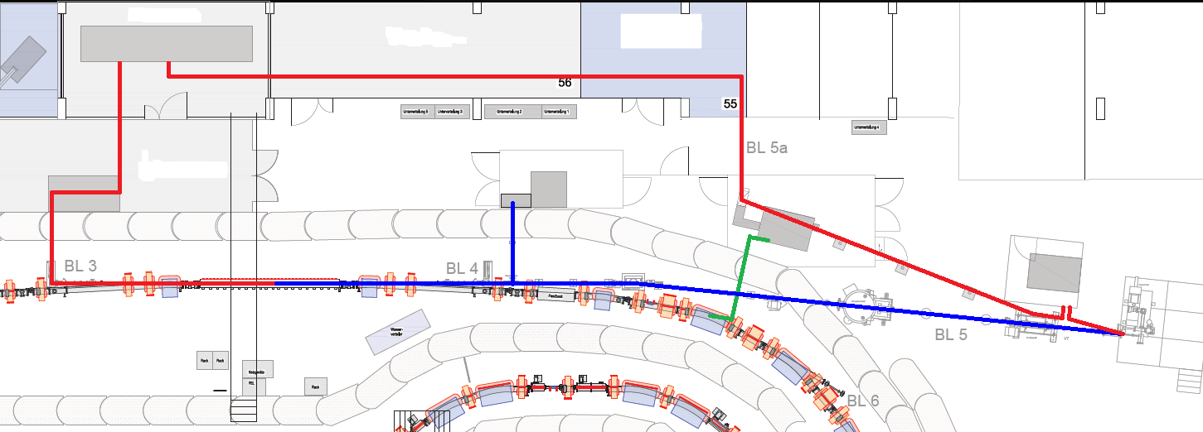

DELTA short pulse facility
3
laser laboratory
diagnostics beamline
pump laser hutch
pump pulse
seed pulse
telescope tank
THz beamline
CHG
THz
U250 undulator
VUV beamline
Laser properties
wavelength | 800 nm
pulse duration | 40 fs
pulse energy | 8 mJ
repetition rate | 1 kHz
DELTA properties
electron energy | 1.5 GeV
bunch length | 100 ps
single bunch current | 20 mA
revolution frequency | 2.6 MHz

Slide 4
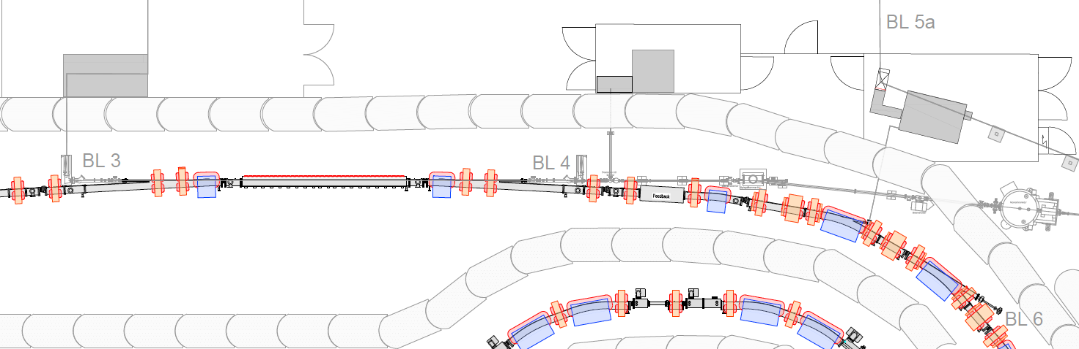
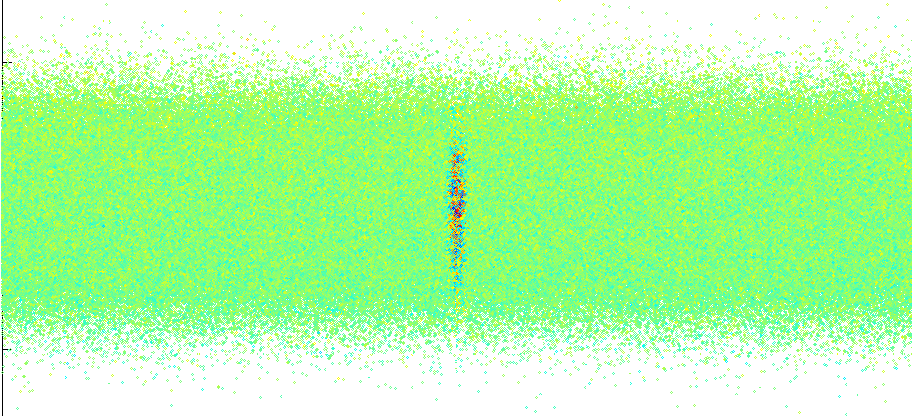
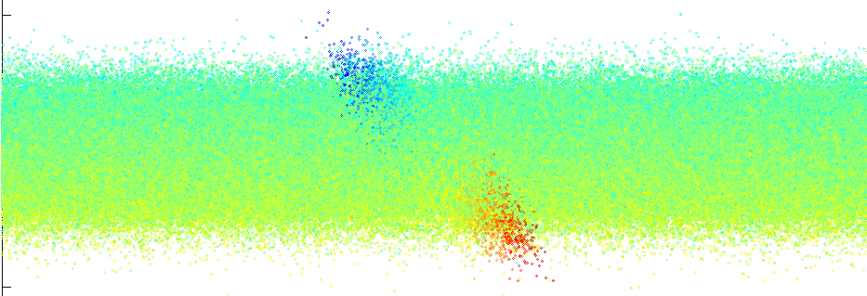
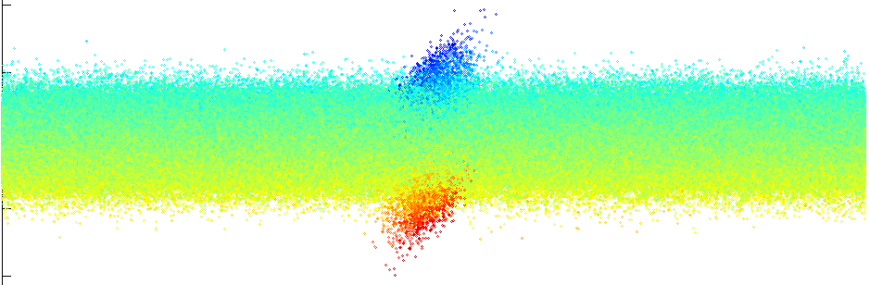
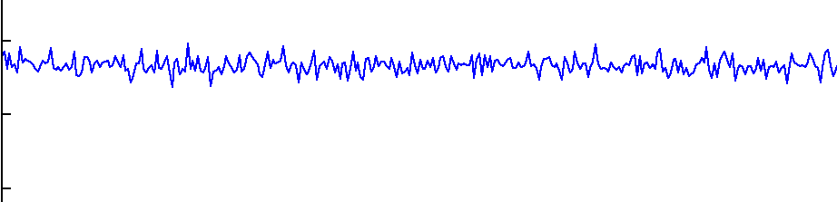
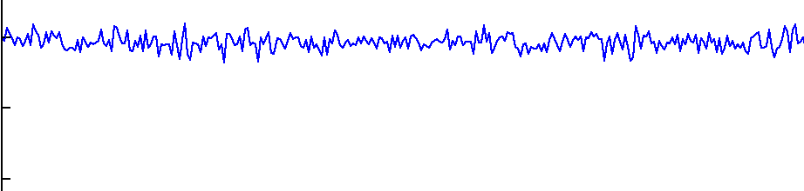
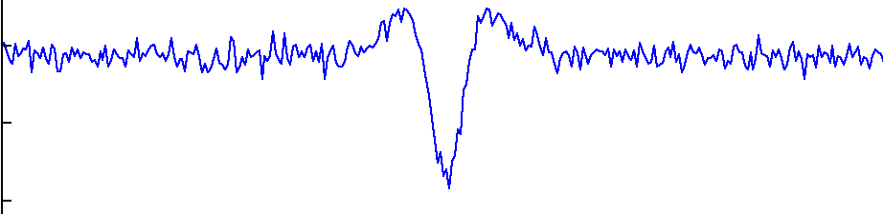
Coherent THz radiation
electromagnetic undulator
THz beamline
development of the electron density
x
s
x
s
x
s
x
s
ρ(s)
1 mm
3,3 ps

Slide 5
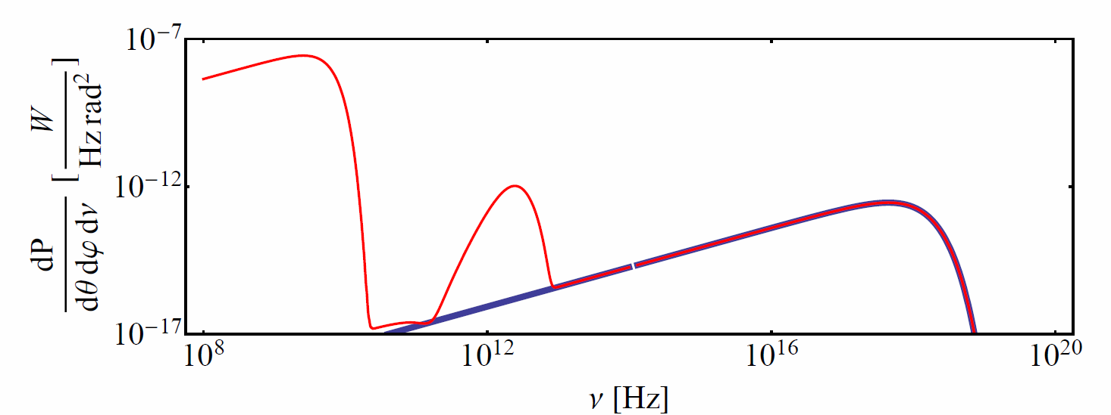
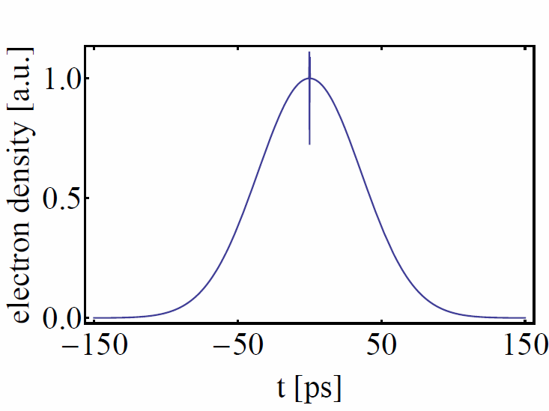
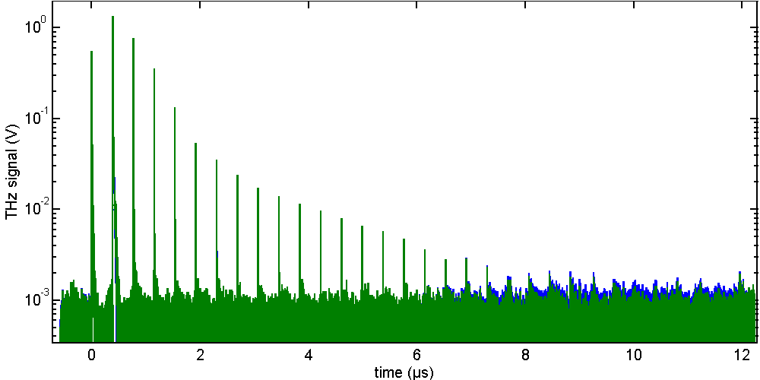
Coherent THz radiation
coherent THz radiation
turn 0
one storage ring revolution period
turn 5
turn 10
turn 15
turn 19

Slide 6
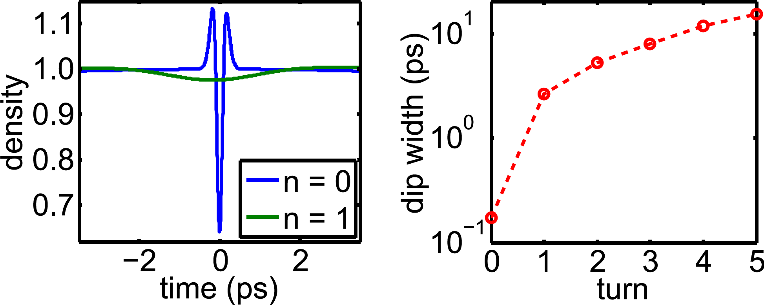
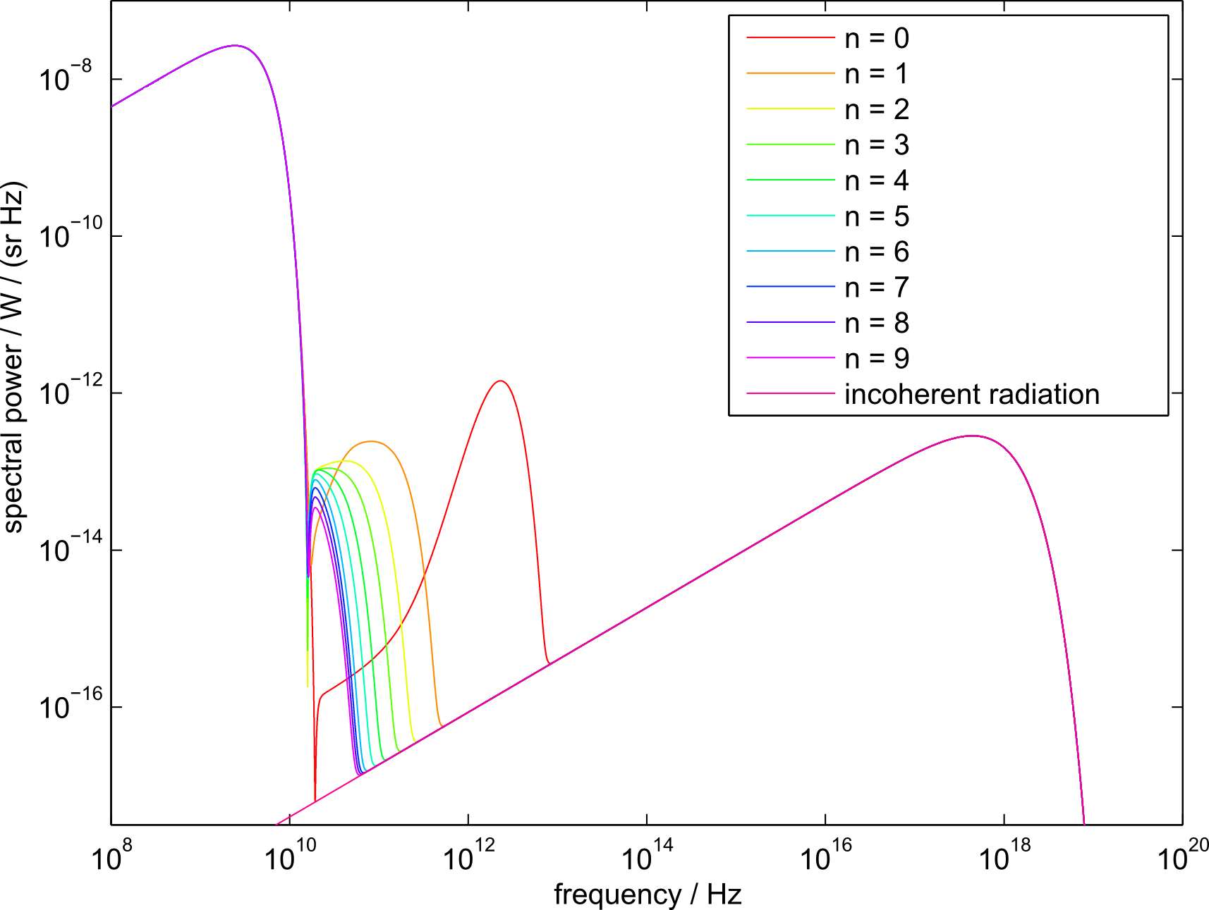
Multi-turn evolution (simulation)
L.-G. Böttger, BSc. thesis, Dortmund (2013)

Slide 7
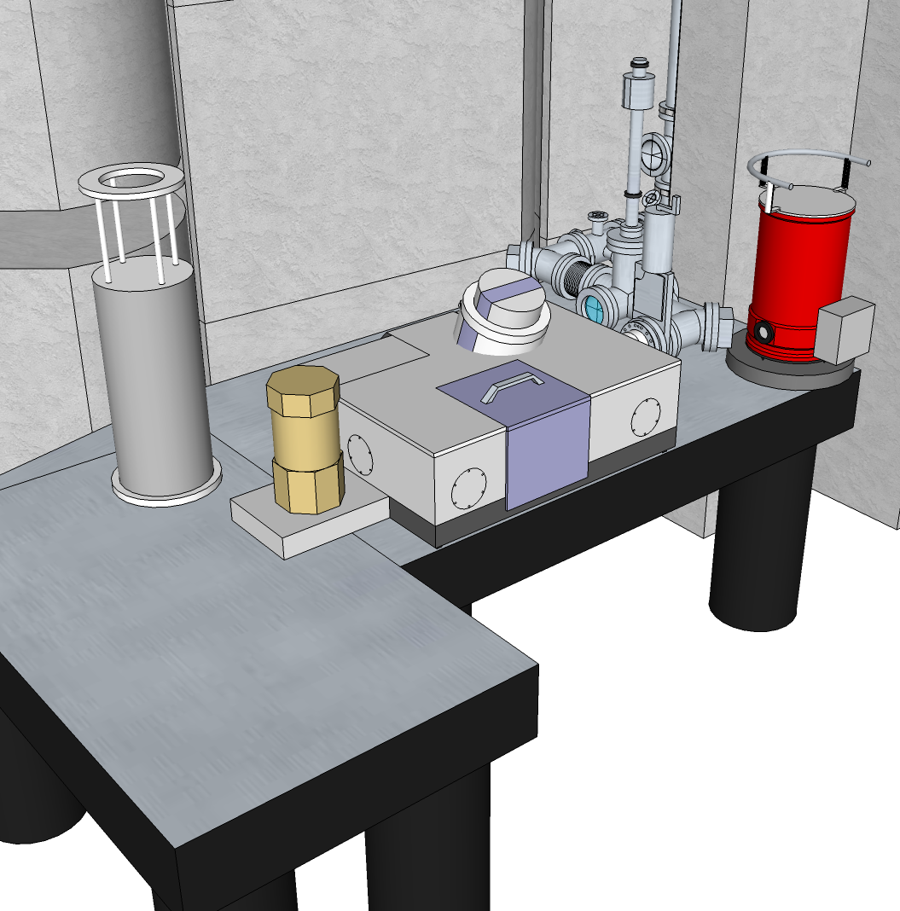
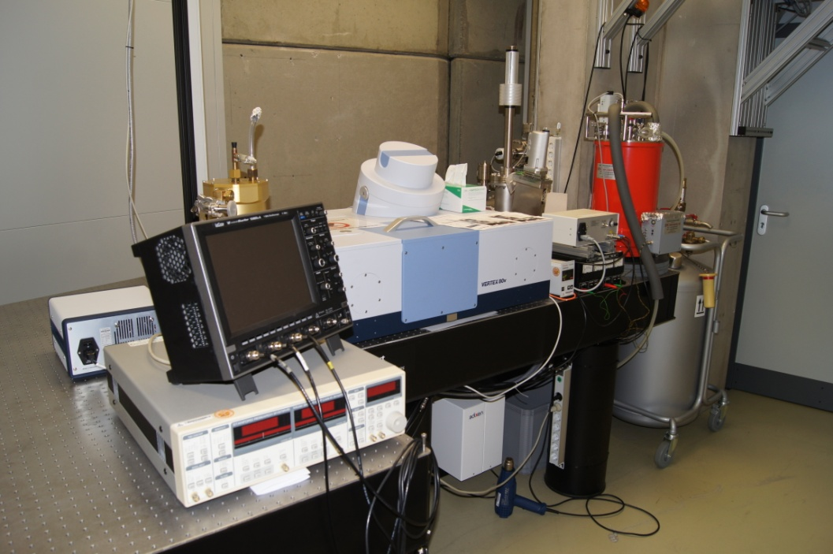
THz beamline
InSb bolometer
Bruker Vertex 80v
spectrometer
YBCO
detector
Si bolometer

Slide 8
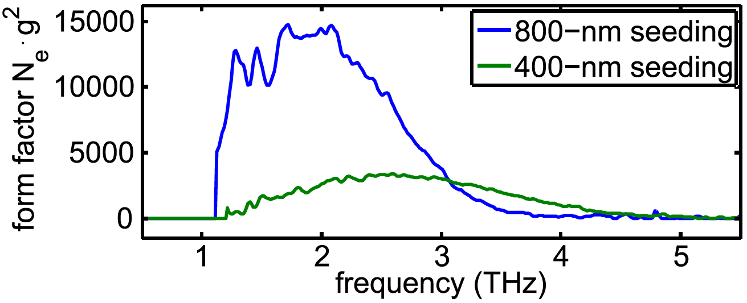
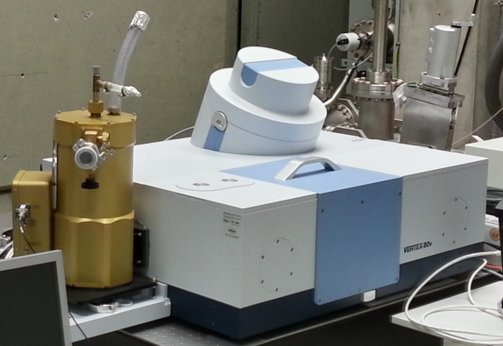
Broadband THz radiation
Fourier transform
FT-IR spectrometer
Si bolometer
spectral range: 1.2 – 7 THz
2nd spectrometer under
construction

Slide 9
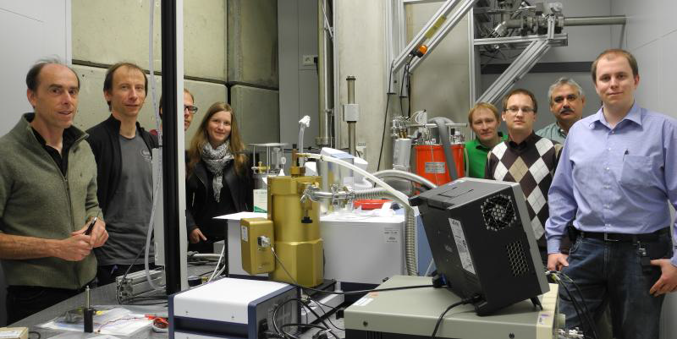
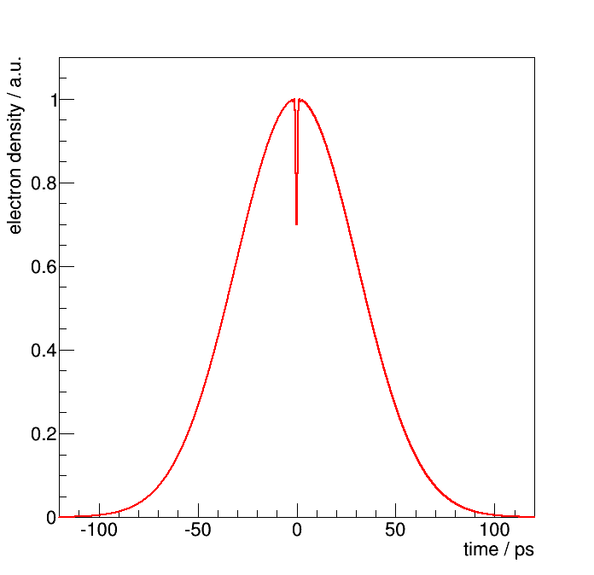
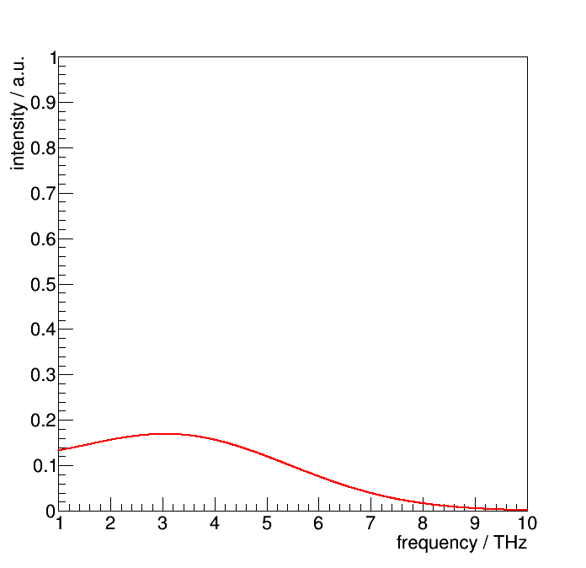
Narrowband THz radiation
cooperation with PhLAM, Lille
multi-dip modulation of the electron bunch
leads to narrow THz spectrum
idea: modulate long, chirped laser pulse with Michelson interferometer
first realized at UVSOR
Simulation:

Slide 10
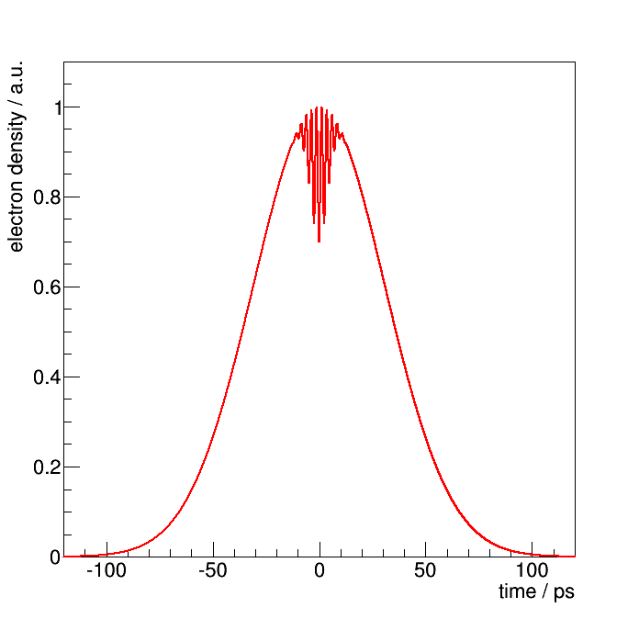
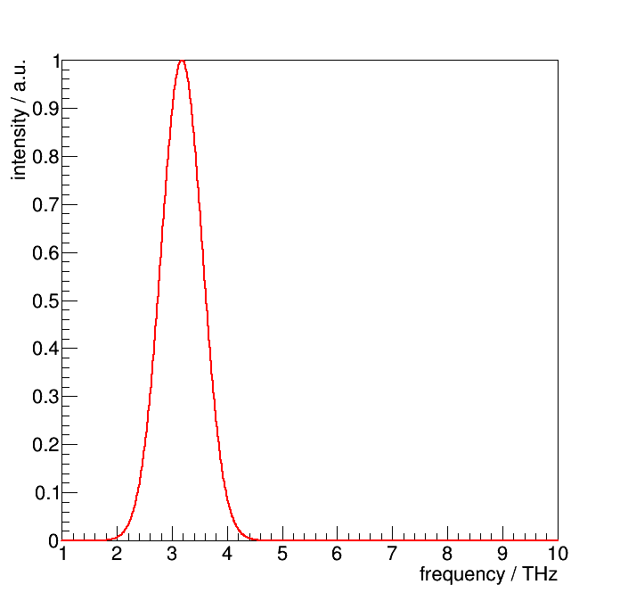
Narrowband THz radiation
cooperation with PhLAM, Lille
multi-dip modulation of the electron bunch
leads to narrow THz spectrum
idea: modulate long, chirped laser pulse with Michelson interferometer
first realized at UVSOR
Simulation:

Slide 11
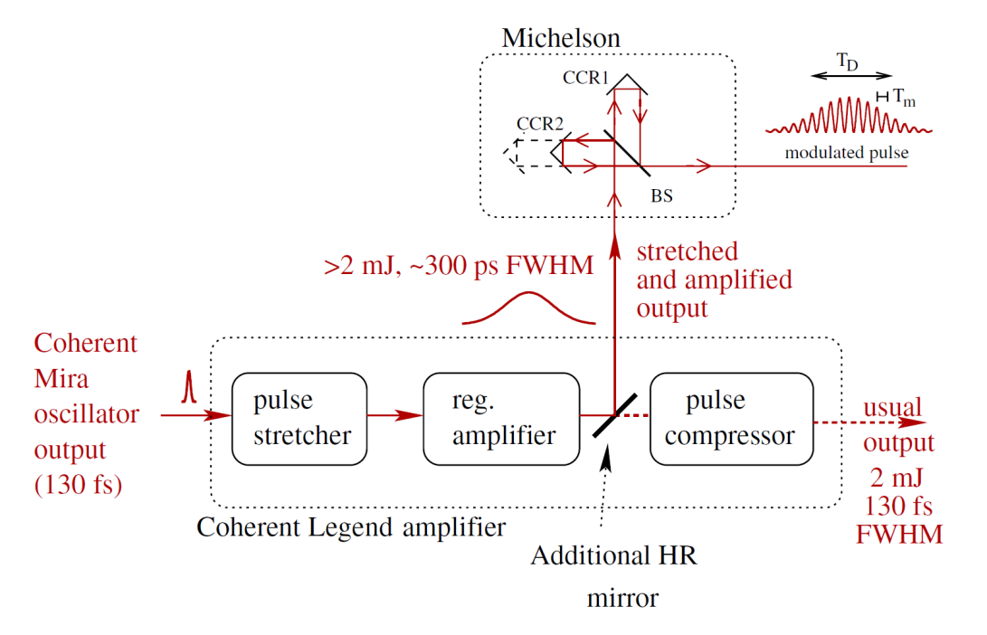
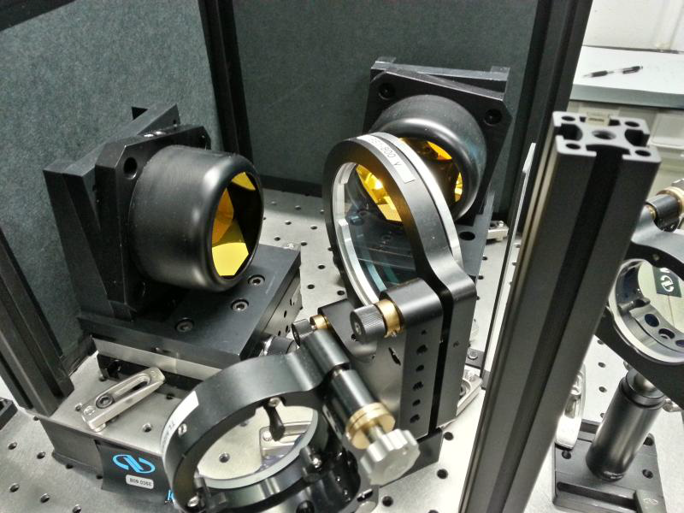
Narrowband THz radiation
cooperation with PhLAM, Lille
multi-dip modulation of the electron bunch
leads to narrow THz spectrum
idea: modulate long, chirped laser pulse with Michelson interferometer
first realized at UVSOR
S. Bielawski et al., Nature Physics 4, 390 (2008)
C. Evain et al., PRST-AB 13, 090703 (2010)

Slide 12
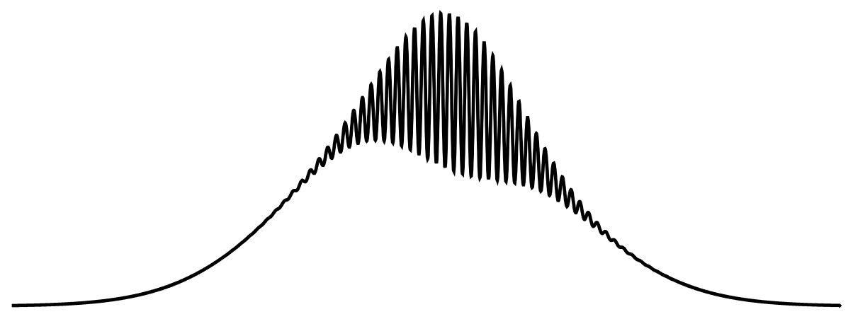
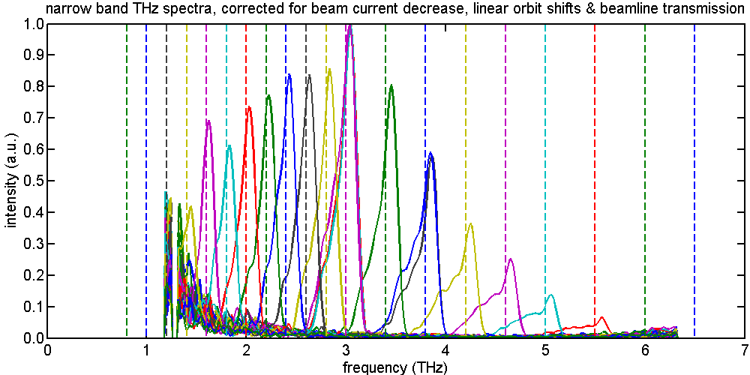
Generation of narrowband THz radiation
laser pulse shape measured
by autocorrelator:
resulting THz spectra:
2 THz mod. freq.
11 ps
DELTA: radiation up to 5.5 THz
UVSOR: limited to 0.7 THz

Slide 13
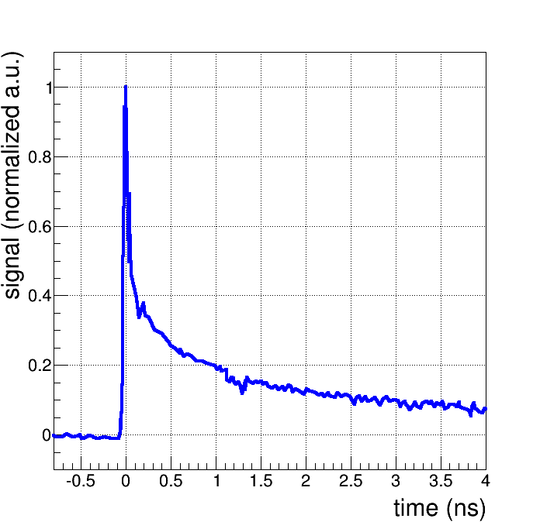
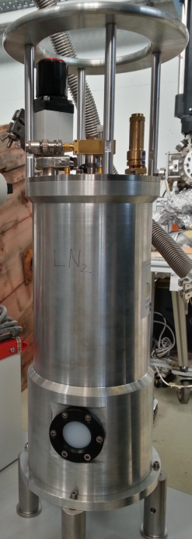
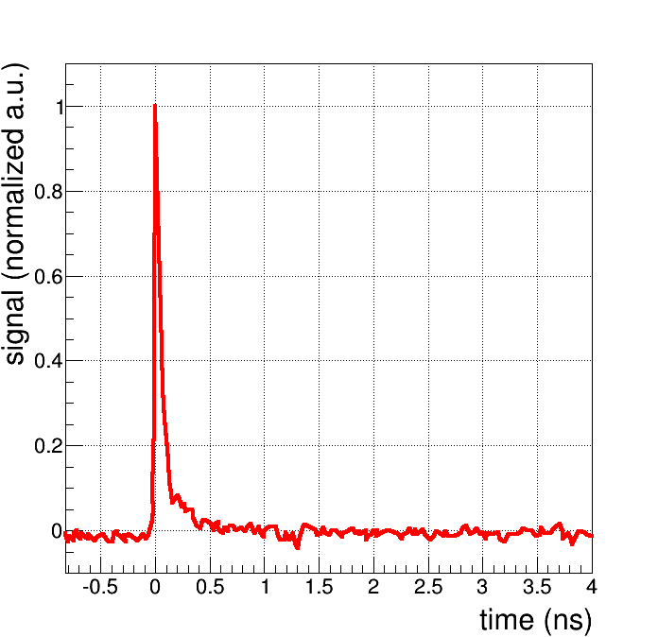
First user experiment
  f > 3 THz :
  bolometric response
YBCO detector:
frequency-dependent
detection mechanism
  f < 3 THz :
  direct electric
  field detection

Slide 14
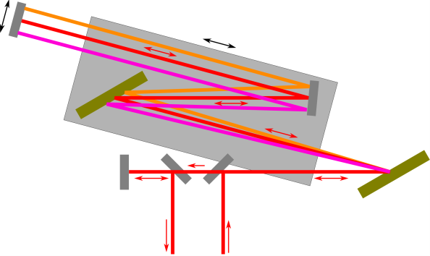
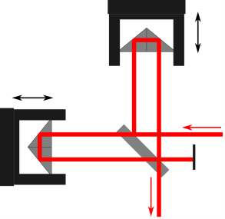
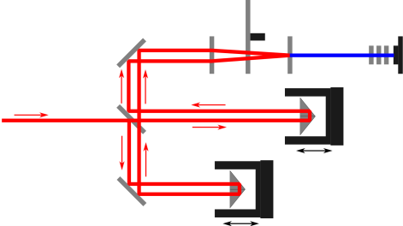
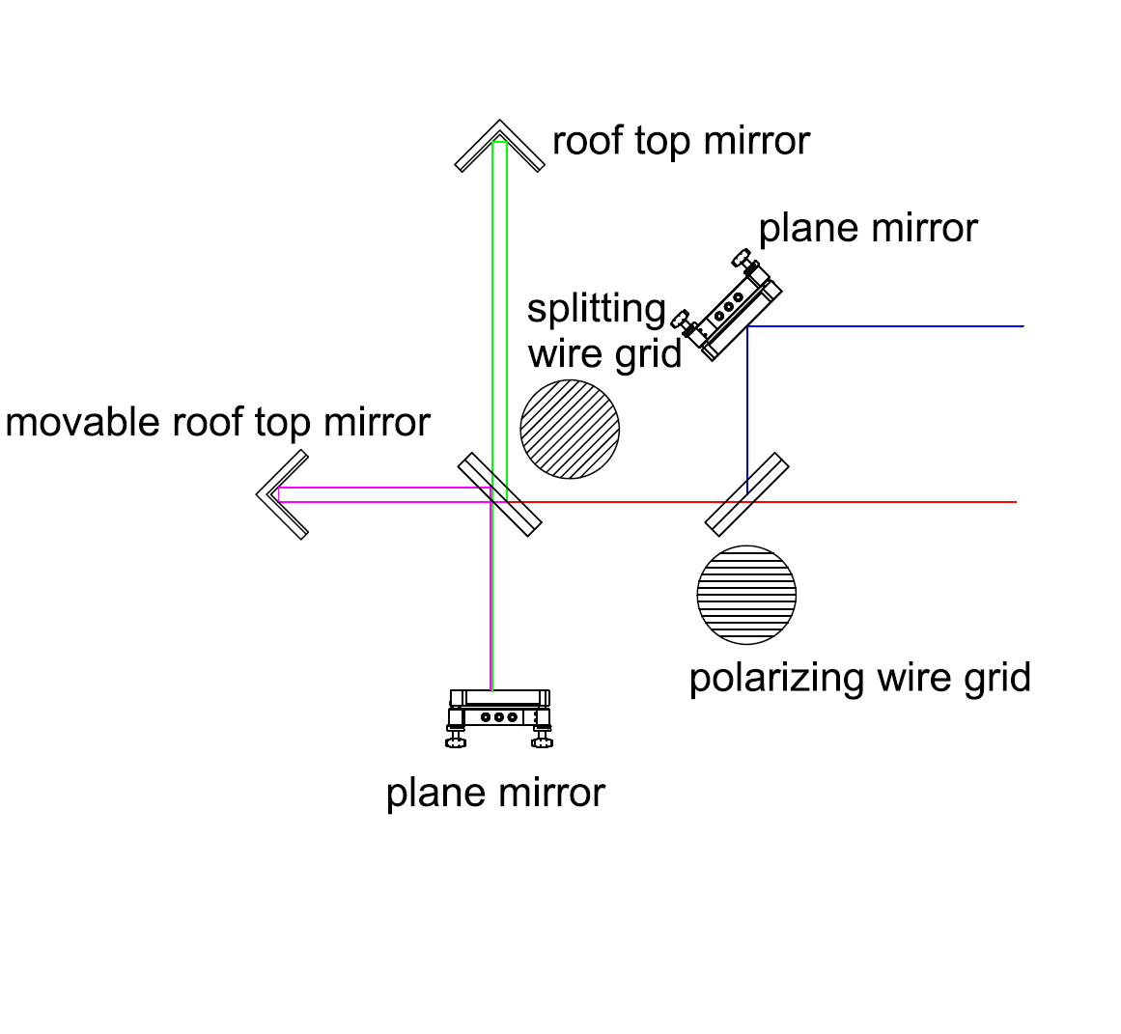
Summary & Outlook
generation of broadband and narrowband coherent THz radiation
first user experiment already carried out
optimized, permanent setup for narrowband THz radiation forseen
further decrease of spectral width / improve spectral shape
polarizing spectrometer for sub-THz range
under construction

Slide 15











It is a pleasure to thank our colleagues at DELTA as well as the technical and administrative staff of the TU Dortmund for supporting this project.
The project has profited from colleagues at other institutes:
This work was funded by:
Thank you for your attention!

