Slide 1


SOLARIS Status
Adriana I. Wawrzyniak
On behalf of Solaris Team
NSRC Solaris
Jagiellonian University
Czerwone Maki 98
30-392 Krakow
www.synchrotron.uj.edu.pl
adriana.wawrzyniak@uj.edu.pl

Slide 2

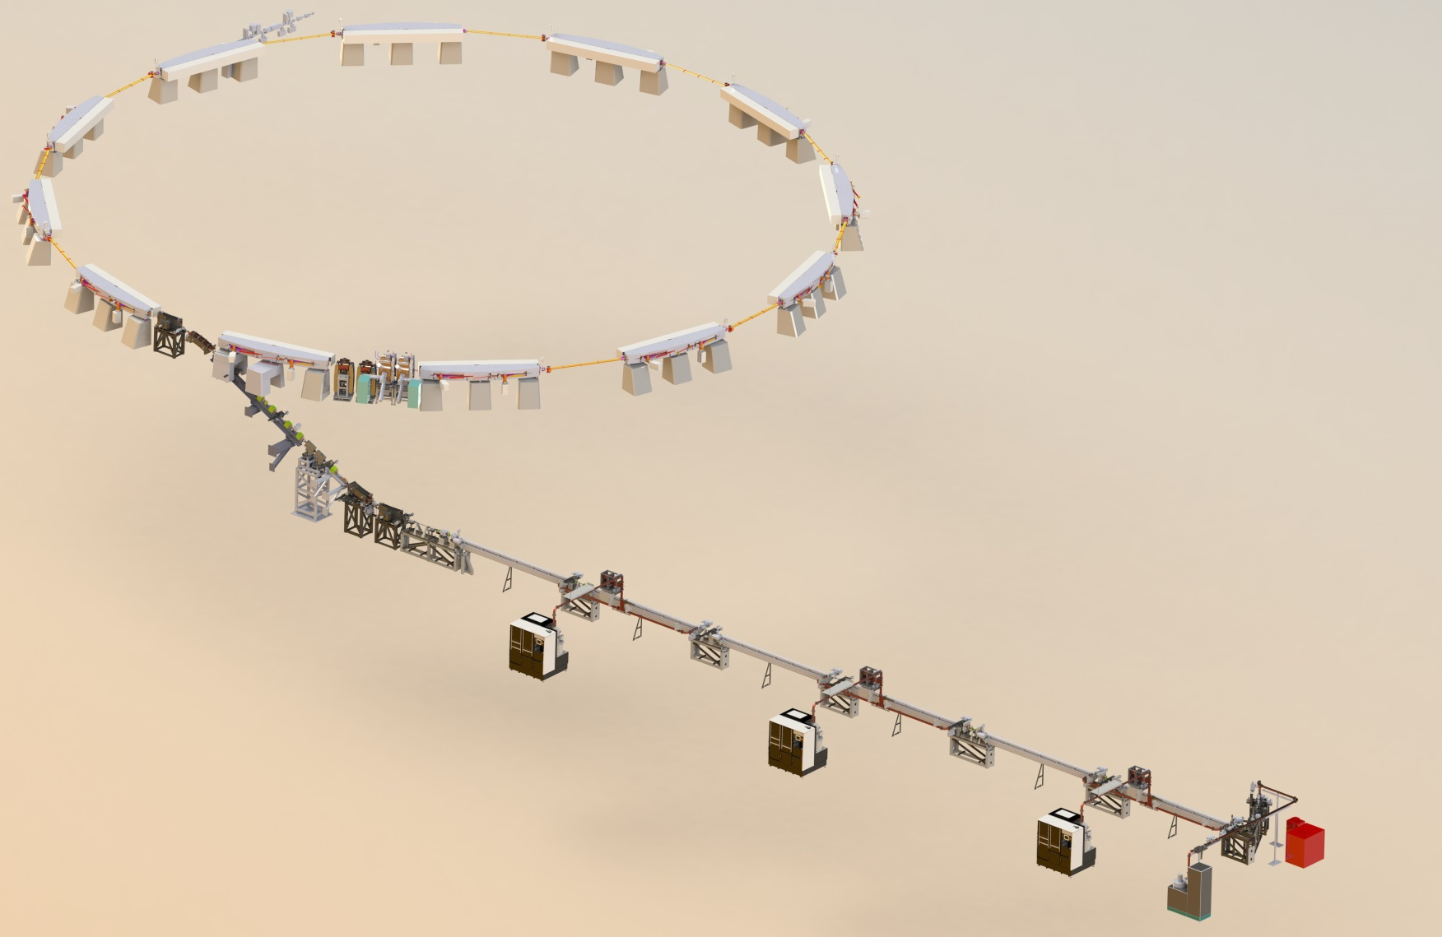
Overview
SOLARIS - 3rd generation light source facility being built in Krakow, Poland at the Jagiellonian University Campus.
600 MeV Injector:
Thermionic RF Gun
6 accelerating structures
Transfer line with DC septum
Normalized emittance 10mm mrad
Energy spread <0.2%
1.5 GeV Storage Ring
12 DBA magnet blocks
100 MHz RF system
300 MHz Landau Cavities
Injection dipole kicker
Ramping
2 Beamlines
Energy | 1.5 GeV
Current | 500 mA
Circumference | 96 m
Emittance (bare lattice) | 5.982 nm rad
Tunes Q_{x}, Q_{y} | 11.22, 3.15

Slide 3
Overview
Tight collaboration with the MAX IV Laboratory in Lund, Sweden.
  Agreement established between Jagiellonian and Lund Universities for mutual cooperation in the construction of Solaris based on MAX IV.
  MAX IV freely giving all know-how, reports, designs, info on tenders, training, ..., to Solaris
  Solaris team (technical) is hosted at MAX IV and participate in project activities and training. Sharing of mutual resources and also providing a support to MAXIV.
  Procurements for Solaris are as options in MAX IV tenders.
Budget 50 M€ financed by the European Regional development Fund. The money covers:
People/Services (16%)
Buildings and laboratories (~23%)
Accelerators (32% Storage Ring, 16% Linac)
2 beamlines (13%)
Land donated and administrative support by the Jagiellonian University

Slide 4




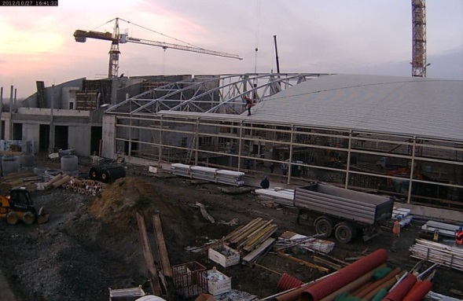
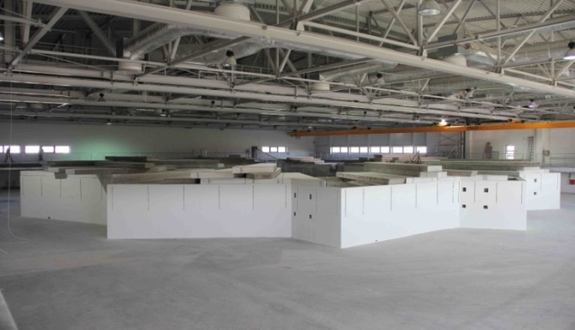
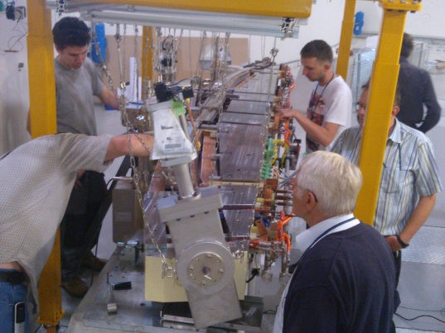
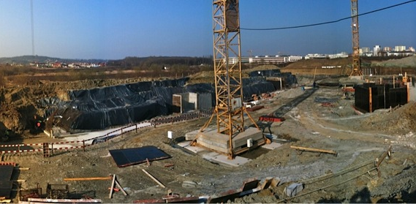
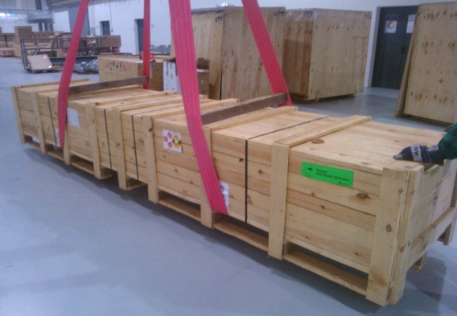
Time Schedule
Timetable
deadline: April 2015 – 5 months to go
2010
2014
2015
2013
2011
2012
Building,design,specs,learning,specs,tenders,contracts, tenders,learning,contracts,tenders,building....
Installation,
start-up

Slide 5
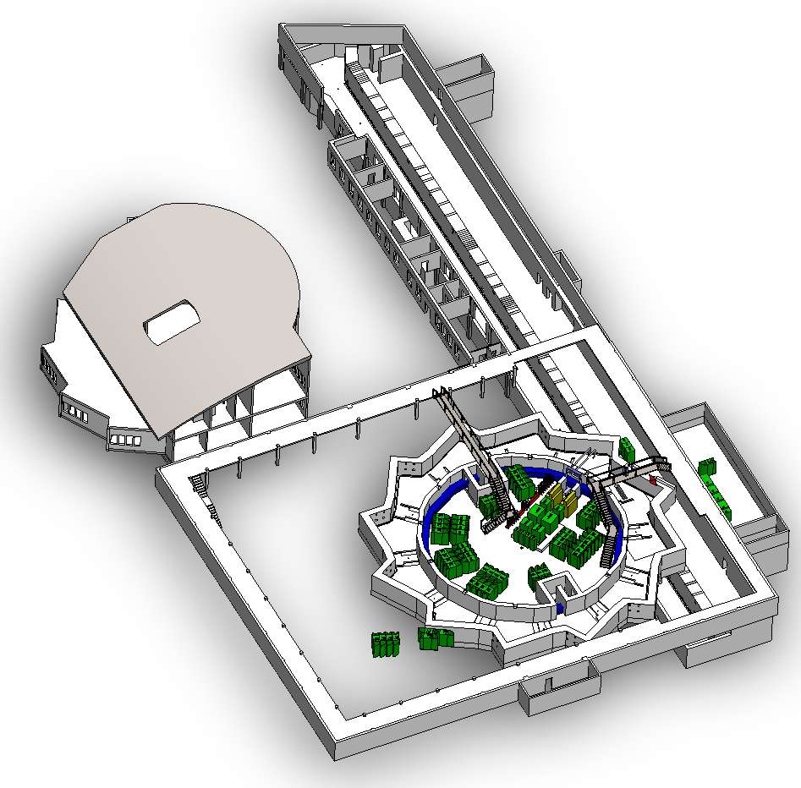
Building Status
Building handover: May 2014
~12 m
Building systems being “commissioned”
Electrical Systems – Functional
HVAC – Functional.
Demi water system and backbone – functional Stable conductivity since 4th September 2014: 0,5µS/cm
Oxygen control being implemented
95% Storage Ring roof slabs removed to allow installation
Iron shield plate on Front End walls in place.
Concrete supports for storage ring magnets in place.
Shield wall holes will be filled with bags of baritic concrete and plugs
False floor in service gallery in place
Cranes upgraded and functional
All linac shield wall holes filled (cable, piping and waveguide) – will adjust during operation
Linac & Technological Tunnels
Office s
~110 m
Experimental hall
50 m
60 m

Slide 6
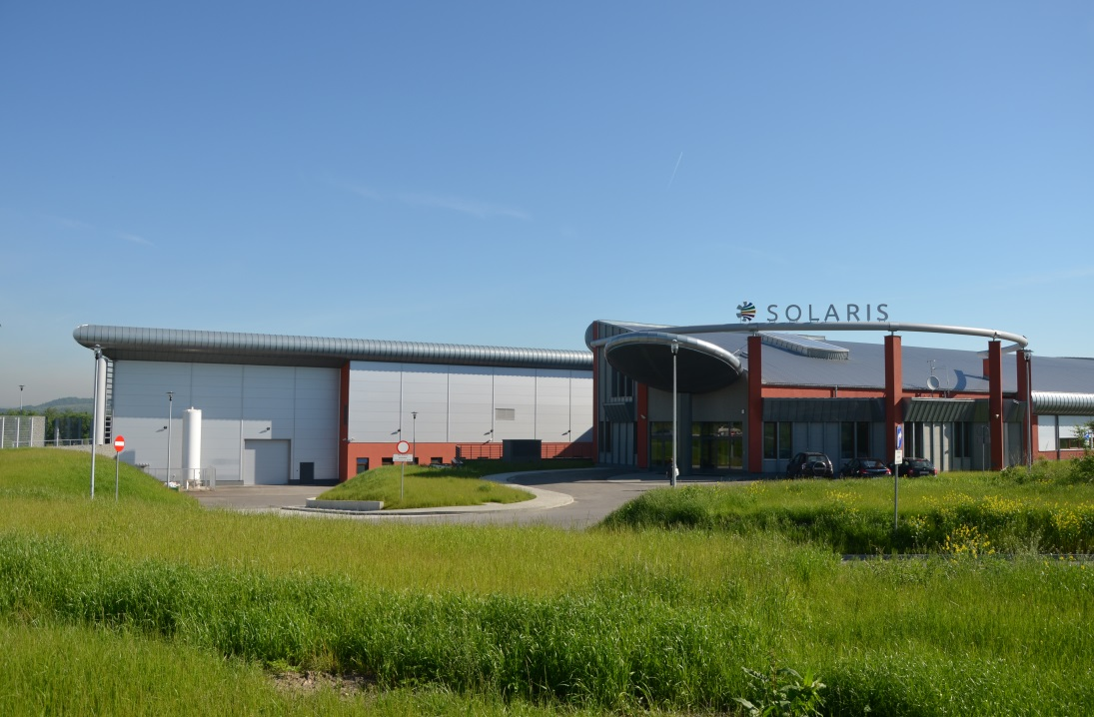
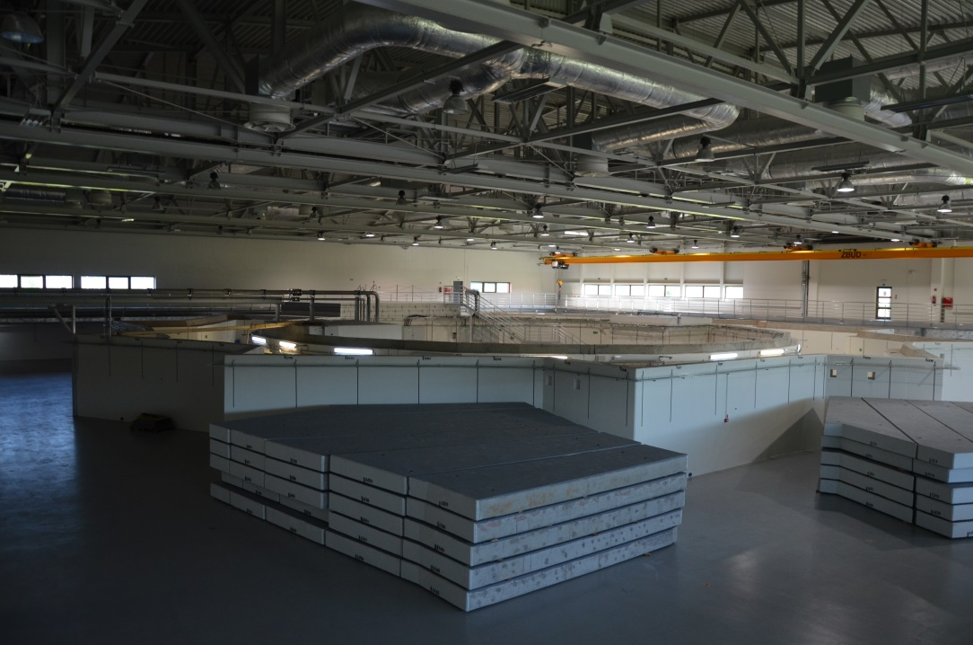
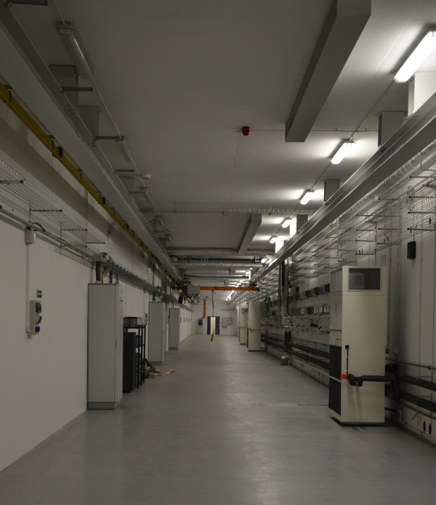
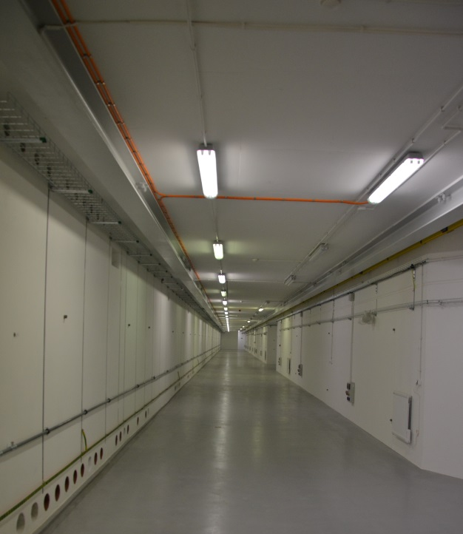
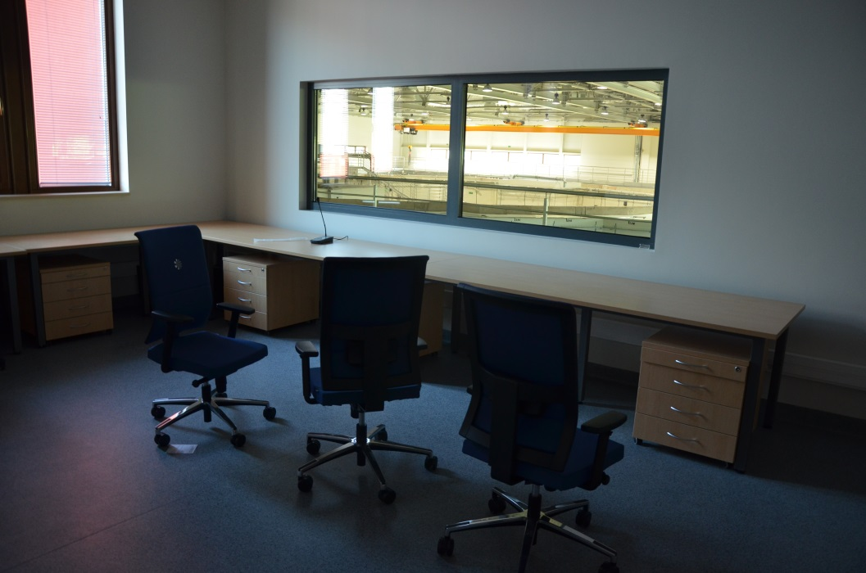
Building Status
May 2014
Monday, 22 September 2014
A.I. Wawrzyniak, Synchrotron SOLARIS - ALBA, Barcelona, Spain
6

Slide 7
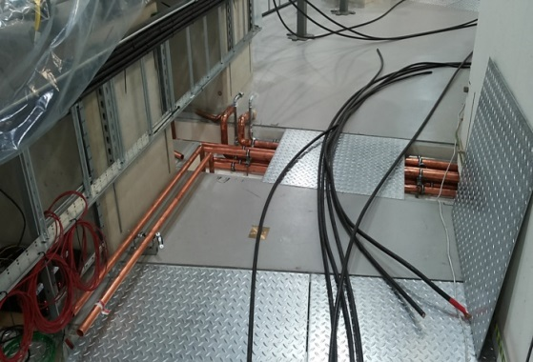

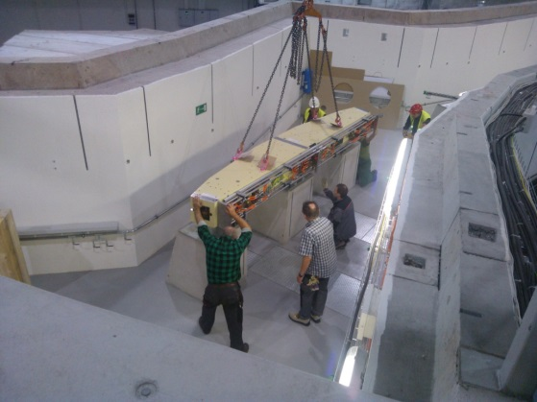

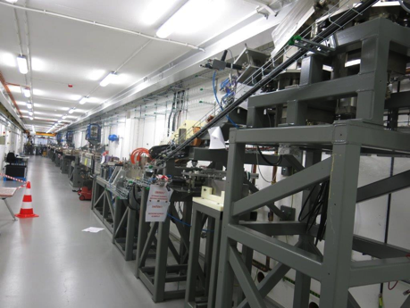

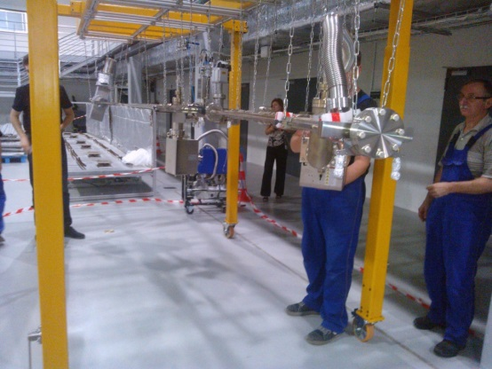
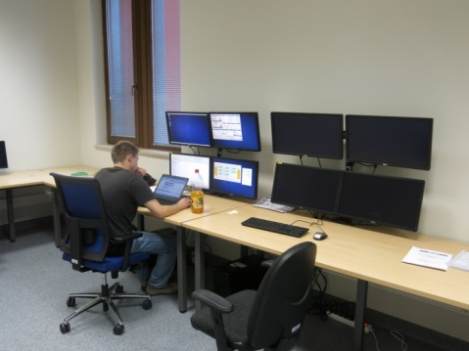
Installation Services
Installation tenders all operational. The contracts are sufficiently flexible to adjust for differences.
Cabling (ZSK)
Plumbing (ZSK)
PLC and PSS (ZSK)
Some delays with the design work for the piping
Minor delays with purchasing of some cables
Logistics (Dudmet)
Mechanical Constructions for stands, supports, strong-back, etc
Vacuum installation (NCBJ Świerk)
Dynamic resource assignments
Control system integration (Cosylab)

Slide 8
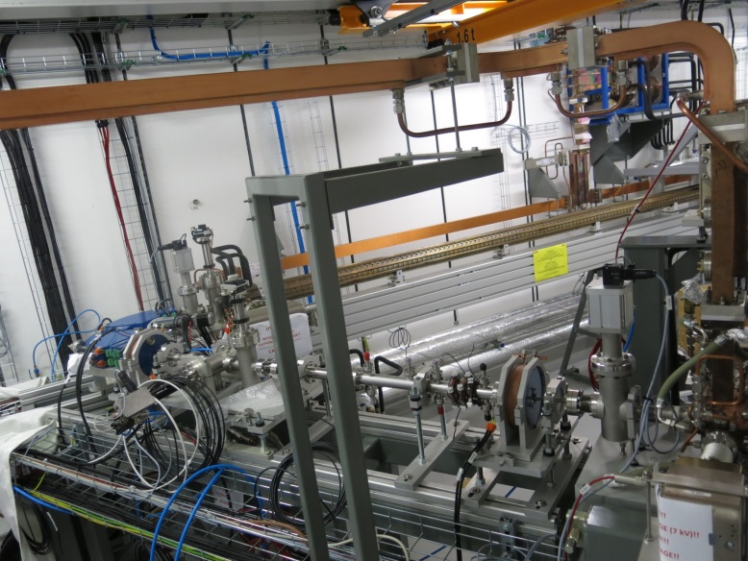
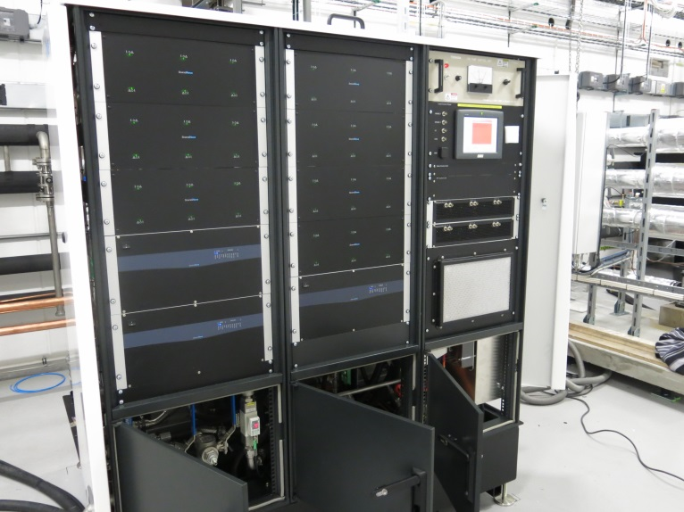
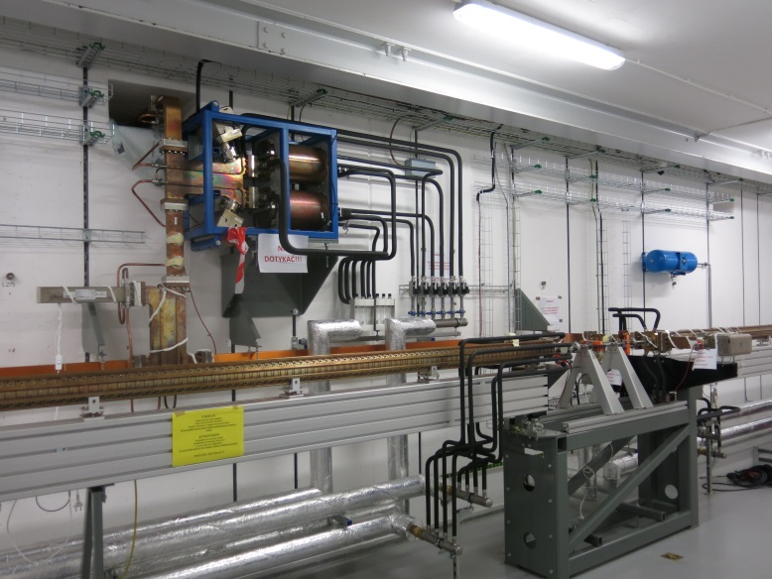
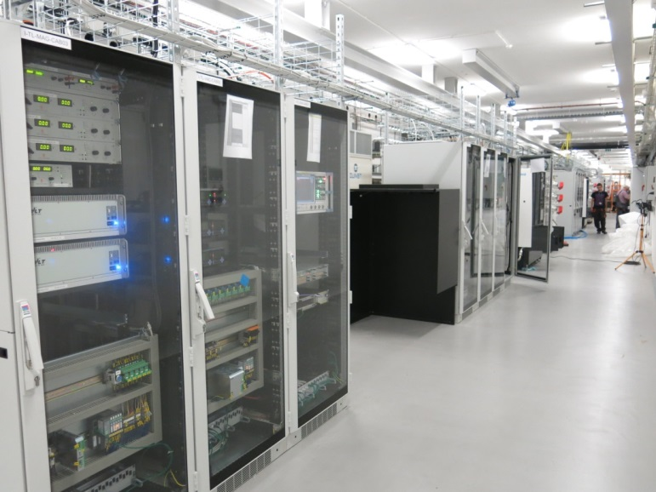
Injector status
Gun System
Delivered and positioned in tunnel
Still to place kicker PS and connect
Minor issues to resolve (cooling connections, mirror to view cathode, wrong waveguide length)
Gun & Linac Modulators:
SAT performed and operational
Linac Structures
Linac, SLED & Waveguides installed
Intersections with magnets and diagnostics installed
Racks with Instrumentations and Power Supplies
RF Linac Conditioning starts November, 17th
Gun conditioning depends of waveguide
Beam tests ~ December (depends on gun)
Piotr Goryl

Slide 9
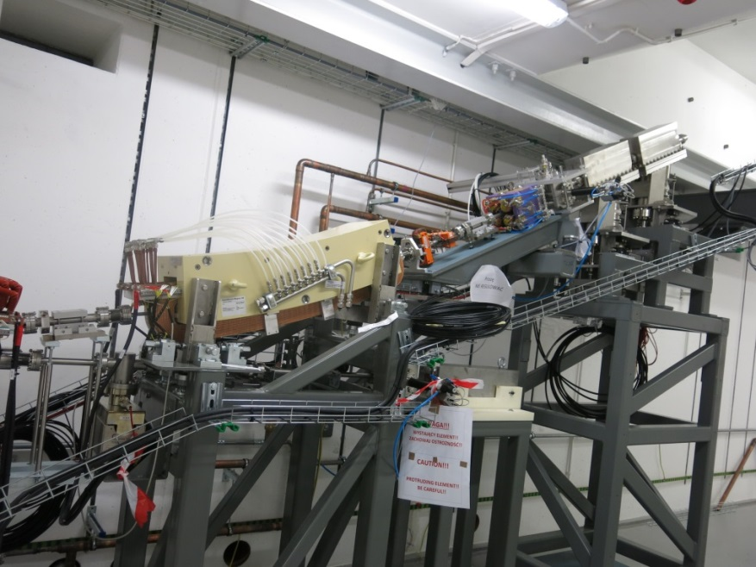
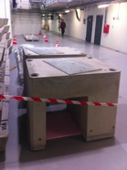
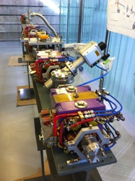
Transfer line and Injection
Transfer Line
Lower part of Transfer Line installed to beam stops. Cables (disconnected) and piping ready.
Upper part pre-assembled and waiting for alignment
Upper part will be installed last (mid-Feb)
Mock-up made and used to verify installation from above.
Temporary shielding over TL holes for Linac operation
Special SR DBA magnet stands manufactured and ready for installation
Injection
Kicker, pinger and power supplies from BINP delivered last week.
Team from BINP is present at Solaris this week to assemble and test the equipment.

Slide 10
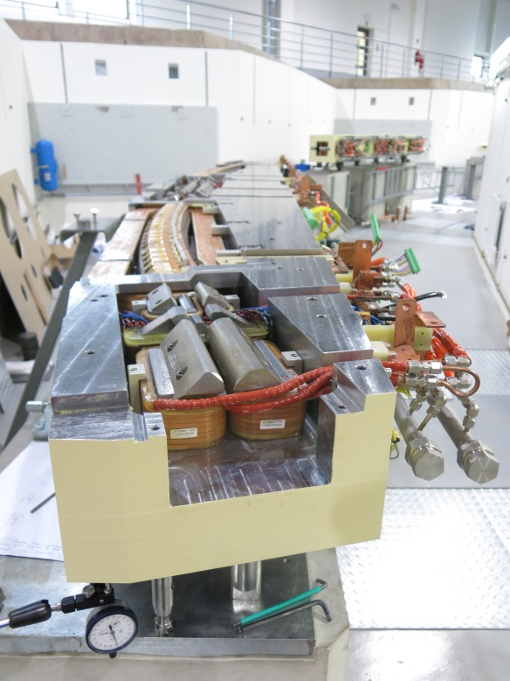
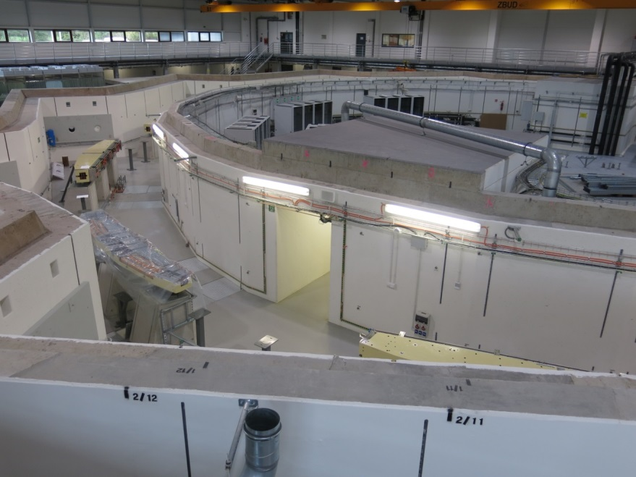
Storage Ring Magnets
Magnet yokes of 1 DBA cell are machined from one solid iron block; high precision of 25µm, ~4.5 m, ~7.5 Tons
All Magnets delivered, 10/12 placed on stands in storage ring.
Encountered greater sag of lower half than expected (~600 to 700 µm, expected (FEM) ~10 µm)
Caused delay for installation
Resolved by rectification procedure Installation time including corrective procedures & tests ~30 hours
One coil may have isolation problems (being solved)
One magnet not accepted (out of spec gradient) and substituted by MAX IV’s 1st magnet.

Slide 11

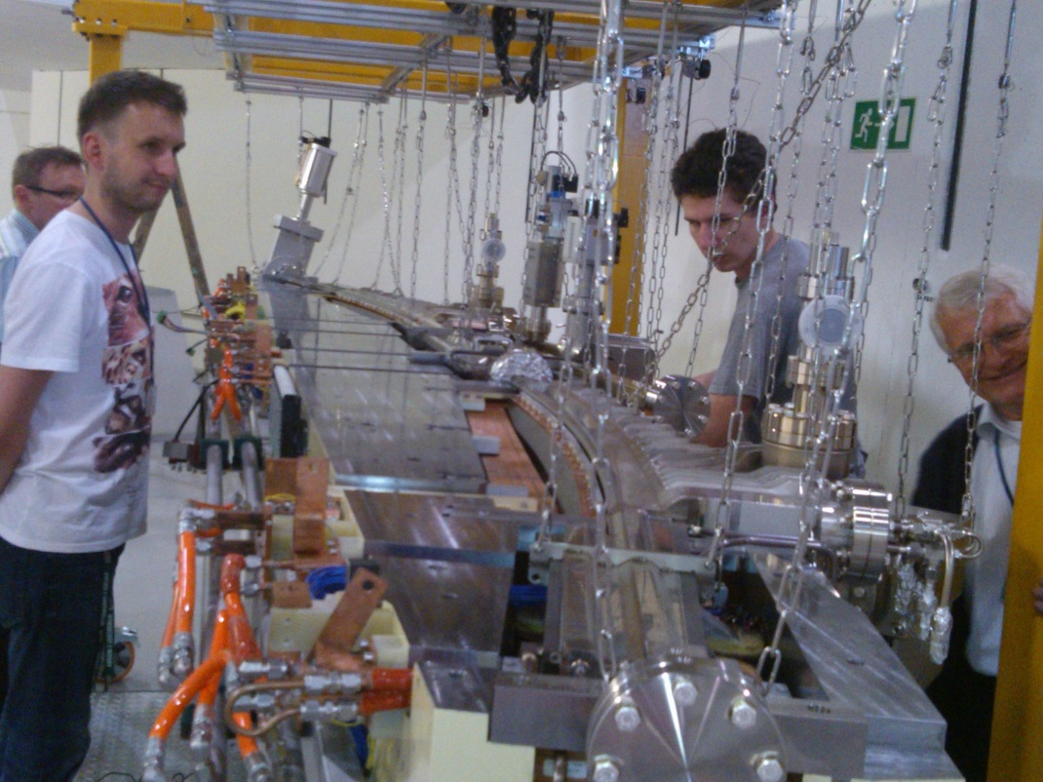
Storage Ring
Vacuum Chambers
Storage ring vacuum chambers being manufactured at FMB Berlin.
Delivery of DBA chambers come with assembled photon absorbers
Two DBA chambers have been delivered end of June 2014, assembled, baked and installed, BUT…

Slide 12
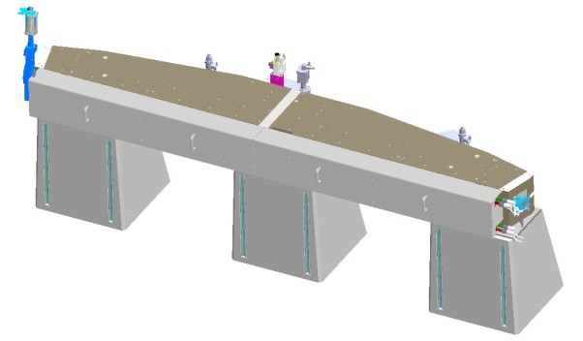
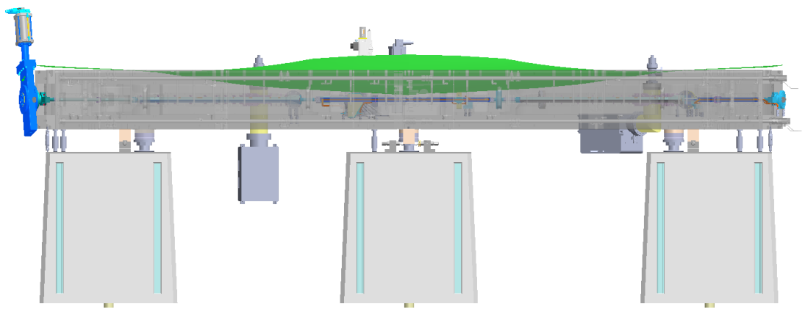
Storage ring installation
Problems with the achromat and VK’s #1
During the installation and assembling of the magnet and achromat vacuum chamber, following problems have appeared:
Achromat sags more than anticipated from FEM calculations
  FEM results: ~10 µm for both half's of the magnet
  Reality: ~500 µm
  (proved by independent measurements using laser tracker, measuring arm; spirit level, and confirmed from Danfysik measurements and from milling factory)

Slide 13
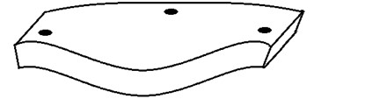
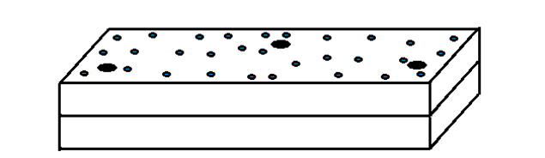
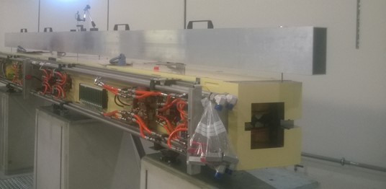
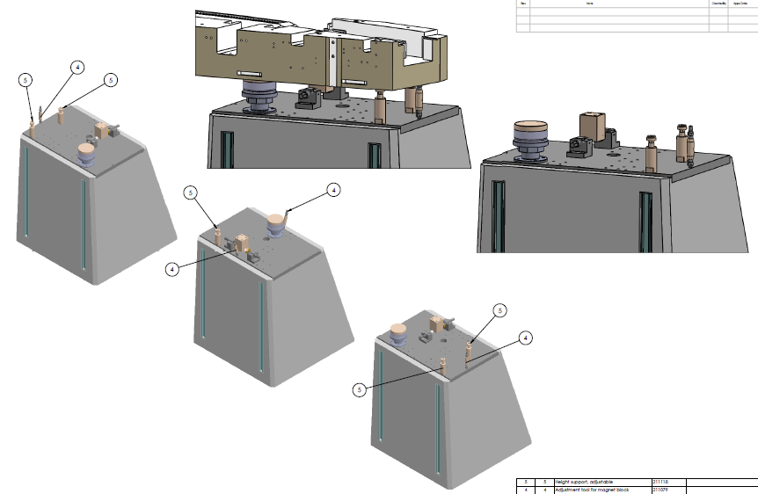
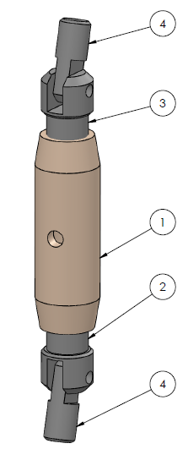
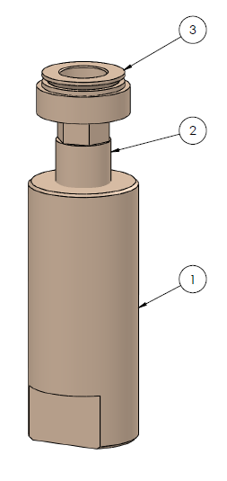
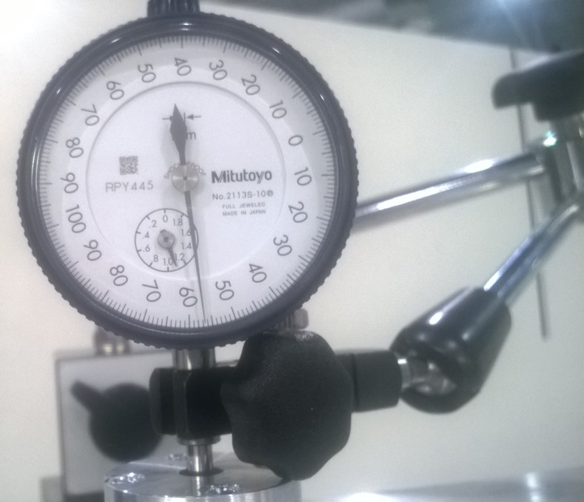
DBA Magnets Sag
DBA magnet weights 7.5 tones and is supported by 3 feet, therefore it may sink of its own weight.
The approximate shape has two maxima at trailing and leading edges and minimum in the middle of length on the inner side.
We believe that deformation affects only decoupled yokes. The block is rigid when yokes are joined with 35 M16 bolts
We measured and rectified this deformation using dedicated instruments:
sag measuring beam
clamp
actuator
dial gauges

Slide 14
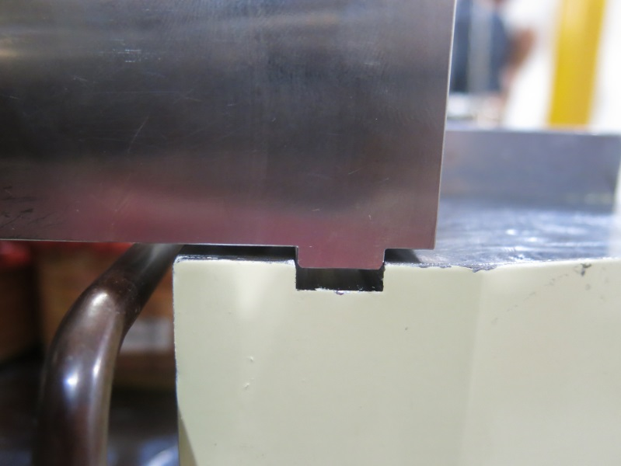
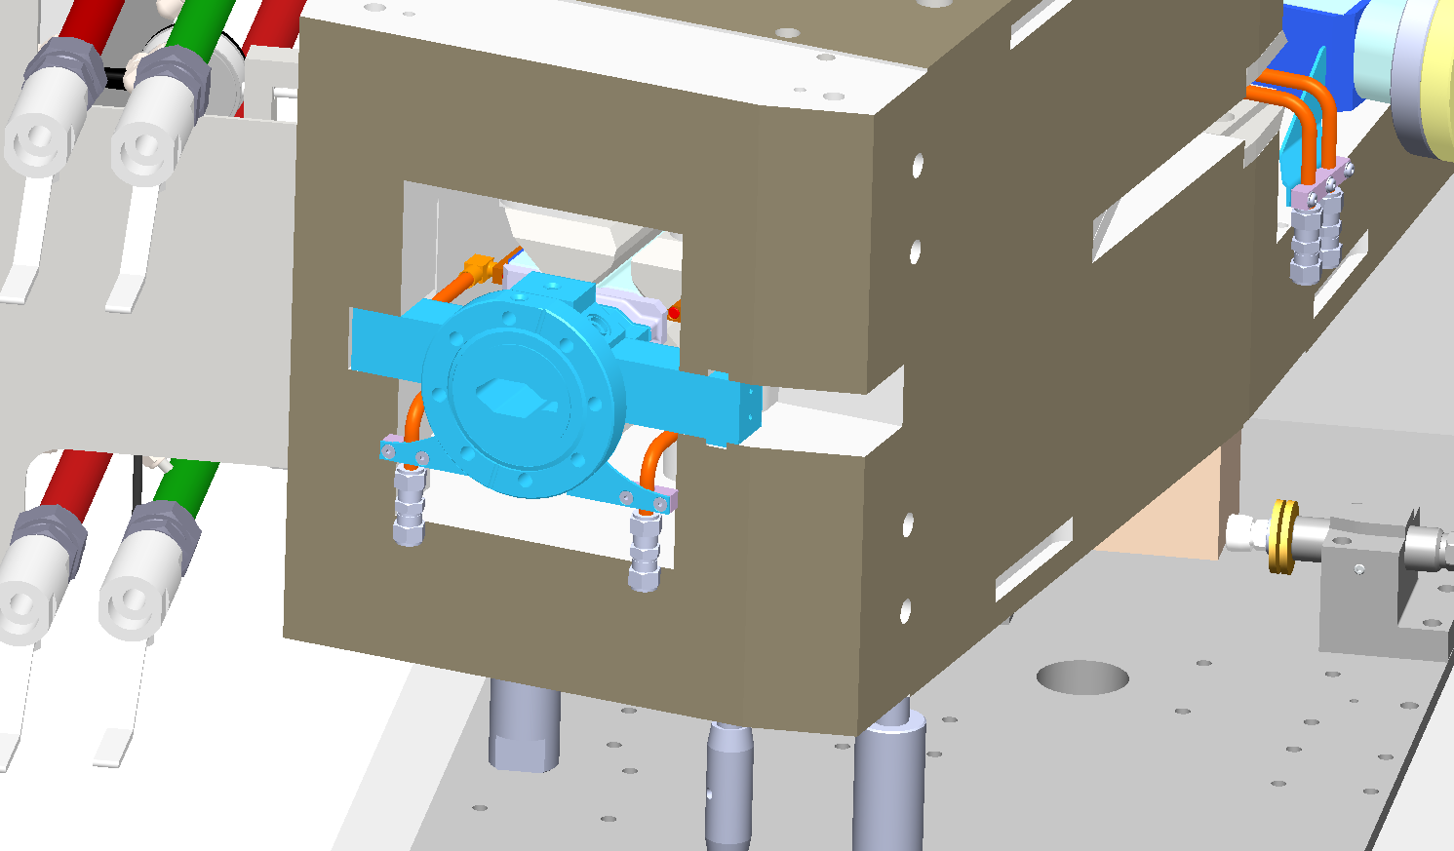
Storage ring installation
Problems with the achromat and VK’s #2
During the installation and assembling of the magnet and achromat vacuum chamber, following problems have appeared:
Wrong tolerances between the two cooperating components: the peg of the BPM and the groove of the magnet. These problems are being corrected by shaving material off the top surface.
Phot. D. Einfeld

Slide 15
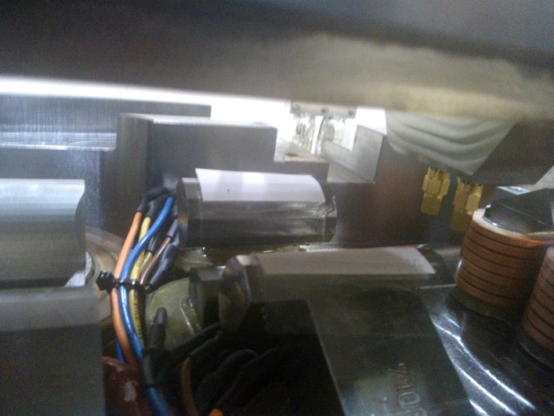
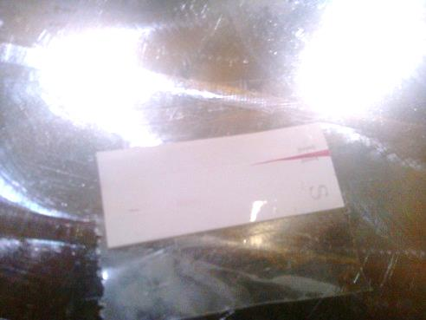
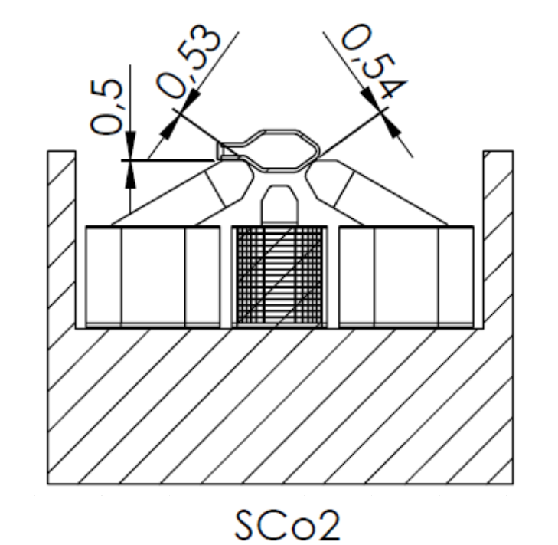
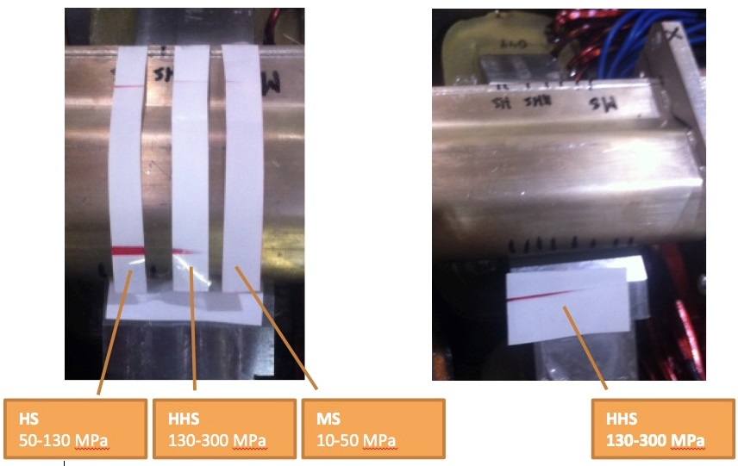
Storage ring installation
Problems with the achromat and VK’s #3
During the installation and assembling of the magnet and achromat vacuum chamber, following problems have appeared:
Collision between the vacuum chamber and the sextupole magnets inside the achromat
Phot. P. Bulira

Slide 16
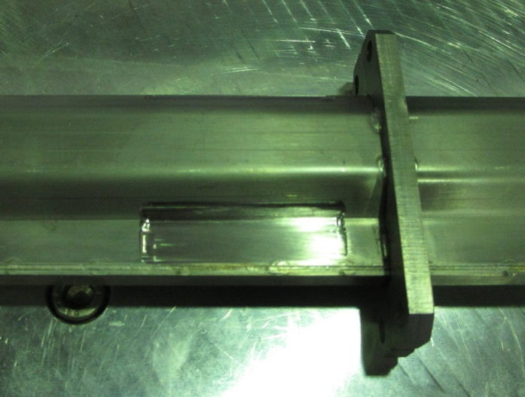
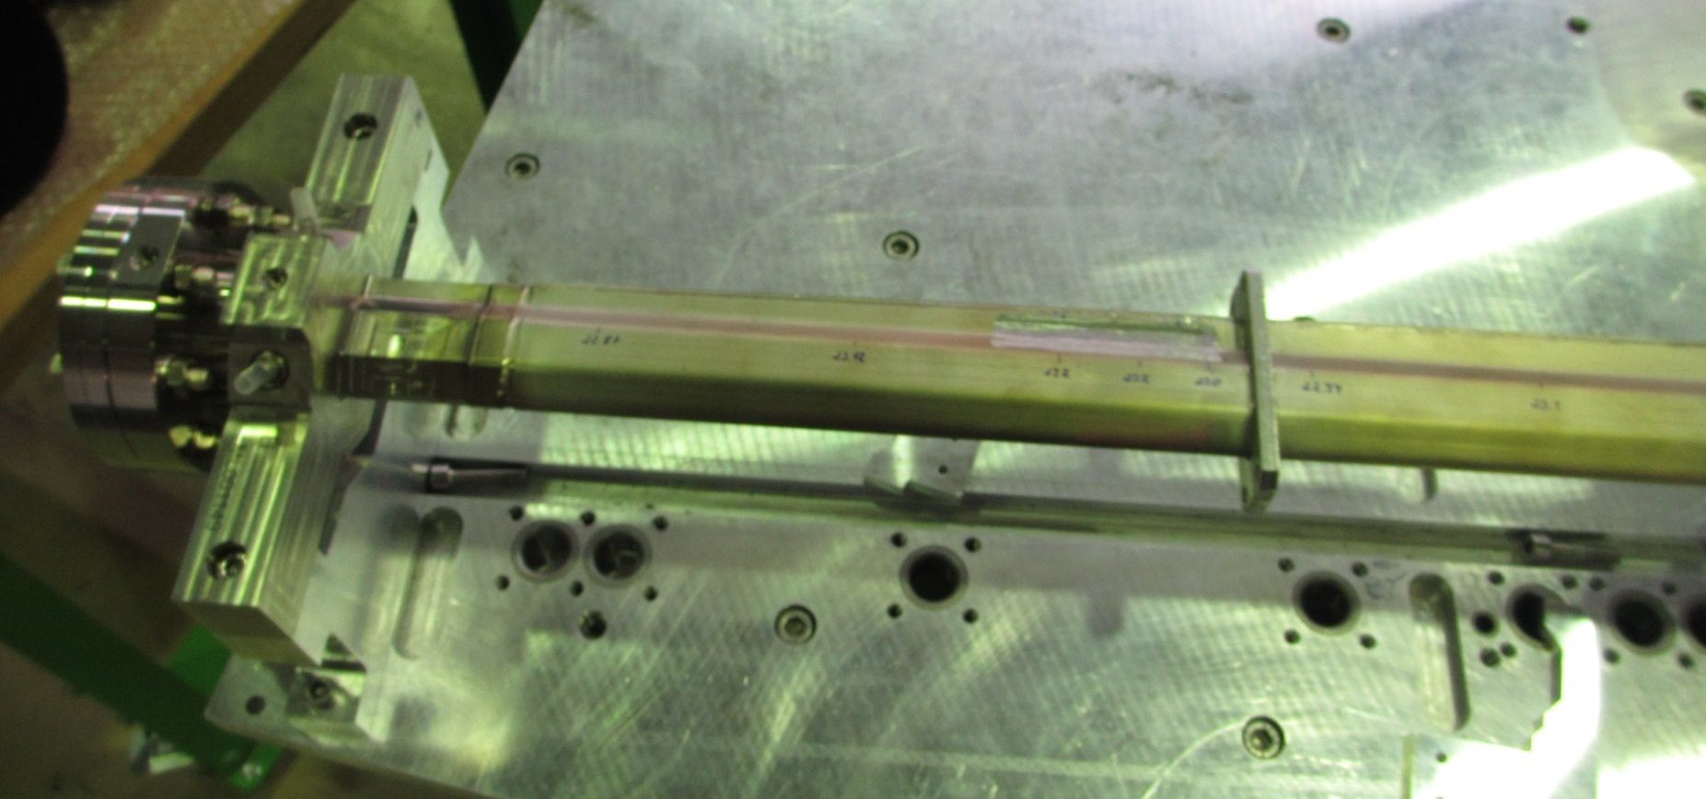
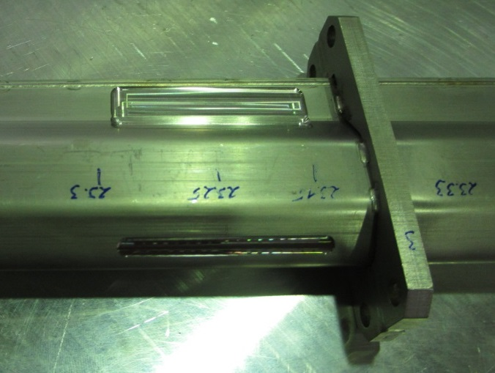
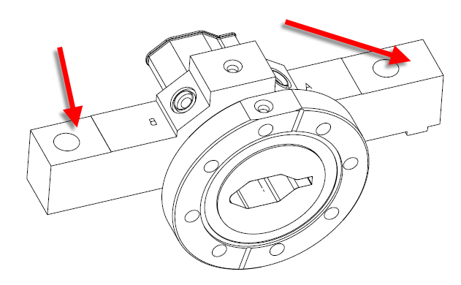
Storage ring installation
Solution
In order to proceed with the storage ring vacuum installation, following steps will be applied:
Rectification of the achromat body
Milling of the vacuum chamber body along colliding surfaces
Milling of the upper surface of the BPM’s
Final delivery for end of January 2015 – highly critical
Storage ring will be complete by start of March
Phot. J. Wiechecki

Slide 17
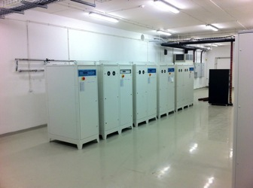
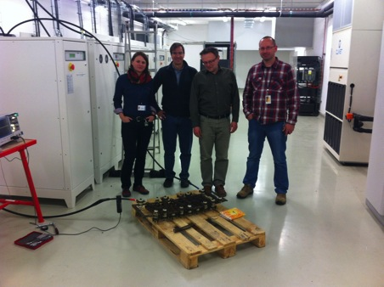
Power Supplies
All power supplies in house and tested
Danfysik PS (dipoles, quads), cabled, piped and functional.
First tests performed with resistive load, inductive load being provided by ELETTRA for further tests.
Recent results indicate that resistance of coils of smaller magnets (sextupoles) is greater than expected. May require some Delta power supplies to be substituted.
17

Slide 18
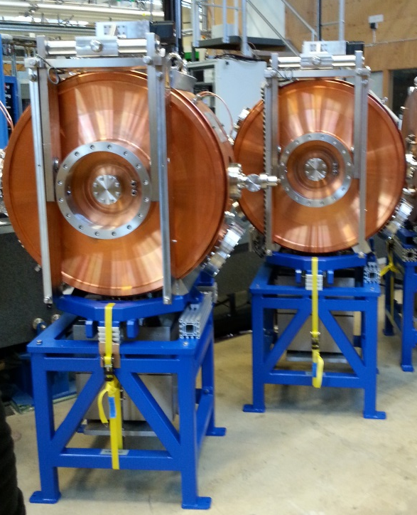
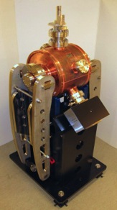
RF Cavities
2 x 100 MHz cavities at MAX-lab conditioned.
Delivery in two weeks time
Cooling units: 50 % at Solaris, rest will be delivered by MAX-lab in two weeks time
Landau cavities are at MAX-lab. Assembly and placement on stands to be done.
Conditioning to be done.
Delivery to Solaris to be agreed but will satisfy termination date of project.
Landaus will not be installed for day-1
18

Slide 19
RF Power Plants
Original contract with Electrosys (Italy) was cancelled by MAX IV, Solaris did the same.
New contract in place with Rhode & Schwartz for 2x60 kW Solid State 100 MHz amplifiers. Nearly off-the-shelf.
Contract still not signed (difficulties with formalities from R&S)
Expect delivery >February 2015
MTBF of amplifier components dependent on cooling system.
To be resolved present status of cooling circuit at Solaris (modification to backbone terminations and water flow).
19

Slide 20



Beamlines
Bending Magnet Beamline: Photoemission Electron Microscopy (PEEM)
1. All main vacuum components are contracted and delivered or manufactured (front end, monochromator, mirror chambers, optic elements, slits and diagnostic)
2. Tender for BL second end station finished 18th November 2014 (one offer was submitted)
3. Installation plan assumes to finish of the BL infrastructure in January 2015
4. Front end installation finishes December 2014 - no obstacles for machine commissioning
5. Plan for maximum outsourcing of the beamline control system development and integration. MPS and PSS for BL should be ready by February 2015.
6. Delay in optic elements (grating) delivery implicates delay in BL vacuum installation. It should be finished end of April 2015
.

Slide 21



Beamlines
The ultra angular resolved photoemission spectroscopy (UARPES) beamline
The construction is done by ELETTRA –Sincrotrone Trieste, Italy
The source of the beamline : EPU, type APPLE II
design and production KYMA, SLOVENIA.
End-Station will be delivered by the end of March 2015
Front-End was delivered yesterday and assembly in Dec. 2014
Undulator delivery end of December 2014
Vacuum chamber delivered,
Beamline Final delivery Assembly and SAT by the end of March 2015

Slide 22
Control System, PSS, PLC
Instrumentation & HL-SW
Personnel Safety System: Covered by Elettra – more work than planned
Control System integration has been out-sourced – Cosylab going smoothly
Machine Protection System – status is OK, linac ready, storage ring progressing
Networks – Linac ready, Storage ring progressing as to plan
Timing system – Linac ready, Storage ring progressing
Linac software (low and high level) ready, physics SW progressing
Storage ring software (low and high level) – work in progress
Subsystem tests are critical – lack of personnel and time
Instrumentation – All electronic equipment delivered, mechanical parts delivered according to FMB schedule
Basic High Level SW for linac ready. Rest is in progress.
Storage ring ramping – High Level (GIU) ready December, Tango server ready (final tests)
Storage ring HLSW – in progress

Slide 23



Personnel Safety System
Majority of team is formally trained (Cat B) and can operate the accelerators.
Radiation monitors – delivered and operational
3 x Gamma and 2 x (Gamma + Neutron)
Personal dosimeters in use.
Elettra provided the PPS logic, software and installation supervision Took longer than anticipated – will require additional work for SR
PSS status:
  Linac: Operational (with temporary modifications to allow use while Storage Ring system still to do)
  Storage Ring: Dec/2014 (may be extended
  On Solaris request to end of Feb/2015)

Slide 24
Solaris Personnel
41 people active with Solaris at present + JU admin
Technical people (33): Accelerator Physics(1), Controls (7+1), Vacuum (1), RF Systems (4), Magnets & PS (2), Mech Engineers (4), Civil Engineering (4+2), Electrical Tech (1), Beamlines (3), Installation Coordinator (1), Radiation Protection (1), Instrumentation (1), [one PhD (diagnostics CERN)]
Formed groups
  RF – includes Gun, Linac, Storage Ring RF systems (3)
  Mechanical Systems – Mechanical Engineering, Vacuum and Alignment (3)
  Controls and IT (8)

Slide 25
Commissioning
Injector Installation Mid June – Mid November 2014(2 months delay)
Subsystem Tests
October-Mid November2014
Conditioning
17th of November 2014
Gun sytem conditioning
Beg. December 2014
Commissioning Mid December 2014 – January 2015
Injector
SR Installation End of July 2014-March2015
Phase I April-May. 2015
Phase II May -June 2015
Phase III June –July... 2015
Subsystem Tests March – April 2015
Storage Ring
April 2015 - end of the project

Slide 26









Acknowledgments
MAX IV TEAM
Machine Advisory Committee
Scientific Advisory Committee
Polish Synchrotrons Users’ Society
Elettra, Sincrotrone Trieste
Jagiellonian University
SOLARIS Team
Special thanks to Dieter Einfeld
…

Slide 27

Thank you

