Slide 1

Chemistry at extreme conditions:
Fe-O system at ultra-high pressure
E. Bykova

Slide 2
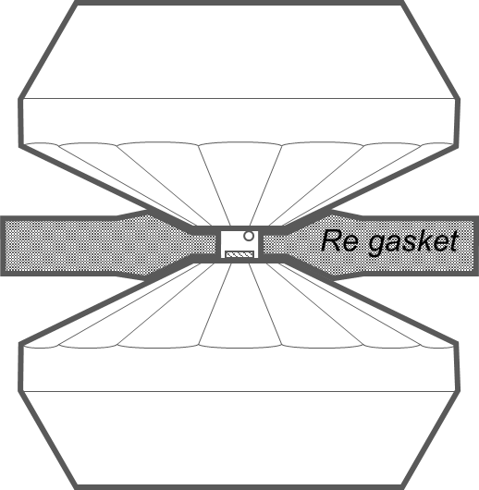
Generation of high pressures and high temperatures
The smaller the primary beam the smaller grains could be studied

Slide 3
Fe-O system at high pressures and temperatures
In modelling of the Earth interiors:
  end-member in MgO-FeO-Al₂O₃-Fe₂O₃-SiO₂ system;
  iron controls redox processes in all stages of the Earth and other planets formation and dynamics.
In solid-state physics and solid-state chemistry:
  Archetypical example in studies of physical properties of transition metal oxides;
  end-member in numerous ferrites systems.
Fe₂O_{3,} Fe₃O₄
(Fe,Mg)O, (Fe,Mg)(Si,Al)O₃
Fe,Ni + (O,S,P,N)
Fe⁰
Fe²⁺
Fe³⁺
O⁻
O²⁻

Slide 4
Fe-O system at high pressures and temperatures
Fe-O system:
Iron has various oxidation states (Fe⁰, Fe²⁺, Fe³⁺)
Oxygen has various oxidation states (O²⁻, O⁻)
Spin transitions
Magnetic ordering
Fe₂O_{3,} Fe₃O₄
(Fe,Mg)O, (Fe,Mg)(Si,Al)O₃
Fe,Ni + (O,S,P,N)
Complex phase diagrams and complex relations between iron oxides
Fe⁰
Fe²⁺
Fe³⁺
O⁻
O²⁻

Slide 5
Known compositions in Fe-O system
FeO
+ polymorphs
Fe₃O₄
+ polymorphs
Fe₂O₃
+ polymorphs
Fe₄O₅
Fe₅O₆
Fe₁₃O₁₉
FeO₂
distorted
polymorph
P2₁/m-Fe₄O₅
distorted
polymorph
C2/m-Fe₅O₆
2-fold-Fe₅O₆
series
of polymorphs
with distorted
wuestite
structures:
R-3m
I2/m
P2₁/m
Pmcn
Pmmn
CaIrO₃-type
CaTi₂O₄-type
New iron oxides:
distorted perovskite type
CaFe₂O₄-type
Fe₅O₇
Fe₁₃O₁₈
Rh₂O₃-II-type
WC-type FeO
distorted Th₃P₄
structures:
I2, I4₁/amd-Fe₃O₄
Fe₇O₉
Fe₂₅O₃₂
Aba2-Fe₂O₃

Slide 6
Structural evolution of iron oxides
FeO
Fe₅O₆
(3FeO·Fe₂O₃)
Fe₄O₅
(2FeO·Fe₂O₃)
Fe₇O₉
(3FeO·2Fe₂O₃)
Building
blocks:
Homologous series
mFeO·nFe₂O₃
WC-FeO
PPv-Fe₂O₃
Fe₅O₇
(FeO·2Fe₂O₃)
HP-Fe₃O₄
(FeO·Fe₂O₃)
HPHT-Fe₃O₄
Bykova E. et al., Structural complexity of simple Fe2O3 oxide at high pressures and temperatures. Nature Commun. (2016).

Slide 7
Phase diagram of FeO
B1-FeO
B2-FeO
rB1-FeO
B8-FeO
*
I2/m-FeO
10 K
P2₁/m-FeO
Ohta, K. et al. (2014) J. Geophys. Res. Solid Earth, 119, 4656
75 GPa, after 2000 K
Fjellvåg, H. et al. (2002) Am. Miner., 87, 347
Kantor, I. et al. (2008) Z. Kristallogr., 223, 461

Slide 8

FeO with distorted wuestite structures
Ambient
conditions
35 GPa
77 GPa
77 GPa, 2000 K
125 GPa, 3100 K
200 GPa, >3000 K
Fm-3m
R-3m
I2/m
P2₁/m
Pmcn
Pmmn
Fe…Fe contacts:

Slide 9
FeO at 200 GPa and 3000 K
WC-type FeO
P-6m2
a = 2.3663(14),
c = 2.429(17) Å
R₁ = 8.3 %
Magnetic
Data collection: ~12 hours

Slide 10
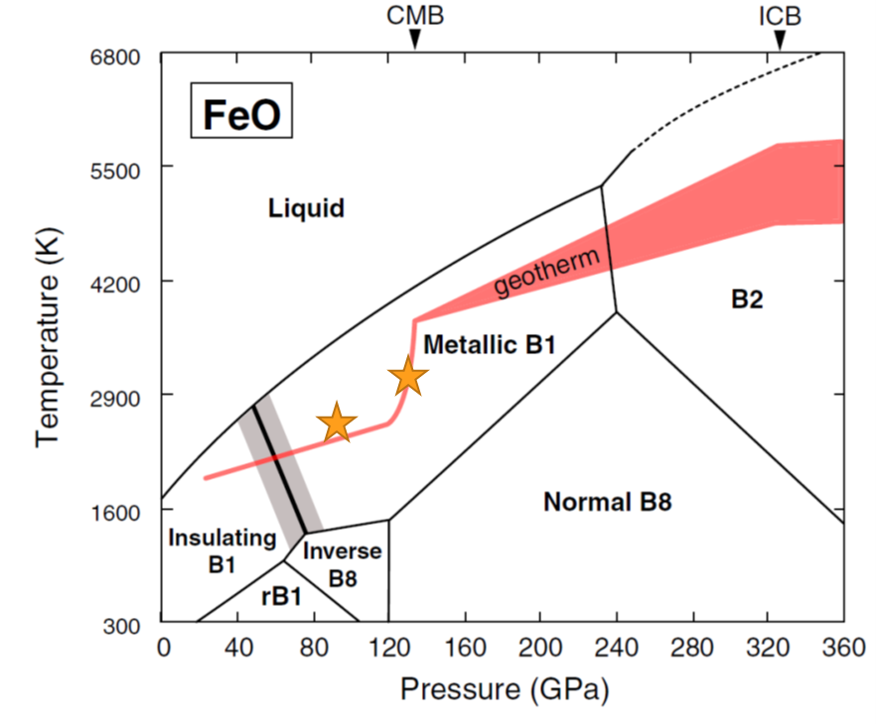
Decomposition of Fe_{0.94}O at extreme conditions
92 GPa and 2550(100) K
32·Fe_{0.94}O → Fe₂₅O₃₂ + 5.08·Fe
Fe₂₅O₃₂
P6-2m
a = 13.246(2),
c = 2.5626(14) Å
126 GPa and 3150(100) K
4·Fe_{0.94}O → Fe₃O₄ + 0.76·Fe
Fe₃O₄
CaFe₂O₄-type
Pnma
a = 7.915(2),
b = 2.4992(18),
c = 9.248(7) Å

Slide 11
FeO in the deep Earth’s interiors
Fe²⁺ is present in the Earth’s deep interiors as component of main constituents of the lower mantle such as magnesiowuestite and bridgmanite. FeO can also form on core-mantle boundary.
Fe₂O_{3,} Fe₃O₄
FeO:
Across the geotherm line (P-T profile of the Earth) FeO is not chemically stable.
Numerous structures of FeO based on wuestite (NaCl) structure exist suggesting possible electronic or magnetic ordering at high-pressure.
WC-FeO with trigonal-prismatic coordination may form at core/core-mantle boundary instead of B1-FeO where Fe2+ is located in octahedra.
(Fe,Mg)O, (Fe,Mg)(Si,Al)O₃
Fe,Ni + (O,S,P,N)
Fe⁰
Fe²⁺
Fe³⁺

Slide 12
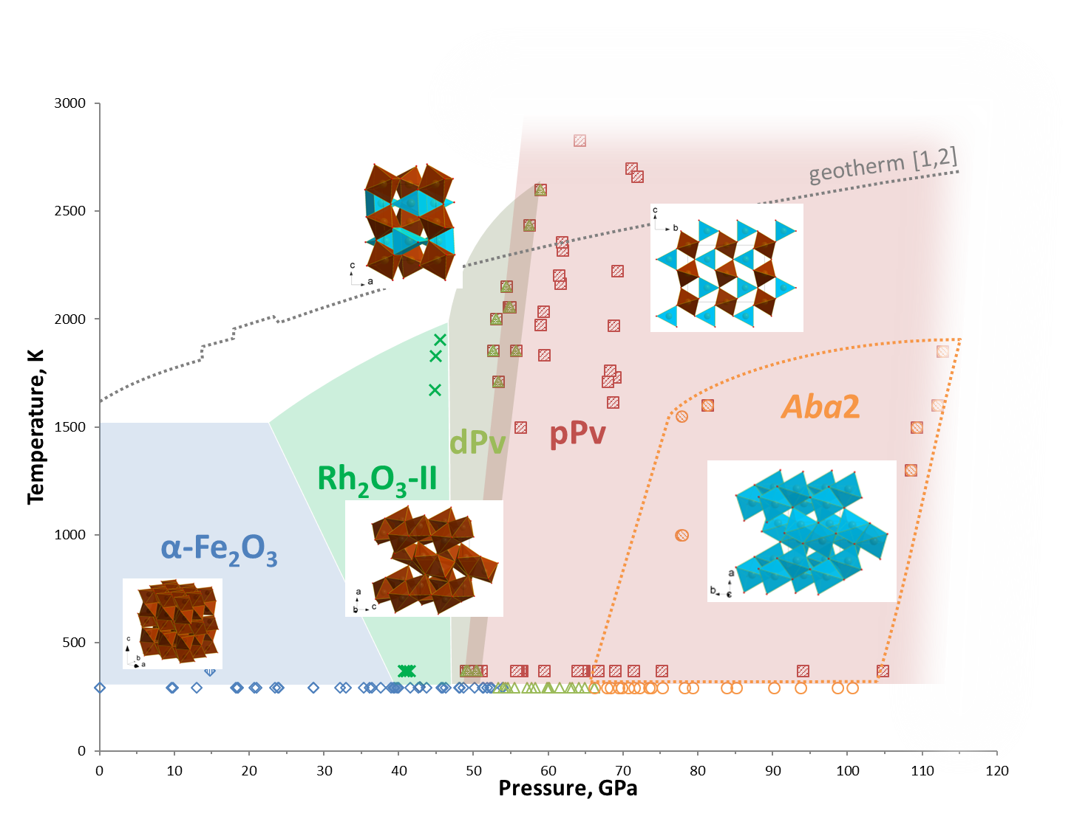
Observed Fe₂O₃ phases
HS/M→LS/NM-Fe_{O}³⁺
HS/M-Fe_{P}³⁺
71 GPa, 2700-3000 K
200 GPa, 3000 K
HS/M-Fe³⁺
HS/NM-Fe³⁺
HS/M-Fe³⁺
LS/NM-Fe³⁺
HS – high-spin
LS – low-spin
HS – high-spin
LS – low-spin
octahedron
prism

Slide 13
Decomposition of Fe₂O₃
71 GPa 2700-3000 K
Fe₅O₇ (FeO·2Fe₂O₃)
C2/m
a = 9.208(7),
b = 2.7327(10),
c = 8.270(5) Å,
β = 105.50(8)°,
V = 200.5(2) Å³
R₁ = 6.4 %
5·Fe₂O₃ → 2·Fe₅O₇ + 0.5·O₂
above 200 GPa and 3000 K
Fe₃O₄
distorted Th₃P₄-type
I4₁/amd
a = 5.951(8),
c = 5.859(11) Å,
R₁ = 10.5 %
Fe₁₃O₁₉
I2/m
a = 9.4111(13),
b = 2.5219(11),
c = 16.8948(18) Å
β = 91.689(13) °
R₁ = 7.7 %
FeO7
FeO6
FeO7
3·Fe₂O₃ → 2·Fe₃O₄ + 0.5·O₂
13·Fe₂O₃ → 2·Fe₁₃O₁₉ + 0.5·O₂

Slide 14
High-pressure high-temperature behavior of Fe₃O₄
80 GPa, 2900 K
Fe₄O₅ + Fe₂O₃
CaFe₂O₄-type
Temperature, K
CaTi₂O₄-type (Bbmm)
Fm-3m
Fe₃O₄
octahedron
prism
Pressure, GPa
HS/M-Fe²⁺
HS/M-Fe³⁺
HS/M-Fe²⁺
HS/M→LS/NM-Fe_{O}³⁺, HS-Fe_{P}³⁺
HS/M→LS/NM-Fe²⁺
HS/M→LS/NM-Fe³⁺, HS-Fe³⁺
Schollenbruch, K. et al. (2011) Am. Miner, 96, 820
HS – high-spin
LS – low-spin
M – magnetic
NM – non-magnetic
Woodland, A.B. et al. (2012) Am. Miner, 97, 1808
Ricolleau A. and Fei Y. (2016) Am. Miner, 101, 719
Greenberg E. (2017) Phys. Rev. B, 95, 195150

Slide 15
Decomposition of Fe₃O₄ at 80 GPa and 2900 K
Fe₃O₄
distorted Th₃P₄-type
I2, twinned
a = 5.951(8),
b = 5.8176(16),
c = 5.859(11) Å,
β = 91.2(2) °
R₁ = 10.5 %
Fe₃O₄
Pnma
a = 8.525(5),
b = 2.6799(13),
c = 8.777(5) Å
FeO7
Fe₂₅O₃₂
P6-2m
a = 13.4275(16),
c = 2.6289(4) Å
R₁ = 5.5 %
Phase #4
Fdd2
a = 5.9279(10),
b = 35.810(8),
c = 8.202(7) Å
25·HP-Fe₃O₄ → 3·Fe₂₅O₃₂ + 2·O₂
Possible thermal gradient during laser heating

Slide 16
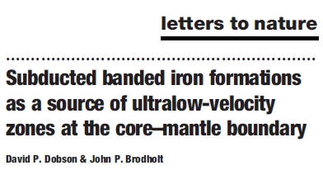
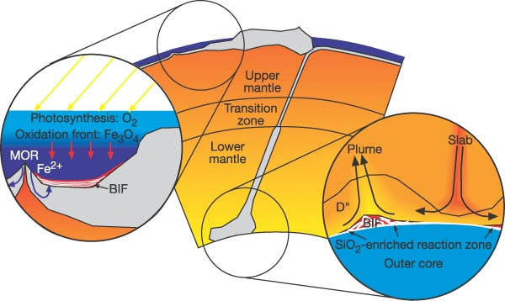
Iron oxides in the Earth’s deep interiors
Oxides of iron:
are present in the Earth’s deep interiors (mainly Fe²⁺),
can be delivered by subducting slabs (banded iron formations),
can form during reaction with water from subducted hydrous minerals on the border with core (D’’ layer).
Fe₂O₃ and Fe₃O₄ may decompose at the conditions of the Earth’s lower mantle producing oxygen fluids
Fe₂O_{3,} Fe₃O₄
(Fe,Mg)O, (Fe,Mg)(Si,Al)O₃
BIF (Fe₂O₃ + Fe₃O₄)
Fe,Ni + (O,S,P,N)
H₂O
FeOOH, FeO₂
Fe⁰
Fe²⁺
Fe³⁺

Slide 17
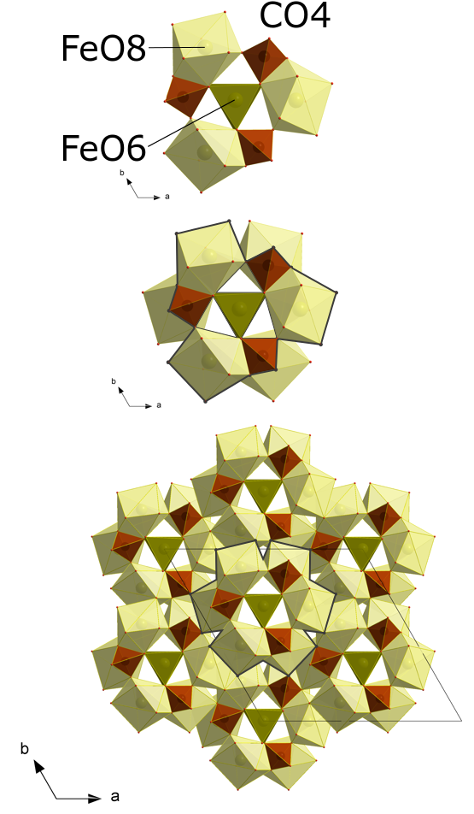
Fe + O₂ → ?
60 GPa, 3000 K
Fe³⁺₄C₃O₁₂
4Fe + 3C + 6O₂ → Fe₄C₃O₁₂
105 GPa, 3000 K
4Fe + 4C + 6.5O₂ → Fe₄C₄O₁₃
C₄O₁₃¹⁰⁻
with CO4 tetrahedra
FeO8
Fe²⁺₂Fe³⁺₂C₄O₁₃
Ba₂Gd₂C₄O₁₃ -type
FeO7

Slide 18
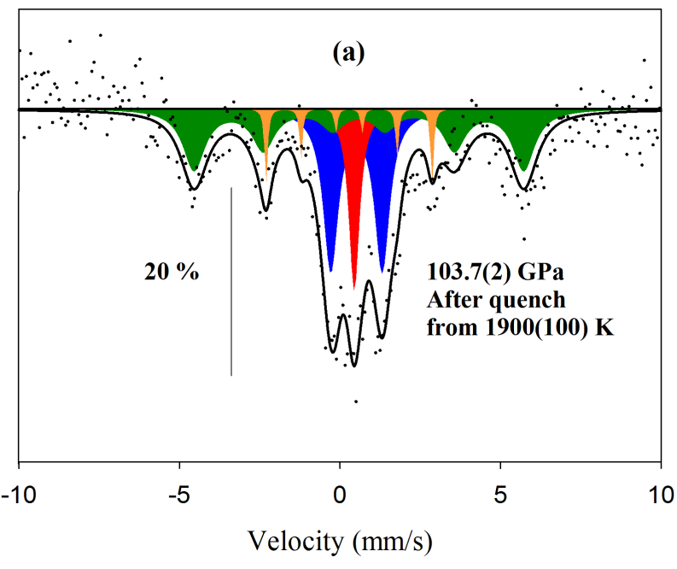
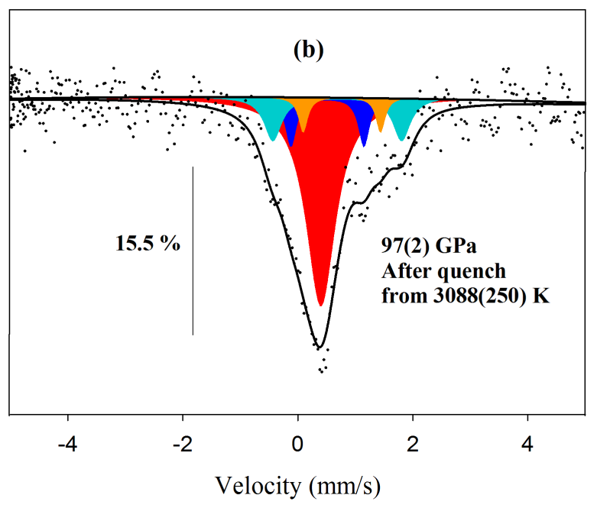
Synthesis of HP-iron carbonates from FeCO₃
104 GPa, 1900 K
Fe₄C₃O₁₂ + Fe₁₃O₁₉ + unreacted FeCO₃
97 GPa, 3100 K
Fe₄C₄O₁₃ + unreacted FeCO₃

Slide 19
Iron carbonates in deep Earth’s interiors
Carbon in the Earth:
Up to 90% of the Earth's carbon budget is in the Earth's mantle and core.
The presence of carbonates in the Earth's mantle is known from diamond inclusions, but how carbon is transported there remains a mystery.
Fe₄C₃O₁₂ and Fe₄C₄O₁₃:
Fe₄C₃O₁₂ and Fe₄C₄O₁₃ are also obtained after laser heating of FeCO₃ at high-pressure.
Fe₄C₄O₁₃ keeps its structure at pressures along the entire geotherm to depths of at least 2500 km, which is close to the boundary between the mantle and the core.
Self-oxidation-reduction reactions can preserve carbonates in the Earth's lower mantle.
Cerantola et al. Stability of iron-bearing carbonates in the deep Earth’s interior. Nature Communications, 2017; 8: 15960

Slide 20
Conclusions
Phase diagram of Fe-O system is very complex and has to be reconsidered based on in situ high-PT synchrotron Moessbauer soursce spectroscopy and single-crystal XRD. Application of nano-focused beams is necessary for studies above megabar.
At certain PT-conditions none of conventional iron oxides (FeO, Fe₃O₄ and Fe₂O₃) is chemically stable
Many crystal structures are possible, but they are built of only a few types of FeOx polyhedra.
Changes in the chemistry and properties of Fe-O compounds along the geotherm may affect the oxygen fugacity in the Earth’s lower mantle and at the CMB.

Slide 21





Acknowledgments
N. Dubrovinskaia, L. Dubrovinsky – BGI
M. Bykov, C. McCammon, S.V. Ovsyannikov, L. Ismailova, G. Aprilis, E. Koemets, S. Chariton – BGI
K. Glazyrin, Z. Konôpková, H.-P. Liermann – P02.2, DESY
C. Prescher, E. Greenberg, V. Prakapenka – 13-IDD, APS
M. Merlini, M. Hanfland – ID15B, ESRF
M. Mezouar, V. Svitlyk – ID27, ESRF
I. Kupenko, V. Cerantola, A.I. Chumakov, R. Rüffer – ID18 ESRF

Slide 22
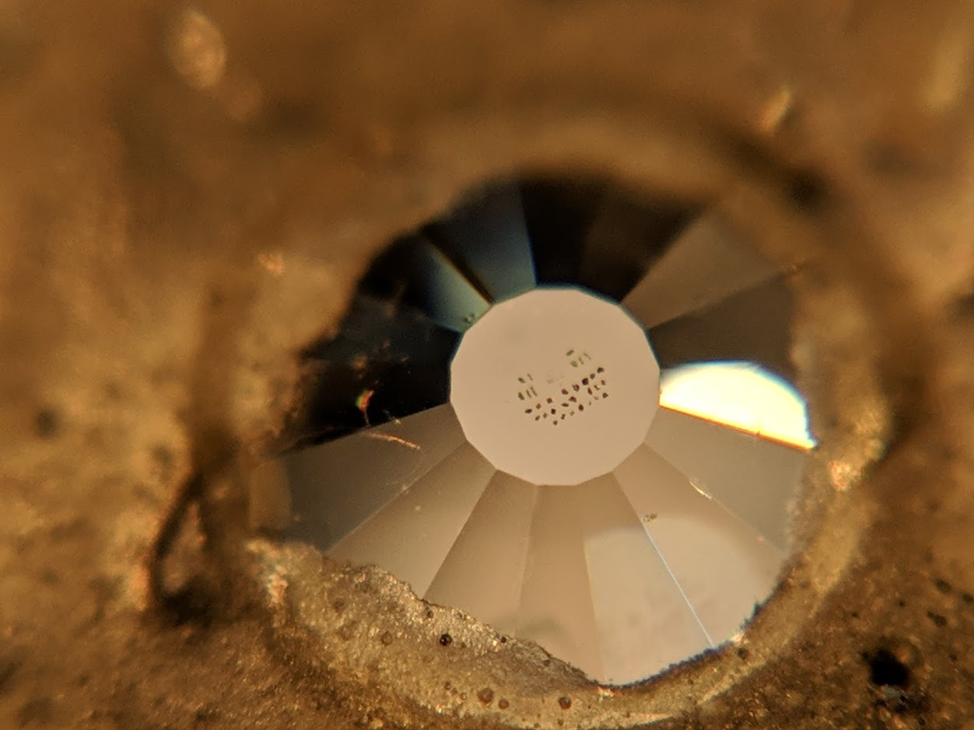
Thank you for attention!

