Slide 1
Good practices on a X-ray nanoprobe
Measuring the focused beam size and position
Sample in the focal plane?
Mechanical stability/Vibrations
In-situ experiments

Slide 2
Focal plane
Localize the focal plane and measure the focused beam size
Measure focused beam size vs distance from KB mirrors
Optimise focused beam size and flux vs useful mirror length
Correct for astigmatism (bringing horizontal and vertical focii into the same plane)
Example (ID16B, 17 keV):
θ_{inc vert} = 8 mrad
f_{vertical}= 0.18 m ⇒ ∆θ_{inc} ≈ 2 µrad
∆ f= f_{hor}- f_{vert} ≈ 50 µm
∆θ_{inc} / θ_{inc} ≈ ∆ f/ f
If angular stability worse than a few µrads ⇒ defocusing
⇒ Find a way to localize focal plane and focused beam in this plane
⇒ Make sample positioning in focal plane “easy”

Slide 3
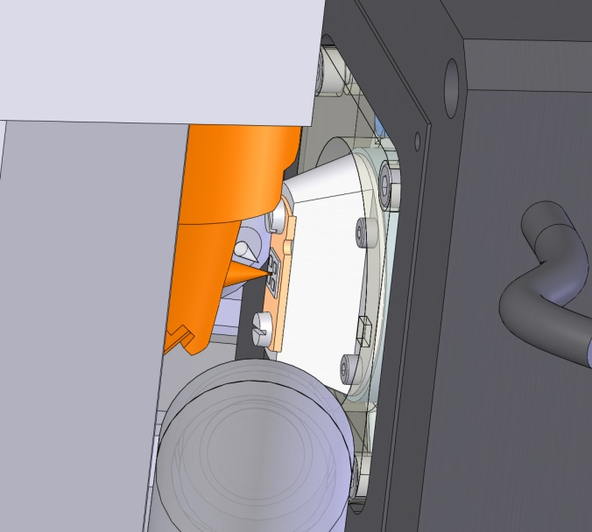
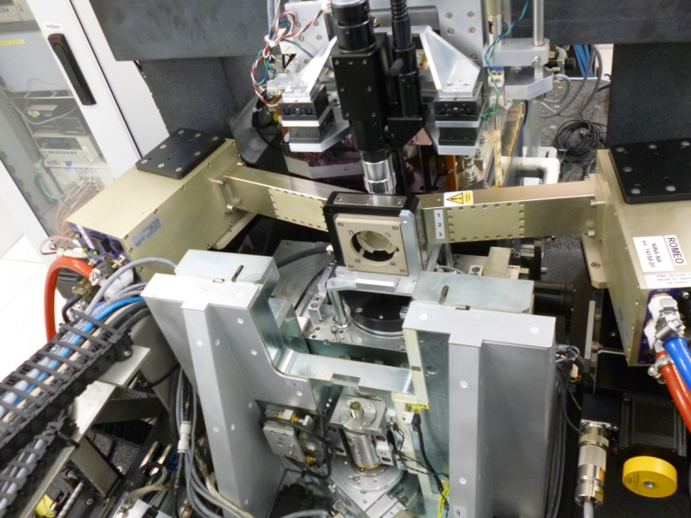
Measuring focused beam size at ID16B
Test object: Ni nano-structures coated by photo-lithography on thin silicon nitride window
Line width: ∼30 nm
Height: 100-200 nm
Vertical and Horizontal scans of Ni lines measured by fluorescence

Slide 4

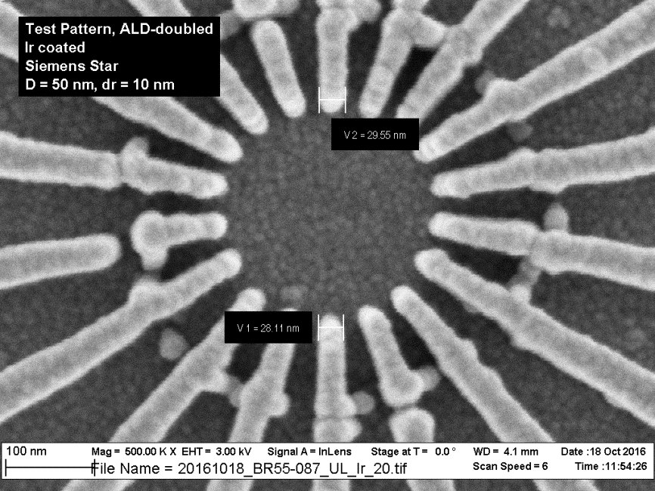
Measuring focused beam size at ID16B
L1 = 29.55 nm
L2 = 28.11 nm
PSI (C. David) Siemens star
XRF: Ir K_{α}
E= 17.5 keV
Focused beam size ≈ 50x50 nm²
Step size: 25 nm

Slide 5
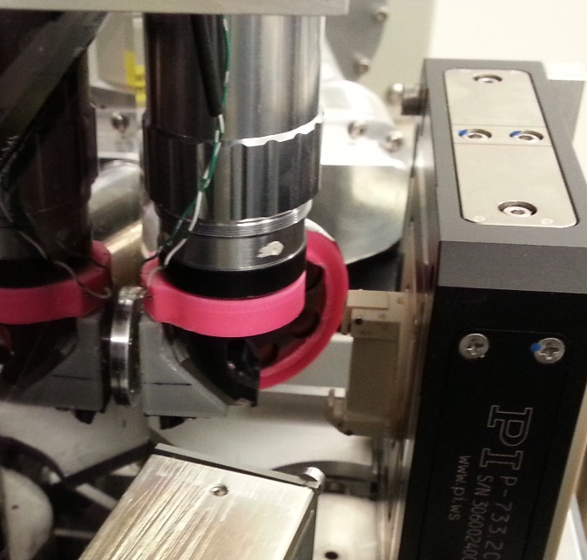
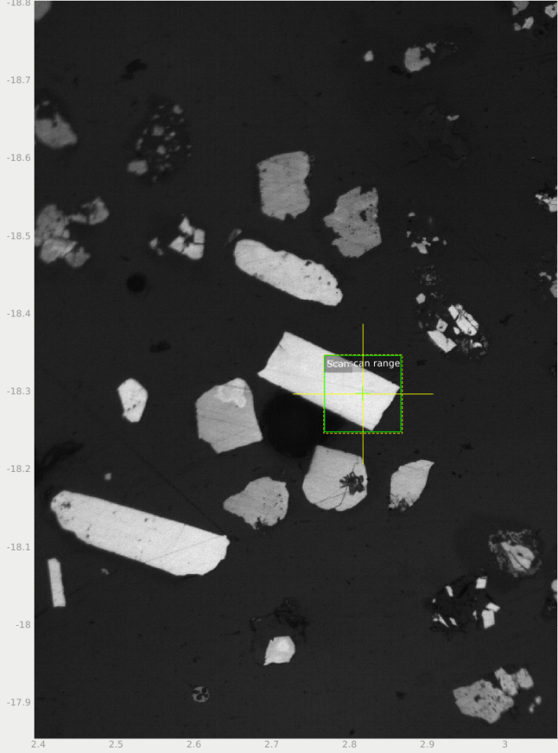
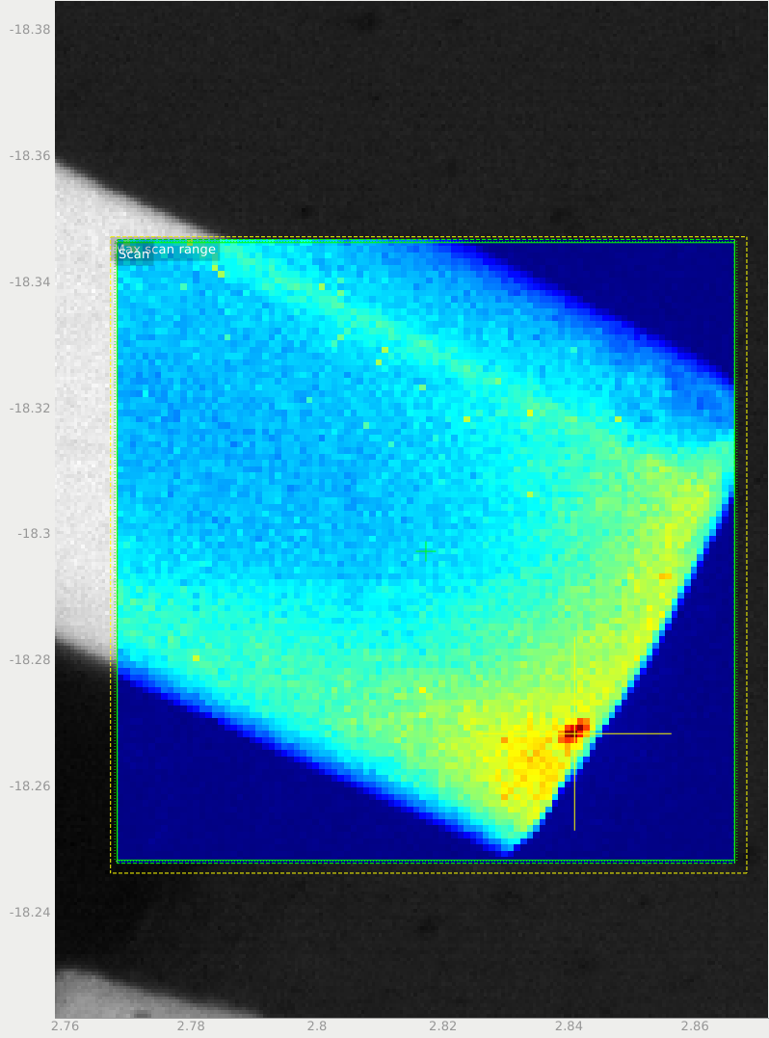
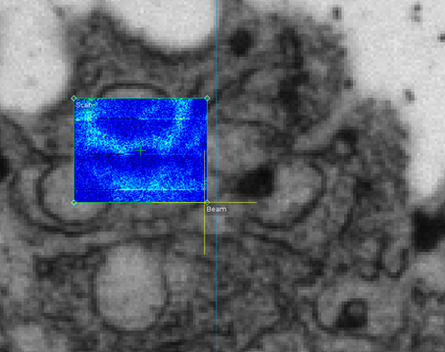
How to place samples in focal plane
Visible light microscope focused on test object located in focal plane:
DOF ≈ 1 µm << X-ray DOF ∼ 30 µm
Microscope aligned to visualize focused beam with crosshair
Remove test object and bring sample in focal plane
(sharp image in visible light microscope)
The crosshair shows where the beam hits the sample
Microscope always in working position ⇒ Fast sample positioning (5 min)
Video microscope
KB mirrors
Sample
X-rays
Mirror
YZ piezo-stage
4.95 µm
5 µm
Visible light microscope image
and X-ray data superimposed
in the same GUI

Slide 6
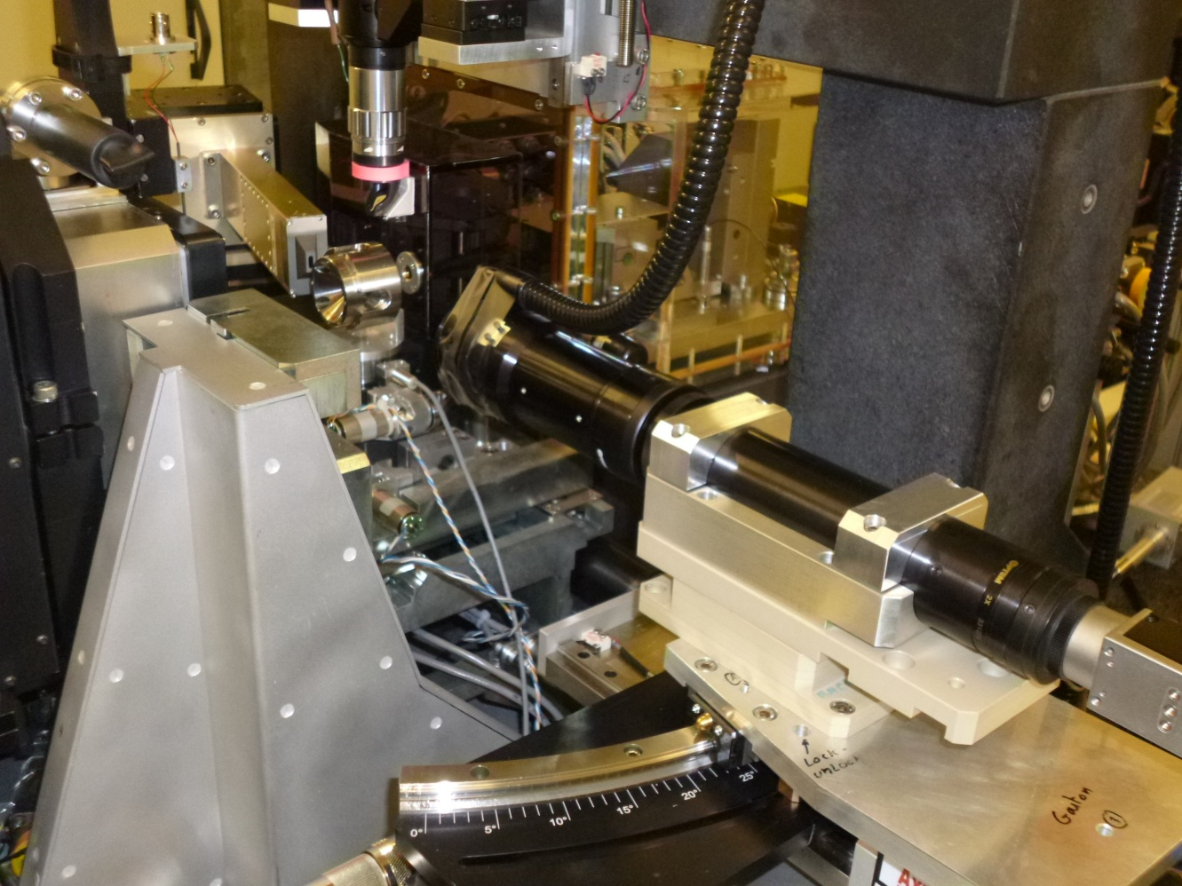
In situ case
Example: Double stage DAC (L. Dubrovinsky)
Problem: How to bring the sample in the focal plane?
Visible light microscope not available
Solved with knife edge scans performed with the “sharp” edge of Rh gasket.
Measured in transmission with a photodiode.
It does not give the spot size but a minimum fwhm is observed when the gasket is in focal plane
Sample positioning in the focal plane:
⇒Careful design to take this step
into account

Slide 7
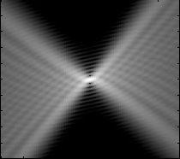
Sample thickness/homogeneity
Depth of focus of X-ray microscope: approx. 30 µm on ID16B
Sample thickness must be thinner than DOF.
If not ⇒ Degradation of spatial resolution because of in-depth penetration
Sample
Sample
Sample homogeneity
Might be an issue for quantification
Sample

Slide 8
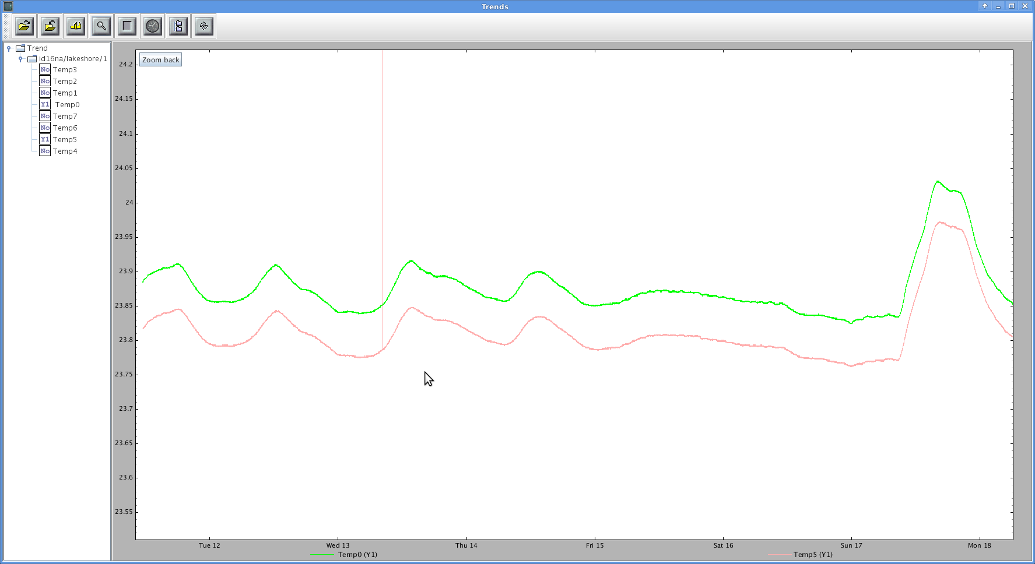
Temperature Stability
Required thermal stability
  Typical overall dimensions of focusing optics assembly: 100 mm
  INVAR α = 1.6⋅10⁻⁶ m/m/K ⇒ expansion of 160 nm/K
Temperature of KB mirrors
Required angular mirror stability < 0.1 µrad
ΔΤ < 0.06 Κ
ID16B
Air conditioning inside Exp. Hutch ∼ +/- 0.05 °C
23.9
23.8
  However: significant are only differential drifts
  Tradeoff between temperature stability and air flow/acoustically excited vibrations
  (thin samples ⇒ “sail” effect)
  ID16B: Laminar Air flow from the ceiling through a micro-porous canvas
  Air lock at the entrance of the exp. Hutch
Tue
Wed
Thu
Fri
Sat
Sun
Mon
Very absorbing samples: might be deformed by thermal heatload

Slide 9
Vibrations
Beamline optics
Kb mirrors: provide a direct demagnification of the source
S
α
lens
Vibrations should be much smaller than angular source size (α =0.12 µrad for ID16B)
Sample
  Stiff design: Aim at in-phase “vibration” of sample and focusing optics
  Position encoding and feedback
  But position sensors can not be placed close to sample (typically 10-20 mm)
  Careful engineering of sample support
  Good sample fixation
And also: Semi-buried building, thick slab decoupled from the walls, 4 tons granite table

Slide 10
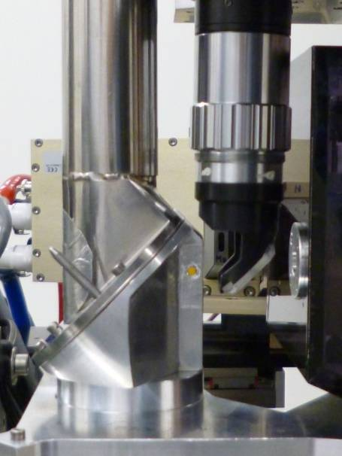
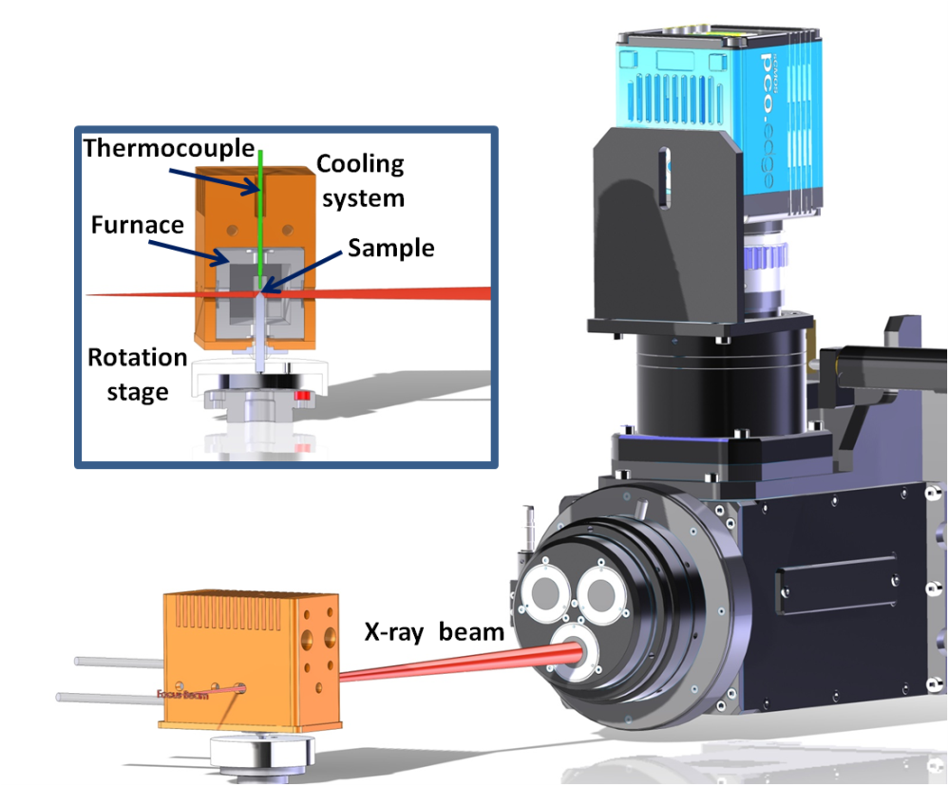
In-situ environments
A nanoprobe should be kept as fixed as possible.
Any in-situ device should be designed to fit with geometrical/mechanical constraints of the nanoprobe.
It does not work the other way around.
In-situ environments available on ID16B
He cryostat (5 K)
Static vacuum (activated charcoals)
Furnace (Tmax = 900°C)
Fully decoupled from sample stage
Air convection around sample minimized
Page 10

Slide 11
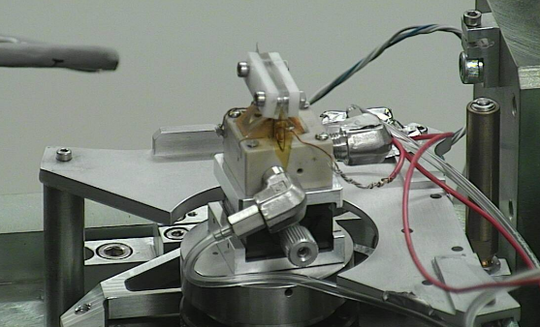
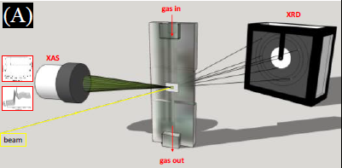
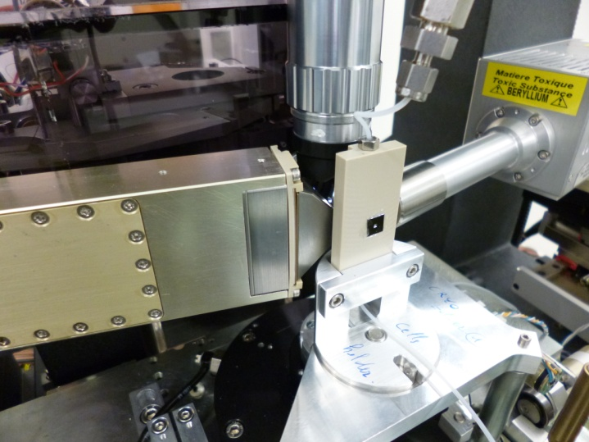
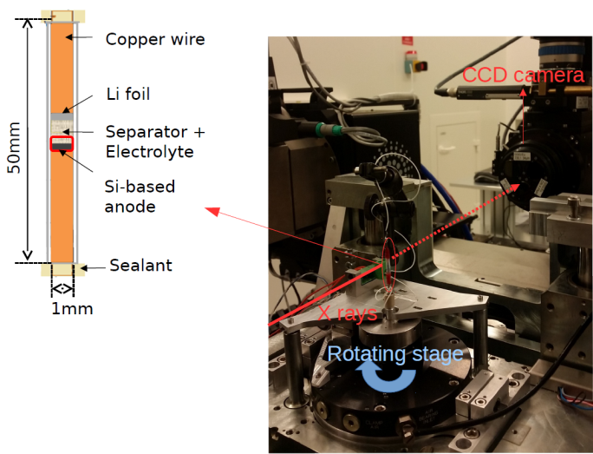
Insitu devices developed by users
Single nanoparticle behavior under
catalytic reaction conditions (A. Beale, UCL England)
Gas flow cell
Follow water distribution in PEM fuel cell (Iryna Zenyuk, Tufts University)
Li Battery: silicon anode degradation followed by nanotomography
E. Maire, INSA Lyon

Slide 12
CONCLUSION
Samples must be placed in the focused beam and in the focal plane!
Not straightforward in case of specific sample environment
To avoid loosing time to align the sample and find the good ROI:
Samples must be precisely pre-characterized
A nanoprobe is not easy to operate in air and at room temperature.
It is even more complicated when additional heat loads or vibrations are introduced
Both sample and nanoprobe stabilities are very important!
A nanoprobe can very easily be transformed into a microprobe…
Any in-situ/in-operando device should be specifically designed to meet the nanoprobe requirements.
There is very little chance that an already existing device fits with the nanoprobe…
Always in close collaboration with beamline scientists.
However sometimes it works!

