Slide 1
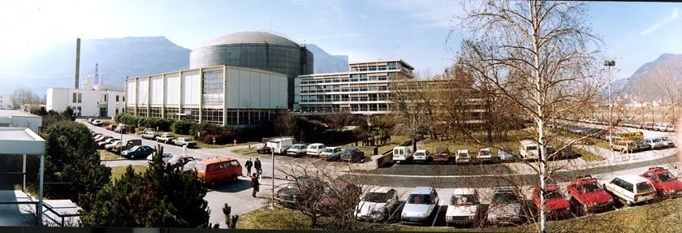
Introduction to Neutron Diffraction
Juan Rodríguez-Carvajal
Diffraction Group at ILL
Institut Laue Langevin, 71 avenue des Martyrs, CS 20156, 38042 Grenoble (France)

Slide 2
Outline
Characteristics of neutrons for diffraction
Diffraction equations: Laue conditions
Comparison neutrons – synchrotron X-rays
Magnetic neutron diffraction
Examples of neutron diffraction studies

Slide 3
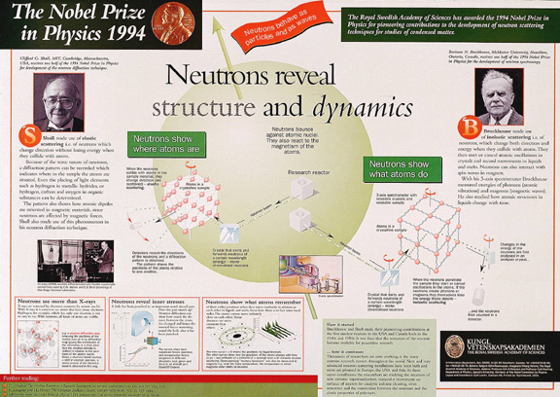
Neutrons for what?
Neutrons tell you “where the atoms are and what the atoms do”
(Nobel Prize citation for Brockhouse and Shull 1994)

Slide 4
Particle-wave properties energy-velocity-wavelength ...
kinetic energy (E) velocity (v) temperature (T).
E= m_{n}v²/2= k_{B} T = p²/2m_{n}= (ħk)²/2m_{n}=(h/λ)²/2m_{n}
momentum (p)
p= m_{n}v = ħ k
wavelength (λ)
ħ=h/2π
wavevector (k)
k= 2π/λ = m_{n}v/ħ

Slide 5
Neutrons, a powerful probe
Matter is made up atoms, aggregated together in organised structures
The properties of matter and materials are largely determined by their structure and dynamics (behaviour) on the atomic scale
distance between atoms ~ 1 Å = 1/100 000 000 cm
Atoms are too small to be seen with ordinary light
(wavelength approx. 4000-8000 Å)
The wavelength of the neutron is comparable to atomic sizes and the dimensions of atomic structures, which explains why neutrons can « see » atoms.
The energy of thermal neutrons is similar to the thermal excitations in solids.
Neutrons are zero-charge particles and have a magnetic moment that interacts with the magnetic dipoles in matter.
Techniques using neutrons can produce a picture of atomic and magnetic structures and their motion.

Slide 6
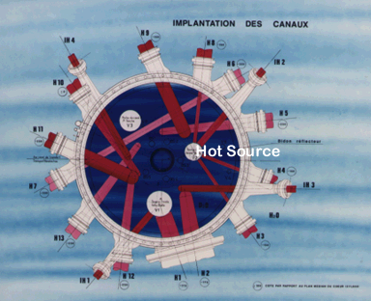
Particle-wave properties
(Energy-Temperature-Wavelength)
E = m_{n}v²/2 = k_{B} T = (ħk)²/2m_{n} ; k = 2π/λ = m_{n}v/ħ
Energy (meV) Temp (K) Wavelength (Å)
Cold 0.1 – 10 1 – 120 4 – 30
Thermal 5 – 100 60 – 1000 1 – 4
Hot 100 – 500 1000 – 6000 0.4 – 1
COLD
THERMAL
HOT
Cold Sources

Slide 7
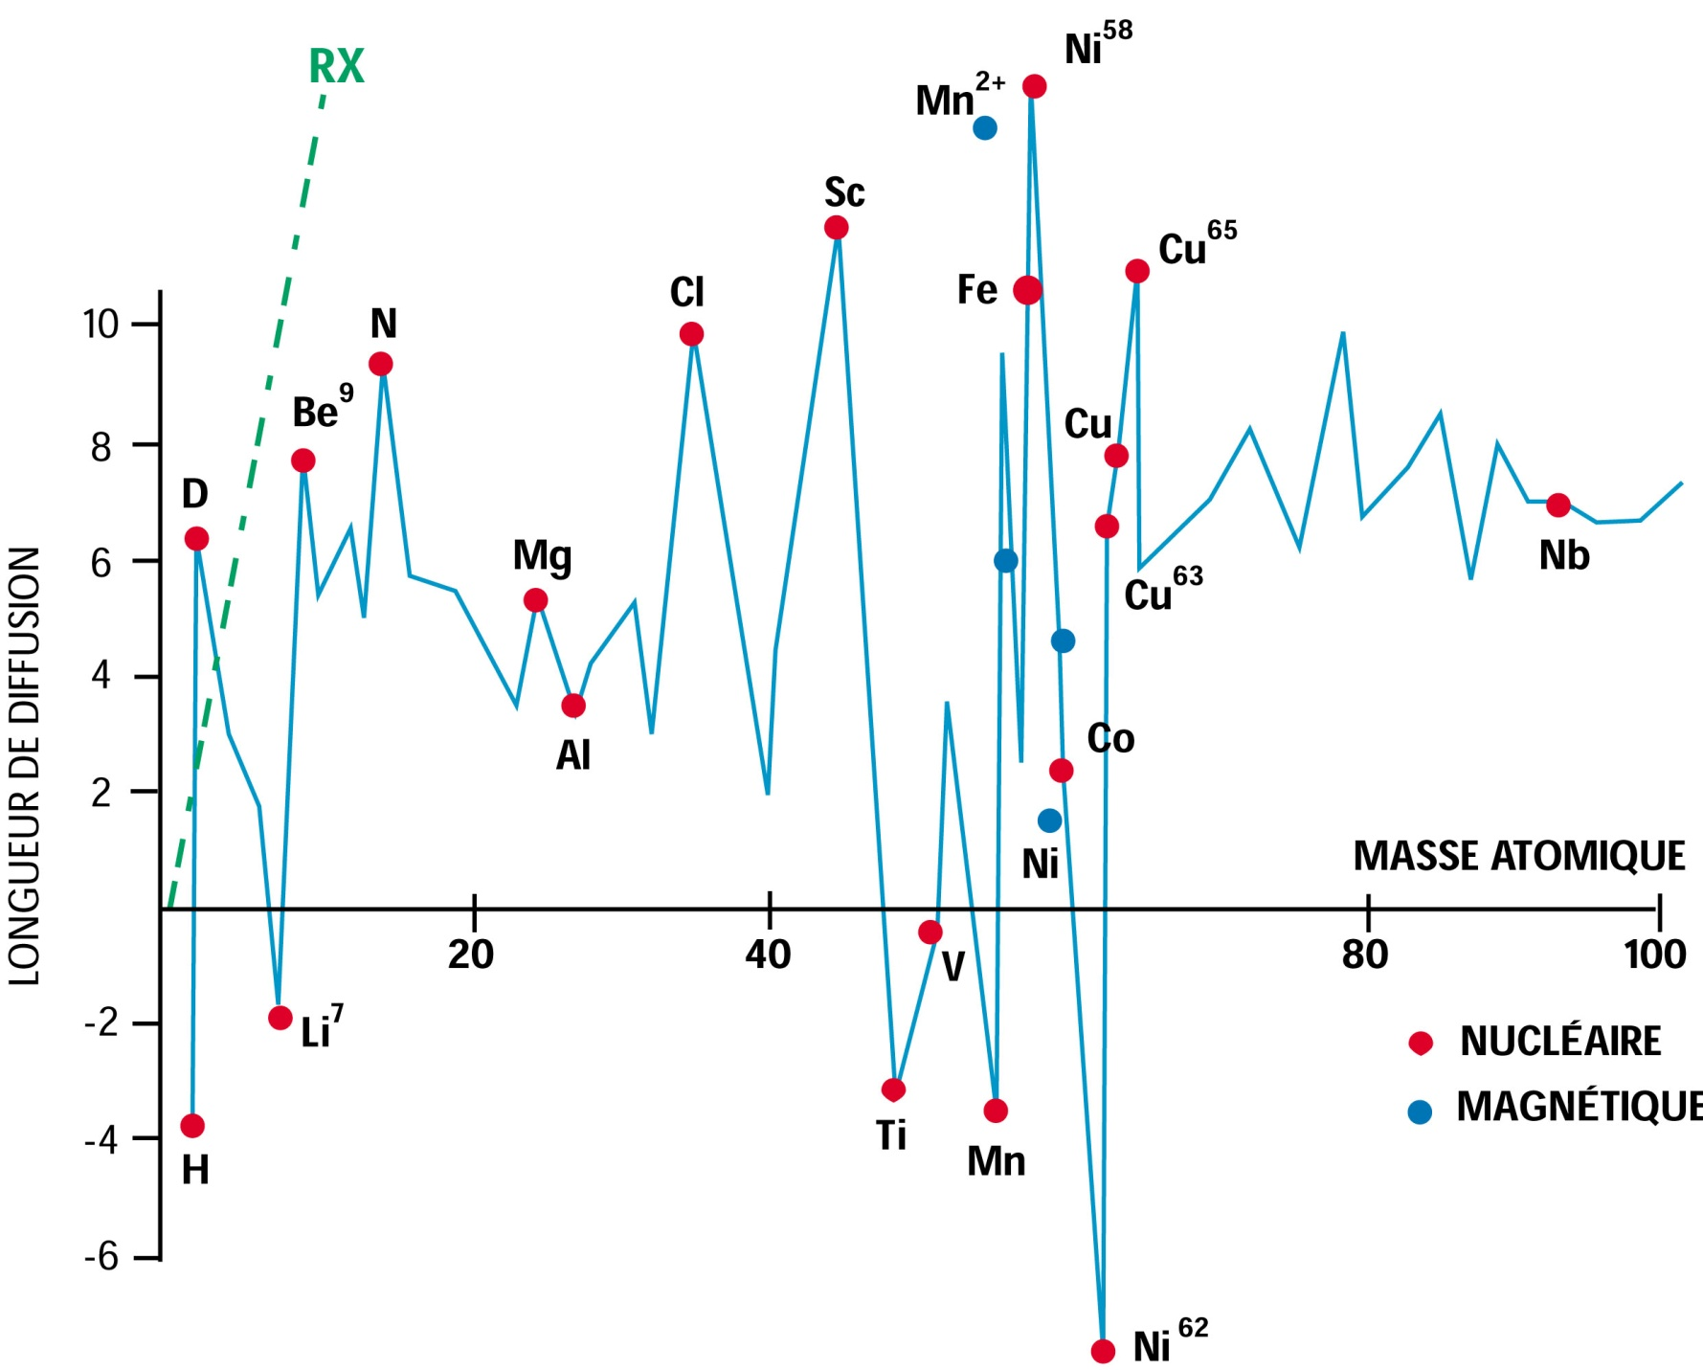
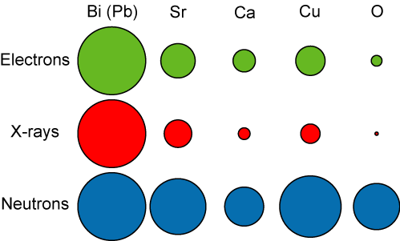
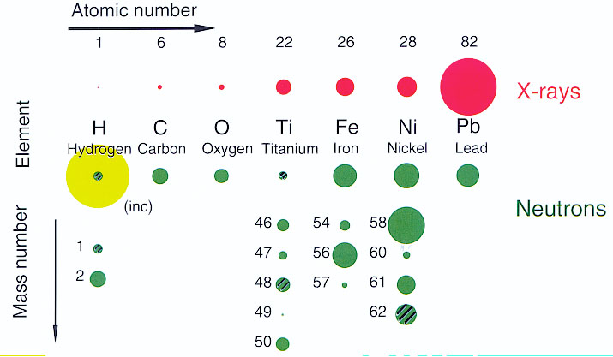
Scattering power of nuclei for neutrons
Light atoms diffuse neutrons as strongly as heavy atoms
The scattering power for X-rays is proportional to the atomic number (number of electrons).
The scattering power for electrons depends on the electrostatic potential
The scattering power for neutrons is of the same order of magnitude similar for all atoms

Slide 8
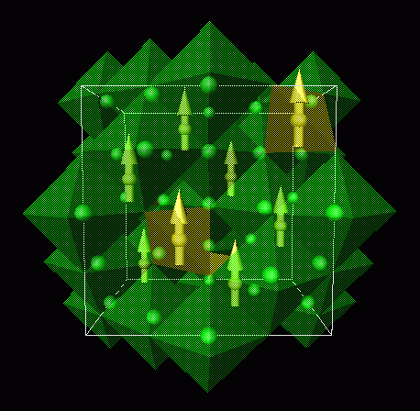
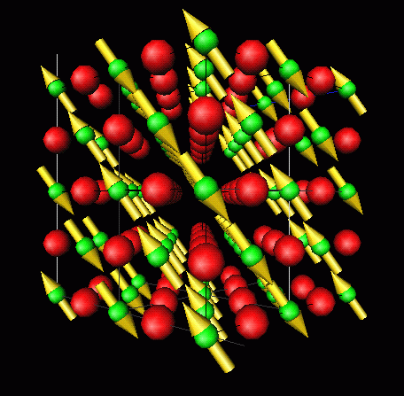
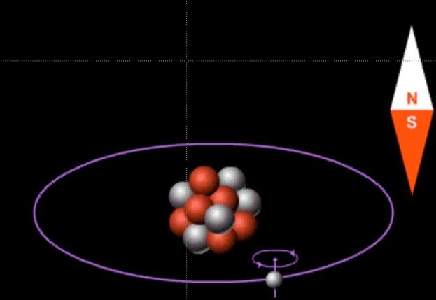
Neutrons for magnetism studies
Neutrons act as small magnets
The dipolar magnetic moment of the neutron interacts strongly with the atomic magnetic moment
Neutrons allow the determination of magnetic structures of materials and measure the magnetization with high precision.
Neutrons are strongly scattered by magnetic materials
Magnetic Crystallography
Ferromagnetic and
antiferromagnetic oxides

Slide 9
Outline
Characteristics of neutrons for diffraction
Diffraction equations: Laue conditions
Comparison neutrons – synchrotron X-rays
Magnetic neutron diffraction
Examples of neutron diffraction studies

Slide 10
Interaction neutron-nucleus
Φ= number of incident neutrons /cm² / second
σ= total number of neutrons scattered/second/Φ
Fermi’s golden rule gives the neutron-scattering Cross-section
➔ number of neutrons of a given energy scattered per second in a given solid angle
(the effective area presented by a nucleus to an incident neutron)
k’
Direction
θ, φ
r
dS
φ
k
θ
z
dΩ
Target

Slide 11
Interaction neutron-nucleus
Weak interaction with matter aids interpretation of scattering data
The range of nuclear force (~ 1fm) is much less than neutron wavelength so that scattering is “point-like”
Fermi Pseudo potential of a nucleus in r_{j}
Plane wave
e ^{ik’·r}
Detector
k’
r
k’
Q
2θ
k
Sample
V(r)
k
Spherical wave
(b/r)e ^{ik·r}
Potential with
a single parameter
Plane wave
e ^{ik·x}

Slide 12
Diffraction Equations
For diffraction part of the scattering the Fermi’s golden rule resumes to the statement: the diffracted intensity is the square of the Fourier transform of the interaction potential
There are different conventions and notations for designing the scattering vector (we use here crystallographic conventions).
Atomic form factor.
Scattering length

Slide 13
Diffraction Equations for crystals
In a crystal the atoms positions can be decomposed as the vector position of the origin of a unit cell plus the vector position with respect to the unit cell
integer
Laue conditions: the scattering vector is a reciprocal lattice vector of the crystal

Slide 14
Diffraction Equations for crystals
The Laue conditions have as a consequence the Bragg Law
Laue conditions: the scattering vector is a reciprocal lattice vector of the crystal
θ
2θ

Slide 15
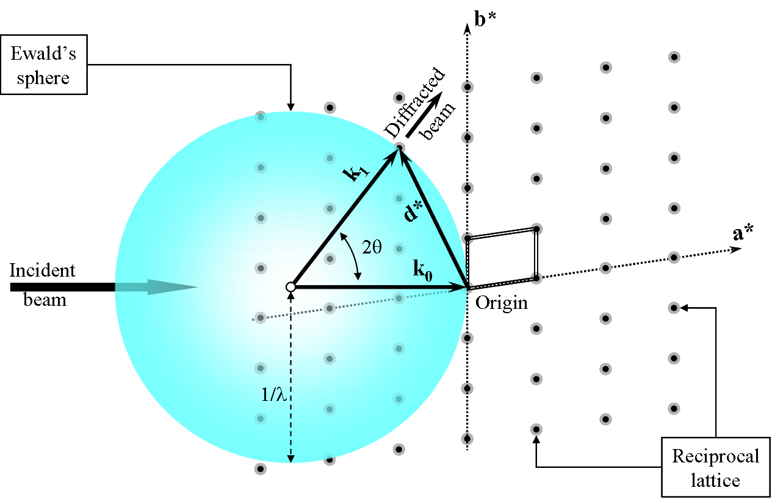
Ewald construction
From Pecharsky and Zavalij
Detector
s_{L}/λ
s_{0L}/λ

Slide 16
Ewald construction
Ewald Sphere
z_{L}
z_{D}
P
s_{L}
x_{D}
O_{D}
s_{0L}
h
2θ
O
ν
Incident beam
ν_{D}
1/λ
γ
γ_{D}
y_{L}
crystal
x_{L}
Laboratory Frame and detector

Slide 17
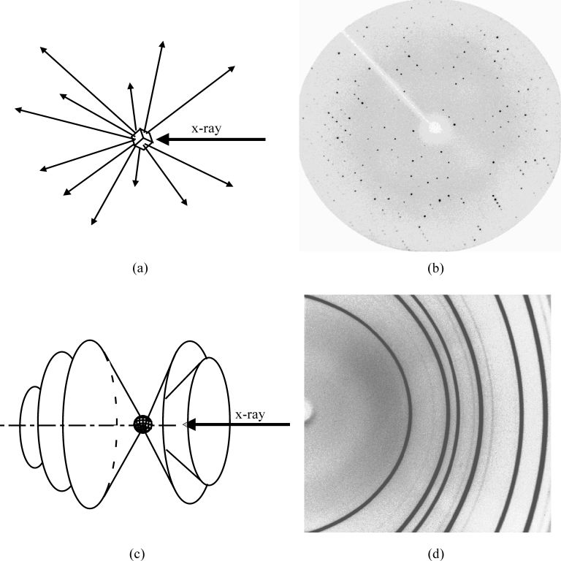
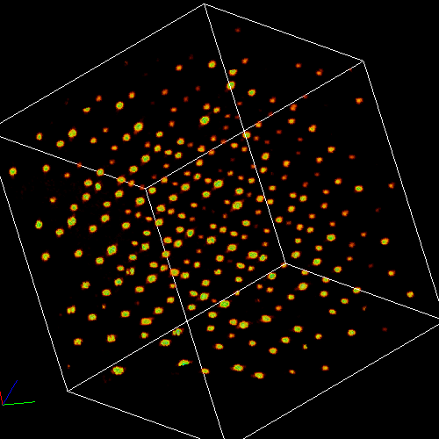
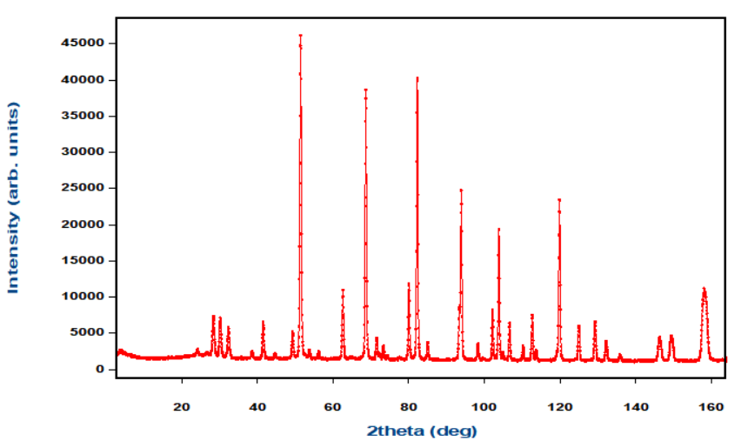
Diffraction patterns
Single Xtal - 2D image + scan –> 3D Int vs 2θ
Powder - 2D image –> 1D Int vs 2θ
Single Crystal
nλ=2d(sinθ)
Powder or polycrystalline solid
Courtesy of Jim Britten

Slide 18
Ewald construction Laue
From Pecharsky and Zavalij
Detector
s_{L}/λ
s_{0L}/λ
1/λ_{max}
1/λ_{min}

Slide 19
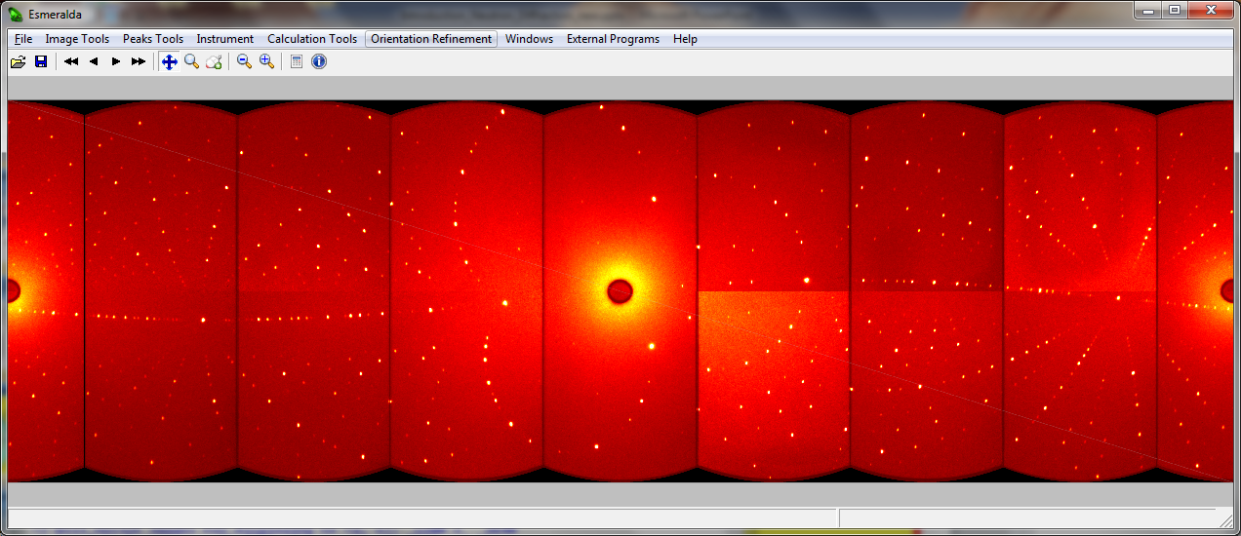
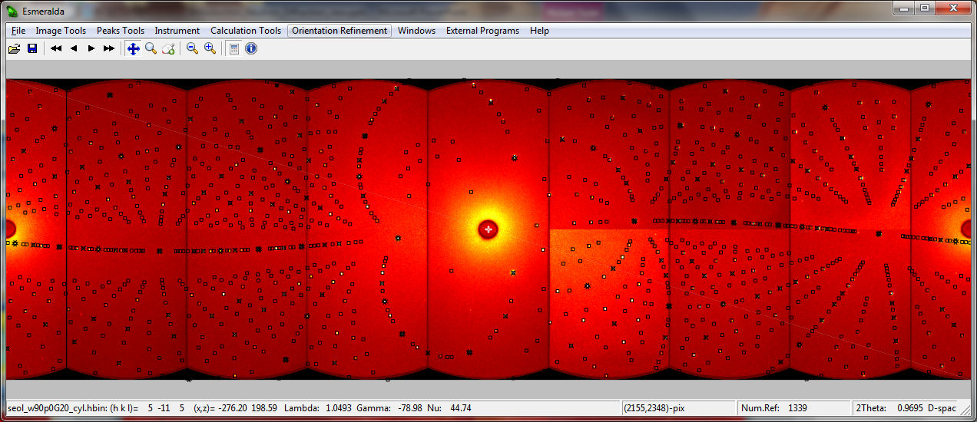
Laue image obtained in Cyclops

Slide 20
Single Crystal and Powder Diffraction
Single Crystal diffraction allows to get with high precision subtle structural details: thermal parameters, anharmonic vibrations.
Drawbacks: big crystals for neutrons, extinction, twinning
Data reduction: Needs only the indexing and integration of Bragg reflection and obtain structure factors. List: h k l F² σ(F²)
Data Treatment: SHELX, FullProf, JANA, GSAS, …
Powder diffraction no problem with extinction or twinning.
Data reduction: minimalistic, needs only the profile intensities and their standard deviations
Data Treatment: FullProf, JANA, GSAS, TOPAS, …

Slide 21
Outline
Characteristics of neutrons for diffraction
Diffraction equations: Laue conditions
Comparison neutrons – synchrotron X-rays
Magnetic neutron diffraction
Examples of neutron diffraction studies

Slide 22
Why neutrons?
NEUTRON DIFFRACTION FOR FUNDAMENTAL AND APPLIED RESEARCH IN CONDENSED MATTER AND MATERIALS SCIENCE
Location of light elements and distinction between adjacent elements in the periodic table.
Examples are:
Oxygen positions in High-T_{C} superconductors and manganites
Structural determination of fullerenes an their derivatives,
Hydrogen in metals and hydrides
Lithium in battery materials
Determination of atomic site distributions in solid solutions
Systematic studies of hydrogen bonding
Host-guest interactions in framework silicates
Role of water in crystals
Magnetic structures, magnetic phase diagrams and magnetisation densities
Relation between static structure and dynamics (clathrates, plastic crystals).
Aperiodic structures: incommensurate structures and quasicrystals

Slide 23
Why neutrons?
The complementary use of X-ray Synchrotron radiation and neutrons (1)
The advantages of thermal neutrons with respect to X-rays as far as diffraction is concerned are based on the following properties of thermal neutrons:
  constant scattering power (b is Q-independent) having a non-monotonous dependence on the atomic number
  weak interaction (the first Born approximation holds) that implies simple theory can be used to interpret the experimental data
  the magnetic interaction is of the same order of magnitude as the nuclear interaction
  low absorption, making it possible to use complicated sample environments

Slide 24
Why neutrons?
The complementary use of X-ray Synchrotron radiation and neutrons (2)
  Powder diffraction with SR can be used for ab initio structure determination and microstructural analysis due to the current extremely high Q-resolution.
  Structure refinement is better done with neutrons (or using simultaneously both techniques) because systematic errors in intensities (texture effects) are less important and because scattering lengths are Q-independent in the neutron case.

Slide 25
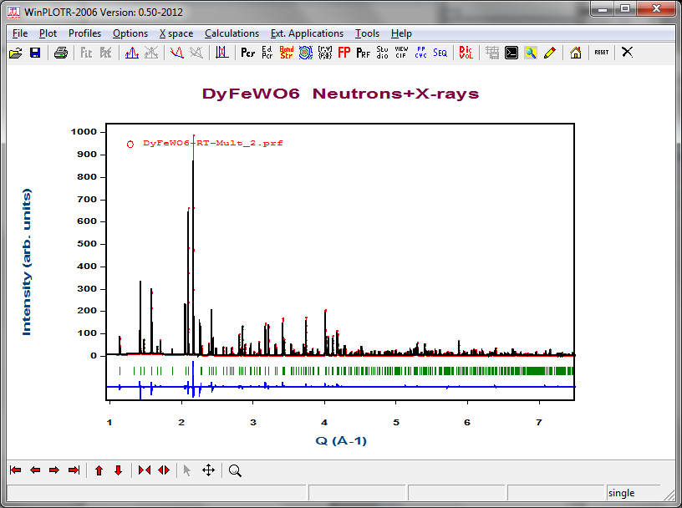

Slide 26
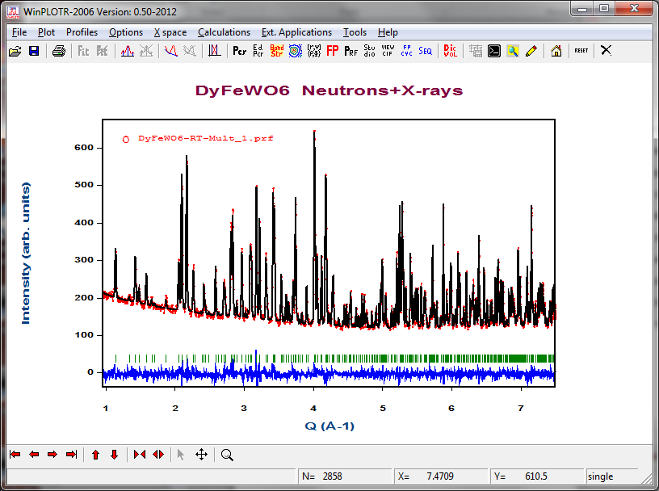

Slide 27
Why neutrons?
The complementary use of X-ray Synchrotron radiation and neutrons (3)
  Magnetic X-ray scattering allows in principle the separation of orbital and spin components. However, SR cannot compete with neutrons in the field of magnetic structure determination from powders.
  The contribution of SR to that field is on details of magnetic structures (already known from neutrons) for selective elements using resonant magnetic scattering (rare earths, U, ...)

Slide 28
Outline
Characteristics of neutrons for diffraction
Diffraction equations: Laue conditions
Comparison neutrons – synchrotron X-rays
Magnetic neutron diffraction
Examples of neutron diffraction studies

Slide 29
Magnetic scattering: magnetic fields
The interaction potential to be evaluated in the FGR is:
Magnetic field due to spin and orbital moments of an electron:
s_{j}
Electron
p_{j}
R
Magnetic vector potential of a dipolar field due to electron spin moment
Neutron
R_{j}
μ_{j}
B_{j}
R+R_{j}
O
Biot-Savart law for a single electron with linear momentum p

Slide 30
Magnetic scattering: magnetic fields
Evaluating the spatial part of the transition matrix element for electron j:
Where is the momentum transfer
Summing for all unpaired electrons we obtain:
M⊥(Q) is the perpendicular component of the Fourier transform of the magnetisation in the scattering object to the scattering vector. It includes the orbital and spin contributions.

Slide 31
Scattering by a collection of magnetic atoms
We will consider in the following only elastic scattering.
We suppose the magnetic matter made of atoms with unpaired electrons that remain close to the nuclei.
Vector position of electron e:
The Fourier transform of the magnetization can be written in discrete form as

Slide 32
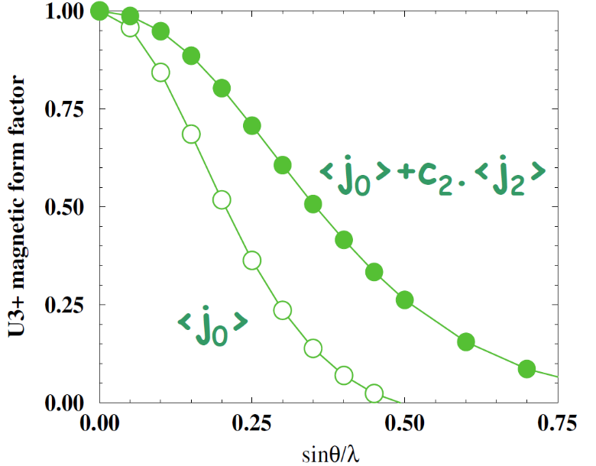
Scattering by a collection of magnetic atoms
If we use the common variable s=sinθ/λ, then the expression of the form factor is the following:

Slide 33
Magnetic scattering
M⊥(Q) is the perpendicular component of the Fourier transform of the magnetisation in the sample to the scattering vector.
Magnetic interaction vector
Magnetic structure factor:
Neutrons only see the components of the magnetisation that are perpendicular to the scattering vector
Q=Q e
M
M ⊥

Slide 34
Elastic Magnetic Scattering by a crystal
For a general magnetic structure that can be described as a Fourier series:
The lattice sum is only different from zero when h-k is a reciprocal lattice vector H of the crystallographic lattice. The vector M is then proportional to the magnetic structure factor of the unit cell that now contains the Fourier coefficients S_{kj} instead of the magnetic moments m_{j}.

Slide 35
Diffraction Patterns of magnetic structures
Portion of reciprocal space
Magnetic reflections
Nuclear reflections
h = H+k
Magnetic reflections: indexed by a set of propagation vectors {k}
h is the scattering vector indexing a magnetic reflection
H is a reciprocal vector of the crystallographic structure
k is one of the propagation vectors of the magnetic structure
( k is reduced to the Brillouin zone)

Slide 36
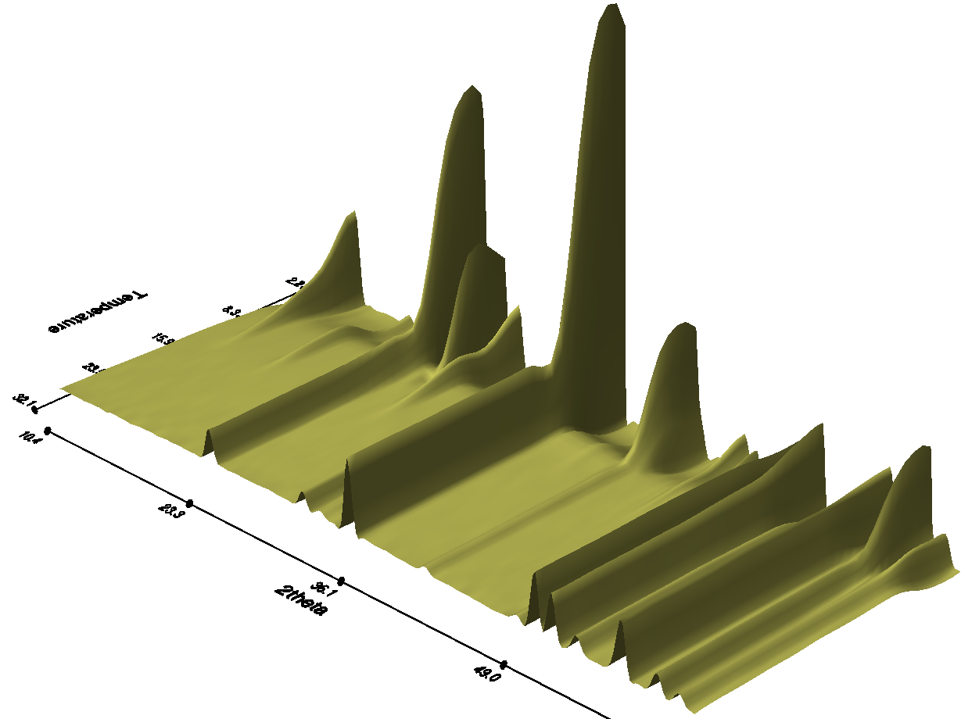
Diffraction Patterns of magnetic structures
Ho³⁺ ordering
Notice the decrease of the paramagnetic background on Ho³⁺ ordering
Cu²⁺ ordering

Slide 37
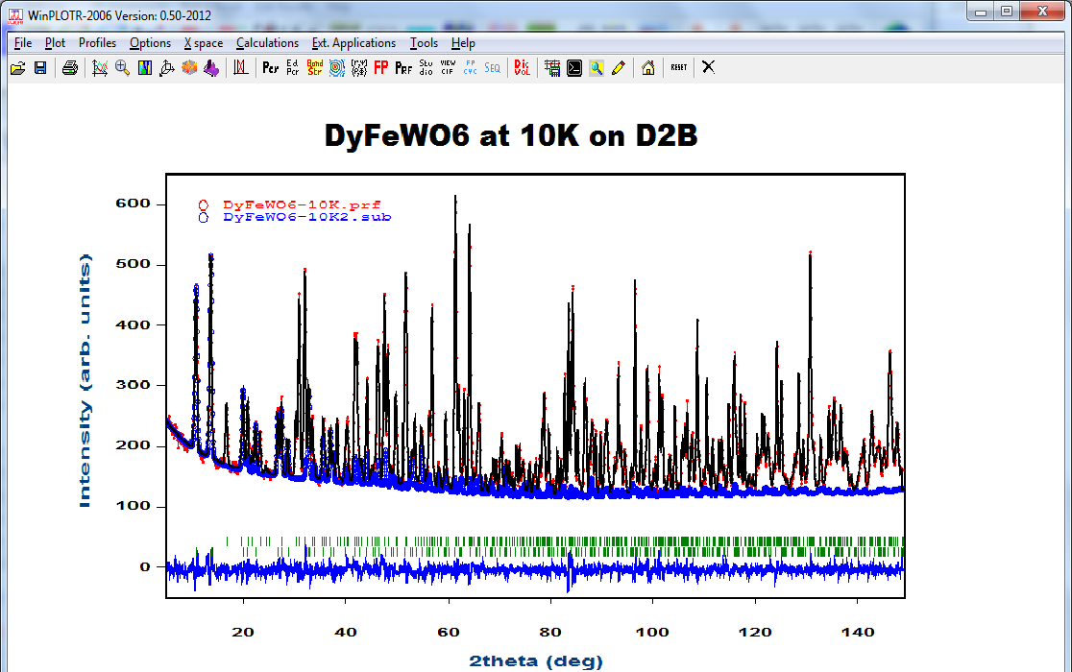
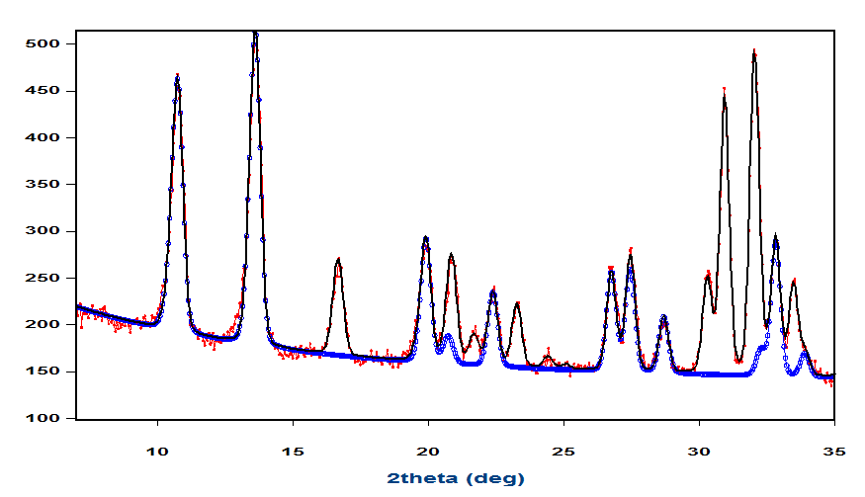
Magnetic refinement on D2B

Slide 38
Outline
Characteristics of neutrons for diffraction
Diffraction equations: Laue conditions
Comparison neutrons – synchrotron X-rays
Magnetic neutron diffraction
Examples of neutron diffraction studies

Slide 39
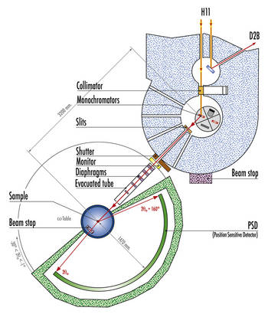
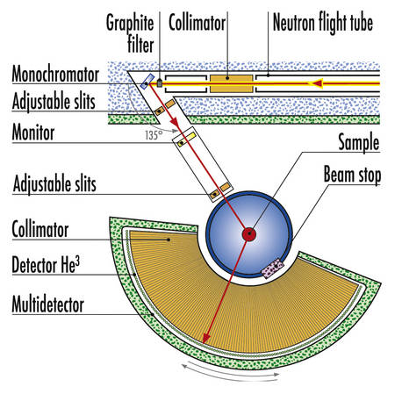
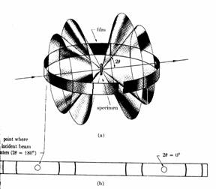
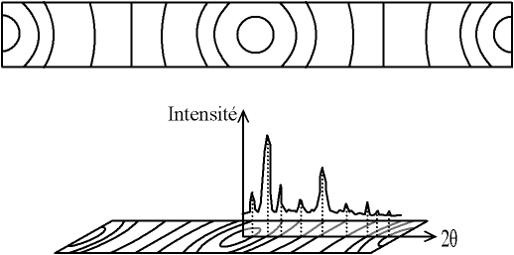
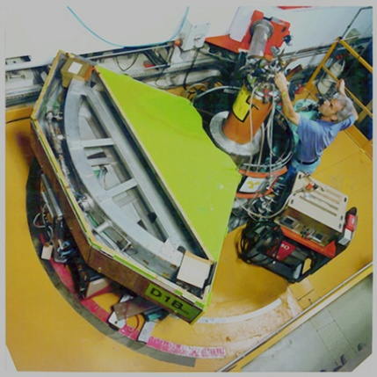
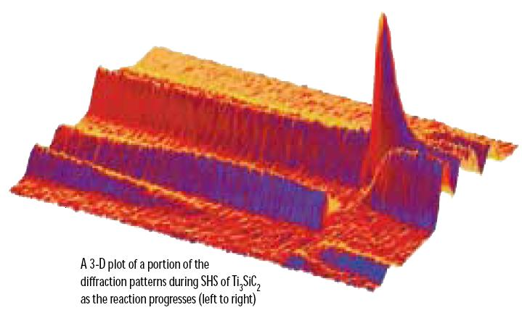
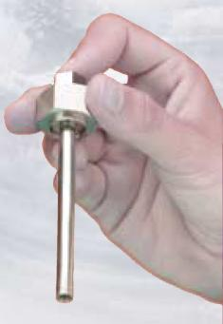
Two Axes Diffractometers: Powders and Liquids
Low Resolution
D20
High Resolution D2B

Slide 40
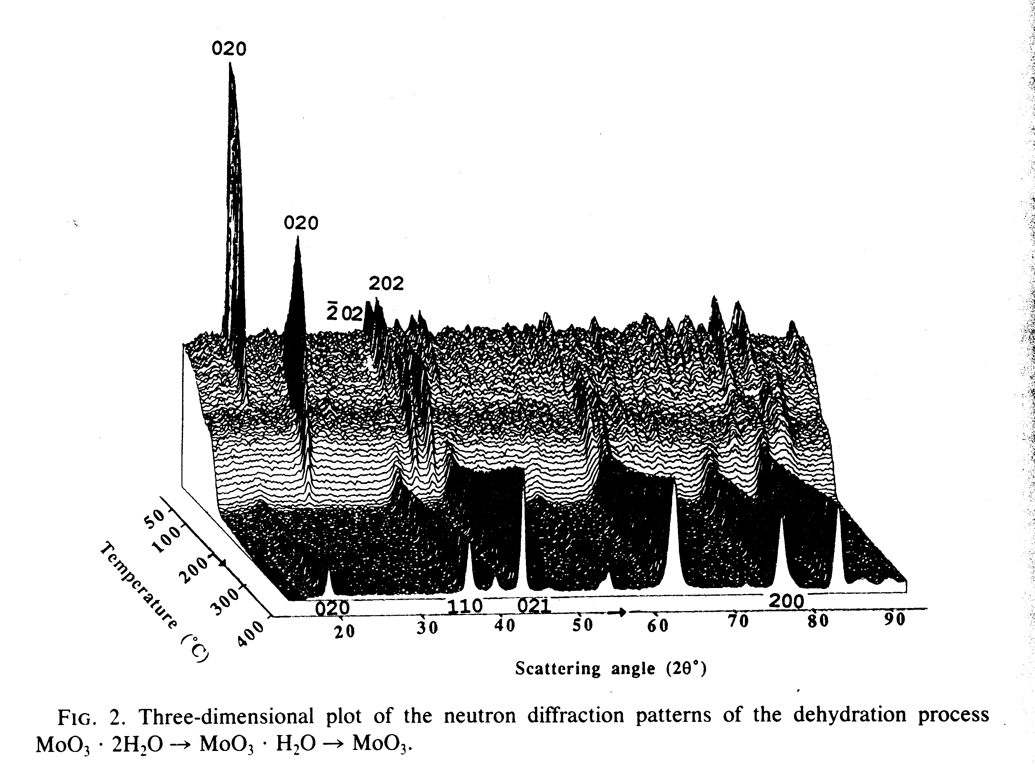
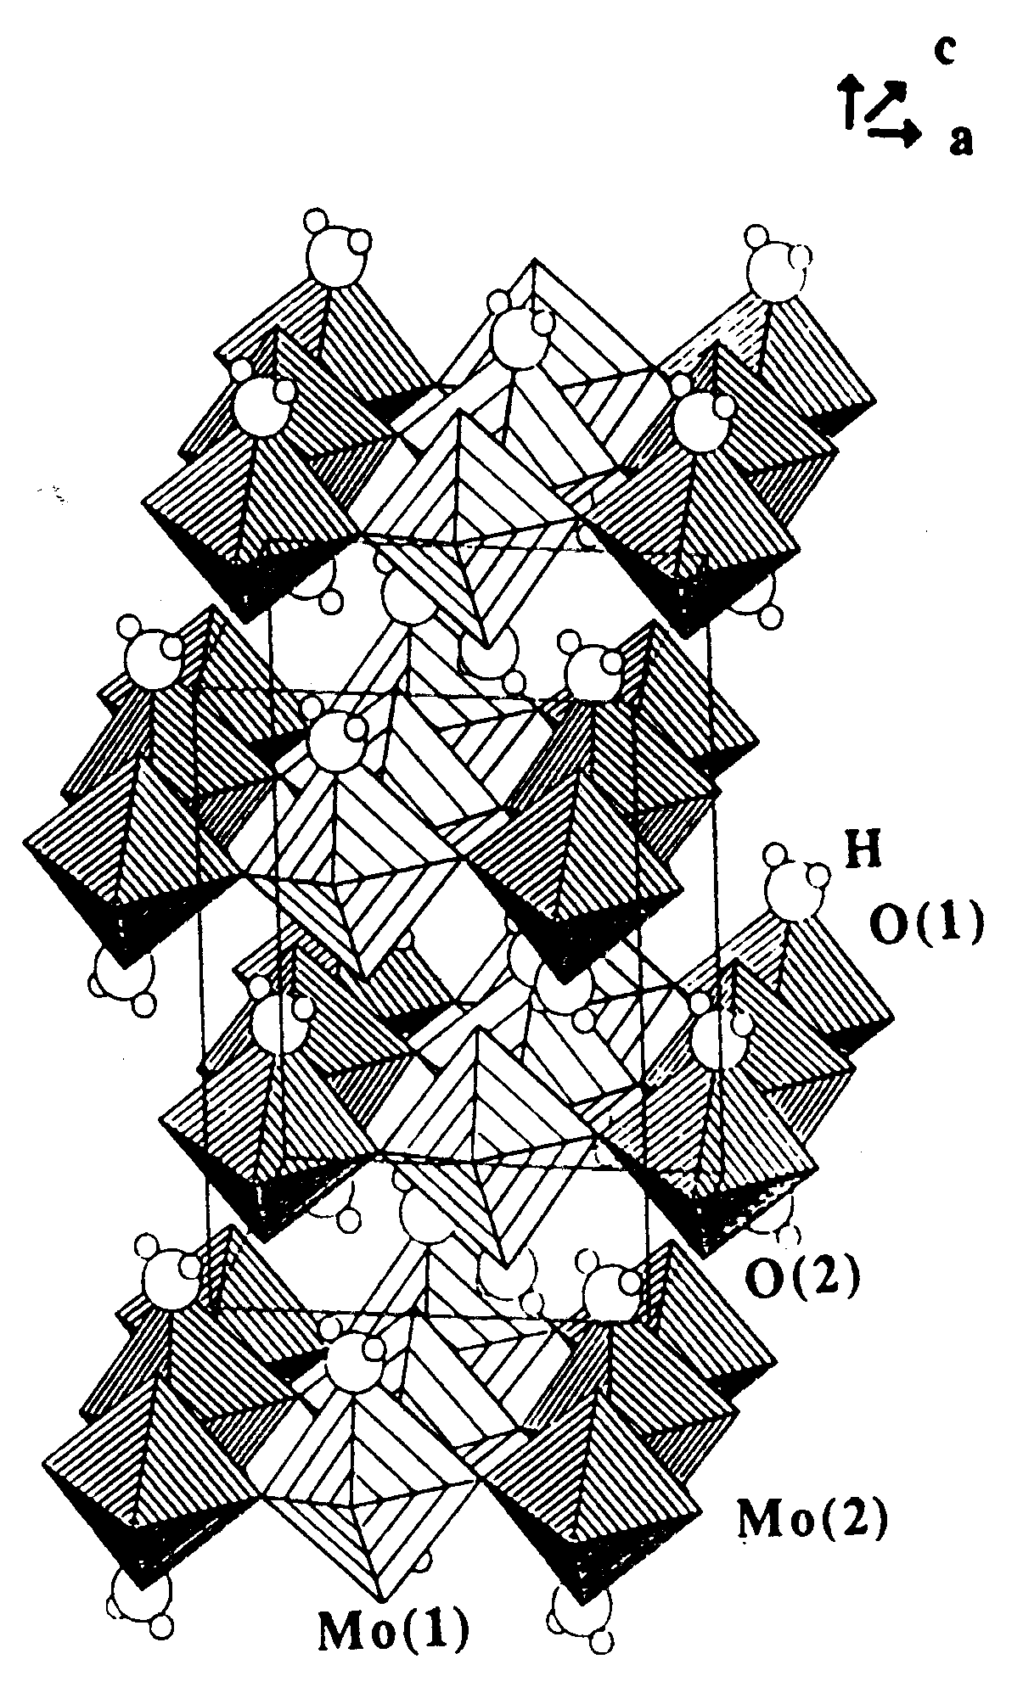
Real time powder diffraction on D1B
Dehydration of MoO₃·2H₂O [N. Boudjada et al.; J. Solid State Chem. 105, 211 (1993)]
RT to 400 ºC in vacuum.
Diffraction pattern / 3 minutes.
MoO₃·2H₂O
RT
MoO₃·H₂O
T = 60 ºC
MoO₃
T = 150 ºC

Slide 41
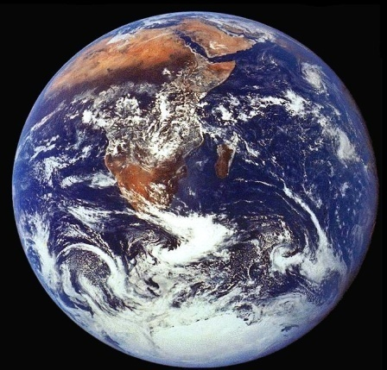
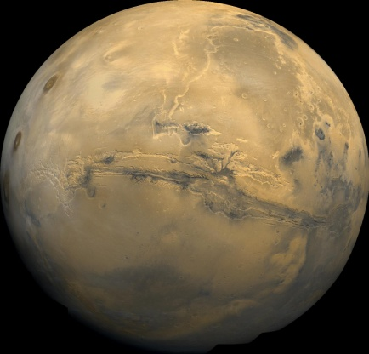
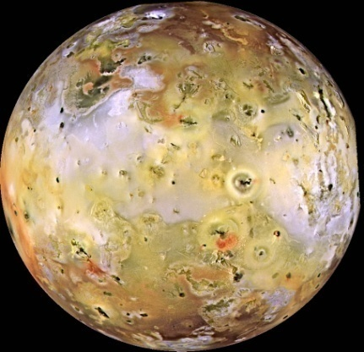
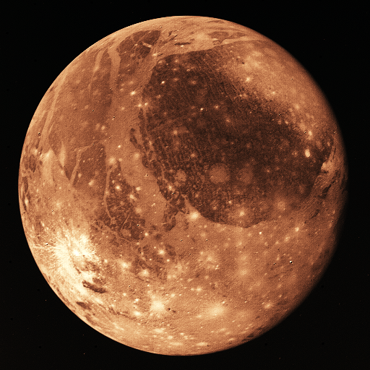
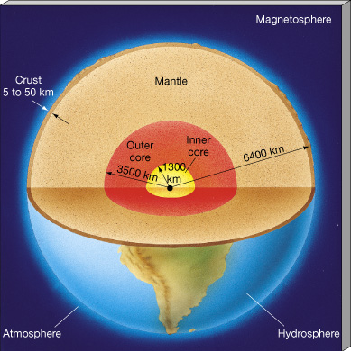
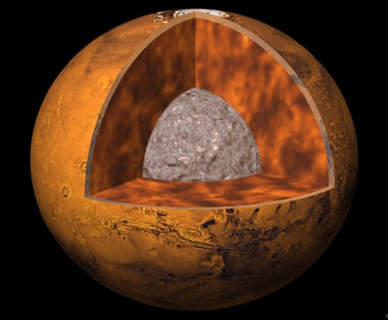
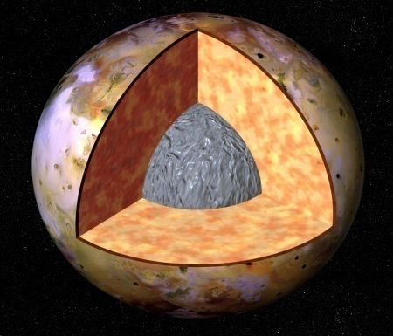
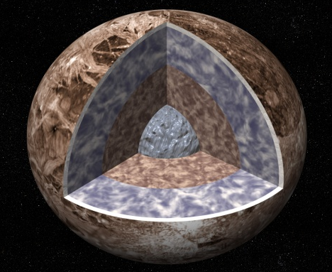
Some Applications: Liquid state → D4
Earth
Mars
Io
Ganymede
What they have in common …?
Metallic cores
Proximity in Solar System
Fluid Outer Core: from 3000 to 5200 km
Primarily Fe with some Ni
Thanks to Gabriel Cuello

Slide 42

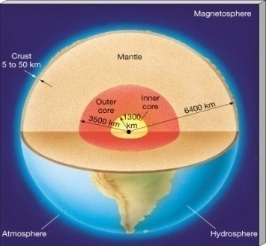
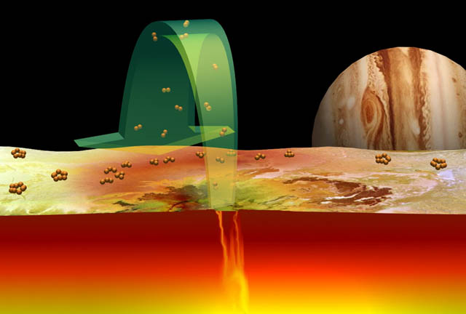
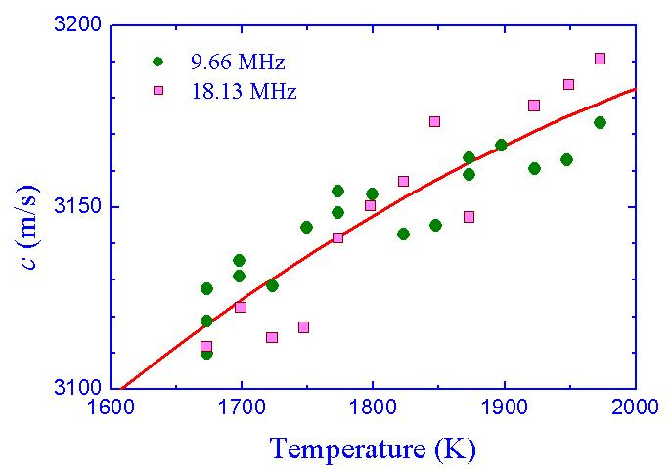
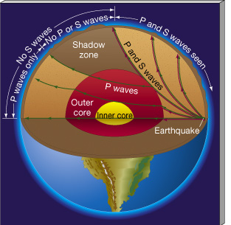
Some Applications: Liquid state
But ρ is 5-10% less than pure Fe+Ni …
Volcanic
Eruptions
Fe
Ni
… there is some light element,
but which? S? O? H? Si?
Hypothesis:
The light element helps
aggregating clusters,
which in turn are
disaggregated by heating
the system.
M. Nasch,
M. H. Manghnani,
R. A. Secco,
Science 277 (1997) 219.

Slide 43
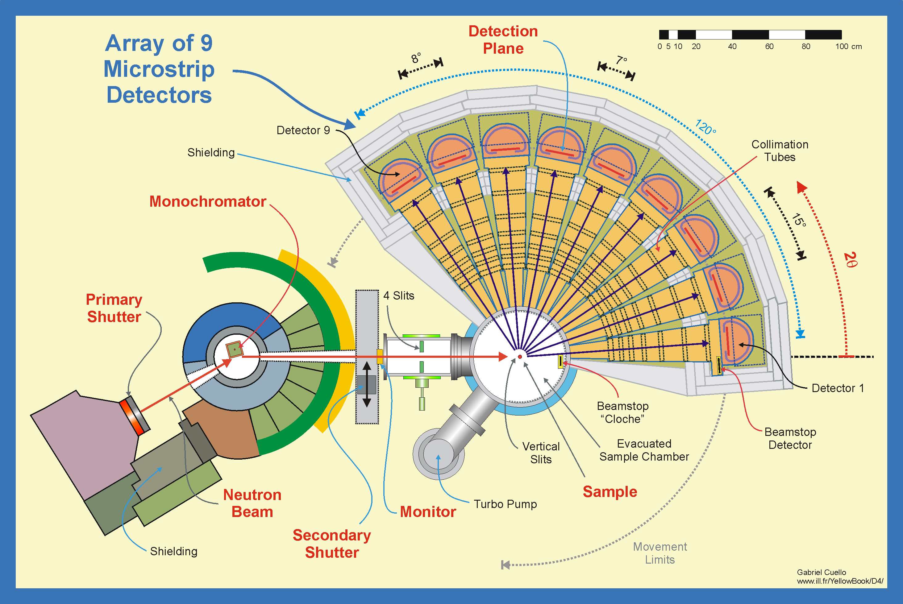
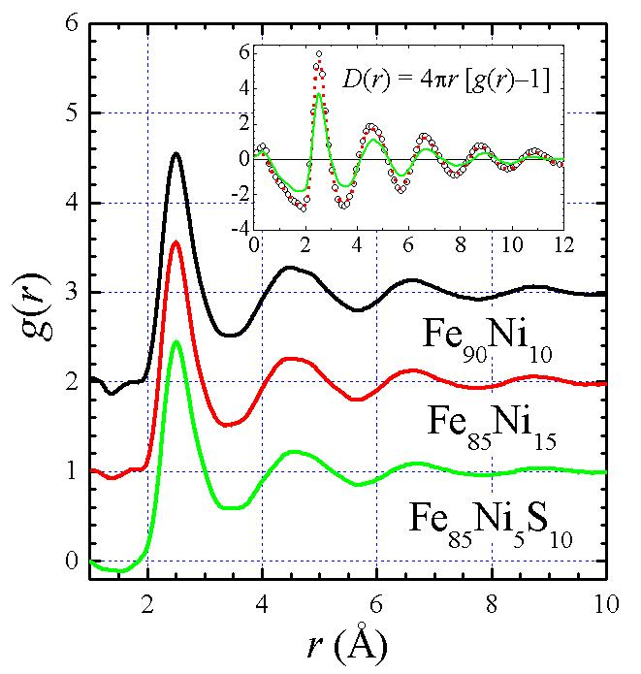
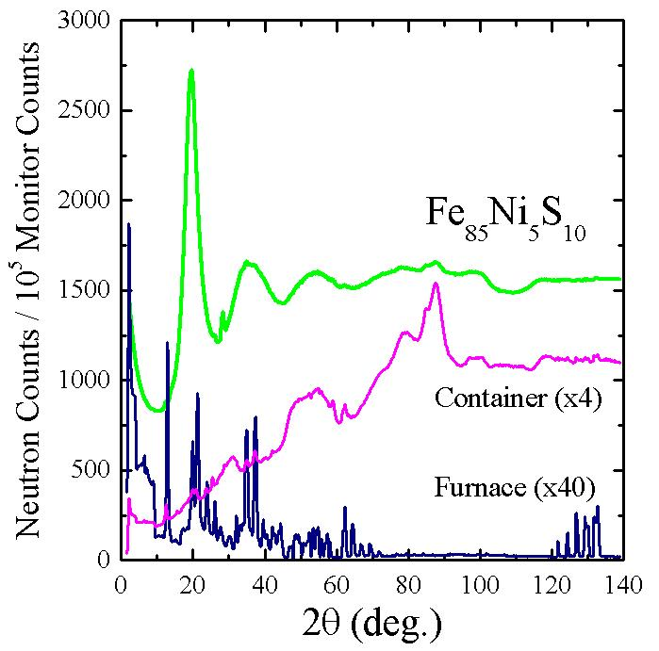
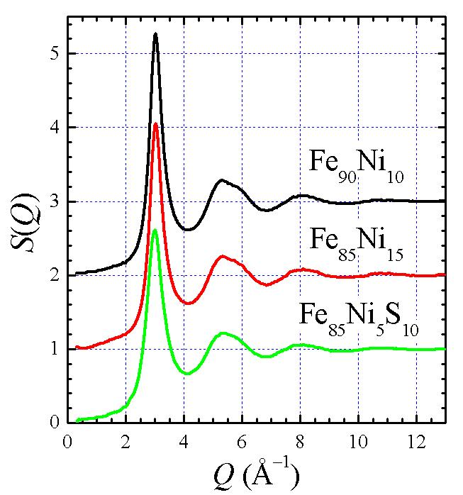
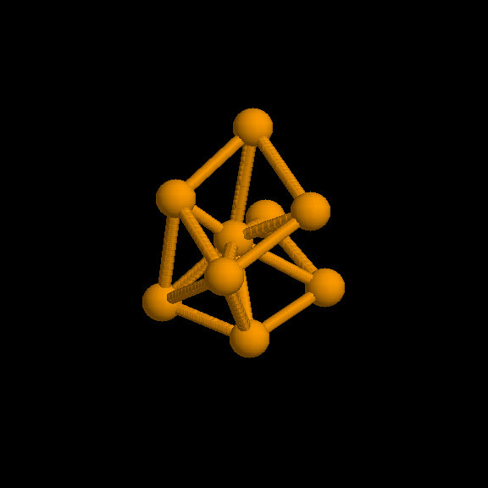
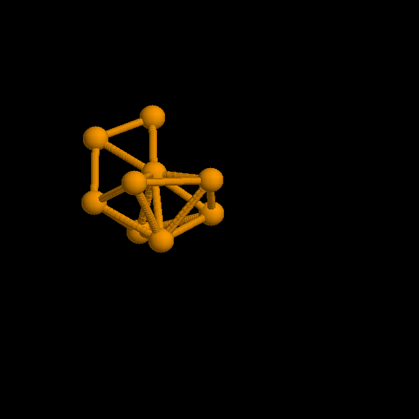
Some Applications: Liquid state
FeNi and FeNiS alloys
Liquid state
High temperature
Special furnace
Two-axis diffractometer
Fe−Fe
Fe−Fe
Fe₈₅Ni₁₅
Fe₈₅Ni₅S₁₀

Slide 44
Levitation of Liquids
Principle of the aerodynamic levitation and laser heating
Mirror
CO₂ Laser
Pyrometer
Video camera
Sample
Levitator
Gas flow

Slide 45
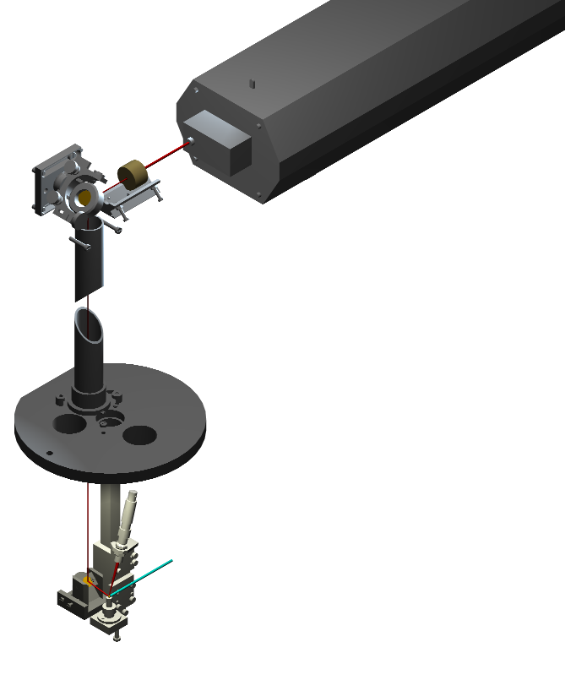
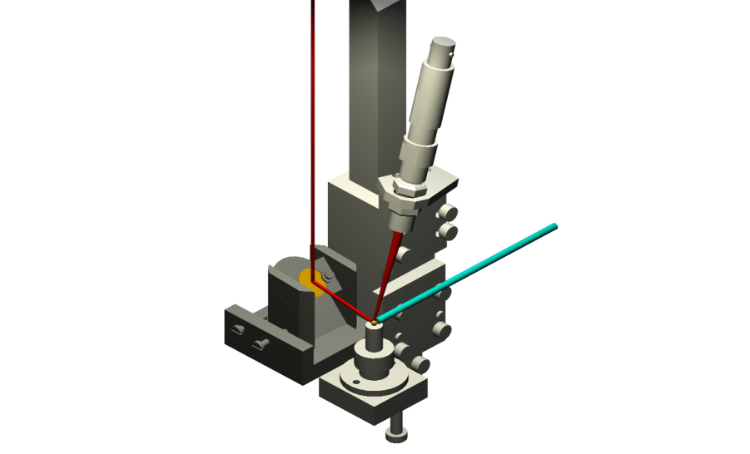

Crystallisation
Laser
1st mirror
CO₂ laser
Neutron beam
Laser
Laser beam
Pyrometer
Neutron beam
2nd mirror
Sample
Cold Point
Gas

Slide 46
Again Crystallisation
Neutron beam
Laser
Dust coming from the sample
B₄C Screen
Laser beams
Neutron beam
Crystallisation due to contacts
Gas
Solutions:
Improvement of the levitation
B₄C screens
Use of a screen in front of the nozzle
Gas

Slide 47





High Temperature Setup
Video Camera
Pyrometer
Spherical mirror
Video Camera
B₄C screens
NaCl window
Sample
Laser

Slide 48
Three Lasers Setup
Laser 1
Laser 2
Neutron beam
B₄C screens
Detector
Gas
NaCl window
Laser 3

Slide 49



Self-propagating High-T Synthesis (SHS) D20
Titanium silicon carbide Ti₃SiC₂
Self-propagating High-temperature Synthesis (SHS)
  Riley, Kisi et al.: 3 Ti : 1 Si : 2 C, 20 g pellet in furnace
  Heating from 850 C to 1050 C at 100 K/min
  Acquisition time 500 ms (300 ms)
Hot isostatic pressing expensive
2.3e4
2.3e4
counts/s/0.1°
counts/s/0.1°
0.1e4
0.1e4
70
30
time/s
35°
time/s
Thanks to
Thomas Hansen
35°
-130
2theta
0
2theta
25°
25°
D.P. Riley, E.H. Kisi, T.C. Hansen, A. Hewat, J. Am. Ceramic Soc. 85 (2002) 2417-2424.
Notes:
Titanium silicon carbide, Ti₃SiC₂, has attracted considerable interest because of a unique combination of physical properties: a high melting point, good high temperature strength, resistance to corrosion and oxidation, high Young’s Modulus, and high electrical/thermal conductivity, characteristics, which are both metallic and ceramic in nature.
Ti₃SiC₂ has a hexagonal crystal structure consisting of double layers of TiC octahedra separated by a planar Si layer. Band structure calculations indicate that ionic, covalent and metallic bonds co-exist within the structure. Potential applications include machinable structural ceramics that are corrosion, creep and oxidation resistant; corrosion and oxidation resistant barrier coatings; intermediate phases in metal-ceramic bonding; electrodes in electrochemical cells e.g. in aluminium smelting; and conducting films on dielectric and semi-conductor devices. The primary difficulty in realising these diverse applications is that, in common with all ternary or higher order phases, it has proven difficult to synthesise without unwanted ‘impurity’ phases. The properties of these impurity phases (e.g. TiC_{x} and Ti_{x}Si_{y} type) are very different from those of Ti₃SiC₂, hence the properties of the final ceramic suffer.
The reactive sintering/hot isostatic pressing process is costly and difficult to scale up. In SHS the heat of reaction provides all of the thermal energy required, the reaction times are very short, and the industrial scale-up is straightforward. However, the products are usually very porous and of lower purity.
In order to optimise an SHS method it is important to focus on the mechanisms that control the growth of Ti₃SiC₂ as a product phase. Because of the great speed of the SHS reactions and the very high temperatures involved,the mechanisms are generally poorly understood because sample characterisation has been reliant on post-reaction techniques. Mechanisms for Ti₃SiC₂ formation by reactive sintering have been developed by these ex-situ methods. In-situ observations of SHS reactions have been successfully performed on several binary systems using synchrotron X-ray diffraction. This has provided valuable insight into the systems studied however there are still some unresolved problems. The synchrotron studies to date use ccd detectors with very limited angular range. In addition, the X-rays used are heavily absorbed by the sample, usually within some tens of microns of the surface. SHS reactions are widely known to cause volatilisation of some chemical species due to the high reaction temperatures attained. In the Ti-Si-C system, the major losses are thought to be Si. It is therefore unclear whether the surface of the sample would be truly representative of the bulk. In order to overcome these shortcomings, we have used neutron diffraction to study the SHS reaction of 3Ti/SiC/C mixtures and demonstrate an entirely new reaction mechanism.
Experimental
Stoichiometric 3Ti:1Si:2C powder mixtures of Ti powder (Sigma-Aldrich, -325mesh, 99.98%), SiC powder (Performance Ceramics Japan, <100μm, 99.9%) and graphite powder (Aldrich, <100μm, 99.9%) were mixed by hand in a mortar and pestle under an inert argon atmosphere (<5ppm 0₂, <10ppm H₂0). A schematic diagram of the sample environment is shown in Figure 1. Two or three × 6g pellets 12.2mm high and 15.2mm in diameter were prepared by cold-pressing at 180 MPa in a steel die. The pellets were stacked and placed at the centre of a 16mm inner diameter (ID) silica (SiO₂) tube with a wall thickness of 1.5mm. An insulating section of Al₂O₃ was place atop a stainless steel support stand with a 3mm thick Ti disc separating the sample from the ceramic. Primary heating, ignition and neutron diffraction data collection were all conducted in a resistive vanadium vacuum furnace operating under a pressure of ~10⁻² mbar. The sample and silica tube, were placed at the centre of an interchangeable (V or Nb), 20mm ID heating element (20-40μm thick). A boron carbide (B₄C) mask positioned 3200mm from the main reactor aperture and 50mm from the sample focal plane limited the neutron beam height to 42mm with a divergence of ±3mm. Care was taken to ensure the support stand, Ti disc, and Al₂O₃ section, were well outside the penumbra of the neutron beam. K-type thermocouples were positioned ~3mm below the base of the Ti disc and used to control the furnace temperature. These also gave a crude capacity to monitor the exothermic ignition of the sample. Neutron diffraction patterns were recorded on the D20 diffractometer at the Institut Max von Laue-Paul Langevin, Grenoble, France, using a neutron wavelength of 1.30079±0.00007Å. The instrument is equipped with a micro-strip position sensitive detector allowing simultaneous detection of a diffraction patterns in the range 10 – 140º 2θ .
A high intensity diffraction pattern was recorded at room temperature from each starting mixture. Samples were then pre-heated from room temperature to 400ºC at 30ºC/min. Between 400ºC and 850ºC the heating rate was maintained at 30ºC/min. During this temperature interval, neutron diffraction patterns were collected for 5s each with an average dead time of 1s for data transfer. From 850ºC to 1050ºC the heating rate was increased to 102ºC/min and the data acquisition time was decreased to 0.9s including 0.4s data transfer time. SHS ignition and combustion reactions occurred towards the latter part of this interval. Data collection was terminated approximately 15-20 minutes after ignition of the self-propagating reaction. [Three samples were studied, 2 in SiO2 and 1 without!]
Post-reaction products were examined using optical microscopy, SEM and XRD (Cu K_{α}). Diffraction patterns were analysed using the Rietveld analysis program Fullprof [ref]. Refined parameters for major phases were typically a zero correction, scale factors, peak shape parameters, atomic occupancies and lattice parameters. An interpolated fixed background was used to account for the presence of amorphous scattering from the silica tubing. This profile was obtained from the room temperature reactants pattern with minor modifications for the influence of increasing temperature. Visual analysis of phase transformations and the reaction mechanism were obtained using the Large Array Manipulation Program(LAMP) [ref].
Results
3.1 Reaction Overview
Due to the excellent time resolution of the experiment (0.5s to record each diffraction pattern and 0.4s for data download), there is an enormous amount of data to analyse. An excellent overview of the time evolution of the experiment is shown in composite diagrams such as Figure 2(a). In Figure 2(a), time is shown on the vertical axis and the diffraction angle (2θ) on the horizontal axis. Increased brightness indicates increased intensity within the diffraction pattern. Select diffraction patterns showing important stages of the reaction are shown in Figure 2(b). Corresponding positions for patterns A, B, C, D and E are indicated in Figure 2(a) by the horizontal marks. Diffraction peak positions in Figure 2(b) may be cross-referenced directly with Figure 2(a) as they have the same 2θ scale. Five distinct stages may be observed to occur in the samples and these may be represented by the diffraction patterns in Figure 2(b). These respectively represent (A) the initial reactants, (B) the start of the α-Ti → β-Ti transformation, (C) a pre-ignition stage between the completion of the α-Ti → β-Ti transformation and the ignition event, (D) the rapid evolution of an intermediate phase, and (E) the formation of the product phase, Ti₃SiC₂. Rietveld analysis results for these five patterns are shown in Table 1 and will be discussed in turn below.
Table 3.* Rietveld Quantitative Phase Analysis Results (%)
- Table of Rietveld results
3.2 Stage 1 - Initial reactants
The diffraction pattern of each sample at room temperature consists of the reactant powders, α-Ti, SiC and graphite as represented by pattern A in Fig 2(b). The presence of an amorphous background (eg at 14-22º 2θ) is attributable to the silica tubing surrounding the sample. This was readily accounted for in the Rietveld analysis via a fixed-point background. Below ### ^{C} the neutron diffraction patterns show only the expected thermal expansion of the reactant phases. This allows an estimate of the sample temperature to be made based on the lattice expansion.
QPA agrees with the starting stoichiometry.

Slide 50

SHS: pre-ignition
Ti α-β transition
  starting at 870 C
Pre-ignition:
  TiC_{x} growth during 1 min
Melting (?) in 0.5 s
50
0
-50
-100
26
28
30
32
34
2 theta/degrees
Notes:
The transformation of α-Ti to the β polymorph is the first significant change in the samples. It is most easily observed by the decrease in the intensity of the diffraction peak at 32.2 degrees and the corresponding increase in the intensity of the peak at 31.2 degrees. Quantitative phase analysis using Rietveld refinement scale factors indicate the completion rate of the transformation precisely. Using the thermal expansion of the reactants to calculate the temperature of the sample, it was estimated that the α-Ti → β-Ti transformation began at 870 C. The complete α-Ti → β-Ti transformation occurs over a certain temperature interval, due to a temperature gradient from the surface to the centre of the sample. The transformation rate is hence controlled by the thermal conductivity of the pellet. Other than this obvious phase transformation, there are no significant changes in the phase composition of the samples prior to the completion of the α-Ti → β-Ti transformation).
Between the end of the α-Ti → β-Ti transformation and the SHS ignition, over a period of around one minute, there are small but significant changes to the diffraction patterns. There is an increase in the intensity of the peak near 30 degrees. This peak is the major reflection from SiC, however it overlaps with TiC. There is an associated decrease in the intensity of the β-Ti reflections (eg at 31.2º). Analysis of the complete diffraction patterns in this region using Rietveld refinements confirms the growth of a TiC_{x} phase at the expense of β-Ti and free carbon.

Slide 51
SHS: intermediate product
Intermediate phase
  TiC, Si substituted
  formed in 0.5 s, 2s delay
  Heating up to 2500 K
  afterwards decay in 5 s
50
0
-50
-100
26
28
30
32
34
2 theta/degrees
Notes:
In less than 0.9s, the entire 20g samples convert converted to a single solid phase with a NaCl structure not unlike TiC. This was confirmed by Rietveld analysis. The intermediate phase is a Si substituted TiC with approximately the same stoichiometry as the overall sample.
The SHS ignition event is readily seen in Figures 2(a) and 3 as a complete discontinuity in the diffraction signal. A closer view of the ignition event is shown in Figure 4(or5?) for one of the samples. In less than 0.9s, the reactant diffraction patterns were replaced by patterns like pattern D in Fig 2(b). The entire 20g samples had apparently converted to a single solid phase with a NaCl structure not unlike TiC. This was confirmed by Rietveld analyses such as the one shown in Figure 5 (or 6?). The intermediate phase is believed to be a Si substituted TiC with approximately the same stoichiometry as the overall sample. Details of the structure and significance of the intermediate phase will be discussed in section 4.3.
The intermediate phase persisted as the only solid phase for six seconds after the ignition event before nucleation and growth of the product phase began. An estimate of the sample temperature during and following SHS ignition was made using the lattice contraction of the intermediate phase on cooling. The lattice parameter at the end of the experiment was used as a reference on the assumption that the sample had cooled to be at the same temperature as the furnace. The thermal expansion coefficient used is that for pure TiC [ref] and may be slightly in error due to Si substitution. The resulting temperature profile is shown in Figure 6(7?) illustrating a maximum of 2500K. The temperature had decreased to approximately ____K before the Ti₃SiC₂ product phase was observed in the diffraction patterns.
In the sample without the SiO2 tube this time was reduced to four seconds.

Slide 52
SHS: final product
Product Ti₃SiC₂
  starts after 5 s incubation
  time constant about 5 s
50
0
-50
-100
26
28
30
32
34
2 theta/degrees
Notes:
After the six-second incubation time, the product phase Ti₃SiC₂ begins to appear in the diffraction patterns at the upper end of Figs 2(a) and 4(5?). The rate of growth is quite rapid and is more clearly illustrated in Figure 3. After only a further 16 seconds or so, 80% of the sample has converted to the product phase and there is little further growth of product phase thereafter. The sample temperature at this time is estimated to have been __-__K. The amount of intermediate phase remaining at the end of the reaction is similar to the amount of TiCx formed in the pre-ignition stage

Slide 53

Diffraction patterns of LaMnO₃ vs Pressure
(ISIS, POLARIS + Paris-Edinburgh cell)
Stability of the Janh-Teller effect and magnetic study of LaMnO₃ under pressure
L. Pinsard-Gaudart, J.Rodriguez-Carvajal, A. Daoud-Aladine, I.N.Goncharenko, M. Medarde, R.I. Smith and A. Revcolevschi. PRB 64, 064426 (2001)

Slide 54

Diffraction patterns of LaMnO₃ vs Pressure
(ISIS, POLARIS + Paris-Edinburgh cell)
Rietveld refinement of LaMnO₃ at RT and 14.6 kbar
In this range of pressure the reflections in the diffraction pattern are still sharp enough for performing a proper refinement
Stability of the Janh-Teller effect and magnetic study of LaMnO₃ under pressure
L. Pinsard-Gaudart, J.Rodriguez-Carvajal, A. Daoud-Aladine, I.N.Goncharenko, M. Medarde, R.I. Smith and A. Revcolevschi. PRB 64, 064426 (2001)

Slide 55



LaMnO₃ vs Pressure
(ISIS, POLARIS + Paris-Edinburgh cell)
Behaviour of different structural parameters of LaMnO₃ up to 70kbar

Slide 56

Magnetic scattering of LaMnO₃ vs Pressure
(LLB, G61 + Goncharenko cell)
Rietveld refinement of the nuclear (fixed) and magnetic scattering of LaMnO₃
The analysis of the magnetic contribution to the diffraction patterns indicates that the mode A continues to be dominant for all pressure range studied. However the mode Ay is unable to explain the diffraction pattern at 67 kbar.
The magnetic structure corresponds to the mixture of two representations
Γ_{3g}(+-) and Γ_{4g}(--) of Pbnm for k=0
[Gx,Ay, Fz] ~ [0,Ay, 0] and [Cx,Fy,Az] ~ [0,0,Az]
Magnetic structure at 67 kbar: [0,Ay,Az]

Slide 57


Magnetic scattering of LaMnO₃ vs Pressure
(LLB, G61 + Goncharenko cell)
Magnetic structure vs pressure

Slide 58
Conclusions LaMnO₃
Stability of the Janh-Teller effect and magnetic study of LaMnO₃ under pressure
L. Pinsard-Gaudart, J.Rodriguez-Carvajal, A. Daoud-Aladine, I.N.Goncharenko, M. Medarde, R.I. Smith and A. Revcolevschi. PRB 64, 064426 (2001)
1: The main effect of pressure is to decrease the orthorhombic distortion by diminishing the tilt angle MnO₆ octahedra (the interatomic distances diminish near isotropically)
2: The Jahn-Teller effect is stable up to 70 kbar
3: The magnetic structure conserve the A-type of ordering but with a deviation of the magnetic moment from the b-axis towards the c-axis

Slide 59
Thank you for your attention
www.neutron.anl.gov

